Slide 1
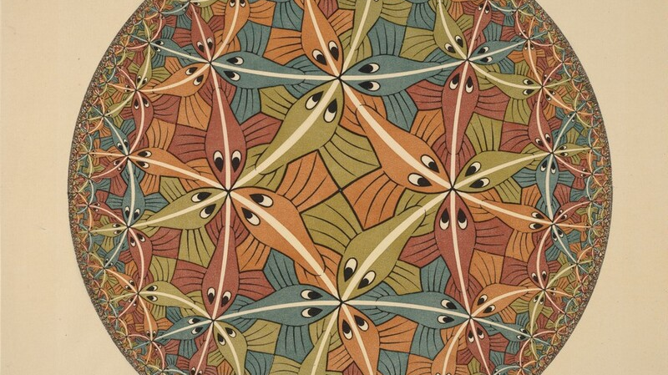
Near-Optimal Encodings of Cardinality Constraints
Bernardo Subercaseaux (bersub@cmu.edu)
Joint work with Andrew Krapivin and Benjamin Przybocki

Slide 2
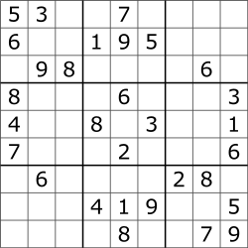



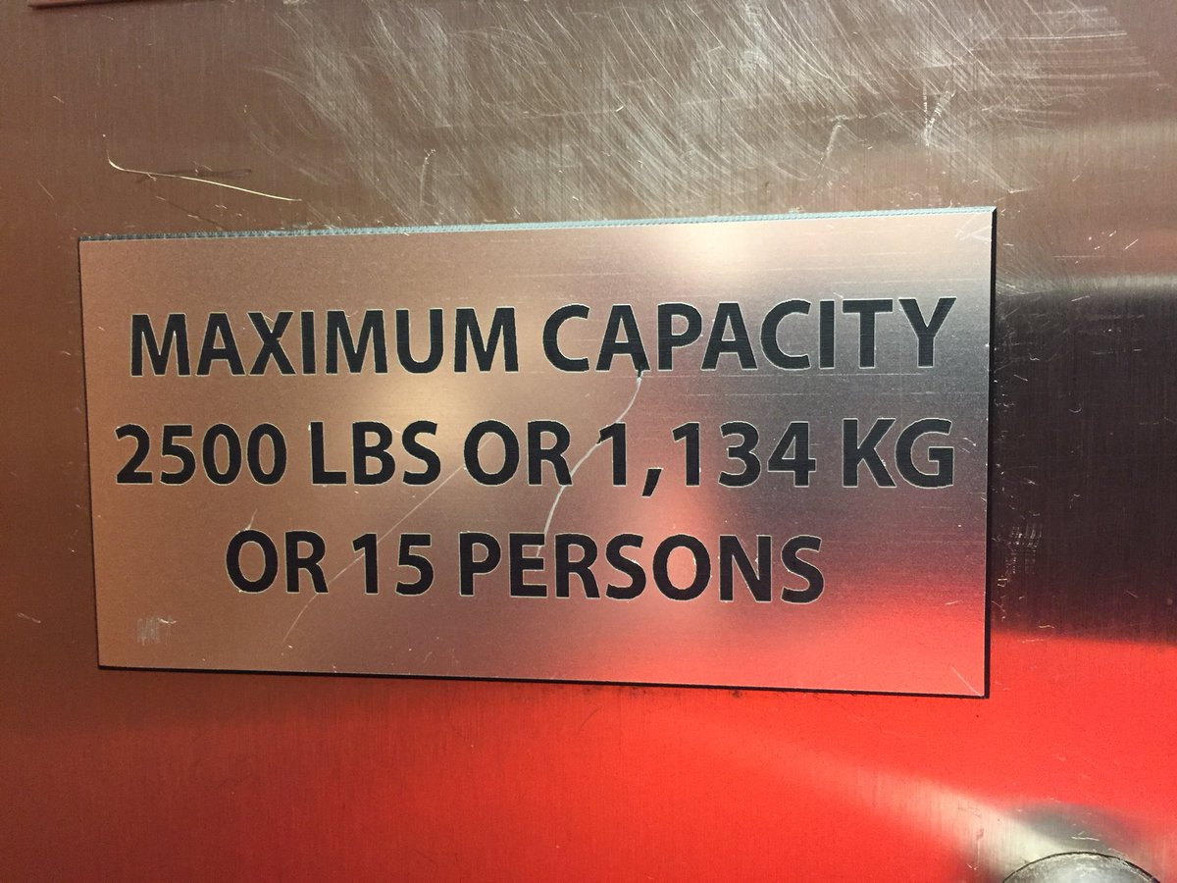
Cardinality constraints are everywhere!
exactly one 7 per row
at most 7 people per table
at least 3 reviewers per paper
exactly two edges per vertex
at most K as an approximation/redundant

Slide 3
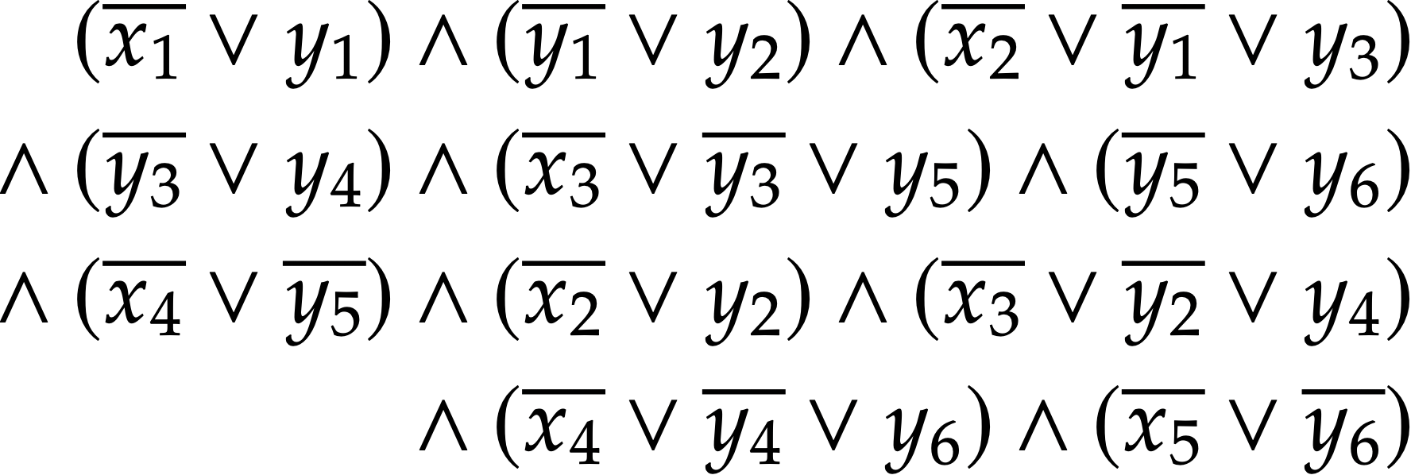
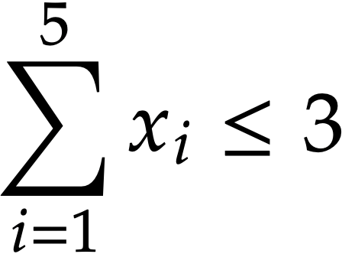
Why encode cardinality constraints?

Slide 4
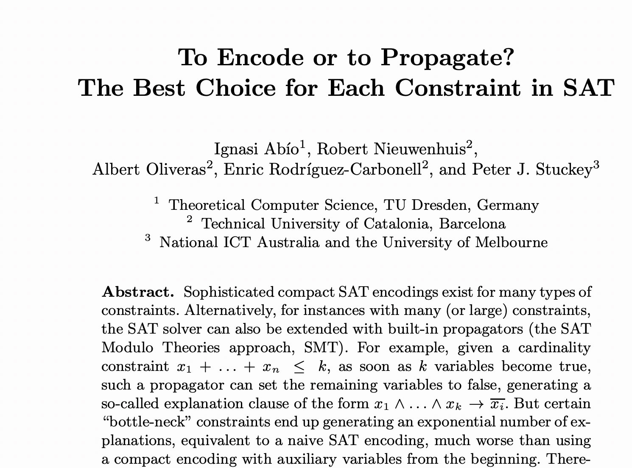
Why encode cardinality constraints?
To Encoder or to Propagate? The Best Choice for Each Constraint in SAT
Abío et al., 2013

Slide 5
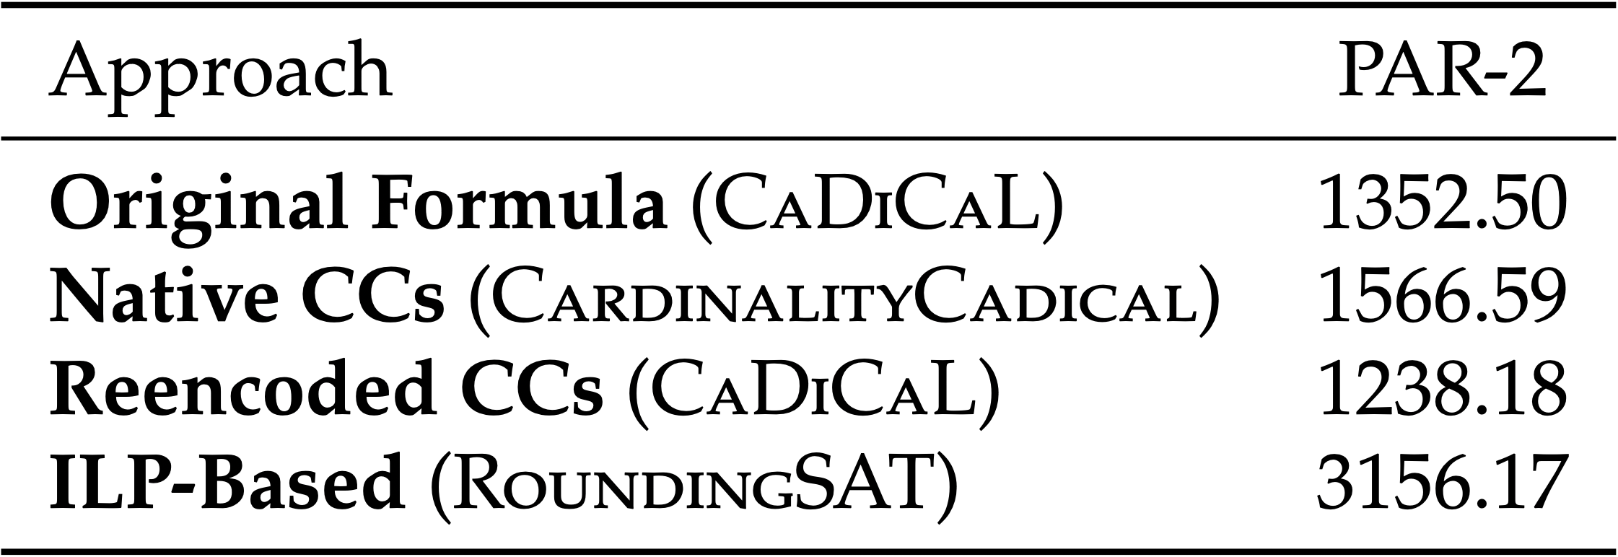
Why encode cardinality constraints?
Anniversary Track formulas with several cardinality constraints
Reeves, Heule, and Bryant (2024)

Slide 6
Why encode cardinality constraints?
Intuition:
auxiliary variables represent intermediate abstractions that are useful for proofs

Slide 7

Why encode cardinality constraints?
Intuition:
auxiliary variables represent intermediate abstractions that are useful for proofs
“If the graph is too sparse, use argument A, and if it’s too dense, use argument B, and in between use argument C”

Slide 8
Considered Factors
# of clauses
# of aux. variables
Propagation strength

Slide 9
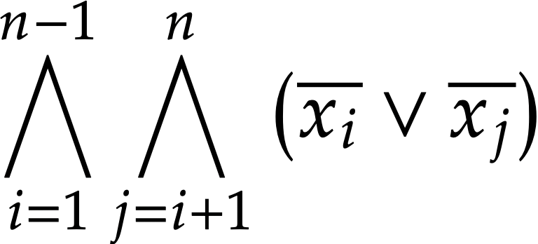
At Most One
Direct encoding: 𝛩(n²) clauses

Slide 10
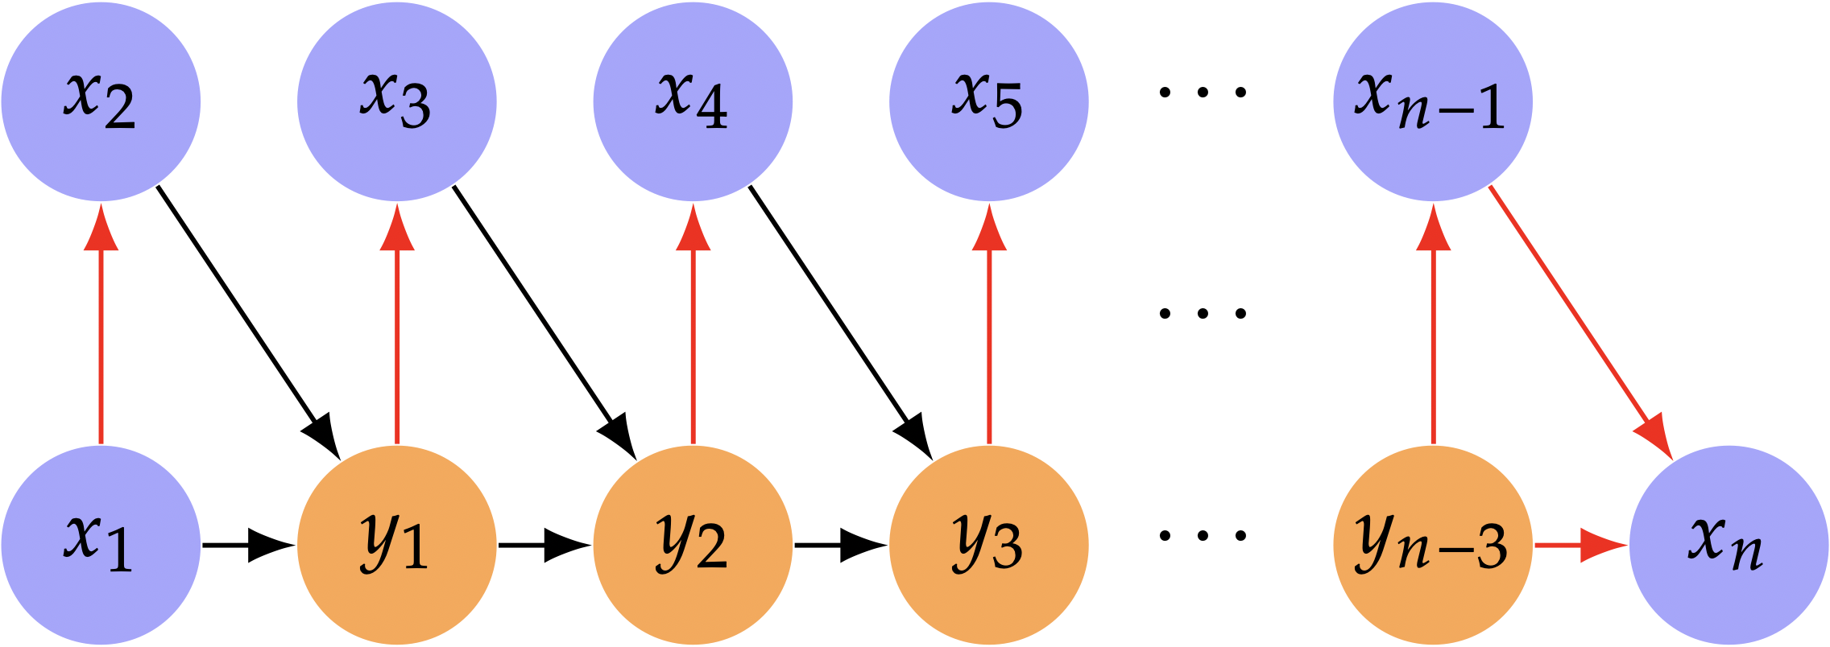
At Most One
Sequential: 3n-6 clauses
Warners (1998)
Ansótegui and Manyà (2004)
Gent and Nightingale (2004)
Sinz (2005)

Slide 11
At Most K

Slide 12
Grid Compression
Two Novel Encoding Techniques

Slide 13
In practice

Slide 14
Near-Optimal Encodings of Cardinality Constraints
Bernardo Subercaseaux (bersub@cmu.edu)
Joint work with Andrew Krapivin and Benjamin Przybocki

