Slide 1
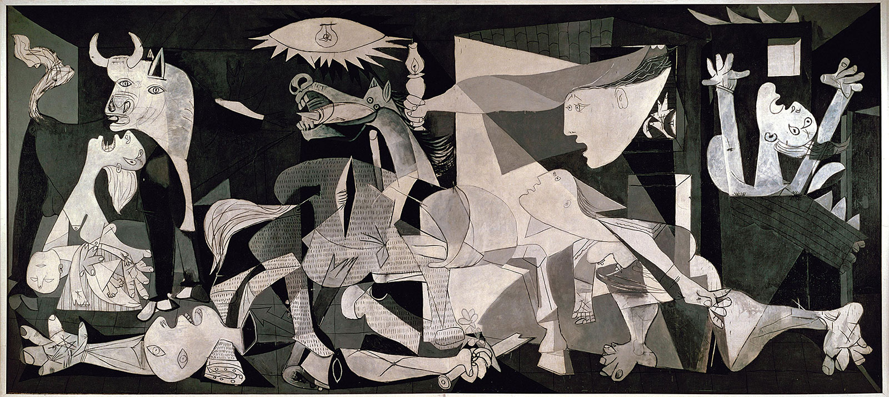
The CNF Encoding Complexity of Boolean Functions
Bernardo Subercaseaux
joint work with Andrew Krapivin and Ben Przybocki

Slide 2
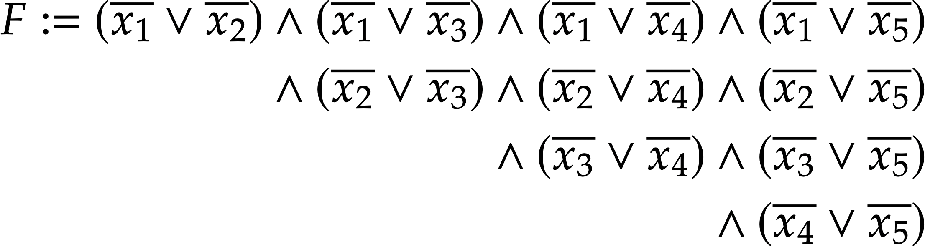
CNF Formula

Slide 3
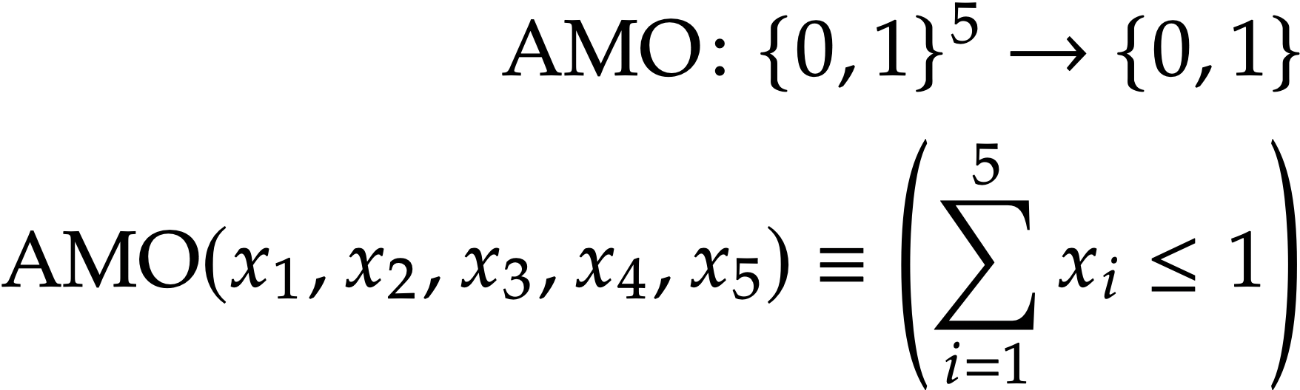
CNF Formula
Boolean
function

Slide 4
CNF Formula
Encodes
Boolean
function

Slide 5

CNF Formula
= 10 clauses
Encodes
Boolean
function

Slide 6
CNF Formula
= 10 clauses
Can we do better?
Encodes
Boolean
function

Slide 7

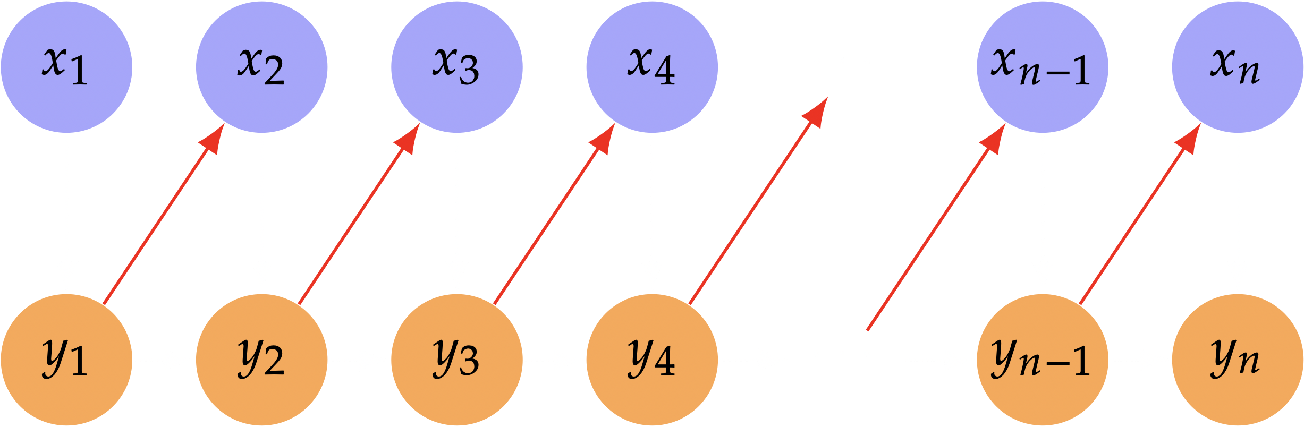
Only with auxiliary variables!

Slide 8
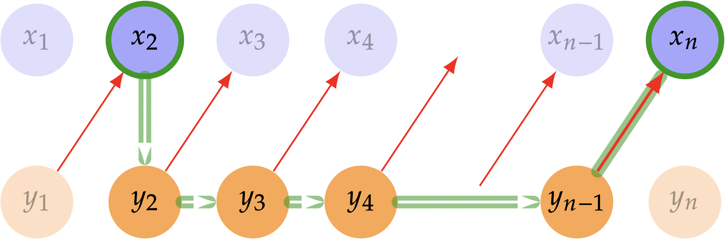
Only with auxiliary variables!

Slide 9
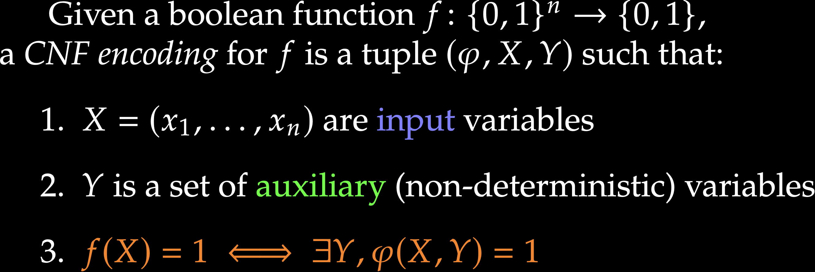
CNF Encodings

Slide 10
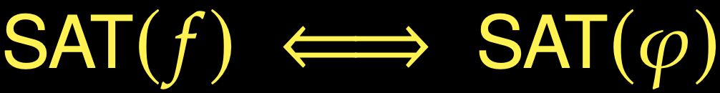
CNF Encodings

Slide 11

CNF Encoding Complexity
Minimum number of clauses to encode a Boolean function

Slide 12
CNF Encoding Complexity
Minimum number of clauses to encode a Boolean function
E.g., what’s the worst case over all functions on n bits?

Slide 13
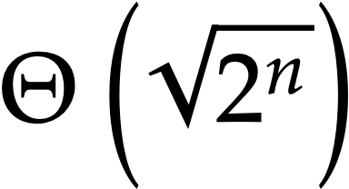
CNF Encoding Complexity
Minimum number of clauses to encode a Boolean function
E.g., what’s the worst case over all functions on n bits?

Slide 14
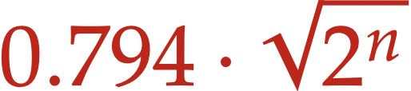
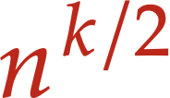
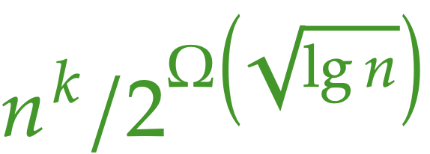
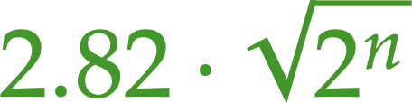
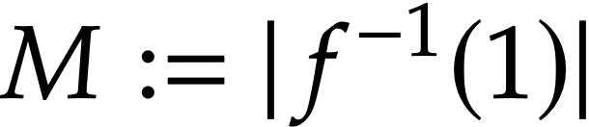
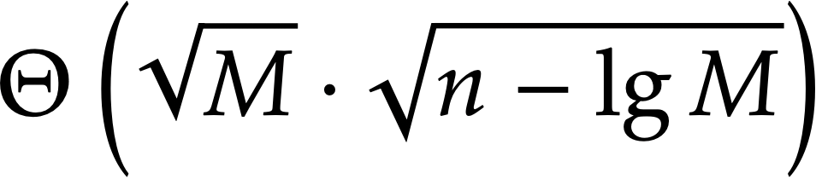
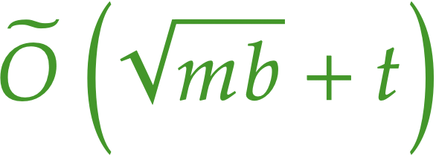
Results
Arbitrary functions
Lower bound:
Upper bound:
k-CNF functions
Lower bound:
Upper bound:
Sparse functions
Functions computable by NRAM in time t with m bits of advice, b used per input:

Slide 15
Why?
It can be relevant to the practice of SAT solving
New perspectives for
circuit complexity
It’s a very nice model that teaches us things about SAT

Slide 16
Encoding
Solving
SAT
Solver
e.g., Kissat
High-level
problem
CNF
formula
UNSAT

Slide 17
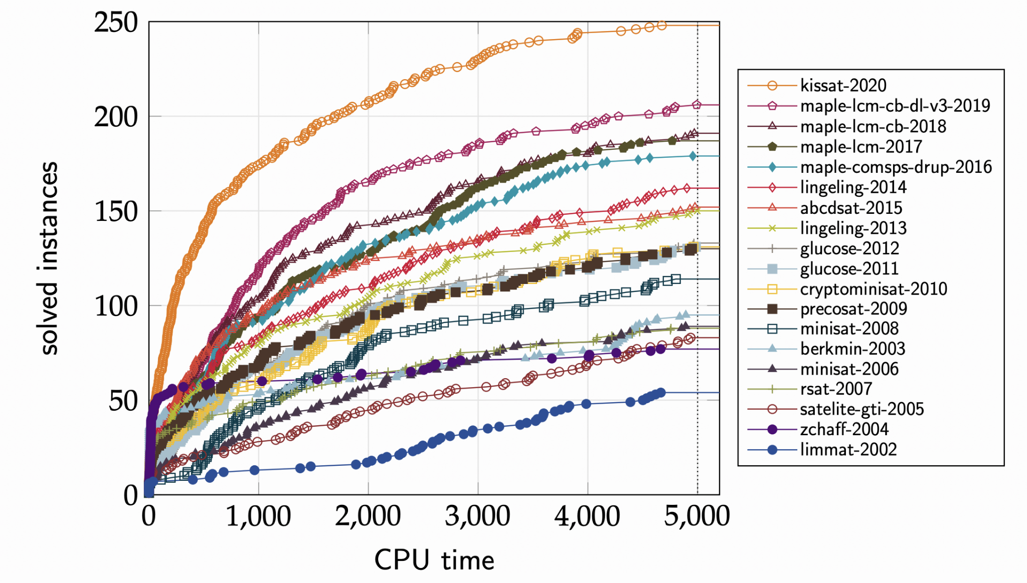
There’s been tremendous progress on solving!

Slide 18
Encodings can matter more than software + hardware
We have gotten x4000 speed-ups on many concrete problems by changing the encoding
An O(n⁴) encoding for n = 500 cannot even be parsed by Kissat! So getting O(n²) makes all the difference
Disclaimer: Design principles of effective encodings are still unclear; art based on hard-won experience

Slide 19
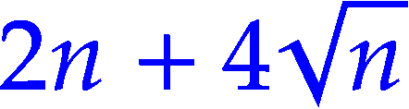
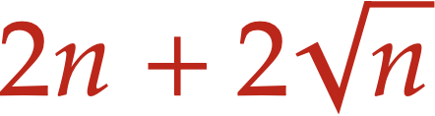
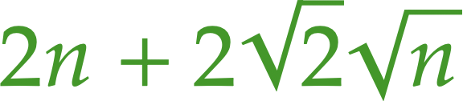
AtMostOne function
Appears everywhere! From Sudokus to Hamiltonian paths
Chen’s encoding (2010): clauses.
Kučera, Savický, Vorel (2017): lower bound for 2-CNF
Krapivin, Przybocki, S. (2026): upper bound, wider!
Applications to circuit complexity:
Improved circuit for Th₂ (from Adleman 1976)
Solved question from Bloniarz (1979) on single-level circuits
Simplified refutation of the single-level conjecture (Wegener, 1991)

Slide 20
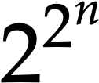
CNF Encoding Complexity
E.g., what’s the worst case over all functions on n bits?

Slide 21
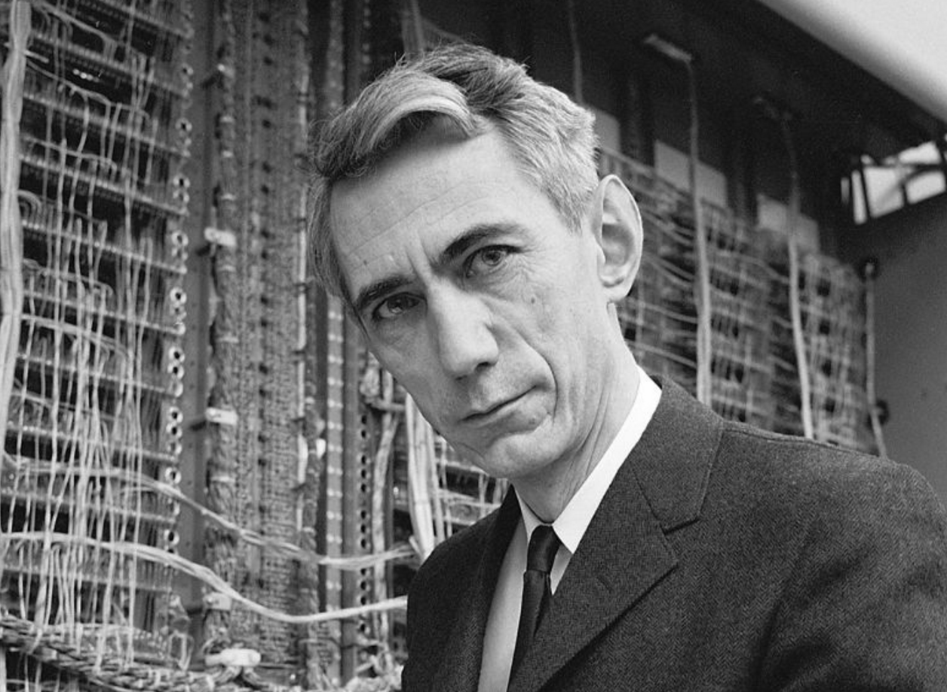
CNF Encoding Complexity
E.g., what’s the worst case over all functions on n bits?
Claude Shannon
But there are boolean functions !

Slide 22

CNF Encoding Complexity
E.g., what’s the worst case over all functions on n bits?
Claude Shannon
But there are boolean functions !
Yes, so some CNF must use literals

Slide 23

Tseitin Transform
of Shannon‒Lupanov circuits
3-CNF

Slide 24

Tseitin Transform
of Shannon‒Lupanov circuits
Our encodings
3-CNF

Slide 25
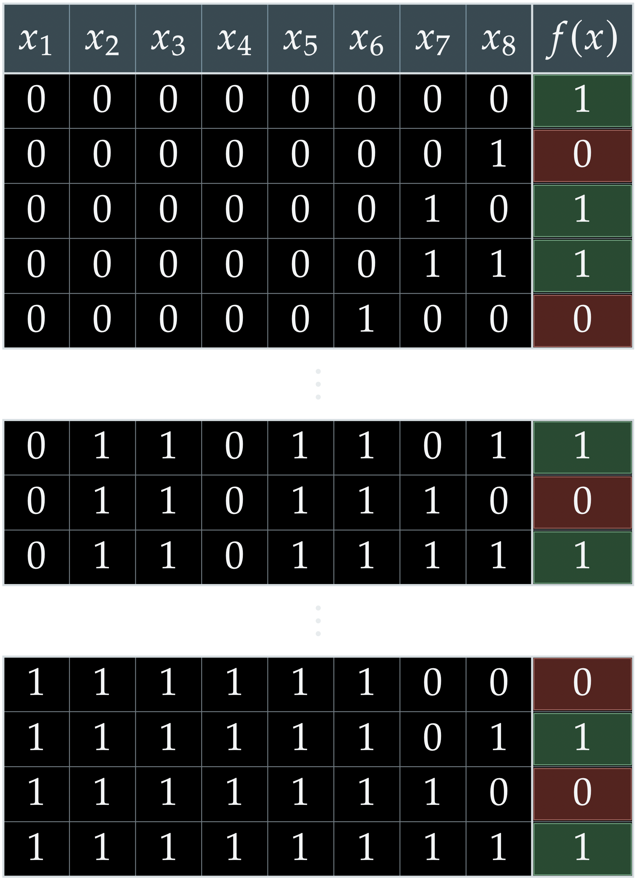


Slide 26


How to implement?
Naïve version:

Slide 27
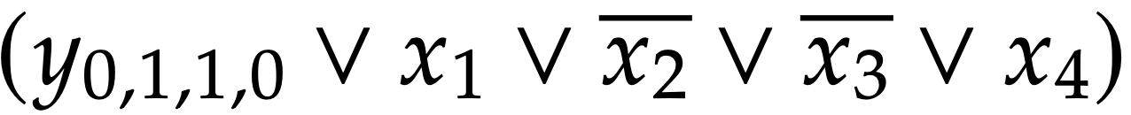
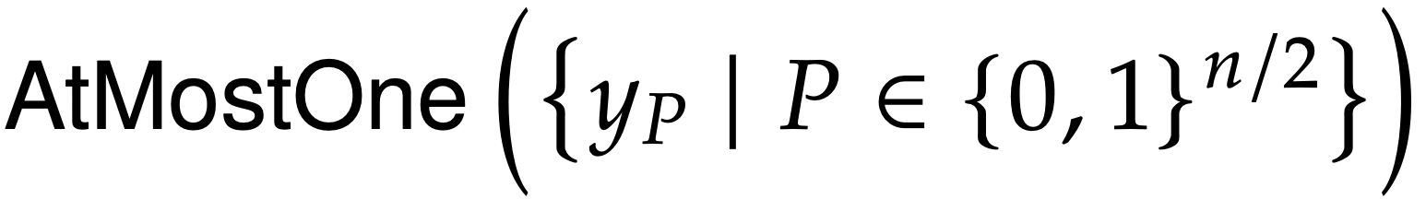
How to implement?
Good version:

Slide 28

Results
Arbitrary functions
Lower bound:
Upper bound:
Sparse functions

Slide 29


Sparse functions in
1) Let be the satisfying assignments
2) We will guess the index i of the satisfying assignment via variables i₁, …, i_{lg M} and check that each input variable matches it.
3) The check for whether x_{j} takes the right value according to the assignment determined by i₁, …, i_{lg M} is a Boolean function on (lg M + 1) bits!

Slide 30
Results
Arbitrary functions
Lower bound:
Upper bound:
Sparse functions
Functions computable by NRAM in time t with m bits of advice, b used per input:

Slide 31
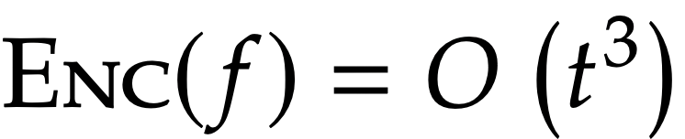
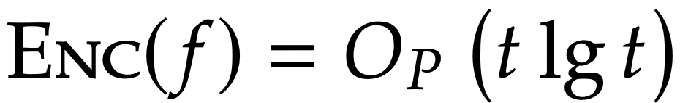
Cook–Levin Theorem (71’, 73’)
If a function f can be computed in time t by a non-deterministic multitape Turing machine, then
Robson’s Theorem (91’)
If a function f can be computed in time t by a non-deterministic RAM program P, in the log-cost model, then

Slide 32
So what’s “wrong” with Robson’s?

Slide 33

Hint:
So what’s “wrong” with Robson’s?

Slide 34
Uniform vs. Non-uniform
Robson’s result is designed for the setting in which we have a problem of growing size n and a fixed program that will handle inputs in time t(n)
But if we use SAT solvers to find the largest number of STOC authors for which no pair of them has collaborated, or to prove optimality of a Super Mario speed-run, there is no growing n

Slide 35


Uniform vs. Non-uniform
So if the graph G of STOC co-authorships is fixed, what is even the Boolean function at play?
takes a subset of vertices, from
and returns whether it’s independent and of size exactly k.
So if G and k will be hardcoded in our CNF, let’s hardcode them into our NRAM machine!

Slide 36

So what’s “wrong” with Robson’s?
It’s too expensive!
Consider an arbitrary Boolean function on n bits, we hardcode it into the program, read the input and look up the answer

Slide 37
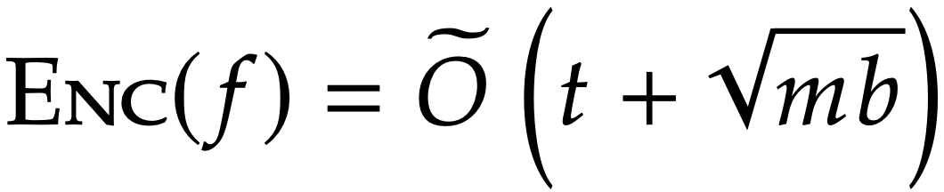
Main Theorem
If a function f can be computed in time t by an NRAM program of constant size, with random access to m bits of advice (which do not depend on the input), but such that for each input at most b bits are accessed, then

Slide 38

Test #1: general functions
Advice: a look-up table A that stores for each
whether it’s satisfying or not. E.g., A[7] = f(0,0,0,1,1,1)
Algorithm: read the input and go look into A. Takes O(n)

Slide 39
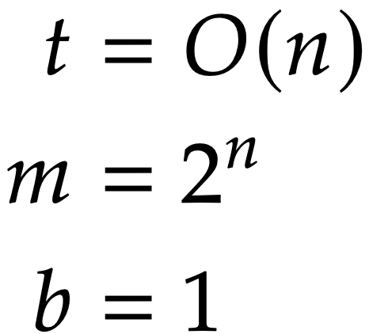
Test #1: general functions
Advice: a look-up table A that stores for each
whether it’s satisfying or not. E.g., A[7] = f(0,0,0,1,1,1)
Algorithm: read the input and go look into A. Takes O(n)

Slide 40

Test #1: general functions
Advice: a look-up table A that stores for each
whether it’s satisfying or not. E.g., A[7] = f(0,0,0,1,1,1)
Algorithm: read the input and go look into A. Takes O(n)

Slide 41


The Temu version:
We think of the advice A, of size m, as a Boolean function
f_{A} which takes an index i (log m bits) and returns A[i]
We start our non-deterministic computation by guessing which b bits of advice will be needed, and what their values are. But they need to be consistent with A, so for each of them we use an encoding of f_{A}

Slide 42


The Temu version:
Variables
Condition

Slide 43

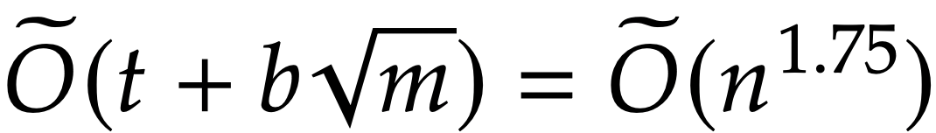
Test #2: Independent Set
We want to encode the function
Our advice is the graph itself (e.g., adjacency list)
and we will check entries.
Consider a graph with n^{1.5} edges, and we want k := n^{0.5}

Slide 44


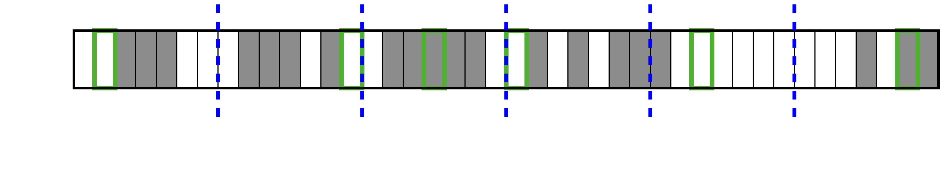
The version:
Suppose we’re very luck and all the b bits we want to read from the advice lie in different blocks of size m/b

Slide 45

The version:
Suppose we’re very luck and all the b bits we want to read from the advice lie in different blocks of size m/b
Then, instead of guessing log m bits per address, we only guess log m/b, so we pay

Slide 46
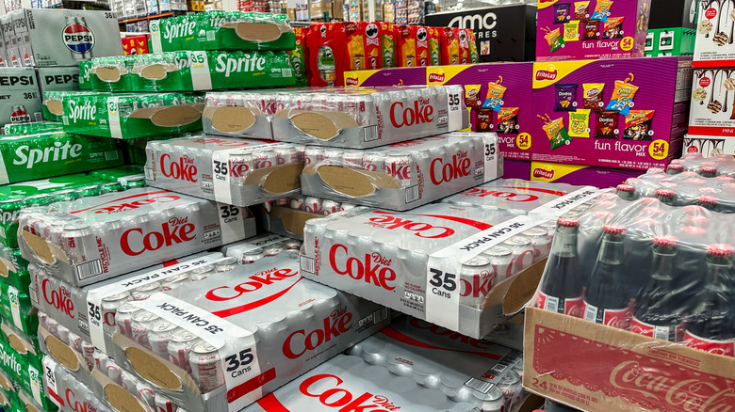
The version:
It’s cheaper because we buy in bulk!

Slide 47
The version:
Suppose we’re very luck and all the b bits we want to read from the advice lie in different blocks of size m/b
Okay but what if I am not lucky?

Slide 48
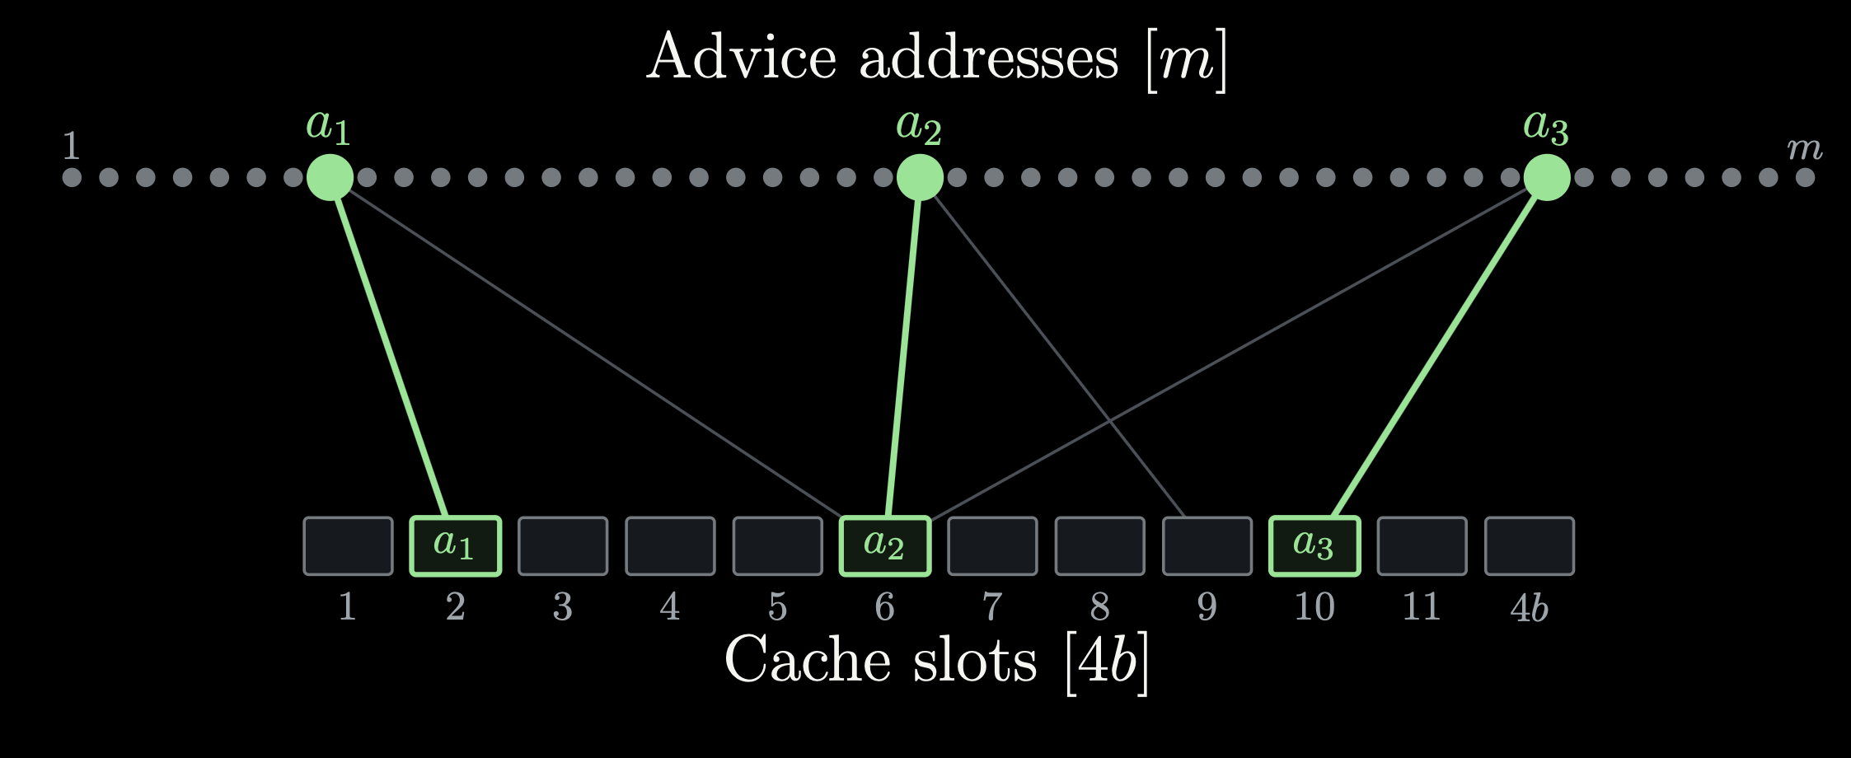
The version:
Okay but what if I am not lucky?

Slide 49


The version:
Consider a bipartite graph
where an edge (i, j) means that memory address i can potentially be mapped to cache slot j
Then, if H is a suitable expander:
each cache slot has few potential addresses it can contain
but any set of b addresses can be matched to slots !

Slide 50

The version:
Variables

Slide 51
The version:
Variables
Condition
Check for emptiness separately, easy!

Slide 52
The version:
Variables
Condition
Check for emptiness separately, easy!
Key observation: since each cache slot only supports a few addresses
g_{j} is a sparse function, with only about m/b satisfying assignments

Slide 53
Results
Arbitrary functions
Lower bound:
Upper bound:
k-CNF functions
Lower bound:
Upper bound:
Sparse functions
Functions computable by NRAM in time t with m bits of advice, b used per input:

Slide 54
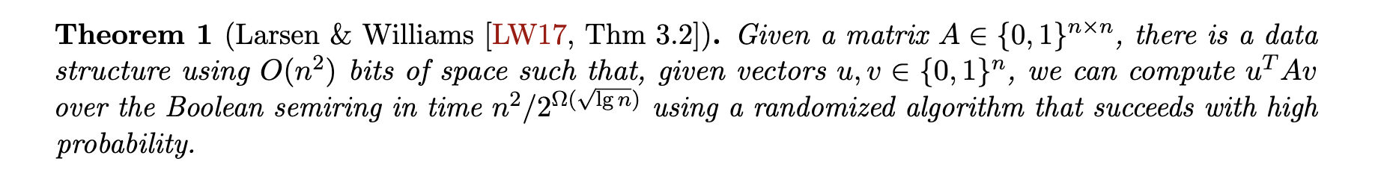


Slide 55
Results
Arbitrary functions
Lower bound:
Upper bound:
k-CNF functions
Lower bound:
Upper bound:
Sparse functions
Functions computable by NRAM in time t with m bits of advice, b used per input:

Slide 56
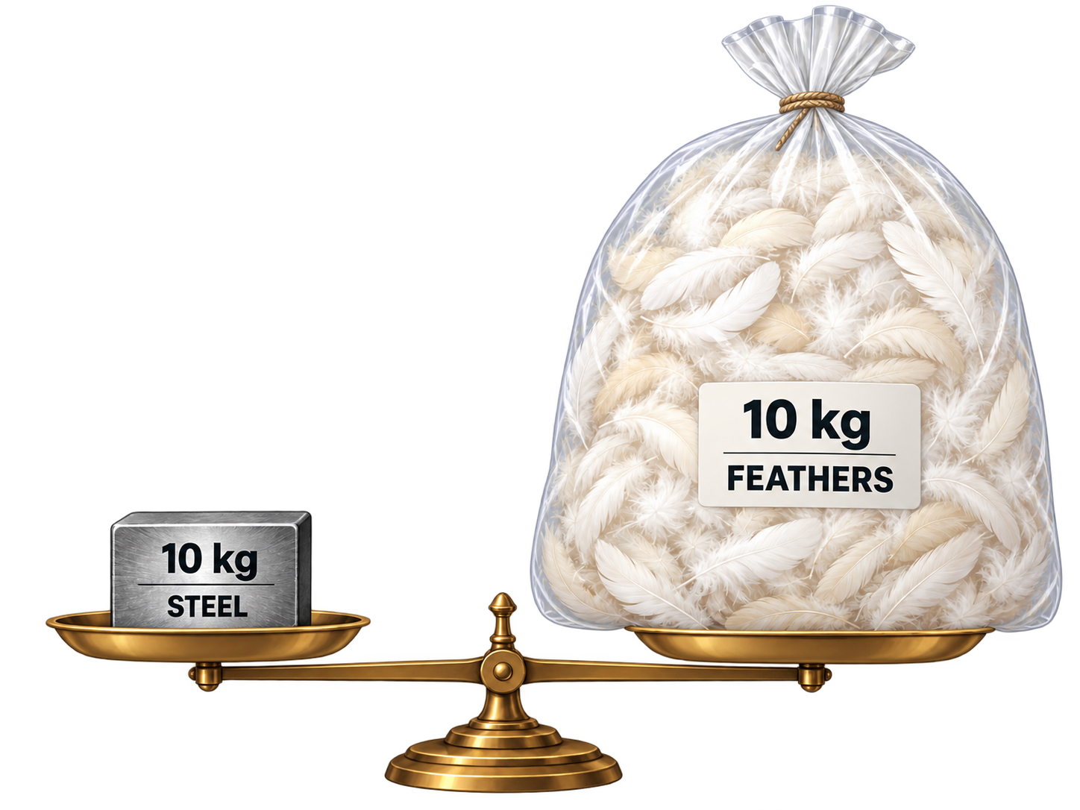
Conclusion: is succinctness always better?

Slide 57
The CNF Encoding Complexity of Boolean Functions
Bernardo Subercaseaux
joint work with Andrew Krapivin and Ben Przybocki

