Slide 1
Designing
Finishing
Slicing & Printing
Figure 1: 3-Step 3D Printing Process

Slide 2
\nodeText
\nodeText
\CSSText
\nodeText
\nodeText

Slide 3
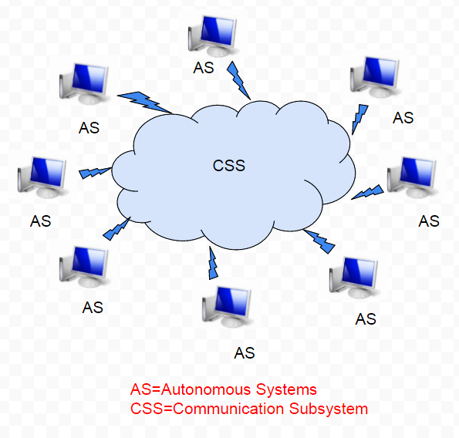

Slide 4
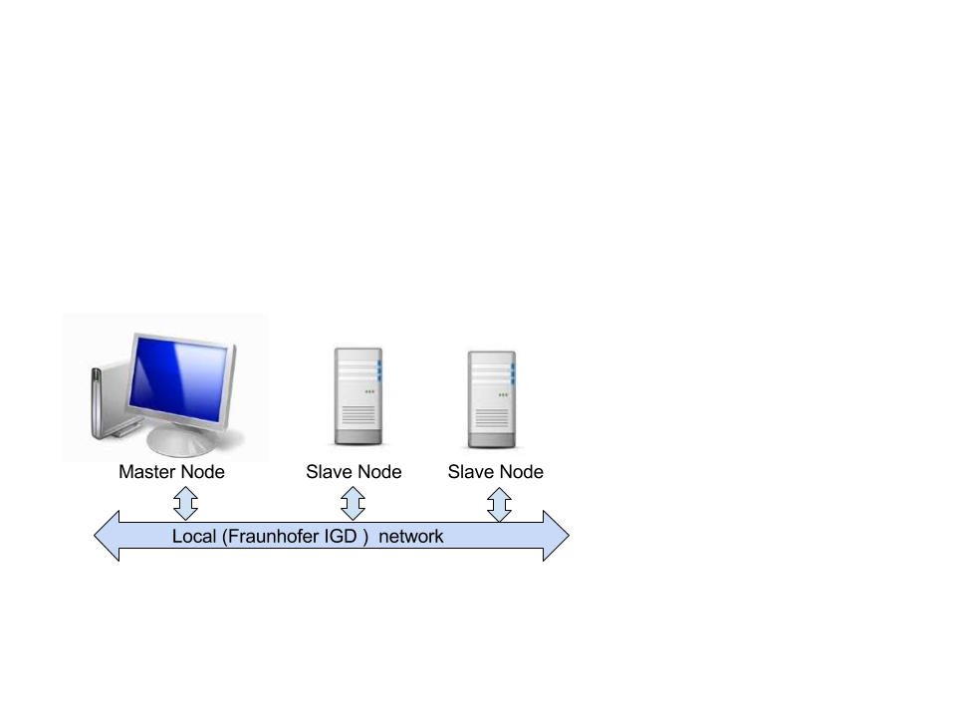

Slide 5
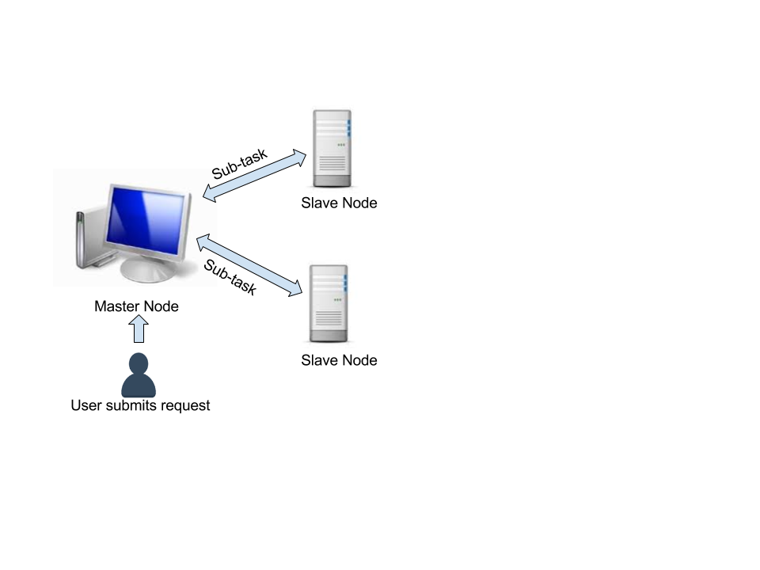

Slide 6

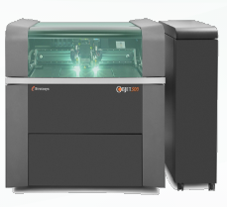
Bitmap
Producer
Objet
PrintJob
Organizer
PrintJob
Preprocessor
. . . .
FileParserPJ

Slide 7
PrintJob
Organizer
PrintJob
Preprocessor
Master
Distributor
. . . .
Master
Merger
FileParserPJ

Slide 8
PrintJob
Organizer
PrintJob
Preprocessor
MasterPJ
Distributor
. . . .
Master
Merger
FileParserPJ

Slide 9
PrintJob
Organizer
PrintJob
Preprocessor
. . . .
Slave
Reporter
FileParserPJ

Slide 10
SlavePJ
Collector
PrintJob
Organizer
. . . .
Slave
Reporter

Slide 11
Input Parsing
Print object arrangement
Rasterization & Voxelization
Tonal Value Calculation
Output Generation
Surface Distance Evaluation
Layer Extraction and Half-toning
repeated chunk-wise

Slide 12
Input Parsing
Print object arrangement
Rasterization & Voxelization
Tonal Value Calculation
Output Generation
Surface Distance Evaluation
Layer Extraction and Half-toning

Slide 13
Shared resources
Physical Resources
- resources which can be shared with some dependence on their location
Computation power
Storage devices
Communication capacity
Virtual Resources
-resources which can be shared independent of their physical location
Operating systems
Software and licenses
Tasks and applications
Services

Slide 14
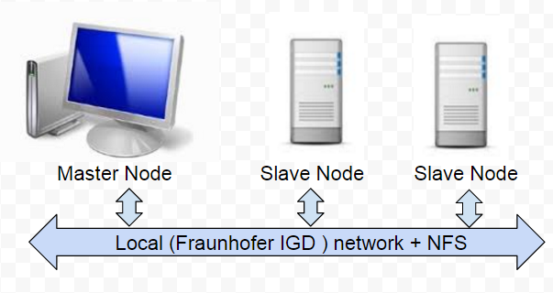

Slide 15
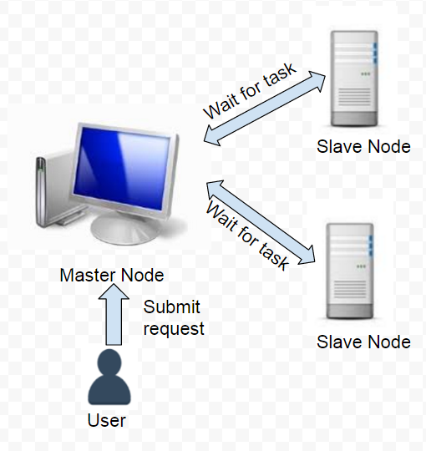

Slide 16
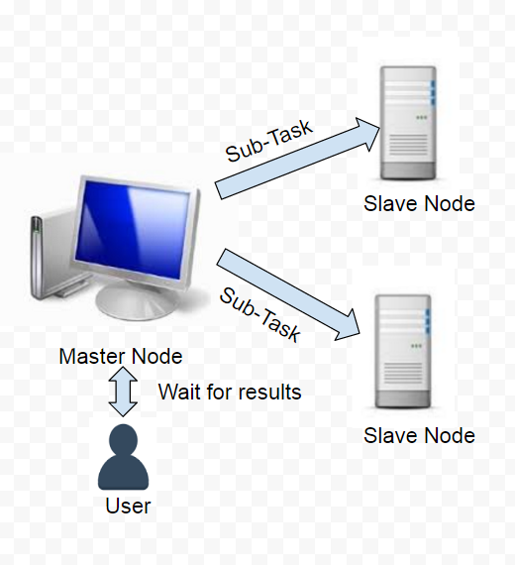

Slide 17
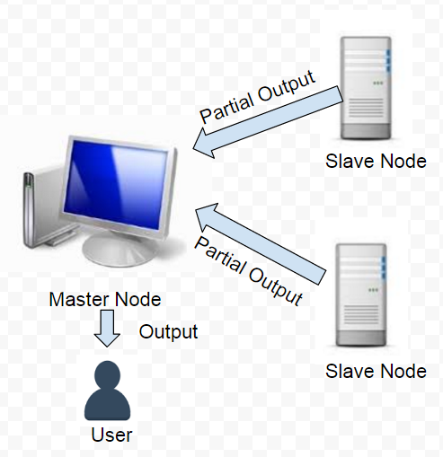

Slide 18
Distributed computing
Peer-to-Peer computing
Cluster computing
Utility computing
Jungle computing
Cloud computing
Grid computing

Slide 19
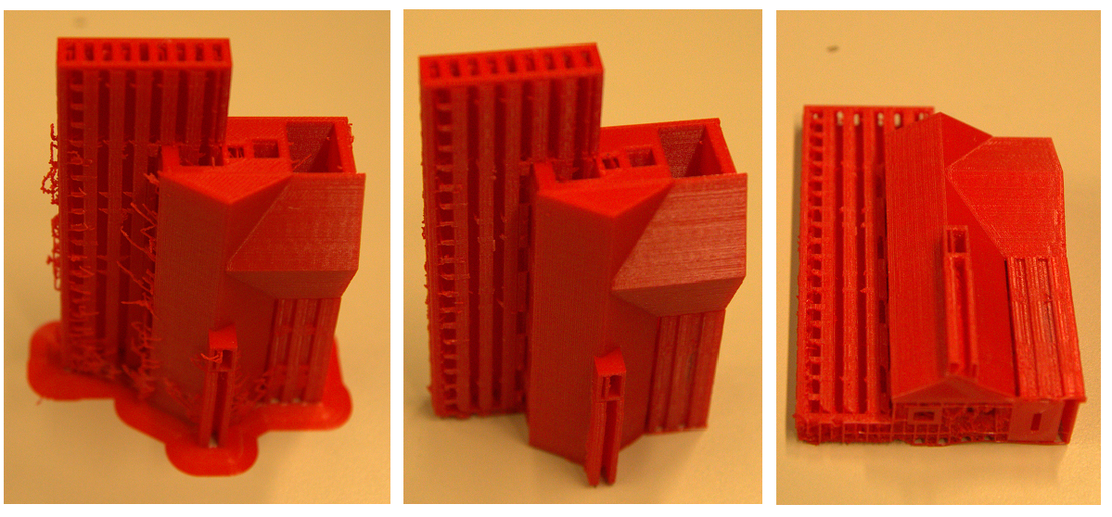

Slide 20
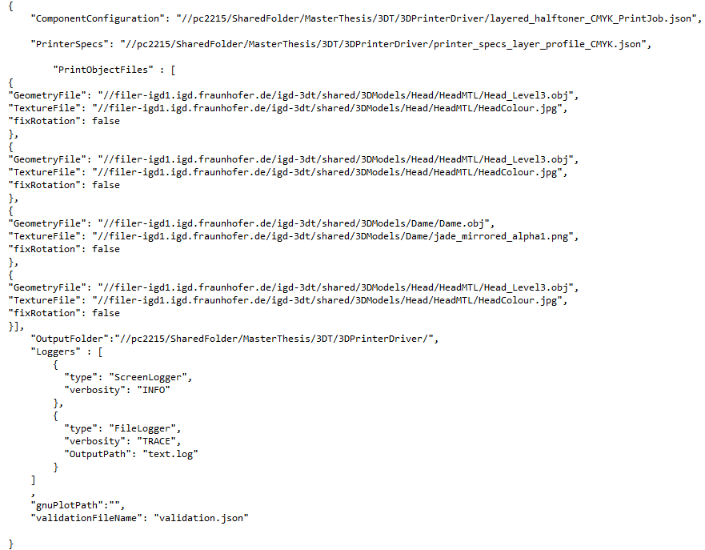

Slide 21
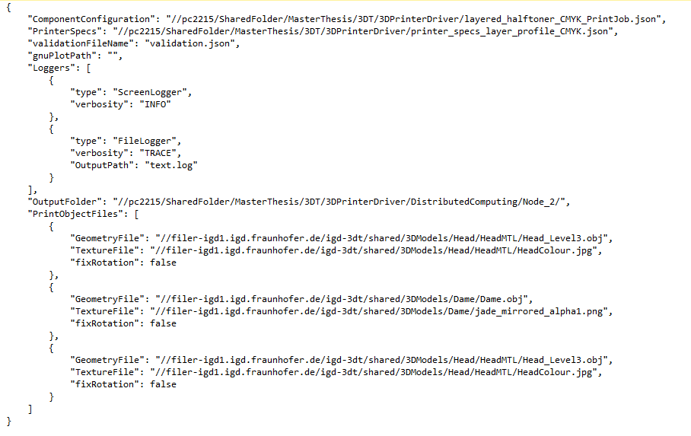

Slide 22
Main Thread-Producer
Insert work-item
Bounded Buffer
Consume work-item
Worker Thread - Consumer
Empty slots

Slide 23


Sender Node
Receiver Node
Sent over the network
Object
Sequence of bytes
Sequence of bytes
Object
Serialization
Deserialization

Slide 24
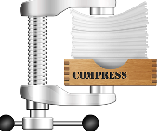

Sender Node
Receiver Node
Sent over the network
Sequence of bytes
Sequence of bytes
Compression
Decompression

Slide 25



Parse the JSON file and get communicator (which uses chosen protocol) by querying the interface
Call send and receive using the communicator
User
Node
MPI
HTTP
TCP/UDP sockets

Slide 26
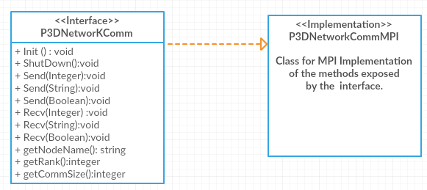

Slide 27
y
super-linear
speedup
S_{p}
linear speedup
sub-linear speedup
# of processors
x

Slide 28
Distributed Cuttlefish
Prototypes
Criteria
I/O Communication
Prototype I
I/O through disk read /writes
Prototype II
I/O by sending data over network

Slide 29
