Slide 1
Designing
Finishing
Slicing & Printing
Figure 1: 3-Step 3D Printing Process

Slide 2
\nodeText
\nodeText
\CSSText
\nodeText
\nodeText

Slide 3
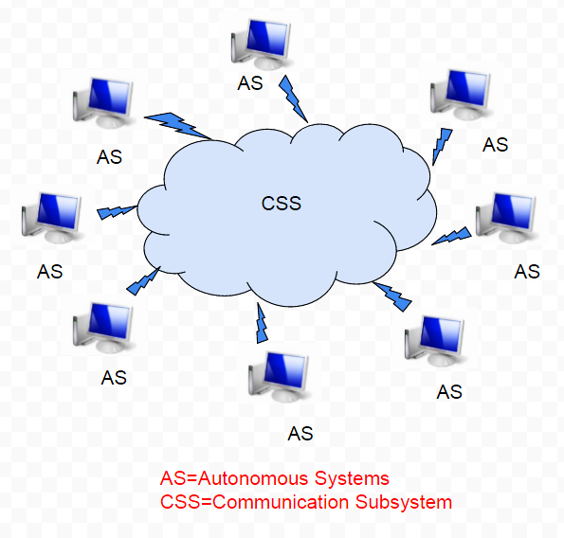

Slide 4
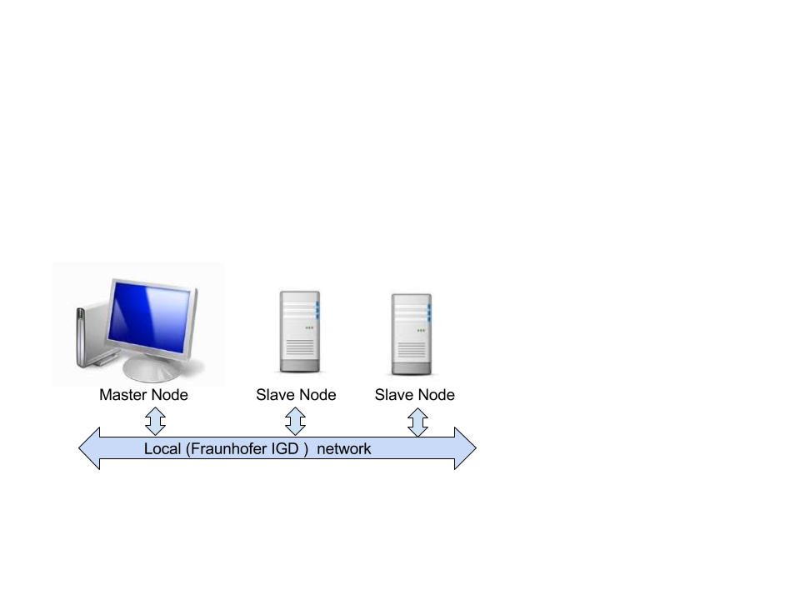

Slide 5
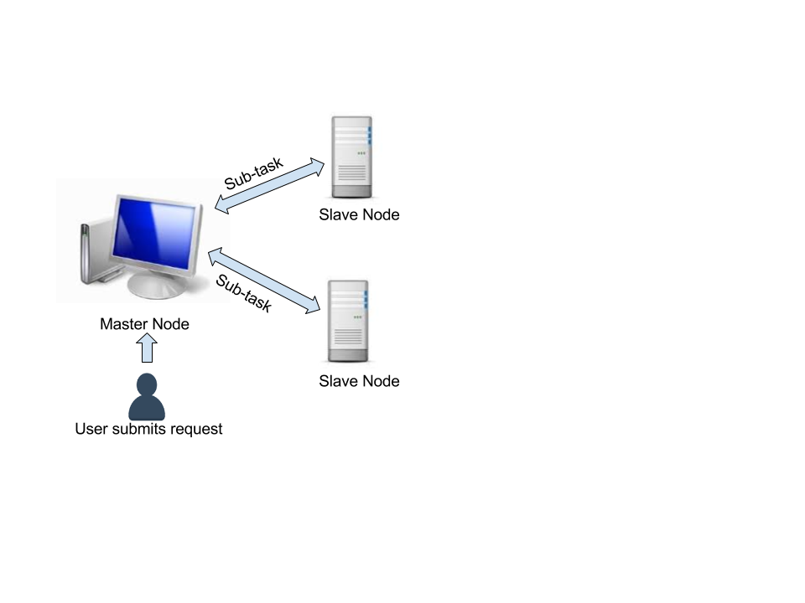

Slide 6

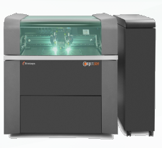
Bitmap
Producer
Objet
PrintJob
Organizer
PrintJob
Preprocessor
. . . .
FileParserPJ

Slide 7
PrintJob
Organizer
PrintJob
Preprocessor
Master
Distributor
. . . .
Master
Merger
FileParserPJ

Slide 8
PrintJob
Organizer
PrintJob
Preprocessor
. . . .
Slave
Reporter
FileParserPJ

Slide 9
Input Parsing
Print object arrangement
Rasterization & Voxelization
Tonal Value Calculation
Output Generation
Surface Distance Evaluation
Layer Extraction and Half-toning
repeated chunk-wise

Slide 10
Input Parsing
Print object arrangement
Rasterization & Voxelization
Tonal Value Calculation
Output Generation
Surface Distance Evaluation
Layer Extraction and Half-toning

Slide 11
Shared resources
Physical Resources
- resources which can be shared with some dependence on their location
Computation power
Storage devices
Communication capacity
Virtual Resources
-resources which can be shared independent of their physical location
Operating systems
Software and licenses
Tasks and applications
Services

Slide 12
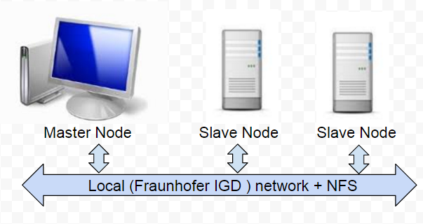

Slide 13
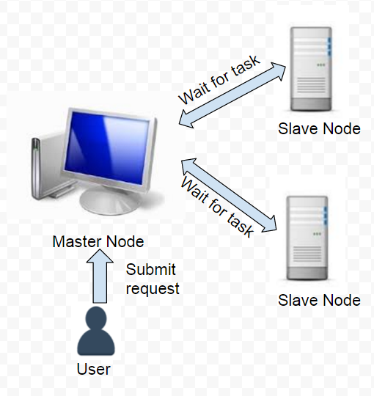

Slide 14
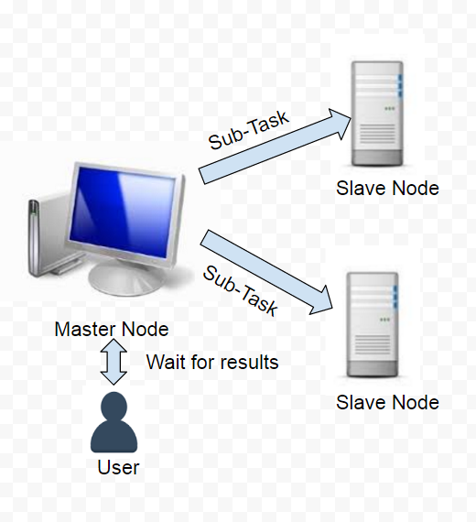

Slide 15
