Slide 1
Signal detection theory
Suresh Krishna
Associate Professor, Physiology
McGill University

Slide 2
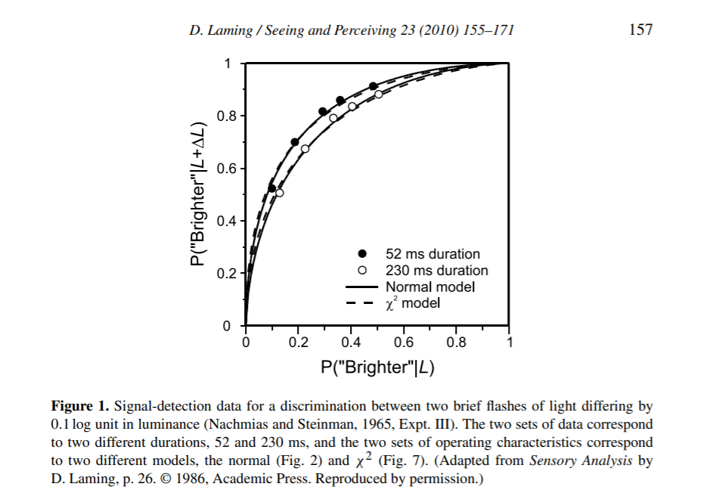
Example of ROC curve with real data

Slide 3
Test interpretation
Sensitivity = True test-positives/(Total number of people with disease) Specificity = True test-negatives/(Total number of healthy people)
PPV=Test-positives with disease/Total number of test positives
1 person in 100 has disease, 99 don’t (this is the ground truth, that we might guess based on other populations, but we don’t know for this set of 100).
Test is 100 percent sensitive, 95 % specific – so 1 true positive, 0.95*99 ~ 94 true negatives, 5 false positives.
Yet, positive predictive value (PPV) is only 1 in 6 = 16.7 percent

