Slide 1
Linear systems (1D)
Suresh Krishna
Associate Professor, Physiology
McGill University

Slide 2
Linear systems
Input I
Black Box
Output O
A*I -> A*O
If I1 -> O1 and I2 -> O2, then I1 + I2 -> O1 + O2
Together, A*I1 + B*I2 -> A*O1 + B*O2

Slide 3
Linear, time-invariant systems
X(t) → Y(t) – signals are functions of time. Like a tone.
If X(t + t1) -> Y(t + t1), for all t1, then time-invariant
Shifting X by time, produces same output but shifted by same time. The system properties are not changing with time.
E.g. X(t) → A*X(t), say A=10
X(t+5) → 10*X(t+5) since A is a constant, and not a function of time
Linear, time-invariant (LTI) systems are very useful, even if wrong baseline models

Slide 4
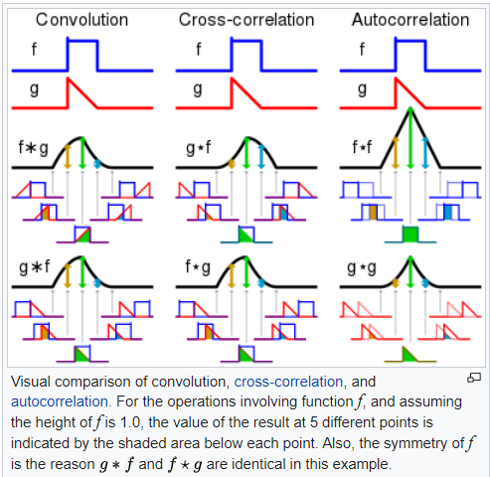
Convolution gives output

Slide 5
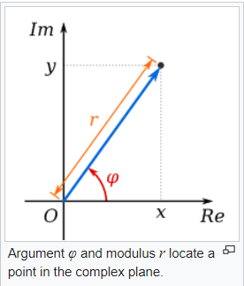
Complex numbers
Figure from Wikipedia article.
x + iy r*e^{iφ} = r * cos φ + i * r * sin φ
x = r * cos φ ; y = r * sin φ
r * e^{iφ} is a complex exponential
r = sqrt(x² + y²) is the amplitude
φ is the phase
And r * e^{i(ωt+φ)} is a complex exponential function of time and is equal to cos(ωt+φ) + i*sin(ωt+φ)

Slide 6
Sinusoids go through with only scaling and phase-shifting
If you pass a complex exponential through an LTI system, you get another complex exponential, with only amplitude and phase being possibly different.
Here, complex exponentials include real numbers, when the phase is 0.
That is, exponentials are eigenfunctions for LTI systems.
Simple proof in Wikipedia.
Because real part of exponential is a cosine and imaginary part a sine, cosines and sines are also eigenfunctions of LTI systems.

Slide 7
Basis functions
For a given class of target functions, a basis set is a minimal spanning set of basis functions: that is, by suitably scaling and adding these functions, you can get any target function.
It is minimal, because for this property to be true for this basis, all the basis functions are needed – you cannot delete any of them.
For a very large class of functions, the set of sinusoids and co-sinusoids are basis functions… aka the Fourier transform. Each target function can be characterized as the amplitude and phase of its basis functions, that when added produce the target function.
A sufficiently long pure-tone’s frequency domain representation is a single sinusoid, for example. Shorter tones will need more frequencies to capture the onset and offset.

Slide 8
LTI systems – frequency domain
For a very large class of functions, the set of sinusoids and co-sinusoids are basis functions… aka the Fourier transform. Each target function can be characterized as the amplitude and phase of its basis functions.
If you add these basis functions, you will get the target function back – this is the inverse Fourier transform.
If you pass a complex exponential through an LTI system, you get another complex exponential, with only amplitude and phase being possibly different.
To get the output of a linear system, often it is easier, to break the input signal into its Fourier basis, scale and phase-shift each basis to capture LTI system’s response, and then add the transformed basis functions to get the output.

Slide 9
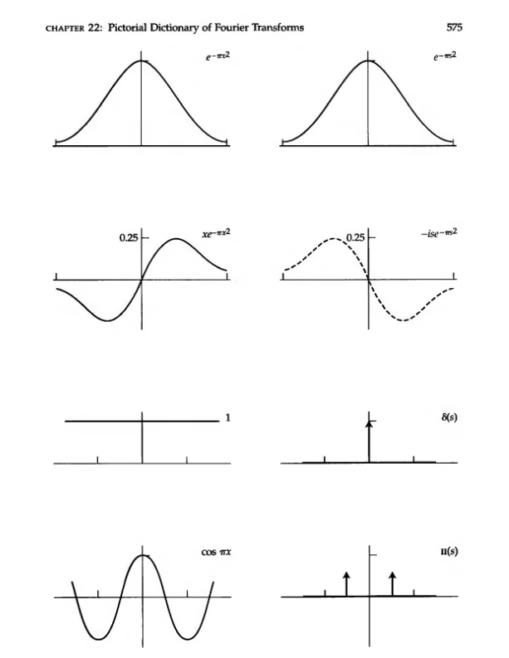
LTI systems – frequency domain

Slide 10
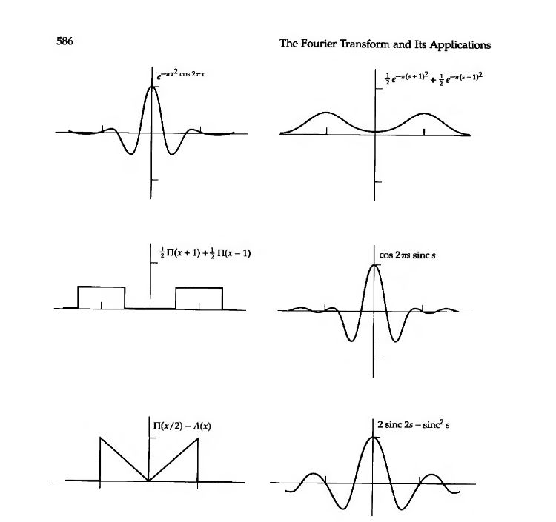
LTI systems – frequency domain

Slide 11
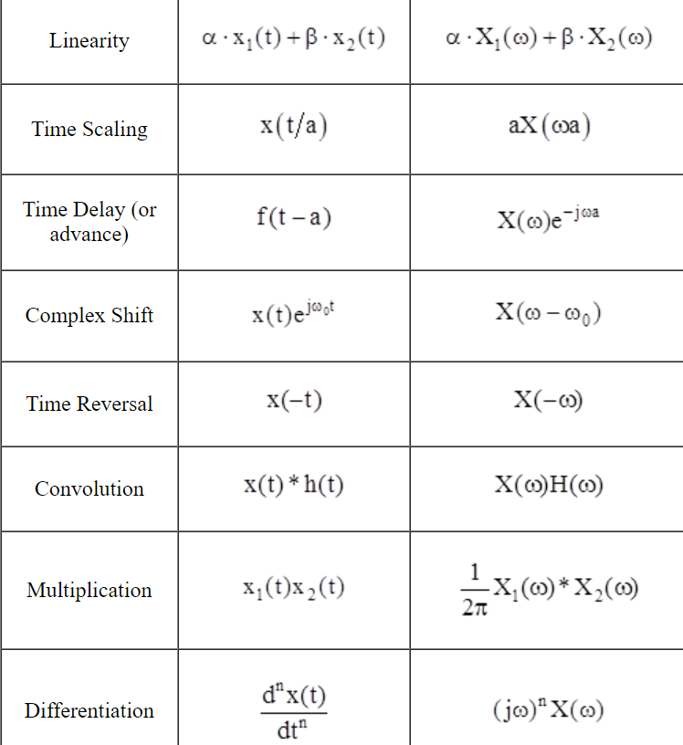
https://lpsa.swarthmore.edu/Fourier/Xforms/FTPairsProps.html

Slide 12
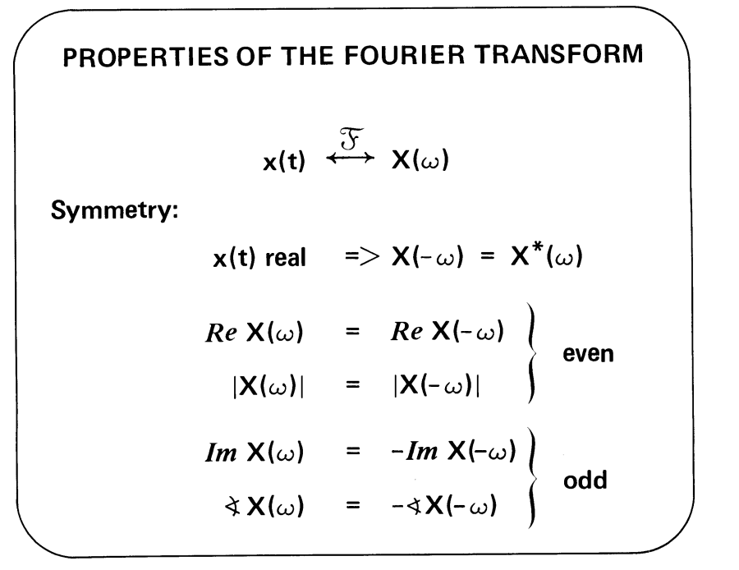
https://ocw.mit.edu/courses/res-6-007-signals-and-systems-spring-2011/403577752d3007ed4ea30e8c61cf90d7_MITRES_6_007S11_lec09.pdf

Slide 13

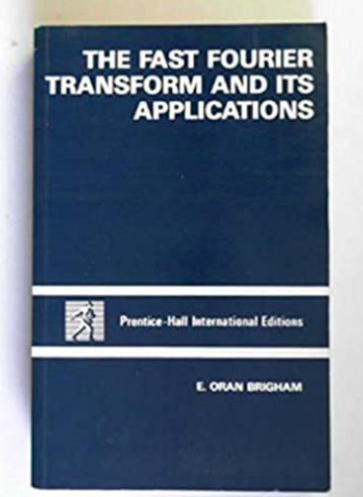
Great book for intuitive understanding
Book for 2D as well, I think.

