Slide 1

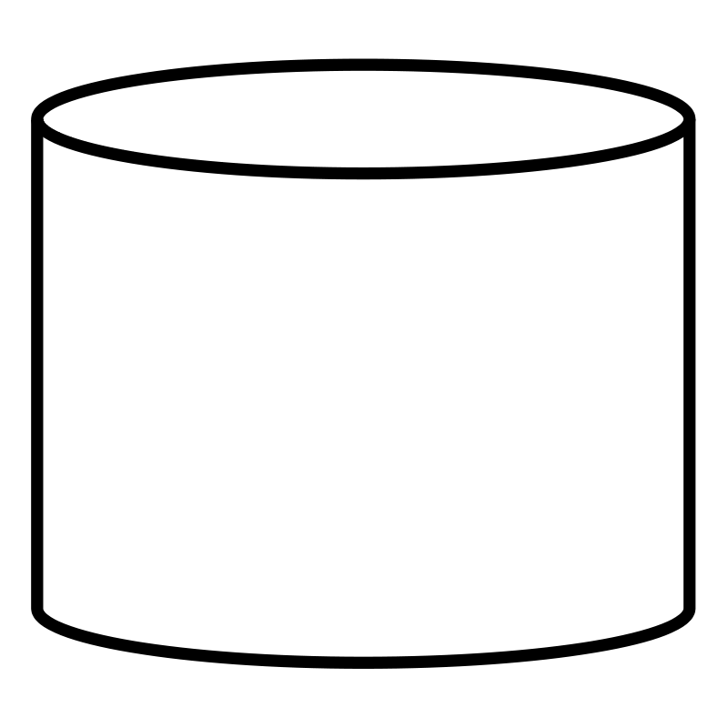
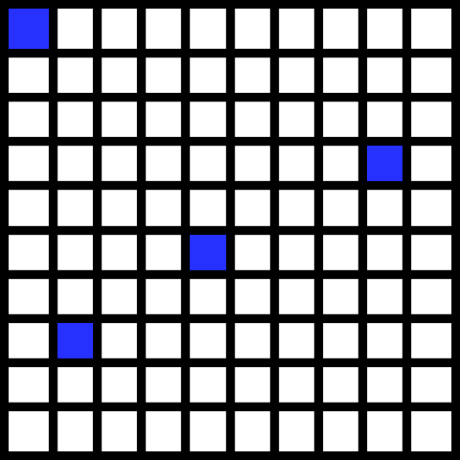

DedupeLibrary
DedupeLibraryXL
Objects
Objects
Index
Container Indices
Master Index
Chunk Folder
Chunk Folder
Chunk Map
Chunk Map
One object chunk map for all objects and chunks
One object chunk map for each container

