Slide 1
International Migration
Relationship to wealth and inequality

Slide 2
Objectives

Slide 3
Objectives
Show main routes of migration
Flows between regions
Twenty countries share of total migration
Economic, family and war related migration
https://rpubs.com/bsvmelo/612580
Find evidence that migration and wealth are econometrically linked

Slide 4
Migration Flows

Slide 5
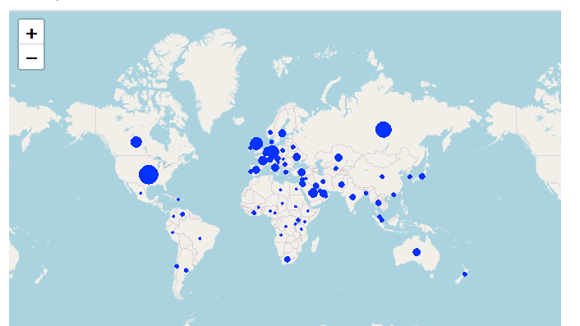
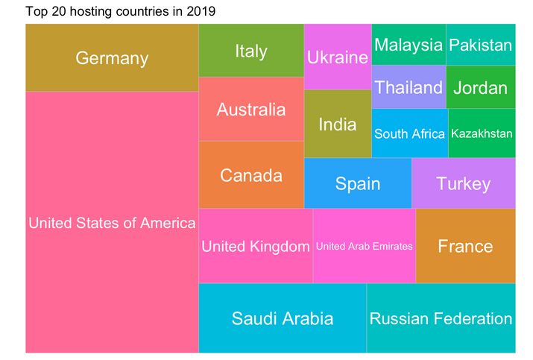
World Wide migration in 2019

Slide 6
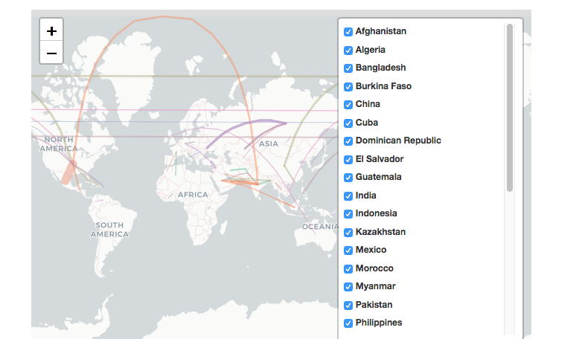
Main migration routes in 2019

Slide 7
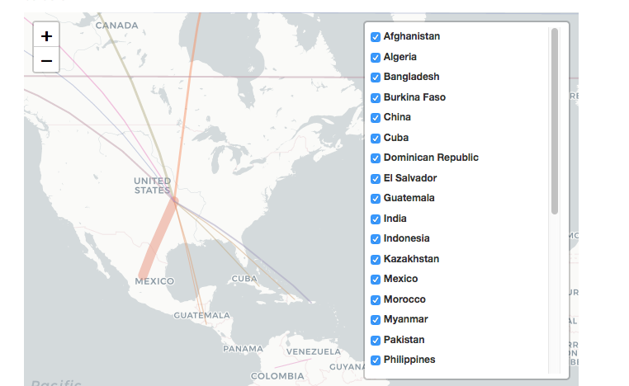
Main migration routes to the US in 2019

Slide 8
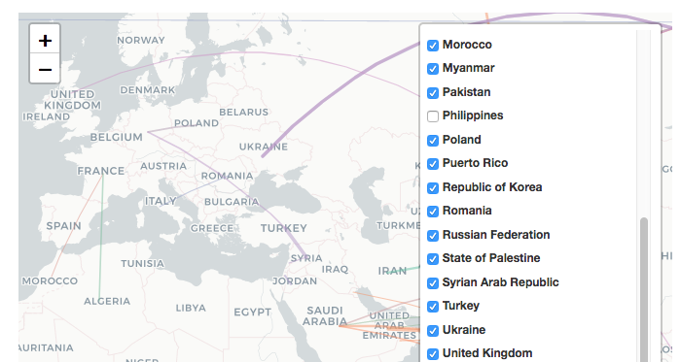
Main migration routes to Europe, Russia in 2019

Slide 9
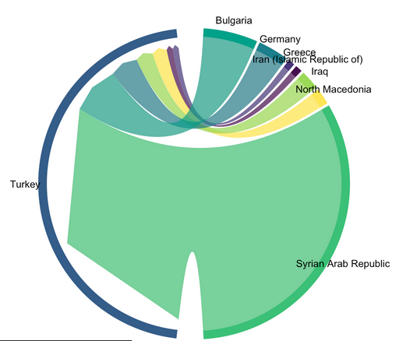
Migration to Turkey in 2019 - not economically related!

Slide 10
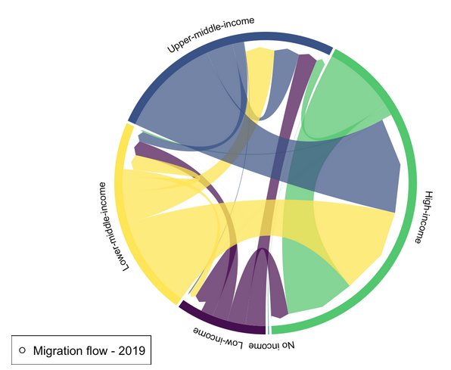
Migration between different income groups - World Bank breakdown

Slide 11
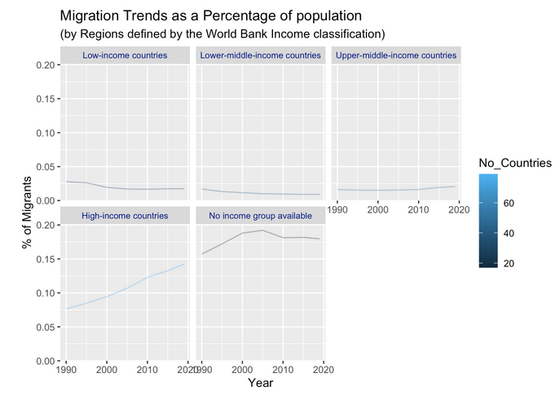

Slide 12
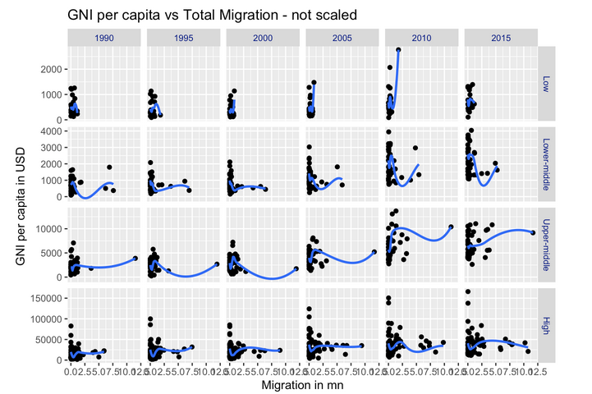
Relationship Migration // Wealth
Gross National Income (GNI) per capita
GINI index: as a measure of inequality
Personal
Remittances (received as % of GDP): as a measure of family ties

Slide 13
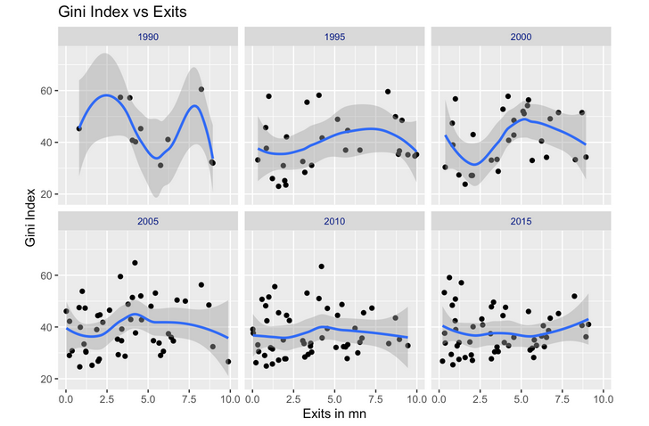

Slide 14
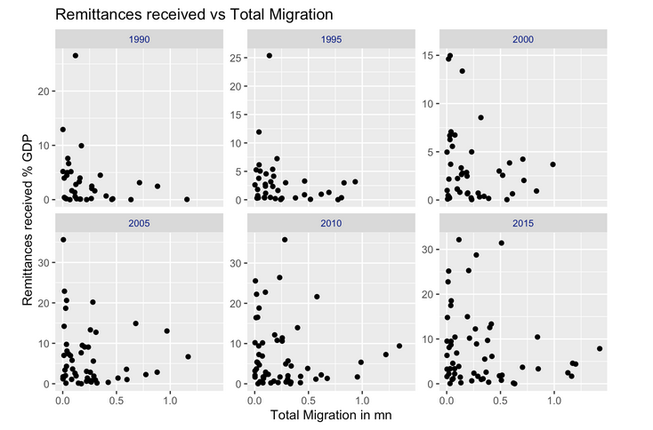

Slide 15
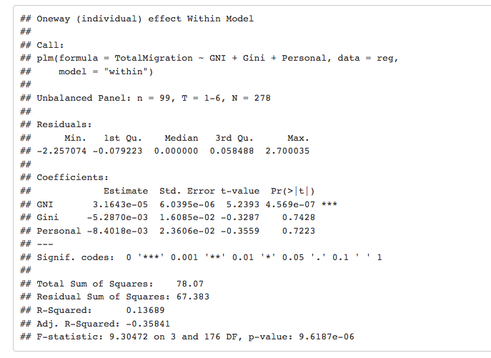
Panel data regression analysis

Slide 16
Conclusion
Link between migration and wealth:
Clear evidence from the flows, and trends
Not clear with econometrics analysis --> limited data set

