Slide 1
3. A Testing Framework
Notes:
Unit Tests - eine Art von Tests, die wir zeitnah zur Programmierung erstellen und nach jeder Programmodifikation ausführen wollen.
Ein mächtiges Framework zumSchreiben und Ausführen von automatischen Tests.

Slide 2
A Testing Framework
P2 — A Testing Framework
Sources
JUnit documentation (from www.junit.org)
© O. Nierstrasz
3.<number>

Slide 3

Roadmap
P2 — A Testing Framework
Junit — a testing framework
  Testing practices
  Frameworks vs. Libraries
  Junit 3.x vs. Junit 4.x (annotations)
Money and MoneyBag — a testing case study
Double Dispatch — how to add different types of objects
JExample
© O. Nierstrasz
3.<number>

Slide 4
Roadmap
P2 — A Testing Framework
Junit — a testing framework
  Testing practices
  Frameworks vs. Libraries
  Junit 3.x vs. Junit 4.x (annotations)
Money and MoneyBag — a testing case study
Double Dispatch — how to add different types of objects
JExample
© O. Nierstrasz
3.<number>

Slide 5
The Problem
P2 — A Testing Framework
“Testing is not closely integrated with development. This prevents you from measuring the progress of development — you can't tell when something starts working or when something stops working.”
Interactive testing is tedious and seldom exhaustive.
Automated tests are better, but,
  how to introduce tests interactively?
  how to organize suites of tests?
© O. Nierstrasz
3.<number>
Notes:
Tests sollten selbstprüfend, automatisiert und wiederholbar sein.

Slide 6
Testing Practices
P2 — A Testing Framework
During Development
When you need to add new functionality, write the tests first.
  You will be done when the test runs.
When you need to redesign your software to add new features, refactor in small steps, and run the (regression) tests after each step.
  Fix what’s broken before proceeding.
During Debugging
When someone discovers a defect in your code, first write a test that demonstrates the defect.
  Then debug until the test succeeds.
“Whenever you are tempted to type something into a print statement or a debugger expression, write it as a test instead.”
Martin Fowler
© O. Nierstrasz
3.<number>
Notes:
Bei Test-getriebener Entwicklung wird - wie der Name schon sagt - die Entwicklung durch automatisierte Tests getrieben, indem neuer Code nur dann geschrieben wird, wenn ein automatisierter Test fehlgeschlagen hat. Die Entwickler müssen Tests schreiben, bevor sie die Implementierung schreiben.

Slide 7


JUnit - A Testing Framework
P2 — A Testing Framework
JUnit is a simple framework to write repeatable tests. It is an instance of the xUnit architecture for unit testing frameworks written by Kent Beck and Erich Gamma
For documentation of how to use JUnit http://junit.sourceforge.net/doc/cookbook/cookbook.htm
© O. Nierstrasz
3.<number>
Notes:
XP Extreme Programming
Junit ist seit 1998 zum De-facto-Standard für Java Entwicklertests geworden und ist in den meisten IDEs integriert.

Slide 8
Frameworks vs. Libraries
P2 — A Testing Framework
In traditional application architectures, user code makes use of library functionality in the form of procedures or classes:
A framework reverses the usual relationship between generic and application code. Frameworks provide both generic functionality and application architecture:
User Application
main()
Library classes
Framework classes
main()
User classes
Essentially, a framework says: “Don’t call me — I’ll call you.”
© O. Nierstrasz
3.<number>
Notes:
Framework - Gerüst, Rahmen oder Skelett. Darin wird ausgedruckt, dass ein Framework in der Regel eine Anwendungsarchitektur vorgibt. Da findet eine Umkehrung der Kontrolle statt. Der Programmierer registriert konkrete Implementierung, die dann durch das Framework gesteuert und benutzt werden, statt wie bei einer Klassenbibliothek, wo Klassen benutzt werden.

Slide 9
JUnit 3.8
P2 — A Testing Framework
JUnit is a simple “testing framework” that provides:
classes for writing Test Cases and Test Suites
methods for setting up and cleaning up test data (“fixtures”)
methods for making assertions
textual and graphical tools for running tests
JUnit distinguishes between failures and errors:
A failure is a failed assertion, i.e., an anticipated problem that you test.
An error is a condition you didn’t check for, i.e., a runtime error.
© O. Nierstrasz
3.<number>
Notes:
Das Framework erkennt und behandelt diese test-Methode automatisch als Testfall, weil ihre Signatur der Konventionen für Testfallmethoden folgt: public void test…().
JUnit stellt Anweisungen für Zusicherung zur Verfügung - erbt die Methode aus der Superklasse.

Slide 10
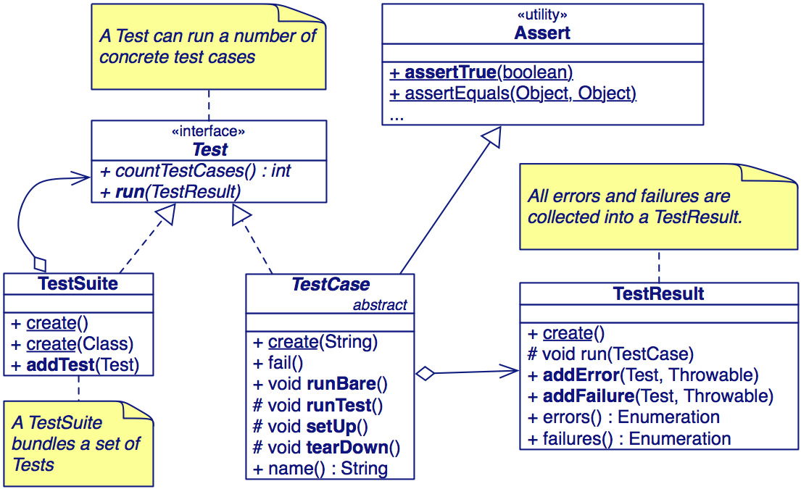
The JUnit 3.x Framework
P2 — A Testing Framework
© O. Nierstrasz
3.<number>
Notes:
Besteht aus wenigen Klassen und circa tausend Zeilen Code.
Assert - Werte und Bedingungen zu testen.
Familie spezialisierter assert…-Methoden, die unsere Testklassen aus Junit erben und mit deren Hilfe eine Reihe unterschiedliche zu testender Behauptungen über unseren Code aufstellen können,

Slide 11
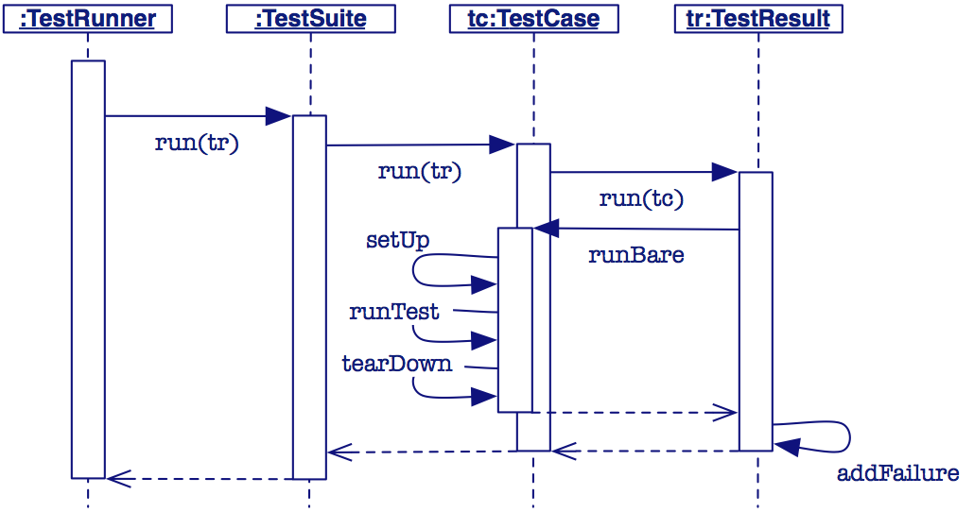
A Testing Scenario
P2 — A Testing Framework
The framework calls the test methods that you define for your test cases.
© O. Nierstrasz
3.<number>
Notes:
Alle Methode mit test…() werden automatisch ausgeführt und ein Testergebnis erzeugt (failure, error, ok)
Failure - ein fehlgeschlagene Zusicherung
Error - ein unerwartetes Problem - zB. NullPointerException, die wir nicht behandeln wollen.

Slide 12
JUnit 3.x Example Code
P2 — A Testing Framework
import junit.framework.*;
public class MoneyTest extends TestCase {
private Money f12CHF; // fixtures
private Money f14CHF;
protected void setUp() { // create the test data
f12CHF = new Money(12, "CHF");
f14CHF = new Money(14, "CHF");
}
void testAdd() { // create the test data
Money expected = new Money(26, “CHF”);
assertEquals(“amount not equal”,
expected,f12CHF.add(f14CHF);
}
...
}
© O. Nierstrasz
3.<number>
Notes:
setUp - ein Fixture - vor jeder Testmethode ausgeführt. Initialisiert common Objekte.
tearDown - nach jeder Testmethode.

Slide 13
Annotations in J2SE 5
P2 — A Testing Framework
J2SE 5 introduces the Metadata feature (data about data)
Annotations allow you to add decorations to your code (remember javadoc tags: @author )
Annotations are used for code documentation, compiler processing (@Deprecated ), code generation, runtime processing
( http://java.sun.com/docs/books/tutorial/java/javaOO/annotations.html )
© O. Nierstrasz
3.<number>

Slide 14
JUnit 4.x
P2 — A Testing Framework
JUnit is a simple “testing framework” that provides:
Annotations for marking methods as tests
Annotations for marking methods that setting up and cleaning up test data (“fixtures”)
methods for making assertions
textual and graphical tools for running tests
© O. Nierstrasz
3.<number>
Notes:
Das einfachste Framework der Welt ist einfacher geworden.
Die Architekur wurde grundlegend geaendert - benutzt Annotations von Java 1.5.
Annotations sind die neue Ausdrucksmittel von Metaprogramming.
Dieses Sprachkonstrukt wird verwendet um Methode als Test-Methode zu markieren.

Slide 15
JUnit 4.x Example Code
P2 — A Testing Framework
import junit.framework.*;
import org.junit.*;
import static org.junit.Assert.*;
public class MoneyTest extends TestCase {
private Money f12CHF;
private Money f14CHF;
@Before public void setUp() { // create the test data
f12CHF = new Money(12, "CHF"); // - the fixture
f14CHF = new Money(14, "CHF");
}
@Test public void testadd() { // create the test data
Money expected = new Money(26, “CHF”);
assertEquals(“amount not equal”,
expected,f12CHF.add(f14CHF));
}
...
}
© O. Nierstrasz
3.<number>
Notes:
Neuer Namespace org.junit - hier steckt der neue Annotationsbasierte Code.
Junit.framework - um Aufwaertskompatibilitaet herzustellen.
Importieren wir die @Test-Annotationen und Methoden der Assert-Klasse. Unser Klasse ist nicht mehr von TestCase abgeleitet.
Tests verwenden das Schluesselwert von Java 1.4. Es werden nicht mehr zwischen Failure und Error unterschieden.

Slide 16
Testing Style
P2 — A Testing Framework
“The style here is to write a few lines of code, then a test that should run, or even better, to write a test that won't run, then write the code that will make it run.”
write unit tests that thoroughly test a single class
write tests as you develop (even before you implement)
write tests for every new piece of functionality
“Developers should spend 25-50% of their time developing tests.”
© O. Nierstrasz
3.<number>
Notes:
Rot: Schreibe einen kleinen Test, der noch nicht funktionieren kann
Mache, dass der Test so schnell wie möglich gut geht. Diese Vorgehensweise hat den psychologischen Effekt, dass sich der Entwickler auf kleine Schritte fokussieren kann und das Ziel (sauberer Code, der funktioniert) nicht aus den Augen verliert.

Slide 17
Roadmap
P2 — A Testing Framework
Junit — a testing framework
  Testing practices
  Frameworks vs. Libraries
  Junit 3.x vs. Junit 4.x (annotations)
Money and MoneyBag — a testing case study
Double Dispatch — how to add different types of objects
JExample
© O. Nierstrasz
3.<number>

Slide 18
Representing multiple currencies
P2 — A Testing Framework
The problem ...
“The program we write will solve the problem of representing arithmetic with multiple currencies. Arithmetic between single currencies is trivial, you can just add the two amounts. ... Things get more interesting once multiple currencies are involved.”
© O. Nierstrasz
3.<number>
Notes:
Schauen wir ein Beispielprogram näher an.
Testgetrieben bietet die Möglichkeit dazu, über die offentliche Schnittstelle nachzudenken.

Slide 19
MoneyTest
P2 — A Testing Framework
We start by defining a TestCase that exercises the interface we would like our Money class to support:
import org.junit.*;
import static org.junit.Assert.*;
public class MoneyTest {
private Money f12CHF;
private Money f14CHF;
@Before public void setUp() { // create the test data
f12CHF = new Money(12, "CHF");
f14CHF = new Money(14, "CHF");
}
...
}
© O. Nierstrasz
3.<number>
Notes:
Wir schreiben eine Testklasse MoneyTest und importieren die Annotations und die Assertions. Wir schreiben ein Fixture für die Testfälle.
Unser Ziel ist das Program inkremental in kleinen Schritten zu entwickeln.

Slide 20
Some basic tests
P2 — A Testing Framework
We define methods to test what we expect to be true ...
@Test public void testEquals() {
assertNotNull(f12CHF);
assertEquals(f12CHF, f12CHF);
assertEquals(f12CHF, new Money(12, "CHF"));
assertFalse(f12CHF.equals(f14CHF));
}
@Test public void testSimpleAdd() {
Money expected = new Money(26, "CHF");
Money result = f12CHF.add(f14CHF);
assertEquals(expected, result);
}
NB: assertTrue, etc. are static imported methods of the Assert class of the JUnit 4.x Framework and raise an AssertionError if they fail.
Junit 3.x raises a JUnit AssertionFailedError (!)
© O. Nierstrasz
3.<number>

Slide 21
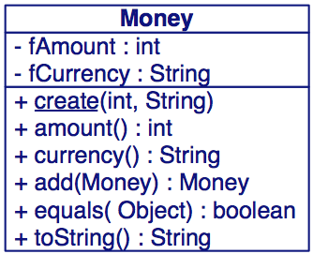
Money
P2 — A Testing Framework
We now implement a Money class that fills our first few requirements:
Note how the test case drives the design!
NB: The first version does not consider how to add different currencies!
public class Money {
...
public Money add(Money m) {
return new Money(...);
}
...
}
What should the class invariant be?
© O. Nierstrasz
3.<number>
Notes:
Dann schreiben wir die Klasse Money, die die minimalen Anforderungen erfüllen.

Slide 22
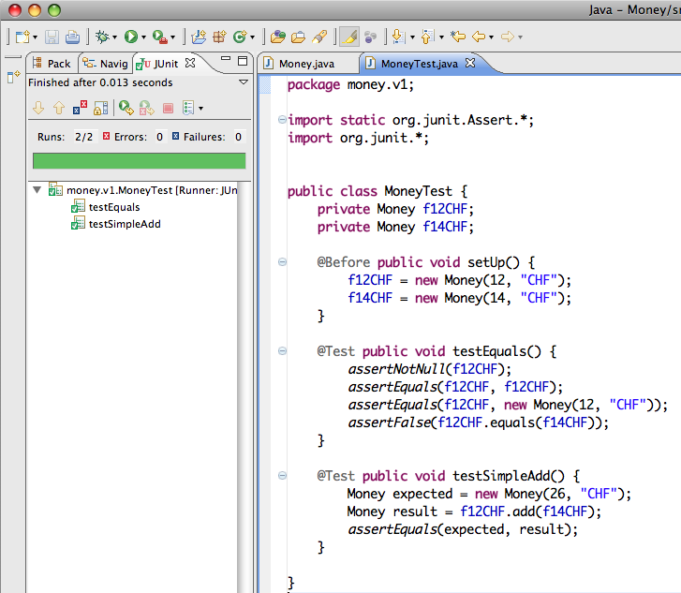
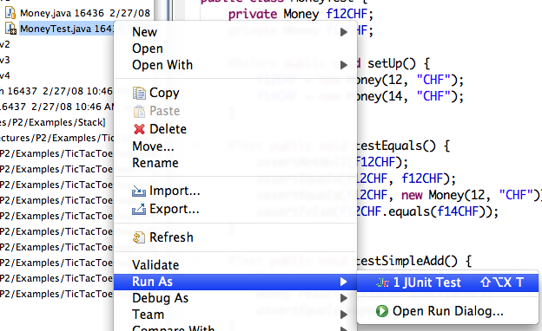
Running tests from eclipse
P2 — A Testing Framework
Right-click on the class
(or package) to run the tests
© O. Nierstrasz
3.<number>
Notes:
Test Runner ist in Eclipse integriert. Einmal gemacht, kann man anschliessend nut auf run-Knopf druecken/

Slide 23
Testing MoneyBags (I)
P2 — A Testing Framework
To handle multiple currencies, we introduce a MoneyBag class that can hold several instances of Money:
import static org.junit.Assert.*;
public class MoneyTest {
...
@Before public void setUp() {
f12CHF = new Money(12, "CHF");
f14CHF = new Money(14, "CHF");
f7USD = new Money( 7, "USD");
f21USD = new Money(21, "USD");
fMB1 = new MoneyBag(f12CHF, f7USD);
fMB2 = new MoneyBag(f14CHF, f21USD);
}
© O. Nierstrasz
3.<number>
Notes:
Das Fixture

Slide 24
Testing MoneyBags (II)
P2 — A Testing Framework
... and define some new (obvious) tests ...
@Test public void testBagEquals() {
assertNotNull(fMB1);
assertEquals(fMB1, fMB1);
assertFalse(fMB1.equals(f12CHF));
assertFalse(f12CHF.equals(fMB1));
assertFalse(fMB1.equals(fMB2));
}
© O. Nierstrasz
3.<number>
Notes:
JUnit erlaubt uns, Werte und Bedingungen zu testen, die jeweils erfüllt sein müssen, damit der Test erfolgreich durchläuft. Assert definiert eine Familie von Assert-Methoden.
assertEquals() - Gleichheit zweier Objekte. Dies erfolgt über der equals Methode.

Slide 25
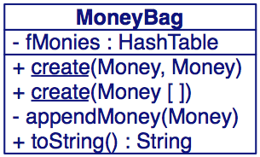
MoneyBags
P2 — A Testing Framework
We can use a HashTable to keep track of multiple Monies:
class MoneyBag {
private Hashtable monies = new Hashtable(5);
MoneyBag(Money m1, Money m2) { ... }
MoneyBag(Money bag[]) {
for (int i= 0; i < bag.length; i++) {
appendMoney(bag[i]);
}
}
private void appendMoney(Money aMoney) {
Money m = (Money) monies.get(aMoney.currency());
if (m != null) { m = m.add(aMoney); }
else { m = aMoney; }
monies.put(aMoney.currency(), m);
}
}
© O. Nierstrasz
3.<number>

Slide 26
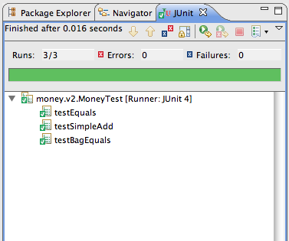
Testing MoneyBags (III)
P2 — A Testing Framework
and we run the tests.
© O. Nierstrasz
3.<number>

Slide 27
Roadmap
P2 — A Testing Framework
Junit — a testing framework
  Testing practices
  Frameworks vs. Libraries
  Junit 3.x vs. Junit 4.x (annotations)
Money and MoneyBag — a testing case study
Double Dispatch — how to add different types of objects
JExample
© O. Nierstrasz
3.<number>

Slide 28
Adding MoneyBags
P2 — A Testing Framework
We would like to freely add together arbitrary Monies and MoneyBags, and be sure that equals behave as equals:
That implies that Money and MoneyBag should implement a common interface ...
@Test public void mixedSimpleAdd() {
// [12 CHF] + [7 USD] == {[12 CHF][7 USD]}
Money bag[] = { f12CHF, f7USD };
MoneyBag expected = new MoneyBag(bag);
assertEquals(expected, f12CHF.add(f7USD));
}
© O. Nierstrasz
3.<number>

Slide 29
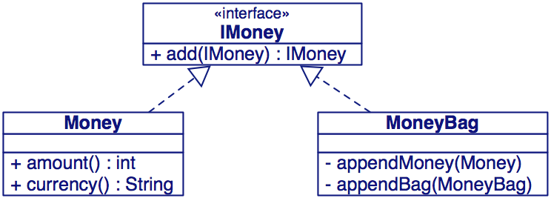
The IMoney interface (I)
P2 — A Testing Framework
Monies know how to be added to other Monies
Do we need anything else in the IMoney interface?
© O. Nierstrasz
3.<number>

Slide 30
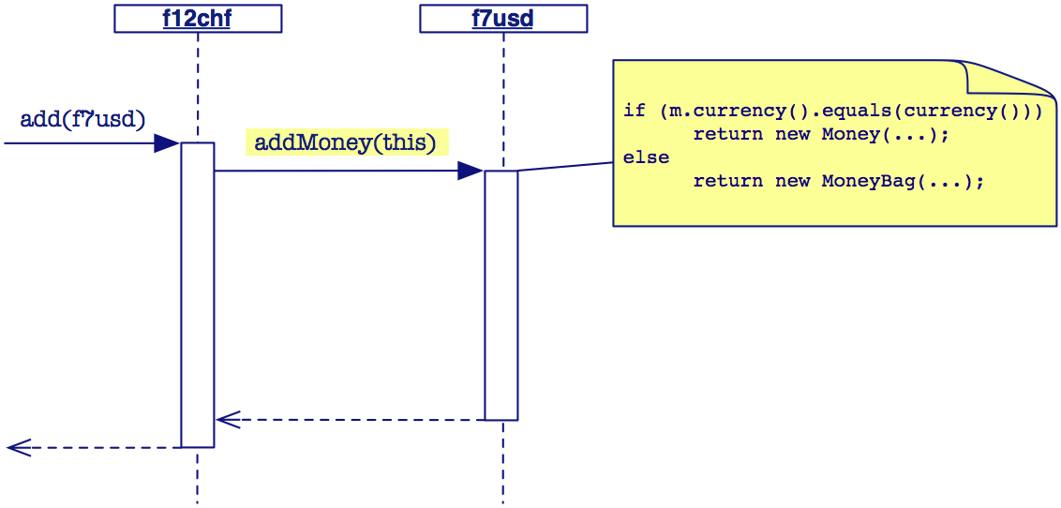
Double Dispatch (I)
P2 — A Testing Framework
Problem: we want to add Monies and MoneyBags without having to check the types of the arguments.
Solution: use double dispatch to expose more of your own interface.
© O. Nierstrasz
3.<number>

Slide 31
Double Dispatch (II)
P2 — A Testing Framework
How do we implement add() without breaking encapsulation?
“The idea behind double dispatch is to use an additional call to discover the kind of argument we are dealing with...”
class Money implements IMoney { ...
public IMoney add(IMoney m) {
return m.addMoney(this); // add me as a Money
} ...
}
class MoneyBag implements IMoney { ...
public IMoney add(IMoney m) {
return m.addMoneyBag(this); // add as a MoneyBag
} ...
}
© O. Nierstrasz
3.<number>
Notes:
Nutzlich wenn Computation von Argumenttyp abhängig ist. Based on the argument type at runtime.

Slide 32
Double Dispatch (III)
P2 — A Testing Framework
The rest is then straightforward ...
and MoneyBag takes care of the rest.
class Money implements IMoney { ...
public IMoney addMoney(Money m) {
if (m.currency().equals(currency())) {
return new Money(amount()+m.amount(),currency());
}
return new MoneyBag(this, m);
}
public IMoney addMoneyBag(MoneyBag s) {
return s.addMoney(this);
} ...
© O. Nierstrasz
3.<number>

Slide 33
Double Dispatch (IV)
P2 — A Testing Framework
Pros:
  No violation of encapsulation (no downcasting)
  Smaller methods; easier to debug
  Easy to add a new type
Cons:
  No centralized control
  May lead to an explosion of helper methods
© O. Nierstrasz
3.<number>

Slide 34
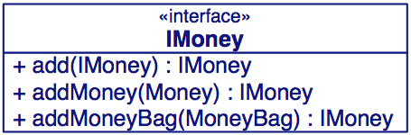
The IMoney interface (II)
P2 — A Testing Framework
So, the common interface has to be:
public interface IMoney {
public IMoney add(IMoney aMoney);
IMoney addMoney(Money aMoney);
IMoney addMoneyBag(MoneyBag aMoneyBag);
}
NB: addMoney() and addMoneyBag() are only needed within the Money package.
© O. Nierstrasz
3.<number>

Slide 35
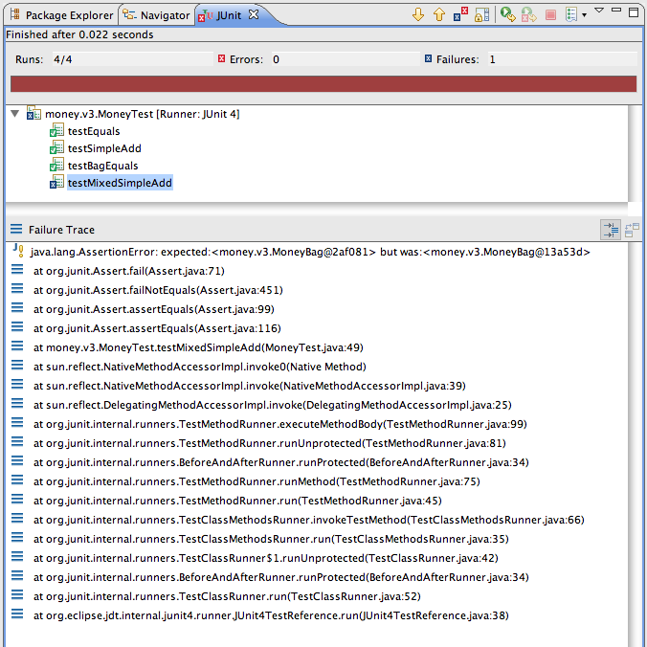
A Failed test
P2 — A Testing Framework
This time we are not so lucky ...
© O. Nierstrasz
3.<number>

Slide 36
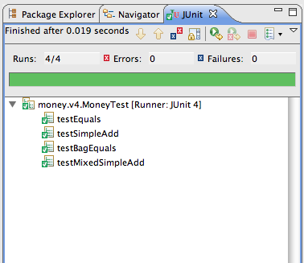
The fix ...
P2 — A Testing Framework
It seems we forgot to implement MoneyBag.equals()!
We fix it:
... test it, and continue developing.
class MoneyBag implements IMoney { ...
public boolean equals(Object anObject) {
if (anObject instanceof MoneyBag) {
...
} else {
return false;
}
}
© O. Nierstrasz
3.<number>

Slide 37
Roadmap
P2 — A Testing Framework
Junit — a testing framework
  Testing practices
  Frameworks vs. Libraries
  Junit 3.x vs. Junit 4.x (annotations)
Money and MoneyBag — a testing case study
Double Dispatch — how to add different types of objects
JExample
© O. Nierstrasz
3.<number>

Slide 38
JExample
Safety Patterns
JExample introduces producer-consumer relationships between tests
  Tests may depend on other tests that produce examples for them
http://scg.unibe.ch/Research/JExample/
© Oscar Nierstrasz

Slide 39
Stack example — imports
Safety Patterns
import java.util.Stack;
import java.util.EmptyStackException;
import static org.junit.Assert.*;
import org.junit.Test;
import org.junit.runner.RunWith;
import ch.unibe.jexample.JExample;
import ch.unibe.jexample.Given;
@RunWith(JExample.class)
public class StackTest {
…
}
© Oscar Nierstrasz

Slide 40
Stack example — dependencies
Safety Patterns
public class StackTest {
@Test
public Stack<String> empty() {
Stack<String> stack = new Stack<String>();
assertTrue(stack.empty());
return stack;
}
@Test(expected=EmptyStackException.class)
@Given("#empty")
public void emptyPopFails(Stack<String> stack) {
stack.pop();
}
...
Tests may return example objects
Consumer tests declare dependencies and arguments
© Oscar Nierstrasz

Slide 41
Stack example — chained dependencies
Safety Patterns
public class StackTest {
...
@Test
@Given("#empty")
public Stack<String> pushOnEmpty(Stack<String> stack) {
stack.push("foo");
assertFalse(stack.empty());
assertTrue(stack.size() == 1);
return stack;
}
@Test
@Given("#pushOnEmpty")
public Stack<String> pushPop(Stack<String> stack) {
stack.pop();
assertTrue(stack.empty());
return stack;
}
...
Dependencies may be chained
© Oscar Nierstrasz

Slide 42
Stack example — multiple dependencies
Safety Patterns
public class StackTest {
...
@Test
@Given("#pushPop; #empty")
public void equality(Stack<String> used,
Stack<String> fresh) {
assertEquals(used, fresh);
}
}
A test may depend on multiple tests
© Oscar Nierstrasz

Slide 43
What you should know!
P2 — A Testing Framework
How does a framework differ from a library?
What is a unit test?
What is an annotation?
How does JUnit 3.x differ from JUnit 4.x
What is a test “fixture”?
What should you test in a TestCase?
How can testing drive design?
What is “double dispatch”? What does the name mean?
© O. Nierstrasz
3.<number>

Slide 44
Can you answer these questions?
P2 — A Testing Framework
How does implementing toString() help in debugging?
How does the MoneyTest suite know which test methods to run?
How does the TestRunner invoke the right suite() method?
Why doesn’t the Java compiler complain that MoneyBag.equals() is used without being declared?
© O. Nierstrasz
3.<number>

Slide 45



License
Safety Patterns
http://creativecommons.org/licenses/by-sa/2.5/
Attribution-ShareAlike 2.5
You are free:
to copy, distribute, display, and perform the work
to make derivative works
to make commercial use of the work
Under the following conditions:
  Attribution. You must attribute the work in the manner specified by the author or licensor.
  Share Alike. If you alter, transform, or build upon this work, you may distribute the resulting work only under a license identical to this one.
For any reuse or distribution, you must make clear to others the license terms of this work.
Any of these conditions can be waived if you get permission from the copyright holder.
Your fair use and other rights are in no way affected by the above.
© Oscar Nierstrasz

