Slide 1

Long Short -Term memory(lstm) in sentiment analysis
Bo Yun

Slide 2
What is RNN?
Type of RNN
RNN for sequential data
Text, genome, handwriting
Memory
Dependency

Slide 3



Feed forward network
Typical Feed Forward Network with sequential data
Chest
Day of the week
Chest
Shoulder
Month of the week
Shoulder
Health Condition of the day
Abs
Abs

Slide 4
Recurrent neural network
RNN with sequential data
Chest
Chest yesterday
Chest
Shoulder
Shoulder yesterday
Shoulder
Abs yesterday
Abs
Abs

Slide 5
Recurrent neural network
When new information is added
Predicted Chest yesterday
Chest
Predicted Shoulder yesterday
Chest
Predicted Abs yesterday
Shoulder
Shoulder
Abs
Chest the day before yesterday
Shoulder the day before yesterday
Abs
Abs the day before yesterday

Slide 6
Recurrent neural network
When new information is added
Chest
Information from prediction t-1
Prediction at time = t
Shoulder
Abs
New Information

Slide 7




















Recurrent neural network
$$y_{0}$$
$$y_{1}$$
$$y_{2}$$
$$w_{y}$$
$$w_{y}$$
$$w_{y}$$
$$w_{R}$$
$$w_{R}$$
$$w_{R}$$
$h^{(t)}$= $g_{h}(w_{i}x^{\left(t\right)}+w_{R}h^{\left(t−1\right)}+b_{h})$
$$h_{0}$$
$$h_{1}$$
$$h_{2}$$
$$w_{i}$$
$$w_{i}$$
$$w_{i}$$
$y^{(t)}$= $g_{y}(w_{y}h^{\left(t\right)}+b_{y})$
$$x_{0}$$
$$x_{1}$$
$$x_{2}$$

Slide 8






Training Recurrent neural network
$$y_{0}$$
$$y_{1}$$
$$y_{2}$$
$$y_{n}$$
$$w_{y}$$
$$w_{y}$$
$$w_{y}$$
$$w_{y}$$
$$w_{R}$$
$$w_{R}$$
$$w_{R}$$
$$h_{0}$$
$$h_{1}$$
$$h_{2}$$
$$………$$
$$h_{n}$$
$$w_{i}$$
$$w_{i}$$
$$w_{i}$$
$$w_{i}$$
$$x_{0}$$
$$x_{1}$$
$$x_{2}$$
$$x_{n}$$

Slide 9
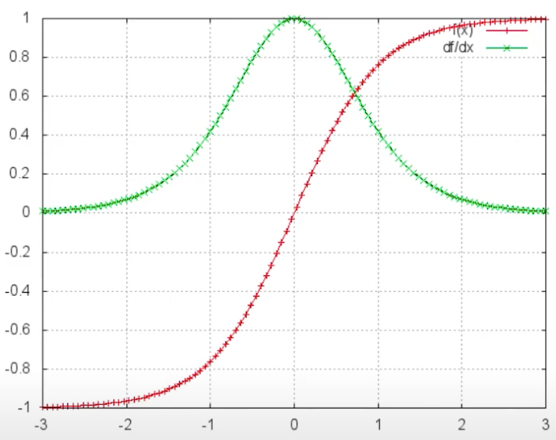
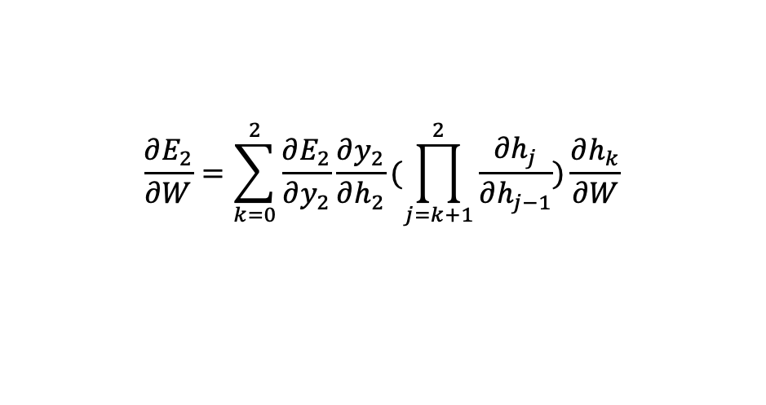



Back propagation through time - vanishing gradient
$$E_{0}$$
$$E_{1}$$
$$E_{2}$$
$$y_{0}$$
$$y_{1}$$
$$y_{2}$$
$$\frac{∂E_{2}}{∂W}=\sum_{k=0}^{2}{\frac{∂E_{2}}{∂y_{2}}\frac{∂y_{2}}{∂h_{2}}(\prod_{j=k+1}^{2}{\frac{∂h_{j}}{∂h_{j−1}})\frac{∂h_{k}}{∂W}}}$$
$$w_{y}$$
$$w_{y}$$
$$w_{y}$$
$$w_{R}$$
$$w_{R}$$
$$w_{R}$$
$$h_{0}$$
$$h_{1}$$
$$h_{2}$$
Signmoid function upper bounded by 1
$$w_{i}$$
$$w_{i}$$
$$w_{i}$$
$$x_{0}$$
$$x_{1}$$
$$x_{2}$$

Slide 10
Back propagation through time - exploding gradient
Linear function instead of sigmoid function
Weights are high
Exploding gradient problem
-> Will show up as NaN during implementation
-> Gradient clipping

Slide 11








Better Solution => use lstm!
$$y_{0}$$
$$y_{1}$$
$$y_{2}$$
$$y_{n}$$
$$w_{y}$$
$$w_{y}$$
$$w_{y}$$
$$w_{y}$$
$$w_{R}$$
$$w_{R}$$
$$w_{R}$$
$$LSTM$$
$$LSTM$$
$$LSTM$$
$$………$$
$$LSTM$$
$$C$$
$$C$$
$$C$$
$$C$$
$$w_{i}$$
$$w_{i}$$
$$w_{i}$$
$$w_{i}$$
$$x_{0}$$
$$x_{1}$$
$$x_{2}$$
$$x_{n}$$

Slide 12
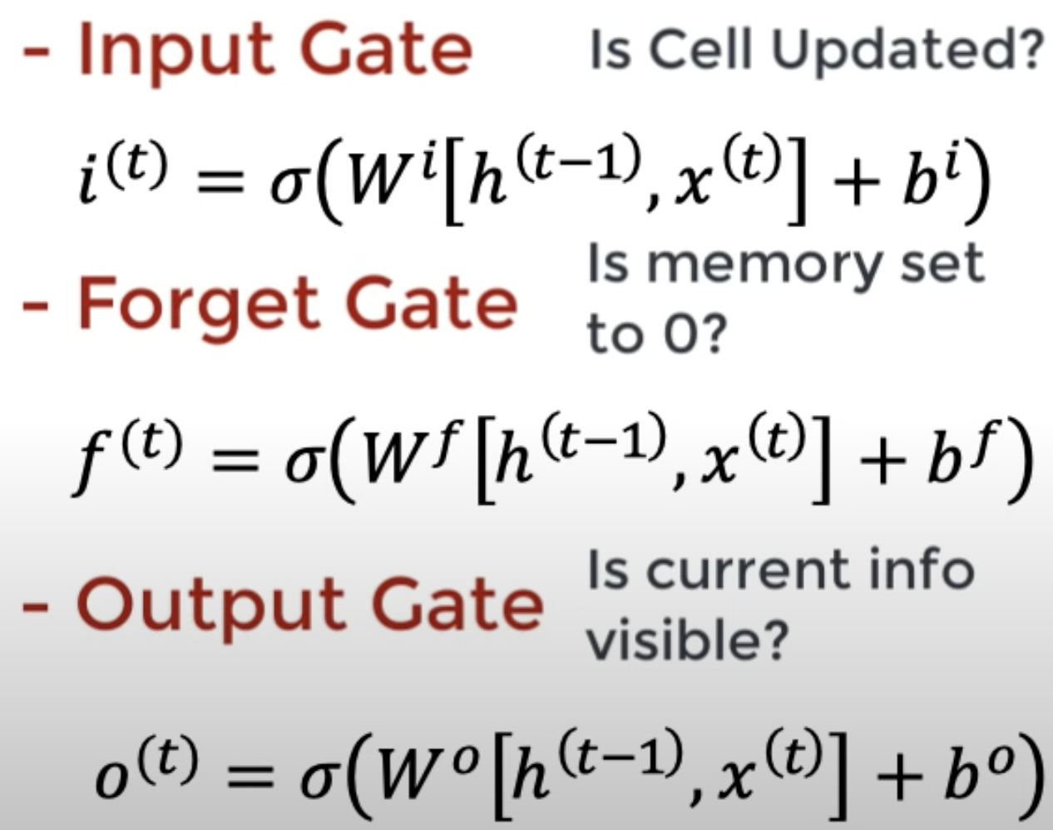













LSTM cell
$$y_{t}$$
$$C_{t−1}$$
$$C_{t}$$
X
+
tanh
$$f_{t}$$
$$i_{t}$$
X
$$O_{t}$$
$$C_{t}$$
X
$$σ$$
$$σ$$
tanh
$$σ$$
$$h_{t−1}$$
$$h_{t}$$
$$x_{t}$$

Slide 13
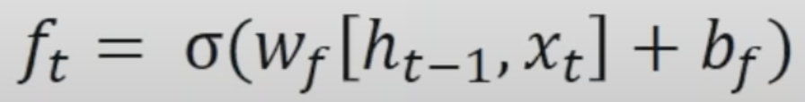
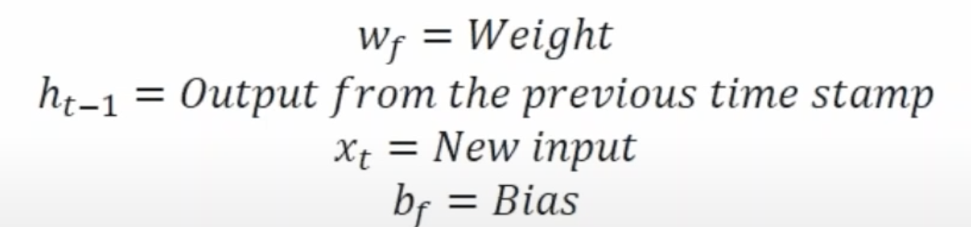












LSTM cell – forget gate
$$y_{t}$$
$$C_{t−1}$$
Forget gate
X
+
tanh
$$f_{t}$$
$$i_{t}$$
X
$$O_{t}$$
$$C_{t}$$
X
$$σ$$
$$σ$$
tanh
$$σ$$
$$h_{t−1}$$
$$h_{t}$$
$$x_{t}$$

Slide 14
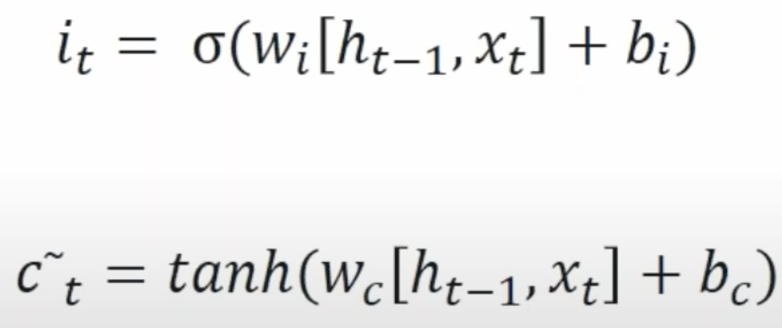
LSTM cell – input gate
$$y_{t}$$
$$C_{t−1}$$
X
+
Input gate
tanh
$$f_{t}$$
$$i_{t}$$
X
$$O_{t}$$
$$C_{t}$$
X
$$σ$$
$$σ$$
tanh
$$σ$$
$$h_{t−1}$$
$$h_{t}$$
$$x_{t}$$

Slide 15
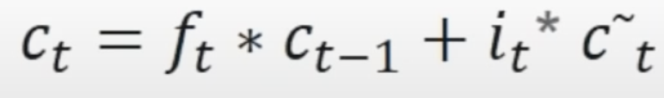

LSTM cell – Update cell state
$$y_{t}$$
$$C_{t−1}$$
$$C_{t}$$
X
+
tanh
$$f_{t}$$
$$i_{t}$$
X
$$O_{t}$$
$$C_{t}$$
X
$$σ$$
$$σ$$
tanh
$$σ$$
$$h_{t−1}$$
$$h_{t}$$
$$x_{t}$$

Slide 16
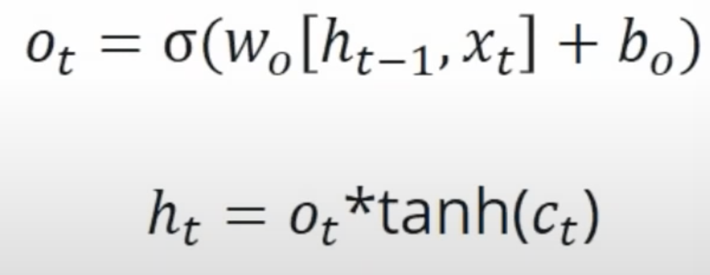
LSTM cell – output gate
$$y_{t}$$
$$C_{t−1}$$
X
+
tanh
$$f_{t}$$
$$i_{t}$$
X
$$O_{t}$$
$$C_{t}$$
X
Output gate
$$σ$$
$$σ$$
tanh
$$σ$$
$$h_{t−1}$$
$$h_{t}$$
$$x_{t}$$

Slide 17
LSTM example
David loves to play around data and draw insights from data everyday, no wonder he is such an amazing data scientist.
His brother Kevin loves to paint everyday. Kevin will be a great painter one day.
“”
“”
“”
“”
“”
data
data
data scientist
…
David
loves
to
play
around
data
amazing
data
data
data
data
data
paint
paint
…
painter
His
brother
Kevin
loves
to
paint
great

Slide 18








LSTM example – forget gate
David loves to play around data and draw insights from data everyday, no wonder he is be such an amazing data scientist.
His brother Kevin loves to paint everyday. Kevin will be a great painter one day.
$$y_{t}$$
Memory data
$$C_{t−1}$$
Forget gate
$$C_{t}$$
X
$$f_{t}$$
$$σ$$
$$h_{t−1}$$
$$h_{t}$$
$$x_{t}$$
paint

Slide 19




LSTM example – input gate
David loves to play around data and draw insights from data everyday, no wonder he is be such an amazing data scientist.
His brother Kevin loves to paint everyday. Kevin will be a great painter one day.
$$y_{t}$$
$$C_{t−1}$$
Forget gate
Adding memory for paint
$$C_{t}$$
X
+
Input gate
$$f_{t}$$
$$i_{t}$$
X
$$C_{t}$$
$$σ$$
$$σ$$
tanh
$$h_{t−1}$$
$$h_{t}$$
$$x_{t}$$
paint

Slide 20


LSTM example – output gate
David loves to play around data and draw insights from data everyday, no wonder he is be such an amazing data scientist.
His brother Kevin loves to paint everyday. Kevin will be a great painter one day.
$$y_{t}$$
$$C_{t−1}$$
Forget gate
Adding memory for paint
$$C_{t}$$
X
+
Input gate
tanh
$$f_{t}$$
$$i_{t}$$
X
$$O_{t}$$
$$C_{t}$$
X
Output gate
$$σ$$
$$σ$$
tanh
$$σ$$
$$h_{t−1}$$
$$h_{t}$$
$$x_{t}$$
paint

Slide 21
LSTM – code walkthrough
https://colab.research.google.com/drive/19B-QlaaRAao5n6UV4yD4xCweMFSumuG3?authuser=2#scrollTo=xYOs9PdhxpTF

Slide 22
summary
Long Short-Term Memory (LSTM) is robust against the problems of long-term dependency.
Forget, Input, and Output gates play key roles

Slide 23
Thank you

Slide 24
Bo yun’s video link
https://www.youtube.com/watch?v=fxAFP_3UDm0

