Slide 1

Apple Sales Report
Uncovering revenue drivers, product trends, and optimization opportunities

Slide 2
OVERVIEW
Dataset at a Glance
1.04M
89
75
30K
Sales Rows
Products
Stores
Warranty Claims
Comprehensive transaction data
Across all categories
Global retail presence
Service and repair data
Zero missing data—complete, analysis-ready dataset spanning sales, products, warranties, categories, and stores.

Slide 3
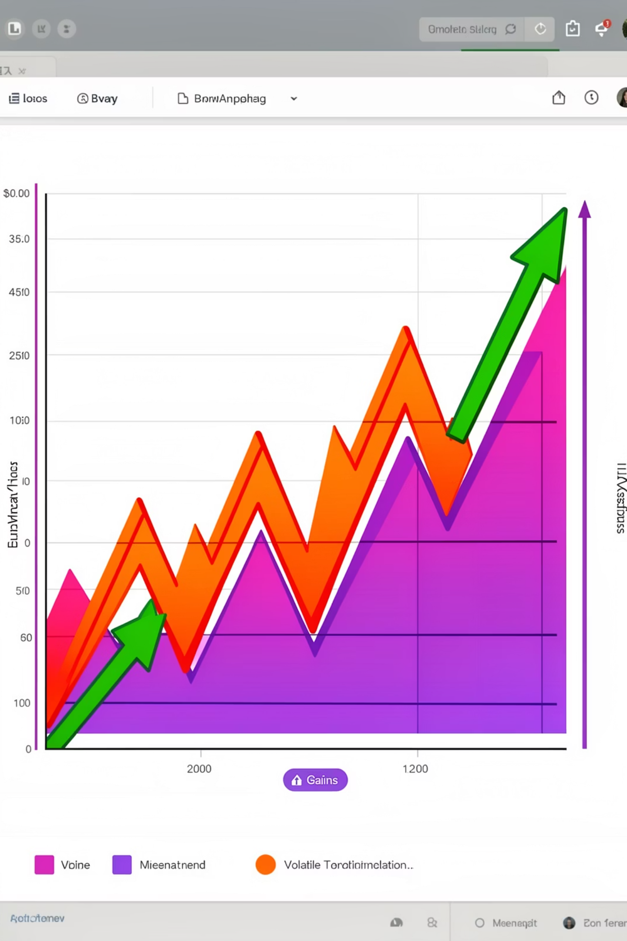
REVENUE TRENDS
Volatile Growth Pattern
1
2021
-21.7% sharp decline
2
2022
-16.7% further drop
3
2023
+13.3% rebound
4
2024
-5.9% mild dip

Slide 4
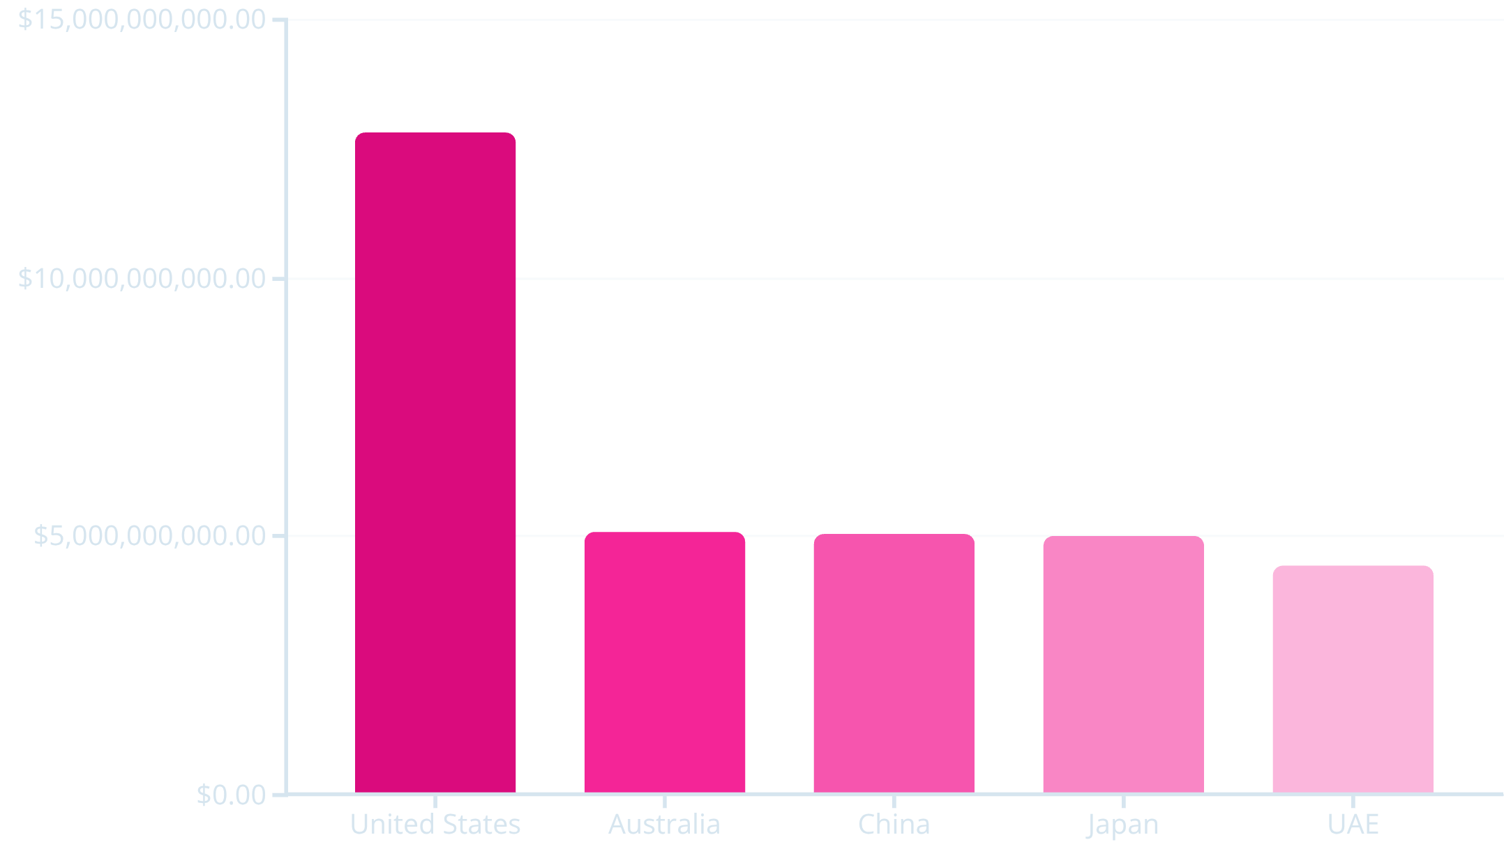
Global Performance Snapshot
US Dominance
United States leads with $12.8bn in total sales—more than double the next market.
Australia, China, and Japan cluster around $5bn each, showing balanced international presence.
US stores average $1,637/month, highest globally.

Slide 5
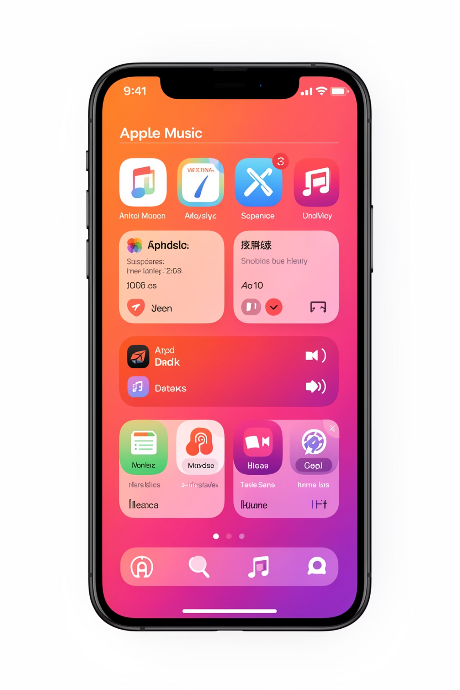
Category & Product Leaders
Top Category
Smartphones
Accessories
Subscription Services lead, driven by Apple Music
1.00M sales, consistent demand
0.70M units, strong attachment rate

Slide 6

WARRANTY INSIGHTS
Repair Status Analysis
Consistent Resolution Rate
Key Concern
Average 25% monthly resolution across all warranty claims in 2024.
Low 25% resolution rate signals opportunity to improve warranty processing efficiency.
Repair status distribution remains balanced: In Progress (7.6K), Pending (7.6K), Completed (7.5K), Rejected (7.4K).
HomePod mini shows highest claim count at 678, followed by MacBook Pro M4 at 381.

Slide 7
High-Risk Products
1
2
3
4
MacBook Retina
Apple News+
HomePod mini
iPhone 13 Pro
352 claims, $231 price point, mid-age product
332 claims, aging subscription service
330 claims, quality concerns evident
367 claims, older flagship model
All flagged products share "High Risk" status with low-to-medium pricing—quality improvements needed.

Slide 8




Store Performance Leaders
Apple Orchard Road
Apple Central World
Apple The Dubai Mall
Apple Champs-Élysées
$163M sales, 151K quantity, 849 repairs
$160M sales, 153K quantity, 803 repairs
$163M sales, 150K quantity, 762 repairs
$163M sales, 151K quantity, 782 repairs

Slide 9




RECOMMENDATIONS
Strategic Action Plan
Reduce Repairs
Boost Launches
Improve product quality to lower high claim rates on aging products
Introduce new products to replace aging inventory and drive growth
Review Pricing
Target Markets
Discount old products to clear warehouse space for new launches
Increase marketing in low-sales cities to expand reach

Slide 10

Key Takeaways
Revenue volatility requires stabilization strategy
Warranty resolution needs improvement
Product portfolio refresh critical
25% rate too low—streamline processes
Many aging, high-risk items need replacement
Address declining trends with product innovation

