Slide 1
COS 433: Cryptography
Lecture 2: Perfect Secrecy
Princeton University
Fall 2005
Boaz Barak
Notes:
1-32
to print, choose File-Page Setup-Landscape, View-Header and Footer, Print-Properties-Long Side and Color,
and deselect Grayscale

Slide 2
Themes of Crypto
  Formal Definitions
  Probability
  Quantifiers
Today:
Formal definition of security – prefect secrecy
Simple & efficient perfectly secure encryption scheme.
Limitations of perfect secrecy

Slide 3
Probability – Quick Review
Notations:
Distribution D - a set and probability function on the set
Supp(D) = set of elements x s.t. Pr[x] > 0
x←_{R}D : x distributed according to D
x←_{R}S : x distributed according to uniform dist on S
U_{n} : uniform distribution on {0,1}^{n}
D ´ D’ : D and D’ are identically distributed.
Lemma: Let D dist. s.t. 8 x, Pr_{D}[x] · δ. Let D’ be independent distribution.
Then Pr[ D=D’] · δ.

Slide 4

Defining Security for Encryptions.
Rules of the game:
Encryption algorithm: E
Decryption algorithm: D
Secret key: k
S
R
k
k←_{R} {0,1}^{n}
k
Notations:
n – length of key
m – length of plaintext
m’ – length of ciphertext
p – plaintext
c – ciphertext
c=E_{k}(p)
p=D_{k}(c)

Slide 5
(Perfect) Semantic Security
For every:
Distribution on plaintexts P over {0,1}^{m}
Function f:{0,1}^{m} → {0,1}*
Define:
δ = prob. of most likely value in f(P)
a-priori chance of guessing f(p) for unknown plaintext p←_{R}P
Then for every adversary Adv,
(probabilistic, w/ unlimited computation)
Pr [ Adv(E_{k}(p)) = f(p) ] · δ
k←_{R}{0,1}^{n} , p←_{R}P
I.e., posteriori prob of learning f(p) = a-priori prob. of learning f(p)

Slide 6

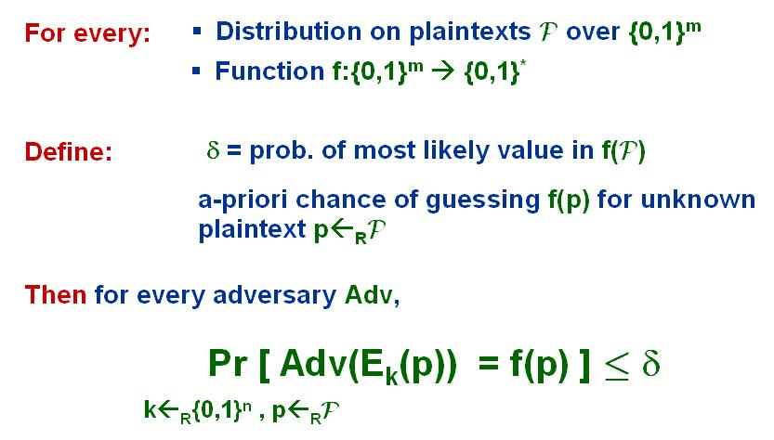
Semantic Security – Game View
S
P , f
k←_{R}{0,1}^{n}
c=E_{k}(p)
p←_{R} P
y
Adv successful if y=f(p)
(E,D) is semantically secure if
Pr [ Adv successful ] · δ
Exercise: 1. Show that Caesar-cipher is not semantically secure.
2. Show that substitution-cipher is not semantically secure.

Slide 7
A Different Definition - Indistinguishability
S
p₁,p₂2{0,1}^{m}
S
P , f
k←_{R}{0,1}^{n}
k←_{R}{0,1}^{n}
c=E_{k}(p_{i})
i←_{R}{1,2}
c=E_{k}(p)
p←_{R} P
j2{1,2}
y
Adv successful if j=i
Adv successful if y=f(p)
(E,D) is indistinguishable if
(E,D) is semantically secure if
Pr [ Adv successful ] · ½
Pr [ Adv successful ] · δ
Theorem: (E,D) is semantically secure , (E,D) indistinguishable

Slide 8
A Perfectly Secure Encryption
Def (XOR operation): For a2{0,1}, a©0 = a , a © 1 = a^{c}
For x,y2{0,1}^{n}, (x© y)_{i} = x_{i} © y_{i}
Known facts:
a©a = 0
XOR = addition mod 2
XOR commutative: a©b = b©a
XOR associative: a©(b©c) = (a©b)© c
The one-time pad scheme:
p = p₁ p₂ p₃ p_{n}
Key length = message length (n)
Encryption: E_{k}(p) = p©k
Decryption: D_{k}(c) = c©k
©
k = k₁ k₂ k₃ k_{n}
c = c₁ c₂ c₃ c_{n}
D_{k}(E_{k}(p)) = (p©k)©k = p©(k©k) = p©0^{n} = p

Slide 9
OTP Has Perfect Secrecy
The one-time pad scheme:
p = p₁ p₂ p₃ p_{n}
Key length = message length (n)
Encryption: E_{k}(p) = p©k
Decryption: D_{k}(c) = c©k
©
k = k₁ k₂ k₃ k_{n}
c = c₁ c₂ c₃ c_{n}
Def: (E,D) is Shannon secure if 9 dist. C s.t. 8 p2{0,1}^{m} E_{U} (p) ~ C.
n
Thm: OTP is Shannon secure.
Proof:
We’ll show that 8 p , E (p) ~ U_{n}
U_{n}
I.e., 8 p, 8 c Pr_{k}[ p©k = c ] = 2^{-n}
I.e., 8 p, 8 c Pr_{k}[ k = p©c ] = 2^{-n}
Exactly one k among 2^{n} possible, s.t. k = p©c.

Slide 10
Recap
Saw 3 equivalent defs for perfectly secure encryption:
Semantic security – matches intuition, applications
Indistinguishability, perfect secrecy – easier to work with
Saw that a simple scheme (one-time pad) is perfectly secure.
Is this the end of the course?
No - Normally we want encryption to use one key for many messages.
As a minimum we want key to be shorter than message.
Is there a perfectly secure enc. with key shorter than message?

Slide 11
No.
Thm: @ perfectly secure scheme (E,D) with |k|<|p|
Before seeing proof, consider the one-time-pad.
Natural extension to longer messages – use pad twice.
k2{0,1}^{n} , p2{0,1}^{2n}
E_{k}(p) = ( k©p_{1..n} , k©p_{n+1..2n} )
Is this secure?

Slide 12
Statistical Security
Perhaps perfect secrecy is too much.
For example, no harm if Adv learns something with 2⁻¹⁰⁰ probability.
S
p₁,p₂2{0,1}^{m}
S
P , f
k←_{R}{0,1}^{n}
k←_{R}{0,1}^{n}
c=E_{k}(p_{i})
i←_{R}{1,2}
c=E_{k}(p)
p←_{R} P
j2{1,2}
y
Adv successful if j=i
Adv successful if y=f(p)
ε
ε
(E,D) is indistinguishable if
(E,D) is semantically secure if
+ε
+ε
Pr [ Adv successful ] · ½
Pr [ Adv successful ] · δ
Definitions are still equivalent, but do they help us get the key size down?

Slide 13
Statistical Security
Focus on indist. definition.
S
p₁,p₂2{0,1}^{m}
Previous implication:
k←_{R}{0,1}^{n}
c=E_{k}(p_{i})
8 p₁,p₂ E_{U} [p₁] ~ E_{U} [p₂]
i←_{R}{1,2}
n
n
j2{1,2}
Lemma 1: If (E,D) ε-indist. then
8 p₁,p₂ Δ(E_{U} [p₁] , E_{U} [p₂]) < ε
Adv successful if j=i
n
n
ε
(E,D) is indistinguishable if
Def: The statistical distance of X and Y is defined as:
+ε
Pr [ Adv successful ] · ½
Δ(X,Y) = ½ ∑_{w} | Pr_{X}[w] – Pr_{Y}[w] |
Thm: @ (E,D) with |k|<|p| that is 0.1-indistinguishable.
Proof uses the probabilistic method.

