Slide 1
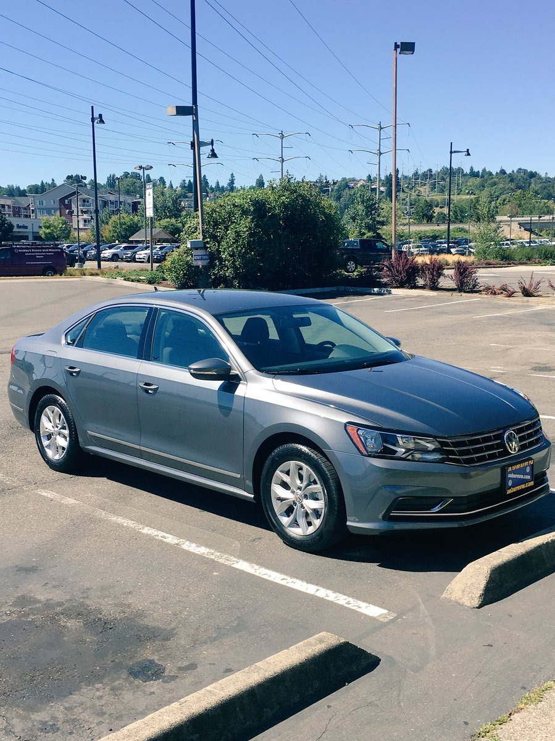




meet new big shout spencer wonderful service
BERT
meet new big shout spencer wonderful service
$$M_{t}$$
$$β_{t}^{w}$$
$$β_{t}^{e}$$
"Everyone meet Piper,
my new 2016 Passat! Big shout out to Spencer at @AuburnVW for the
wonderful service
CLIP
$$θ_{t}$$
CL
densecap
CLIP
$$θ_{v}$$
$$M_{v}$$
$$β_{v}^{w}$$
$$β_{v}^{e}$$
front tire car blue road light pole black parked street
front tire of a car
a blue car on the road
a light pole
a black tire on a car
a car parked on the street
front tire car blue road light pole black parked street
BERT
Encoder
Decoder

Slide 4


meet new big shout spencer wonderful service
BERT
meet new big shout spencer wonderful service
$$M_{t}$$
$$β_{t}^{w}$$
$$β_{t}^{e}$$
"Everyone meet Piper,
my new 2016 Passat! Big shout out to Spencer at @AuburnVW for the
wonderful service
CLIP
$$θ_{t}$$
CL
densecap
CLIP
$$θ_{v}$$
$$M_{v}$$
$$β_{v}^{w}$$
$$β_{v}^{e}$$
front tire car blue road light pole black parked street
front tire of a car
a blue car on the road
a light pole
a black tire on a car
a car parked on the street
front tire car blue road light pole black parked street
BERT
Encoder
Decoder

Slide 5




BERT
$$M_{t}$$
$$β_{t}^{w}$$
$$β_{t}^{e}$$
"Everyone meet Piper,
my new 2016 Passat! Big shout out to Spencer at @AuburnVW for the
wonderful service
meet new big shout spencer wonderful service
...
GCN
CLIP
meet new big shout spencer wonderful service
$$θ_{dt}$$
Graph construction
CL
$$θ_{dv}$$
front tire car blue road light pole black parked street
CLIP
GCN
$$M_{v}$$
$$β_{v}^{w}$$
$$β_{v}^{e}$$
front tire of a car.
a blue car on the road.
a light pole.
a black tire on a car.
a car parked on the street.
front tire car blue road light pole black parked street
...
densecap
BERT
Encoder
Decoder

Slide 6
BERT
$$M_{t}$$
$$β_{t}^{w}$$
$$β_{t}^{e}$$
"Everyone meet Piper,
my new 2016 Passat! Big shout out to Spencer at @AuburnVW for the
wonderful service
meet new big shout spencer wonderful service
...
GCN
CLIP
meet new big shout spencer wonderful service
$$θ_{dt}$$
Graph construction
CL
$$θ_{dv}$$
front tire car blue road light pole black parked street
CLIP
GCN
$$M_{v}$$
$$β_{v}^{w}$$
$$β_{v}^{e}$$
front tire of a car.
a blue car on the road.
a light pole.
a black tire on a car.
a car parked on the street.
front tire car blue road light pole black parked street
...
densecap
BERT
Encoder
Decoder

