Slide 1
Garbled Circuits: An Intro
Ben Terner
CS6501 - Cryptography

Slide 2
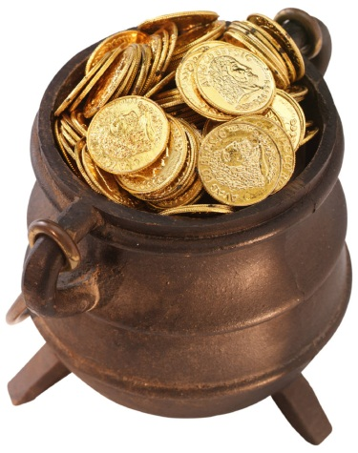
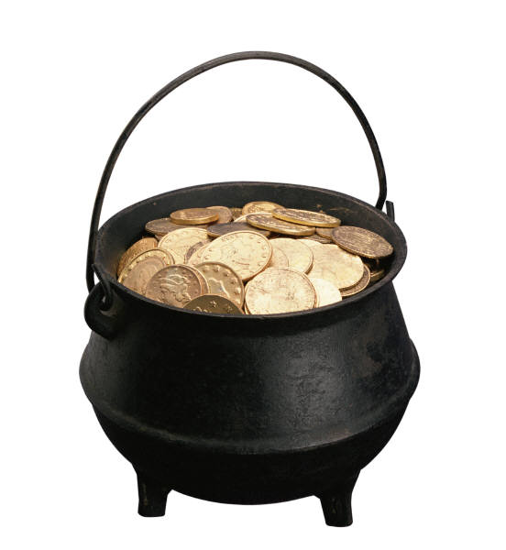
fn(x,y)
TRUST

Slide 3
fn(x,y)
TRUST

Slide 4
fn(x,y)
??
VT (NSA)

Slide 5
Yao’s Garbled Circuits
Gen
Eval
Notes:
Yao’s Garbled Circuit scheme is an interactive two-party protocol for secure computation
We encode a function as a circuit and then evaluate the circuit in a way we’re going to describe
Gen is going to generate the garbled circuit, and eval is going to evaluate it
If you would like to know about encoding a function as a circuit, we can talk offline

Slide 6
Briefly, Definitions
X
Z
Gate
Y
Notes:
Input wire,
Output wire
Wires hold a value

Slide 7
Briefly, Definitions
K_{x}
K_{z}
Gabled Gate
K_{y}
K <- G(1^n)
To Eval: K_{z} = 0 ≈_{c} K_{z} = 1
Notes:
Replace x and y values with keys
Keys hide the “semantic value” of a “wire”

Slide 8
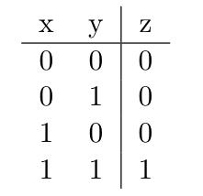
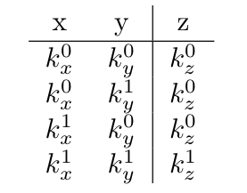


Garbled Gates
Notes:
This slide shows the translation of an AND gate
Gen will convert every standard gate to a garbled gate
Idea: Eval shouldn’t know what the semantic value of the output wire is
The keys are generated using the key generation function for an encryption scheme: Gen(1^n)

Slide 9

Garbled Gates
Notes:
C is for ciphertext!
Idea: doubly encrypt the (randomly) chosen output key with encryptions of the input keys
Gen sends Eval the doubly-encrypted keys
Eval must decrypt them in order to find the inputs to her next gate

Slide 10
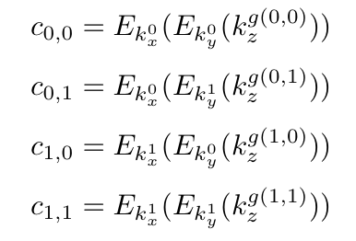
Garbled Gates
Notes:
And this completely defines a single gate
Security properties?

Slide 11
Inputs
Gen Sends all K_{x}
OT for Eval’s K_{y}
Gen
Eval
Notes:
How to preserve input privacy

Slide 12
Point and Permute
Notes:
Simply encrypting the output values and ordering them in this way when Gen sends them to Eval leaks the semantic value of the output key!
Also, naively, Eval would have to try to decrypt every entry, wasting a lot of effort

Slide 13
Point and Permute
?
?
?
?
?
?
?
?

Slide 14
Point and Permute
p is a random permutation bit
b_{i} is the semantic value of wire i
p_{i} = π_{i} XOR b_{i}
w_{i} = K_{z} || p_{i}
C = E_{k1}(E_{k2}(w_{i}))
(p1,p2) from input wires identify which table entry Eval should decrypt and how Gen should permute
Notes:
B_{i} is the semantic value of a wire
π is a one-time pad chosen for each gate

Slide 15
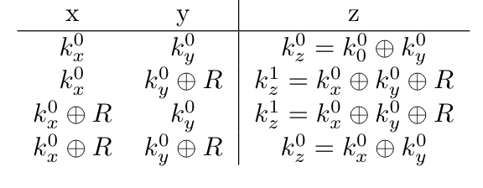
Free XOR
For all i in {x,y,z}:
K_{i}¹ = K_{i}⁰ XOR R
Notes:
Gen generates a random R the length of the keys and uses it
Gen now no longer has to send any information for an XOR gate
Eval simply XORs her inputs together
K_z now dependent on the inputs, not generated independently

Slide 16
Garbled Row Reduction 3
Let s be a unique identifier:
s = Gid || p₀ || p₁
Let ciphertexts be
C = H(k_{x} || s) XOR H(k_{y} || s) XOR K_{z}
For the first gate (p₀=p₁=0), define C = K_{z} =
H(k_{x} || s) XOR H(k_{y} || s)
Notes:
Little cs are permutation bits
Big C is a ciphertext
Note that for the first gate, Gid || p || p will be Gid || 0 || 0
In this way, the first key is implicit and predefined
Eval can only learn it if she has both correct input keys

Slide 17
Garbled Row Reduction 2
Consider each key to be a point in GF(2^{n})
Idea:
Gen constructs polynomials using input, output keys
Gen sets output keys to be points on a curve
Gen sends info (2 ciphertexts) about the polynomial to Eval
Eval uses her input keys and the ciphertexts to interpolate the polynomial

Slide 18
Garbled Row Reduction 2
Even Gates
Gen computes c1,c2,c3,c4 cipher texts as before
c = H(k_{x} || s) XOR H(k_{y} || s) XOR k_{z}
c₁ = P(1) c₄ = P(4)
c₂ = Q(2) c₃ = Q(3)
k_{z}⁰ = P(0)
k_{z}¹ = Q(0)
Gen sends P(5), Q(5) to Eval
Eval interpolates P(0) or Q(0) using one point sent by Gen
and one point she derives from input keys
Notes:
Explain abuses of notation

Slide 19
Garbled Row Reduction 2
Odd Gates
Gen computes c1,c2,c3,c4 cipher texts as before
c = H(k_{x} || s) XOR H(k_{y} || s) XOR k_{z}
c₁ = Q(1) c₂ = P(2)
c₄ = P(4) c₄ = P(4)
Gen also calculates c₅ = Q(5) = P(5), c₆ = Q(6) = P(6)
k_{z}⁰ = Q(0)
k_{z}¹ = P(0)
Gen sends c₅, c₆ to Eval
Eval interpolates P(0) or Q(0) using two points sent by Gen
and one point she derives from input keys
Notes:
Without loss of generality, this is an OR gate

