Slide 1

Exploratory Data Analysis
G2M Case Study
06.09.2021

Slide 2
Introduction
XYZ is a private firm in US. Due to remarkable growth in the Cab Industry in last few years and multiple key players in the market, it is planning for an investment in Cab industry and as per their Go-to-Market(G2M) strategy they want to understand the market before taking final decision.
Objective: Provide actionable insights to help XYZ firm in identifying the right company for making investment.
The analysis has been divided into three parts:
Introducing Dataset
Forecasting profit and number of rides per person for each cab type
Recommendations for investment

Slide 3
Introducing Dataset

Slide 4
Data Understanding
16 features (Two of them added by analyst)
Time period of data: 31/01/2016 to 31/12/2018
Number of data: 359,392
Profit is calculated by: [KM Travelled] – [Price Charged]
Age grouped by: 18-30 age as young
30-45 age as elder
45+ age as old

Slide 5
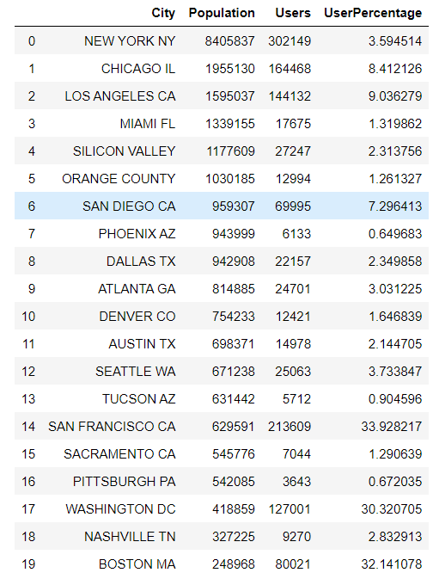
User Percentage for Each City
User percentage calculetad by:
[Users] / [Population]

Slide 6
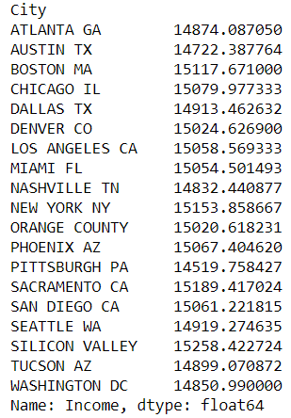
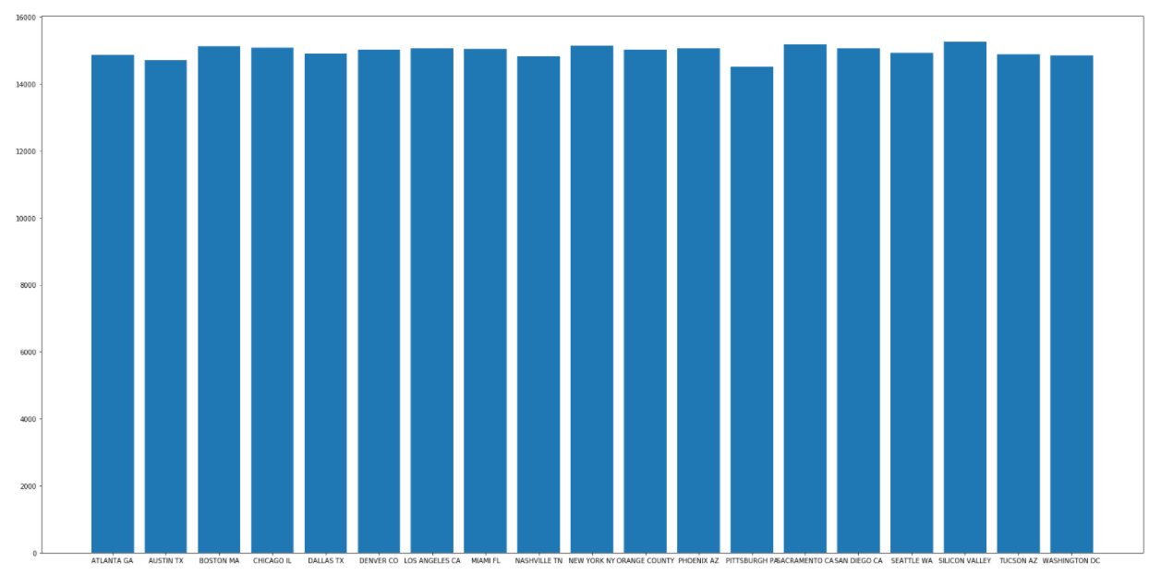
Mean of Customer’s Income for Each City

Slide 7
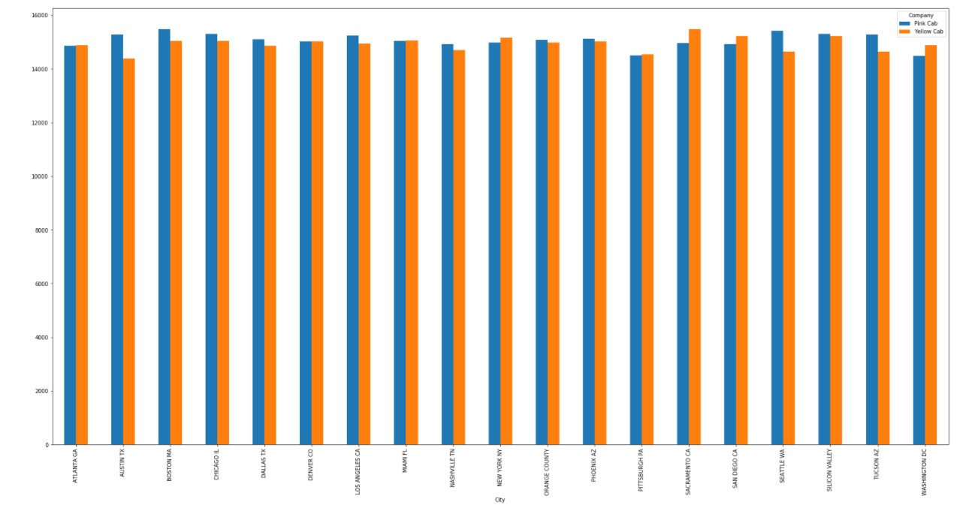
Comparison of Income of Customers for Each City

Slide 8


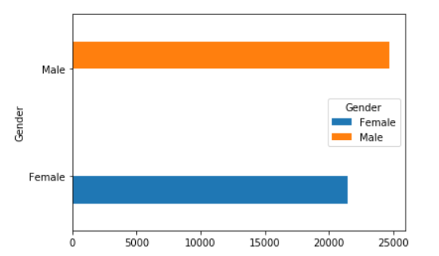
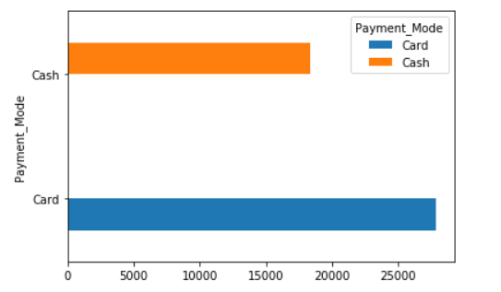
General Gender and Payment Mode Count

Slide 9
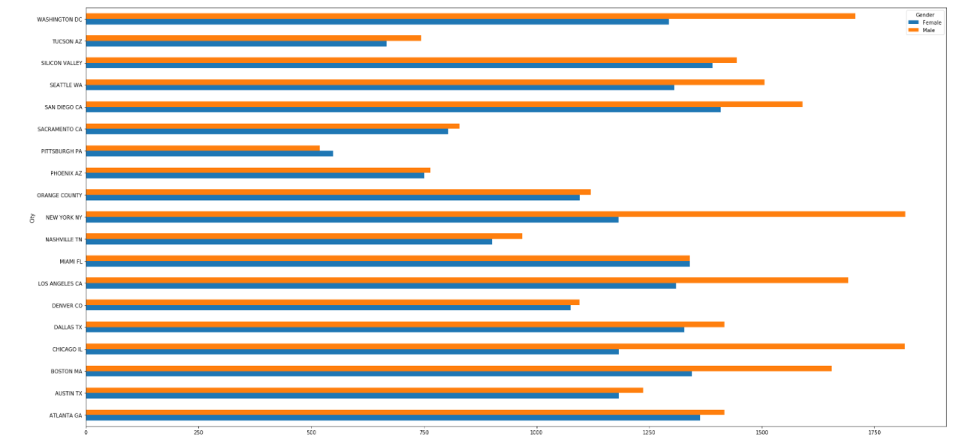
Comparison of Gender of Customers for Each City

Slide 10
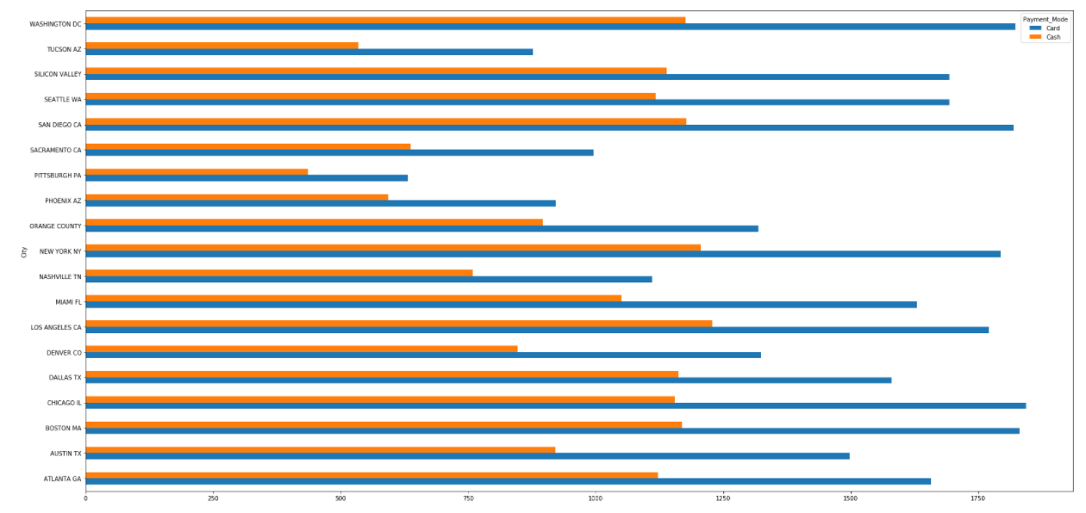
Comparison of Payment Mode of Customers for Each City

Slide 11
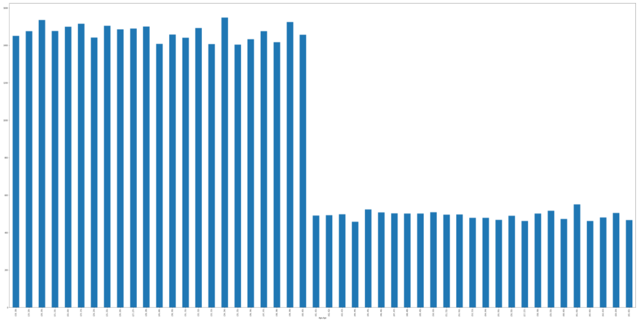
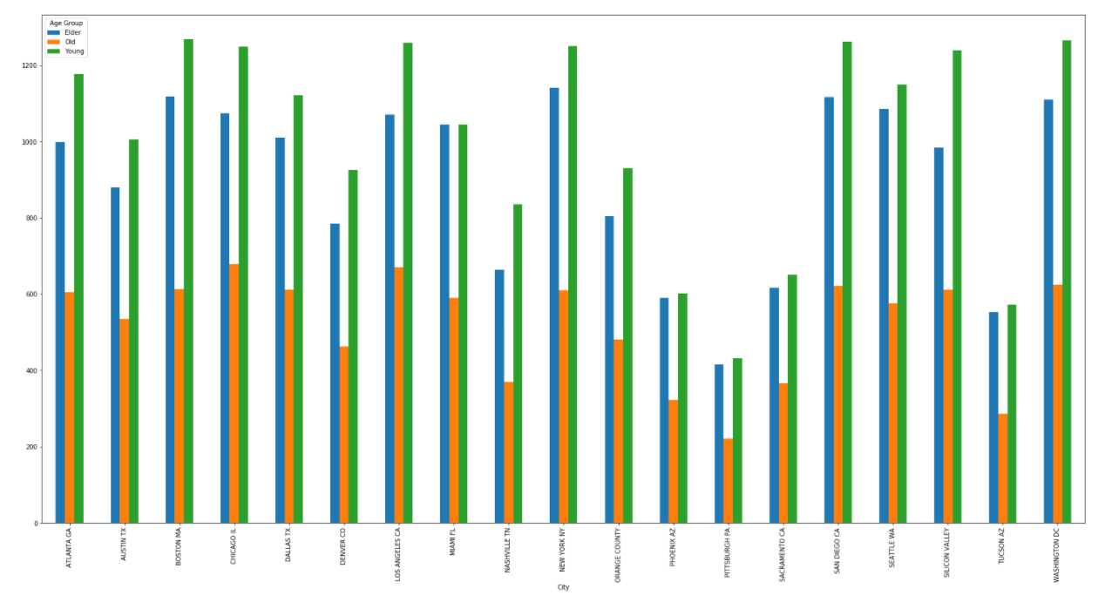
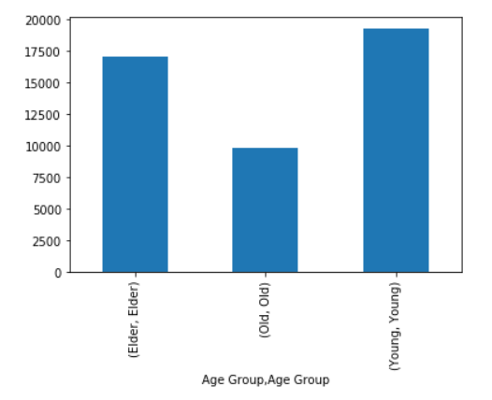
Age Distribution(18-65)

Slide 12
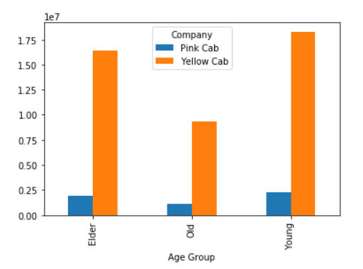
Comparison of Sum of Income for Each Age Group

Slide 13
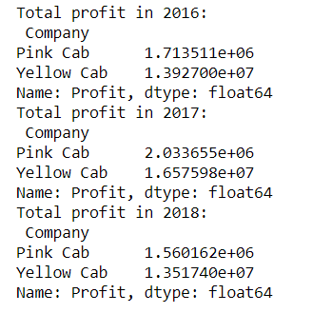
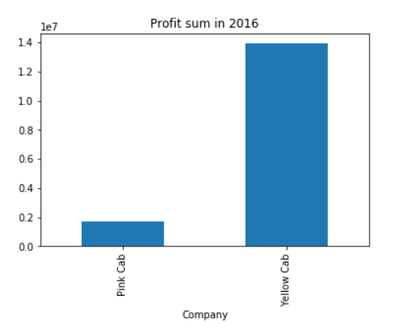
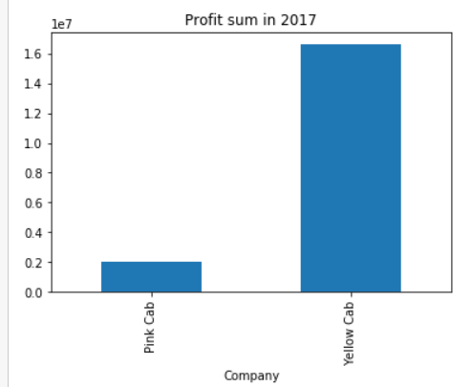
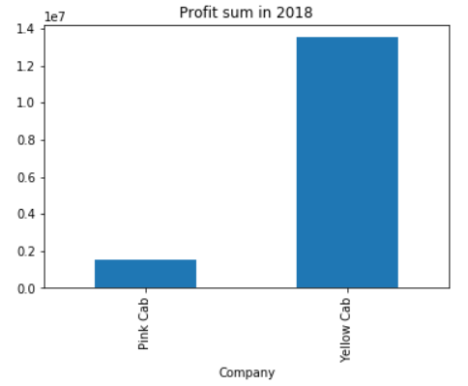
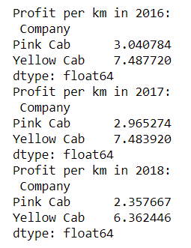
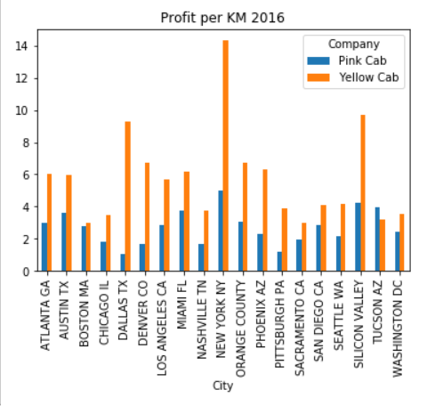
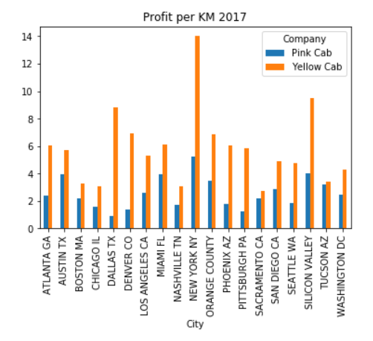
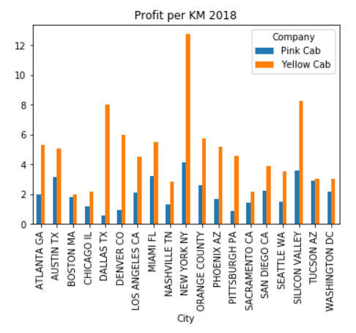
Total Profit Comparison for Each Year

Slide 14
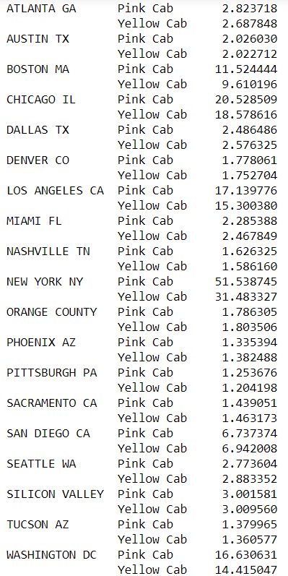
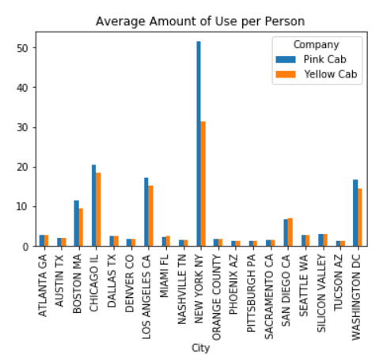
Average Amount of Use per Person

Slide 15
FORECASTING

Slide 16
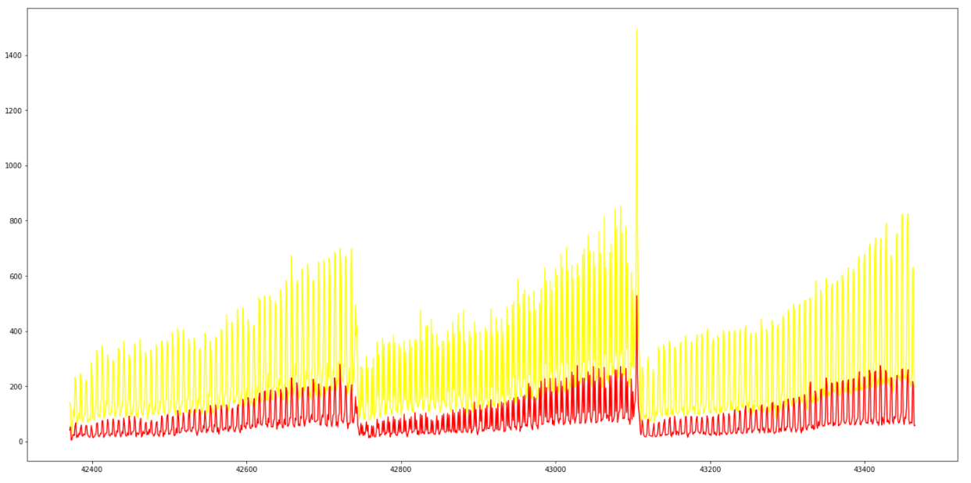
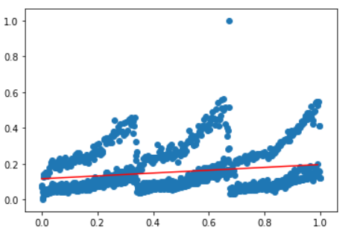
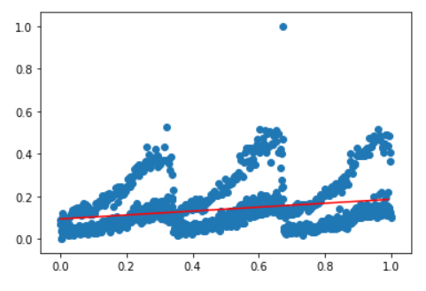
Forecasting for Number of Use per Day(Yellow- Pink)
Yellow coefficient=0.0795
Pink coefficient=0.0924
Yellow line is yellow cab’s data
Red line is pink cab’s data
Yellow Cab
Pink Cab

Slide 17
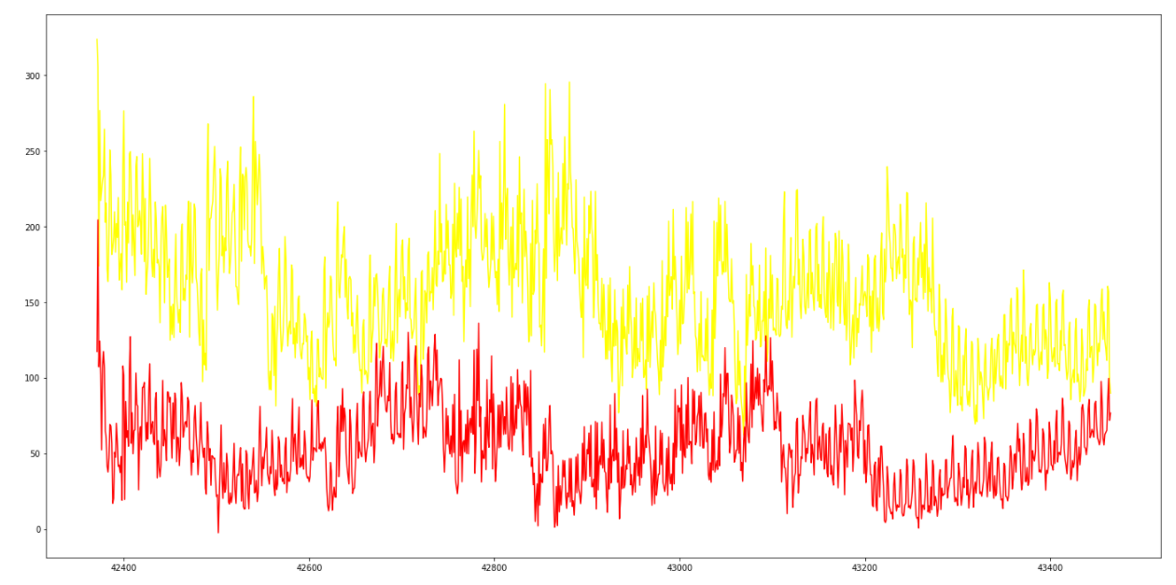
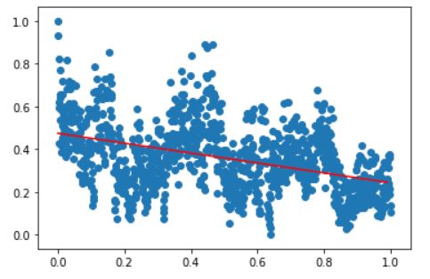
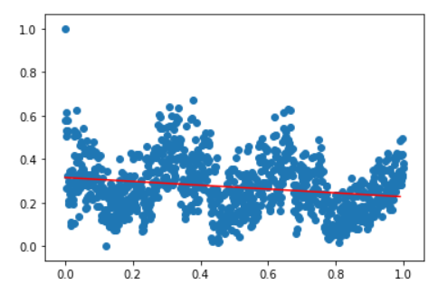
Mean of Profit Forecasting(Yellow-Pink)
Yellow coefficient=-0.2317
Pink coefficient=-0.0884
Yellow line is yellow cab’s data
Red line is pink cab’s data
Yellow Cab
Pink Cab

Slide 18
RECOMMENDATIONS

Slide 19
Recommendations
Customer's Income: In 11 city pink cab’s customers has higher income but it is not big difference between two of them.
Average amount of use per person for each city: In 11 city Pink Cab’s customers average number of use is more than Yellow Cab’s average number of use in this 3 year period.
Yearly analysis of profit per km for each city: Yellow Cab has higher profit in this three year period and Yellow Cab has lead in Profit per KM.
Number of use per day(Regression): Pink Cab’s coefficient value is more than Yellow Cab’s. Because of this reason Pink Cab growing faster.
Averge profit per trip for each day(Regression): Both company is reducing. Pink Cab’s coefficient value is more than Yellow Cab’s. Because of this reason Yellow Cab reducing faster.
Result: Pink Cab’s customers are using cabs more often but Yellow cab has higher profit and profit/km. Regression analysis resulted that Pink Cab has more adventage but Yellow Cab’s profit adventage is too much higher. As a result making investment to Yellow Cab is more logical.

Slide 20

Berke Tugay Arslan
Thank You

