Slide 1
Snow Removal in Montreal
Amber Holsopple, Jordan Lastnik, and Behzad Tabibian

Slide 2
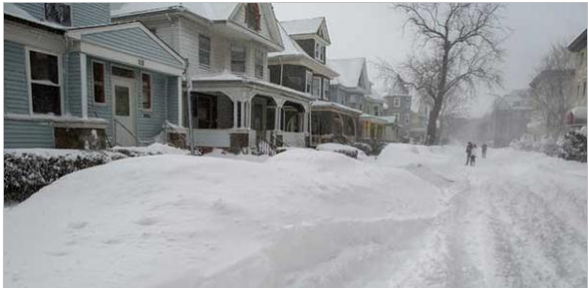
Background
Snow removal is an important, yet costly process in many northern cities. Snow can be cleared from streets and sidewalks by plowing and shoveling, but in prolonged sub-freezing temperatures, the resulting banks of accumulated snow can impede pedestrian and vehicular traffic and must be cleared.

Slide 3
Background
Large cities are divided into sectors and then snow removal operations are carried out concurrently in each sector.
In Montreal, snow is collected and loaded onto trucks and disposed of in areas like rivers, quarries, sewer chutes, and surface holding areas.
Different disposal sites can accommodate different amounts of snow due to physcial size or environmental restrictions on amount of snow (by salt and de-icing chemicals) that can be dumped into rivers.

Slide 4
Capacity of Disposal Sites (in 1,000s of cubic meters)
 | 1 | 2 | 3 | 4 | 5
Capacity | 350 | 250 | 500 | 400 | 200

Slide 5
Background
The cost of removing and disposing of snow depends mainly on the distance it must be trucked. The city of Montreal uses the straight-line distance between the center of each sector to each of the various disposal sites as an approximation of the cost involved in transporting snow between these locations.
Each sector may only be assigned to one disposal site.

Slide 6
Distance from Sector to Disposal Site (in kilometers)
Sector | 1 | 2 | 3 | 4 | 5
1 | 3.4 | 1.4 | 4.9 | 7.4 | 9.3
2 | 2.4 | 2.1 | 8.3 | 9.1 | 8.8
3 | 1.4 | 2.9 | 3.7 | 9.4 | 8.6
4 | 2.6 | 3.6 | 4.5 | 8.2 | 8.9
5 | 1.5 | 3.1 | 2.1 | 7.9 | 8.8
6 | 4.2 | 4.9 | 6.5 | 7.7 | 6.1
7 | 4.8 | 6.2 | 9.9 | 6.2 | 5.7
8 | 5.4 | 6.0 | 5.2 | 7.6 | 4.9
9 | 3.1 | 4.1 | 6.6 | 7.5 | 7.2
10 | 3.2 | 6.5 | 7.1 | 6.0 | 8.3

Slide 7
Background
Using past snowfall data, the city of Montreal estimated the annual volume of snow requiring removal in each sector as four times the length of streets in the sectors in meters (it is assumed that each linear meter of street generates four cubic meters of snow to remove over an entire year)

Slide 8
Estimated Annual Snow Removal Requirements (in 1,000s of cubic meters)
1 | 2 | 3 | 4 | 5 | 6 | 7 | 8 | 9 | 10
153 | 152 | 154 | 138 | 127 | 129 | 111 | 110 | 130 | 135

Slide 9
Problem Modeling
This problem is an instance of multi-bin packing.
In general form it is NP-hard problem:
With a solution we can check if it is optimal in polynomial time.
There are various heuristic methods to solve the problem.
Here we use Solver’s method.

Slide 10
Question 1, 2, and 3
Create a spreadsheet that Montreal could use to determine the most efficient snow removal plan for the coming year. Assume it costs $0.10 to transport one cubic meter of snow one kilometer.
What is the optimal solution?
How much will it cost Montreal to implement your snow disposal plan?

Slide 11
Mathematical Model
Variables:
x_{ij} =1 if we assign sector i = 1, 2, …, 10 to disposal site
j = 1, …, 5
and
x_{ij} = 0 otherwise

Slide 12
Objective Function
Minimize 153*1000*0.10(3.4x₁₁ + 1.4x₁₂ + … + 9.3x₁₅) +
152*1000*0.10(2.4x₁₂ + 2.1x₂₂ + … + 8.8x₂₅) +
.
.
.
135*1000*0.10(3.1x₁₀₁ + 6.5x₁₀₂ + … + 8.8x₁₀₅)
Note: 1000*0.10 is repeated every where and can be removed as it does not change the solution of optimization.

Slide 13
Constraints
Subject to
x₁₁ + x₁₂ + … + x₁₅ = 1
x₂₁ + x₂₂ + … + x₂₅ = 1
x₁₀₁ + x₁₀₂ + … + x₁₀₅ = 1
152x₁₁ + 152x₂₁ + … + 135x₁₀₁ ≤ 350
152x₁₂ + 152x₂₂ + … + 135x₁₀₂ ≤ 250
152x₁₅ + 152x₂₅ + … + 135x₁₀₅ ≤ 200
x₁₁, x₁₂, … , x₁₀₅ Є {0,1}
…
…

Slide 14
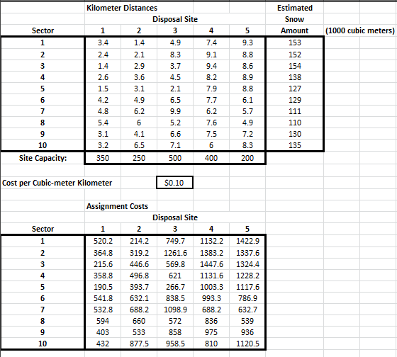

Slide 15
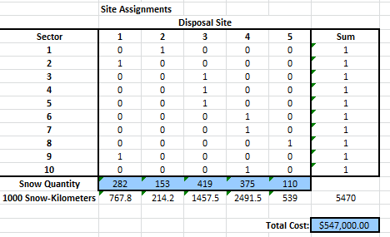

Slide 16
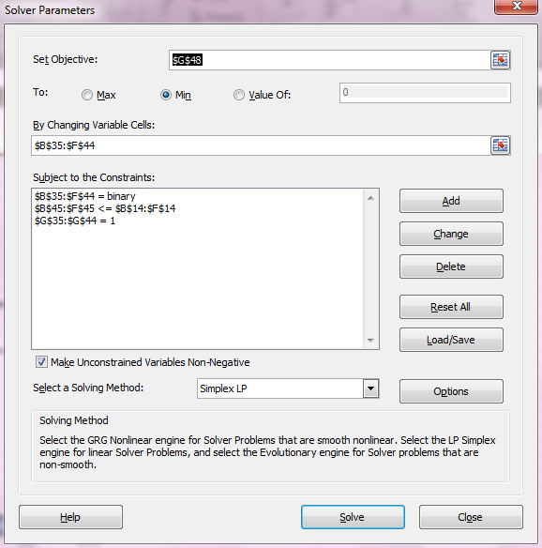

Slide 17
Results

Slide 18
Results
Sectors 2 and 9 should deliver to Disposal Site 1.
Sector 1 should deliver to Disposal Site 2.
Sectors 3, 4, and 5 should deliver to Disposal Site 3.
Sectors 6, 7, and 10 should deliver to Disposal Site 4.
Sector 8 should deliver to Disposal Site 5.
The total cost of the snow removal project using these assignments is $547,000.00

Slide 19
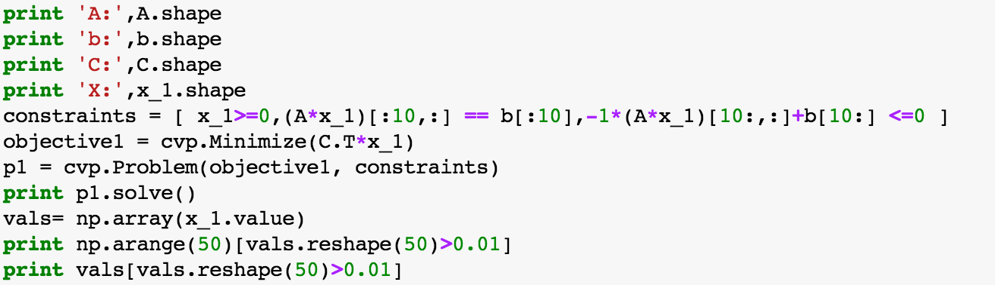
Linear Programming in Python and CVX
Solving the linear program:
Cost: 478,4000
We can use CVX to compute Lagrange multipliers and rule out those constraints which do not reduce costs.

Slide 20
Question 4
Ignoring the capacity restrictions at the disposal sites, how many different assignments of sectors to disposal sites are possible?
5**10
Since every sector can be assigned to 5 sites, note that we are discarding the limits.

Slide 21
Question 5
Suppose Montreal can increase the capacity of a single disposal site by 100,000 cubic meters. Which disposal site’s capacity (if any) should be increased and how much should the city be willing to pay to obtain this extra disposal capacity?

Slide 22
Mathematical Model
Variables:
x_{ij} =1 if we assign sector i = 1, 2, …, 10 to disposal site
j = 1, …, 5
and
x_{ij} = 0 otherwise
y_{j} = 1 if we expand site j = 1, 2, …, 5 and 0 otherwise

Slide 23
Objective Function
Minimize 153*1000*0.10(3.4x₁₁ + 1.4x₁₂ + … + 9.3x₁₅) +
152*1000*0.10(2.4x₁₂ + 2.1x₂₂ + … + 8.8x₂₅) +
.
.
.
135*1000*0.10(3.1x₁₀₁ + 6.5x₁₀₂ + … + 8.8x₁₀₅)

Slide 24
Constraints
Subject to
x₁₁ + x₁₂ + … + x₁₅ = 1
x₂₁ + x₂₂ + … + x₂₅ = 1
x₁₀₁ + x₁₀₂ + … + x₁₀₅ = 1
152x₁₁ + 152x₂₁ + … + 135x₁₀₁ ≤ 350 + 100y₁
152x₁₂ + 152x₂₂ + … + 135x₁₀₂ ≤ 250 + 100y₂
152x₁₅ + 152x₂₅ + … + 135x₁₀₅ ≤ 200 + 100y₅
x₁₁, x₁₂, … , x₁₀₅ Є {0,1}
y₁ + y₂ + … + y₅ ≤ 1
y₁. y₂, …, y₅ Є {0,1}
…
…

Slide 25
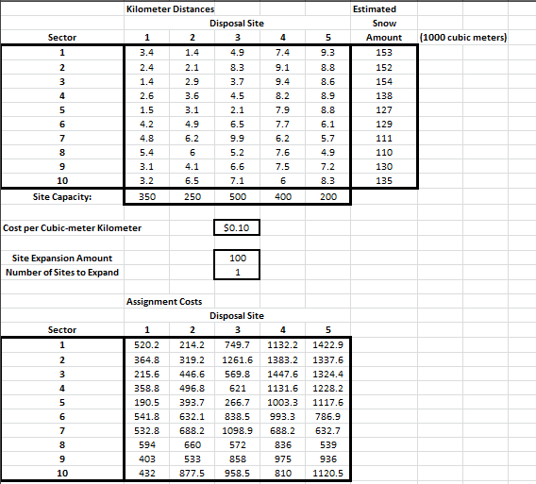

Slide 26
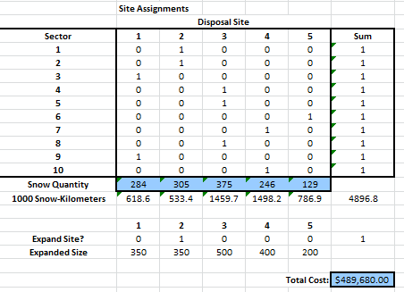

Slide 27
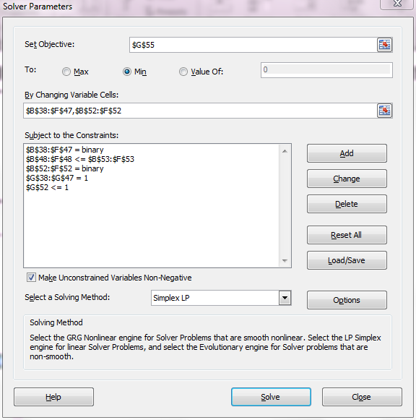

Slide 28
Results

Slide 29
Results
We should expand disposal site 2.
Sectors 3 and 9 should deliver to Disposal Site 1.
Sectors 1 and 2 should deliver to Disposal Site 2.
Sectors 4, 5, and 8 should deliver to Disposal Site 3.
Sectors 7 and 10 should deliver to Disposal Site 4.
Sector 6 should deliver to Disposal Site 5.
The total cost of this project comes to $489,680.

Slide 30
Comparisons
Original Capacities
Expanded Capacities
Sectors 2 and 9
Sector 1
Sectors 3, 4, and 5
Sectors 6, 7, and 10
Sector 8
SITE 1
Sectors 3 and 9
Sector 1 and 2
Sectors 4, 5, 8
Sectors 7 and 10
Sector 6
SITE 2
SITE 3
SITE 4
SITE 5
Cost: $547,000.00
Cost: $489,680.00

Slide 31
Result
So, if the city of Montreal were to expand a site and not pay more than the original cost, they should pay no more than the difference between the two costs to expand disposal site 2.
$547,000.00 - $489,680.00 = $57,320.00

