Slide 1

publicpuzzle.com
Just click a corner to pick your answer.
A mass trivia game where,
everyone, everywhere, learns together.

Slide 2
NOT Happy
Happy
How happy are you to try this?
Very Happy
OMG! HAPPY

Slide 3
Student
Professor
Which best describes you?
Other
Confused

Slide 4
OLD
YOUNG
Which best describes you?
MIDDLE
AGED

Slide 5
12/3
2^0
2 + 2 =
21/7
8-6

Slide 6
12/3
2^0
2 + 2 =
21/7
8-6

Slide 7

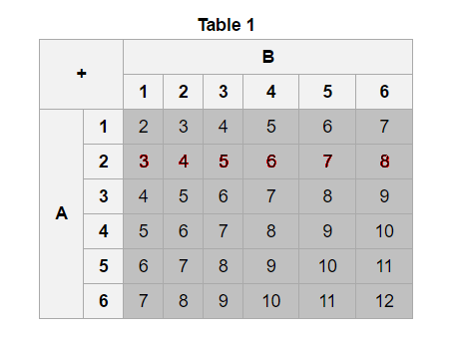
2
-----
36
6
-----
36
1
-----
12
2
-----
18

Slide 8
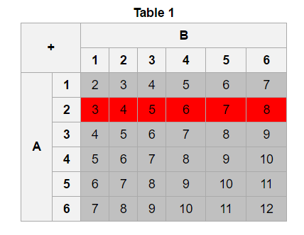
2
-----
36
6
-----
36
1
-----
12
2
-----
18
Clearly, A = 2 in exactly 6 of the 36 outcomes, thus P(A=2) = ⁶⁄₃₆ = ¹⁄₆.

