Slide 1
Application Mobile : Gestion de régime alimentaire
Bilel TAIEB
03/05/2019
Notes:
This template can be used as a starter file for presenting training materials in a group setting.
Sections
Sections can help to organize your slides or facilitate collaboration between multiple authors. On the Home tab under Slides, click Section, and then click Add Section.
Notes
Use the Notes pane for delivery notes or to provide additional details for the audience. You can see these notes in Presenter View during your presentation.
Keep in mind the font size (important for accessibility, visibility, videotaping, and online production)
Coordinated colors
Pay particular attention to the graphs, charts, and text boxes.
Consider that attendees will print in black and white or grayscale. Run a test print to make sure your colors work when printed in pure black and white and grayscale.
Graphics, tables, and graphs
Keep it simple: If possible, use consistent, non-distracting styles and colors.
Label all graphs and tables.

Slide 2


Sommaire

Slide 3
Sommaire
Contexte du projet
Environnement de travail
Modélisation du projet
Démonstration
Conclusion
Notes:
Give a brief overview of the presentation. Describe the major focus of the presentation and why it is important.
Introduce each of the major topics.
To provide a road map for the audience, you can repeat this Overview slide throughout the presentation, highlighting the particular topic you will discuss next.

Slide 4

Contexte
Notes:
This is another option for an overview using transitions to advance through several slides.

Slide 5
Contexte
Chaque jour, notre corps a besoin d’énergie pour fonctionner et accomplir correctement ses missions. Cette énergie nous est fournie par les aliments que nous consommons. Et elle s’exprime en calories.
L’unité de mesure de l’énergie couramment utilisée en nutrition est ce que l’on appelle la kilocalorie (kcal) : 1 kcal = 1 000 calories.
Alors, pour évaluer le "juste" nombre de calories dont vous avez besoin chaque jour pour maintenir votre poids stable, il existe une formule.
Notre projet a pour objectif de créer une application mobile qui permet de gérer le régime alimentaire quotidiennement.
Notes:
Give a brief overview of the presentation. Describe the major focus of the presentation and why it is important.
Introduce each of the major topics.
To provide a road map for the audience, you can repeat this Overview slide throughout the presentation, highlighting the particular topic you will discuss next.

Slide 6
Environnement de travail
Notes:
This is another option for an overview using transitions to advance through several slides.

Slide 7
Environnement de travail : Languages et Frameworks
Typescript/Javascript, Html, css
Ionic 4 (Framework Web et Mobile + client),
Angular 7 (Framework MVC Web et mobile)
Apache Cordova (Cibler plateforme Web et Mobile : Android, Ios avec un même code)
SqLite, Cordova plugin for Sqlite Storage (Base de données locale)
Notes:
Give a brief overview of the presentation. Describe the major focus of the presentation and why it is important.
Introduce each of the major topics.
To provide a road map for the audience, you can repeat this Overview slide throughout the presentation, highlighting the particular topic you will discuss next.

Slide 8
Environnement de travail : Outils
Visual Studio Code (Ide)
Android Studio (Android SDK, Emulateur Device Android, Logcat)
UmlDesigner : (Modélisation Uml)
Notes:
Give a brief overview of the presentation. Describe the major focus of the presentation and why it is important.
Introduce each of the major topics.
To provide a road map for the audience, you can repeat this Overview slide throughout the presentation, highlighting the particular topic you will discuss next.

Slide 9
Modélisation du Projet
Notes:
This is another option for an overview using transitions to advance through several slides.

Slide 10
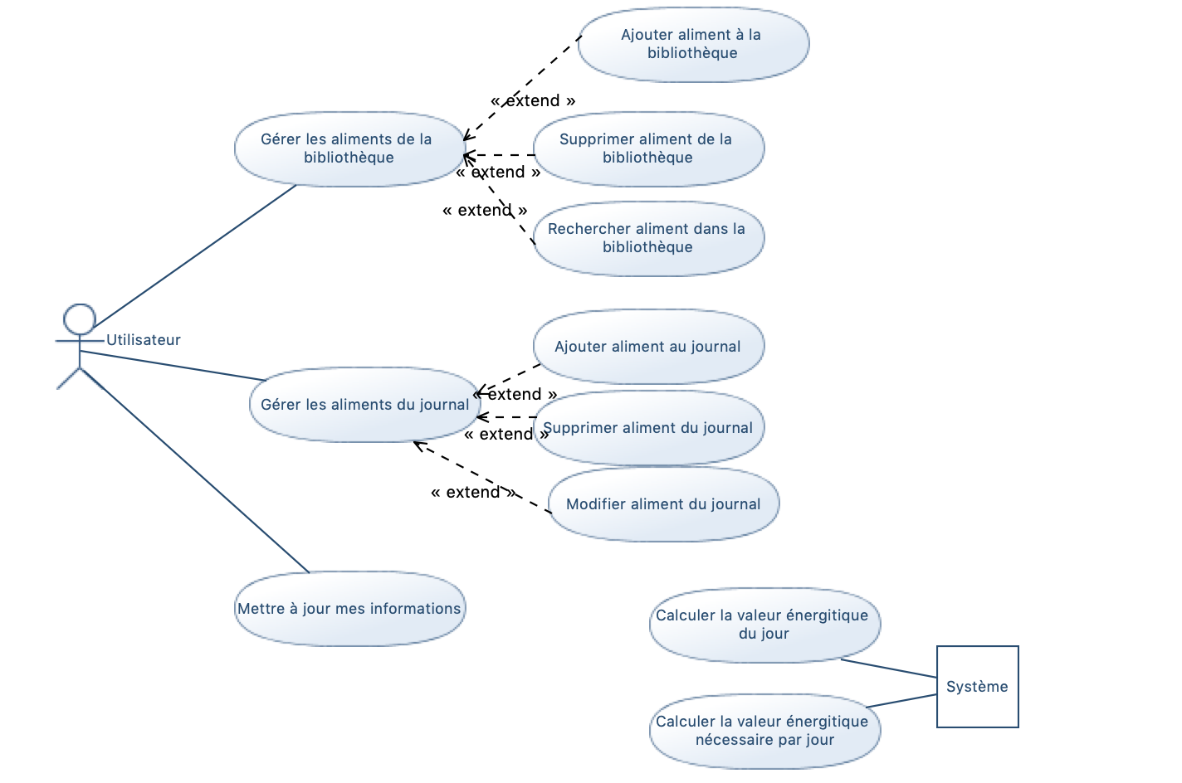
Modélisation du projet: Diagramme de cas d’utilisation
Notes:
Give a brief overview of the presentation. Describe the major focus of the presentation and why it is important.
Introduce each of the major topics.
To provide a road map for the audience, you can repeat this Overview slide throughout the presentation, highlighting the particular topic you will discuss next.

Slide 11
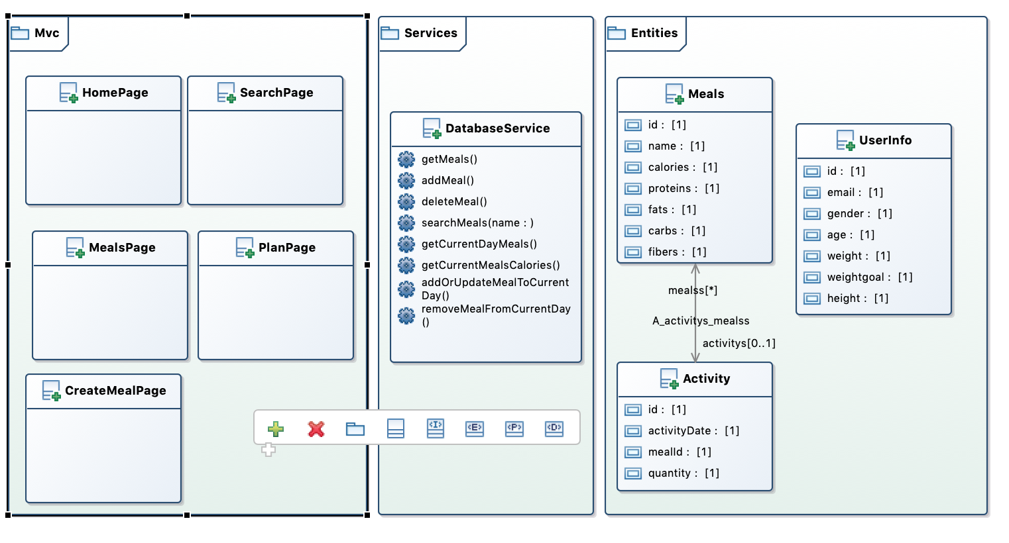
Modélisation du projet: Diagramme de classe
Notes:
Give a brief overview of the presentation. Describe the major focus of the presentation and why it is important.
Introduce each of the major topics.
To provide a road map for the audience, you can repeat this Overview slide throughout the presentation, highlighting the particular topic you will discuss next.

Slide 12
Démonstration
Notes:
This is another option for an overview using transitions to advance through several slides.

Slide 13
Démonstration : Notes (1)
Générer des pages/service ionic et angular :
generate database service services/database
Cette commande génère une classe de service (DatabaseService.ts) dans un sous répertoire services
generate page ionic meals
Cette commande génère notre contrôleur Angular (MealsPage.ts) et vue Angular (MealsPage.html)
Notes:
Give a brief overview of the presentation. Describe the major focus of the presentation and why it is important.
Introduce each of the major topics.
To provide a road map for the audience, you can repeat this Overview slide throughout the presentation, highlighting the particular topic you will discuss next.

Slide 14
Démonstration : Notes (2)
Lancer l’application sous android grace à Cordova :
ionic cordova run android –l
L’argument –l pour recharger automatiquement l’application
Lancer l’émulateur depuis Android Studio et afficher la fenêtre de Log (Logcat)
Permet de suivre le déroulement de l’application : console.log(“message”)
Notes:
Give a brief overview of the presentation. Describe the major focus of the presentation and why it is important.
Introduce each of the major topics.
To provide a road map for the audience, you can repeat this Overview slide throughout the presentation, highlighting the particular topic you will discuss next.

Slide 15
Démonstration : Application
Lancement de l’application
Notes:
Give a brief overview of the presentation. Describe the major focus of the presentation and why it is important.
Introduce each of the major topics.
To provide a road map for the audience, you can repeat this Overview slide throughout the presentation, highlighting the particular topic you will discuss next.

Slide 16
Conclusion
Notes:
This is another option for an overview using transitions to advance through several slides.

Slide 17
Conclusion
Ionic est un Framework intéressante pour dévlopper à la fois des application Web et mobile quelque soit la plateforme avec un seul code.
Angular m’a permis de comprendre au mieux le modèle MVC
Notes:
Give a brief overview of the presentation. Describe the major focus of the presentation and why it is important.
Introduce each of the major topics.
To provide a road map for the audience, you can repeat this Overview slide throughout the presentation, highlighting the particular topic you will discuss next.

Slide 18
Resources
https://ionicframework.com/docs
https://angular.io/guide/quickstart
https://devdactic.com/ionic-4-sqlite-queries/
https://www.youtube.com/watch?v=fZ4giHzXfSg

Slide 19
Questions?

