Slide 1
Tennis Ball Tracker
HarvardX: CS 50
Introduction to Computer Science
Branch Archer
Amarillo, TX, USA
Notes:
Hi,
My name is Branch Archer. This is my project for CS 50, a Tennis Ball Tracking system.

Slide 2
Project Outline
Handheld iPad camera (no tripod)
10 frames/second
Player serves tennis ball while being filmed
Download images to PC
Process images on a web page, using JavaScript
Programmatically identify location of tennis ball within each frame
640 X 480 pixels = 307,200 pixels
Notes:
The idea behind this project is that I would like to be able to take images from a tennis match and identify the location of the tennis ball within those images.
I use a standard iPad for recording the images. I'd like to be able to record without a tripod, so that a spectator could conveniently record.
I installed an application on the iPad that is capable of filming at 10 frames/second with good resolution.
I recorded my son serving a tennis ball, then downloaded the images to a PC, acting as a web server.
I then processed those images using JavaScript, and programmatically identify the location of the tennis ball within each frame.

Slide 3
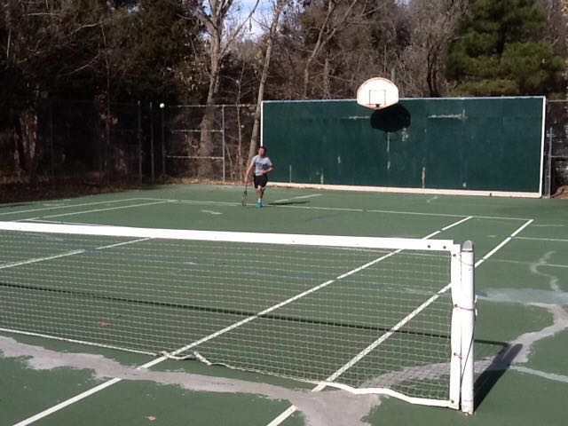
Sample Image
Notes:
This is a sample image from the data set. It is relatively simple for a human observer to identify the tennis ball (click).
However, an apparently simple concept encounters numerous challenges in actual implementation.

Slide 4
Challenges encountered
Large volume of data
640 X 480 pixels = 307,200 pixels
640 X 480 X 3 = 921,600 RGB color samples
Must be reasonably efficient due to data size
Tiny signal
Ball is perhaps 50 pixels out of about 300,000
Mis-registration between consecutive images
Rotation and translation
Very significant in terms of image processing
Notes:
The first challenge is related to the sheer volume of data. Each image acquires a 640 x 480 grid, or 307,200 individual pixels. There are 3 color values for each pixel, or almost a million data values. The algorithm for identifying the ball must be reasonably efficient to avoid overwhelming the computer resources, especially since the project is implemented in JavaScript, as JavaScript does not run natively on the host processor.
Another challenge is that the signal is relatively tiny. The ball occupies in the neighborhood of 50 pixels out of 300,000 … the proverbial needle in a haystack.
Finally, since the project scheme precludes use of a tripod, I found there is mis-registration between images.

Slide 5
Algorithm employed
Subtract test image from test image
Tag candidate pixels (set other pixels to black)
Important to eliminate as many pixels as possible
Yellow ball (Red + Green): Signal taken as Red + Green – Blue
Group candidate pixels into contiguous 'globs' of pixels
Cull globs to product single best candidate for ball
Notes:
Moving from generalities to specifics, we need to implement a concrete algorithm which is capable of identifying the location of the tennis ball in an image.
My approach begins with subtracting a reference image from a test image. The result of the subtraction should eliminate much of the signal of stationary objects, facilitating discrimination between stationary and moving objects.
The pixels in the subtracted image are then filtered based on meeting a certain intensity threshold. Since the ball is yellow, I selected that threshold based on the sum of the red and green (which combines to yellow), and subtracted the red. At this point we have identified moving yellowish pixels.
Then I group the selected pixels into contiguous groups of pixels that I call globs.
Finally, I cull through the globs to identify the tennis ball.

Slide 6
Glob accretion
 |  |  |  | 1 | 2 |  | 5 | 6
 |  | 7 | 8 | 3 | 4
 |  | 9 | 10
Notes:
Time does not permit detailed discussion of the glob accretion algorithm, but the idea is straightforward. I initially place each pixel which meets the screening threshold in its own glob. Then I iterate through the globs. For each glob, I find any other glob which is adjacent to it, and merge the globs.
In this case, pixels 1 through 4 were merged in the first pass. Pixels 5 and 6 were merged into a separate glob. Pixels 7 through 10 were merged into a 3rd glob. On the second pass, pixels 1 through 4 and 7 through 10 were merged into a single glob of 8 pixels.

Slide 7
Culling globs
Minimum size threshold: 10 pixels
Minimum fill of encompassing circle: 75%
Nearby area clear of signal
3
X
3
X
Notes:
The final step is to cull the globs. The first and simplest step is to eliminate tiny globs. The tennis ball is about 50 pixels, so I found that I could safely eliminate globs smaller than 10 pixels.
Next, some of the globs have very irregular shape, not round like a tennis ball. If a glob does not fill more than 75% of its encompassing circle, I cull that glob from the list. In this case, the elliptical glob is kept, but the irregular shape is eliminated.
At this point, I found the remaining globs tend to be either associated with motion of the player, or the tennis ball itself. Globs associated with the player are near one another, whereas the ball is removed from other remaining globs. To cull the tennis player globs, I eliminate any globs which have other globs nearby.

Slide 8
Opportunities for Enhancement
Operate natively on iPad using Objective-C or Swift
Automatically register images
Use scene geometry to identify 3-D position of ball, then calculate speed

