Slide 1



PRICE NEGOTIATION CHATBOT SYSTEM
AHSAN Batool deborah
JUSTIN nAVROJ

Slide 2

Agenda
OVERVIEW
ARCHITECTURE
FEATURES
IMPLEMENTATION
USE CASES
CHALLENGES AND SOLUTION
CONCLUSION

Slide 3

OVERVIEW
Primary Purpose:
To facilitate seamless and effective price negotiations through an intelligent chatbot.
Aims to enhance user experience by providing personalized recommendations and adaptive negotiation strategies.
Function:
Engages users in dynamic pricing discussions.
Utilizes historical data and user input to tailor negotiation tactics.

Slide 4
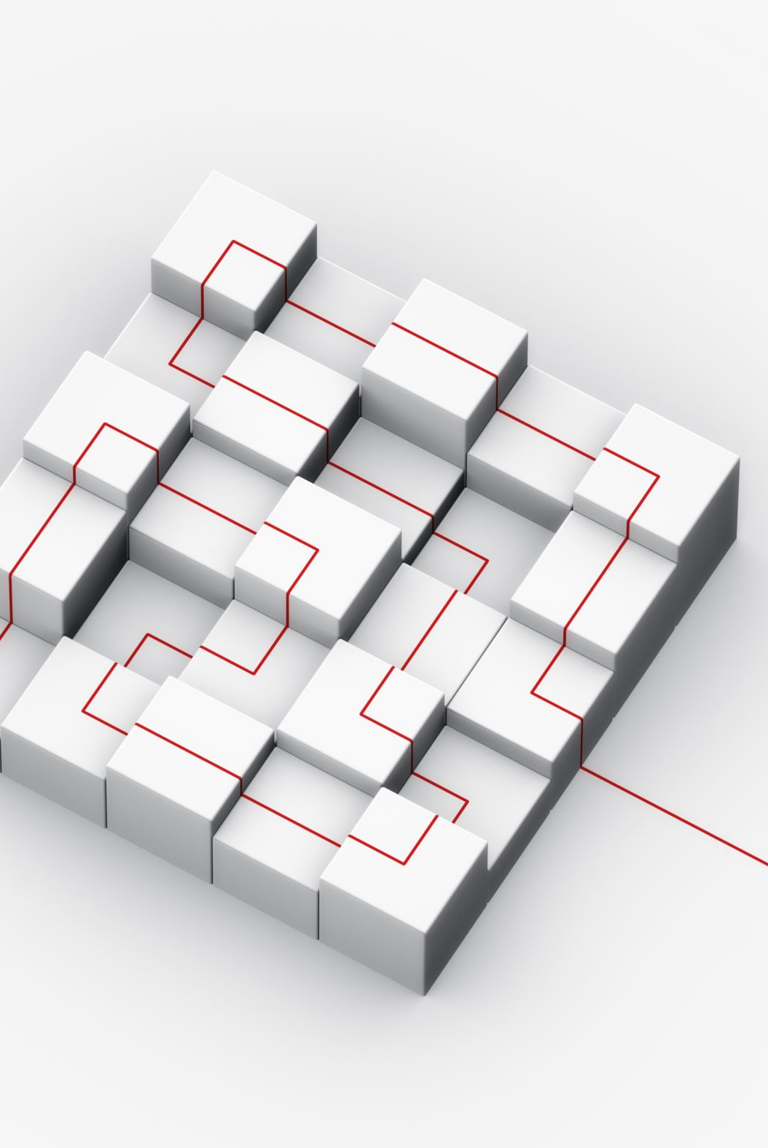
ARCHITECTURE
NLP Models: OpenAI Integration:
  Powers natural language understanding and generation.
  Handles conversation flow and user queries.
Retrieval-Augmented Generation (RAG):
  Combines pre-trained language models with a retrieval system.
  Enhances responses with relevant information from the database

Slide 5
ARCHITECTURE
Database Integration:
MySQL Database:
  Stores historical negotiation data, user profiles, and product information.
  Provides real-time data retrieval for personalized interactions.
Langraph:
Visualizes and integrates data flow and architecture components.
Ensures cohesive system design and functionality.

Slide 6
FEATURES
Personalized User Recommendations:
Analyzes user preferences and past interactions.
Suggest tailored products and offers.
Adaptive Price Negotiation:
Adjusts negotiation strategies based on user responses and market conditions.
Uses data-driven insights to optimize pricing tactics.
Dynamic Interaction:
Engages users with contextually relevant dialogue.
Adapts responses based on real-time data and user input.

Slide 7
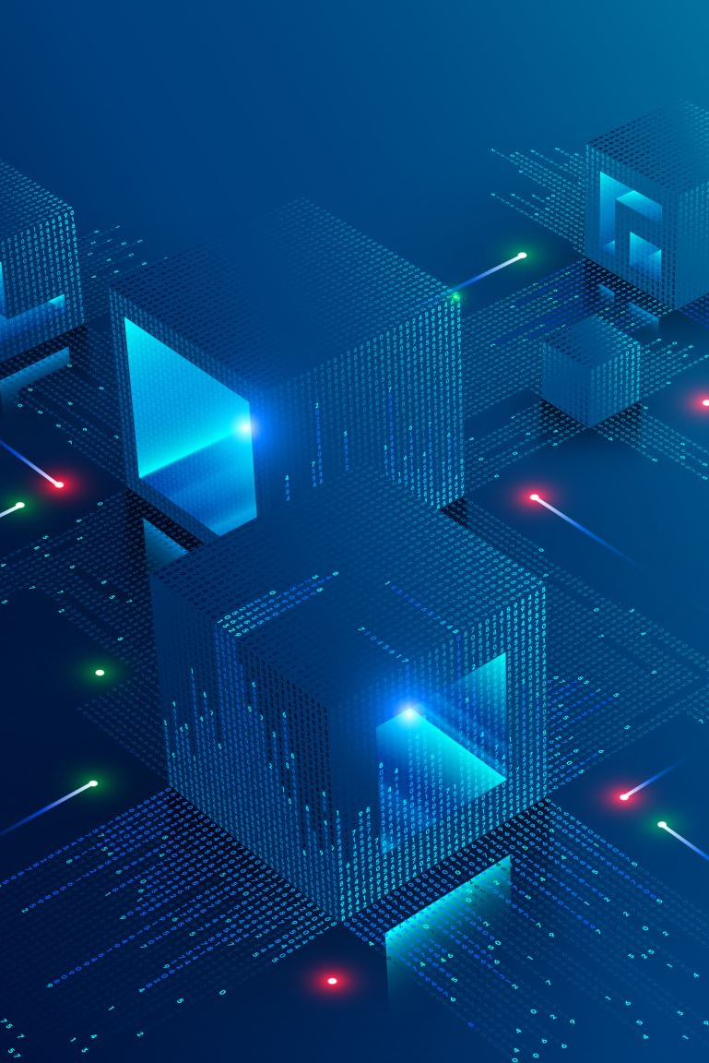
IMPLEMENTATION
Technologies Used:
OpenAI:
  For natural language processing and conversation management.
MySQL:
  For data storage and retrieval.
RAG:
  For integrating external knowledge into chatbot responses.
Langraph:
  For system design and architecture visualization.
Platforms:
Amazon Web Services (AWS) Elastic Compute Cloud (EC2):
  For deploying and hosting the chatbot application.
Python:
  For scripting and integrating different components.

Slide 8
USE CASES
E-commerce Platforms:
Assists users in negotiating prices for products.
Provides personalized recommendations based on user behavior.
Customer Service:
Enhances customer engagement through adaptive negotiation techniques.
Streamlines support for price-related queries and issues.
Retail and Sales:
Facilitates price adjustments and promotions based on user interactions.
Improves sales strategies through data-driven insights.

Slide 9

CHALLENGES AND SOLUTIONS
Challenge 1: Integrating OpenAI with MySQLSolution:
  Utilized RAG to bridge the gap between language models and database information.
  Ensured smooth data retrieval and response generation
Challenge 2: Personalization AccuracySolution:
  Implemented advanced algorithms to analyze user behavior and preferences.
  Continuously updated recommendation models based on user feedback.

Slide 10

SUMMARY
The price negotiation chatbot leverages advanced NLP and data retrieval technologies to offer personalized and adaptive interactions.
It enhances user experience by providing tailored recommendations and optimized negotiation strategies.

