Slide 1
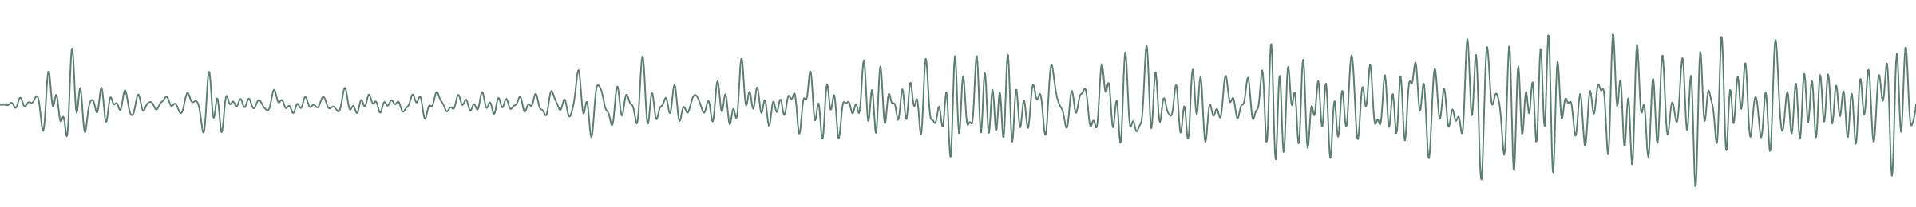
AI-BASED Hand Gesture Classification Analysis Using EMG Signals
Burak Talha Güçlü | N24111151
Notes:
This deck presents the whole study in detail: problem, data, features and their meaning, the six models with their parameters, and a detailed comparison.

Slide 2
AGENDA
Presentation Outline
1
Problem, EMG and motivation
2
Datasets and hand gestures
3
Signal preprocessing
4
Feature selection and meanings
5
Six models: parameters & rationale
6
Evaluation methodology
7
Results and detailed comparison
8
Cylindrical effect & per-class analysis
9
Challenges and recommendations
10
Conclusion
Notes:
Agenda: problem, data, features (detailed), the six models' parameters, evaluation, comparison, the cylindrical effect and recommendations.

Slide 3
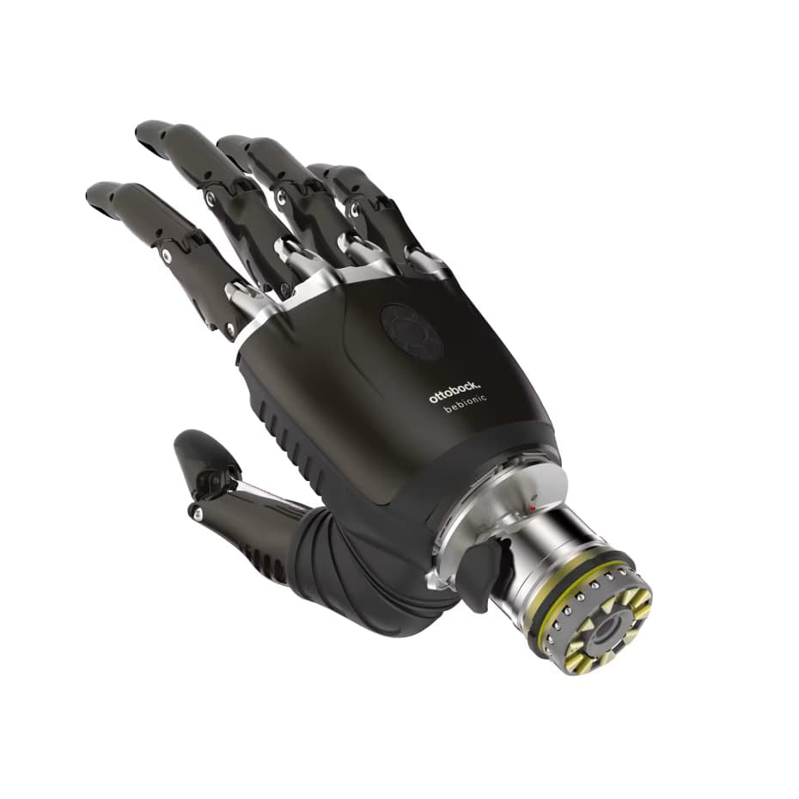
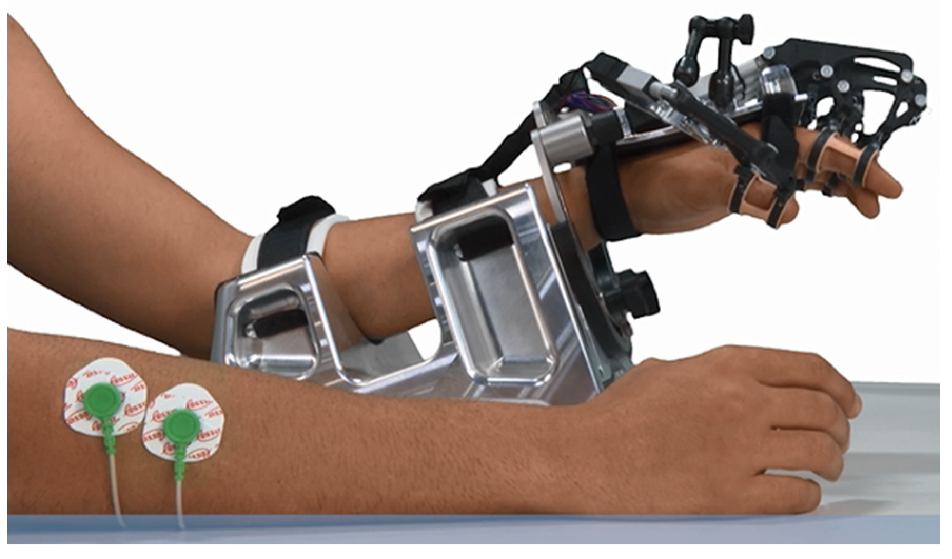
PROBLEM & MOTIVATION
Why EMG Hand-Gesture Recognition?
The signal varies from person to person, even from trial to trial.
Similar grips produce very close muscle activation.
So, the choice of features and model is decisive.
EMG (electromyography) measures the electrical activity produced when a muscle contracts. Decoding which gesture is performed from forearm surface signals is a critical problem for prosthetics, rehabilitation and human–machine interfaces.
CORE CHALLENGE
Prosthetic hand control
Natural control for amputees
Rehabilitation
Muscle-activation tracking and therapy
Human–machine interface
Touchless commands / interaction
Notes:
Problem: gesture recognition from EMG for prosthetics/rehab/interfaces. Main difficulty: signal variability and confusion of similar gestures.

Slide 4
BACKGROUND
What Is a Surface EMG Signal?
Surface EMG (sEMG) electrodes measure the electrical activity produced when the forearm muscles contract. Different gestures activate different muscle groups → distinguishable signal patterns.
Non-invasive, real-time, low-cost
Noisy; varies by person and trial
The raw waveform is high-dimensional → summarized by features
Time-domain features are cheap and effective
Notes:
EMG basics: surface electrodes read muscle electrical activity. As it is noisy and variable, we window it and extract features instead of using the raw waveform.

Slide 5
OVERVIEW
The Study's Pipeline
1
2
3
4
5
6
›
›
›
›
›
5 Classical
Raw EMG
Windowing
Features
Scaling
Evaluation
SVM · RF · MEET · KNN · MLP
1D CNN branch (both datasets): after Windowing, the raw windows are standardized and fed
straight to the 1D CNN — the time-domain Feature step (3) is skipped.
Notes:
Pipeline: raw signal → windowing → features → scaling → model → evaluation. Held fixed so the models are compared fairly.

Slide 6
DATASETS
Two Complementary Datasets
NinaPro DB5
Custom Data
Open-source benchmark database
2-channel recording
Channels
8 (Myo armband)
Channels
2
Subjects
S1, S2, S5, S10
Subjects
Ecem, Selman
Gestures
7 classes
Gestures
5 classes
Sampling
200 → 1000 Hz
Sampling
1000 Hz
Features
32 dims/window
Features
8 dims/window
Size
19,591 windows
Size
67,885 windows
Notes:
NinaPro: 8 channels, 4 subjects, 7 gestures, open-source. Custom: 2 channels, 2 subjects, 5 gestures. The channel difference is the main driver of the results.

Slide 7
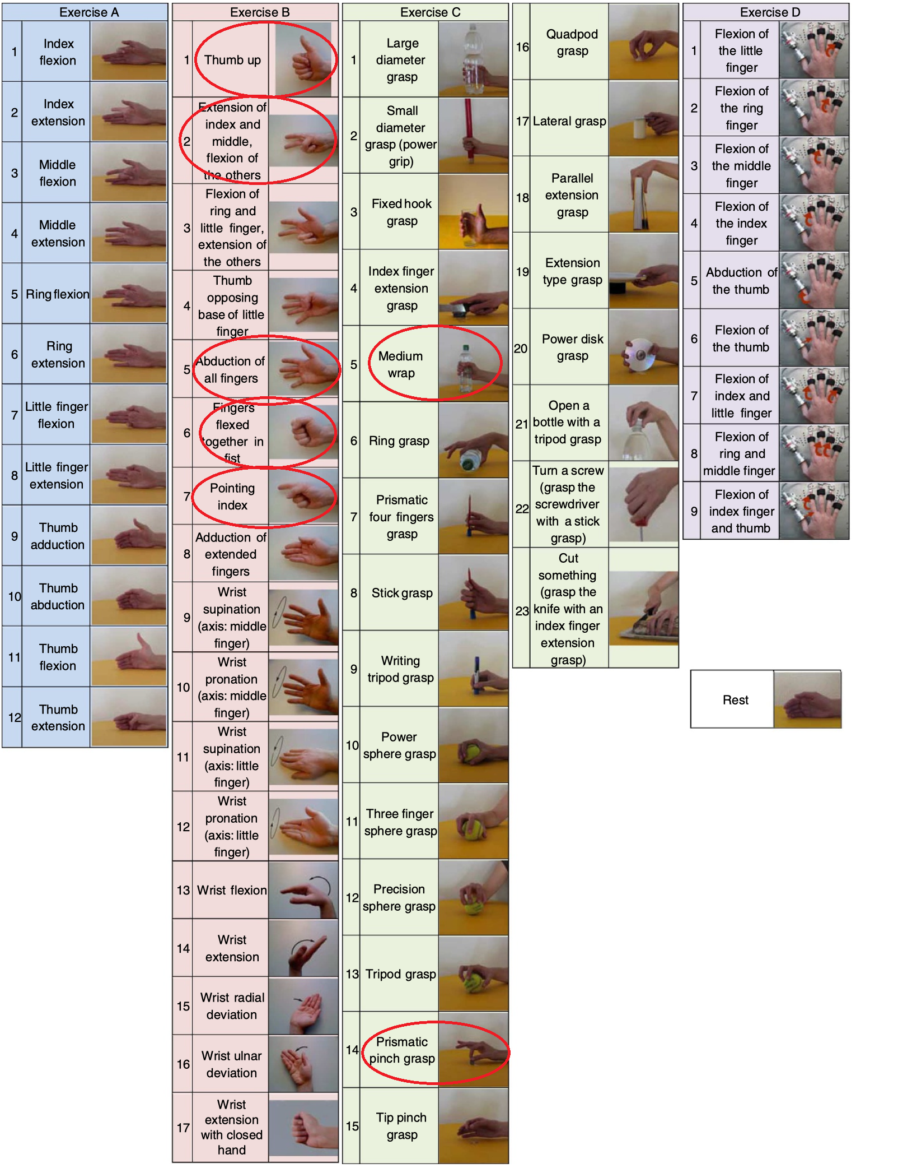
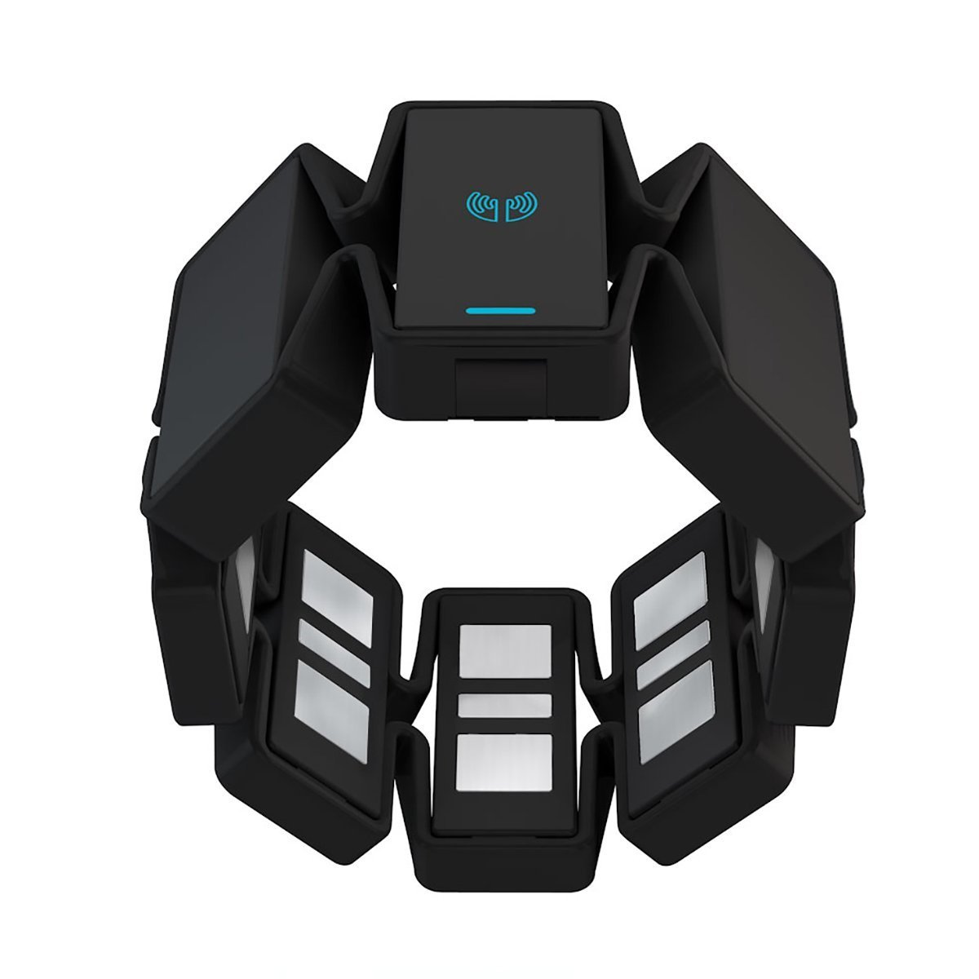
DATASET 1
NinaPro DB5 — Details
A standard sEMG benchmark. The first 8 channels of the Myo armband are used. The 200 Hz raw signal is upsampled to 1000 Hz for temporal resolution. B- and C-series gestures are taken from the E2 and E3 exercise files.
8
4
7
19.591
EMG channels
subjects
gestures
window
Why NinaPro? Standard, multi-subject and reproducible; results are comparable with the literature.
Notes:
NinaPro DB5 detail: 8 channels, S1/S2/S5/S10, E2-E3 exercises, 200→1000 Hz. Being standard makes results comparable.

Slide 8
DATASET 2
Custom Data — Ecem & Selman
Collected from two subjects with a low-cost 2-channel setup. Signals are stored per channel (ch1, ch2) for each gesture across four .mat files.
2
2
5
67.885
EMG channels
subjects
gestures
window
Limitation: Only 2 channels → limited spatial information to separate similar grips. This is the main reason behind later performance gaps.
Notes:
Custom data: 2 channels, 2 subjects, 5 gestures, ~68k windows. The 2-channel limit is the source of the later cylindrical–closed confusion.

Slide 9
METHOD
Signal Preprocessing — Parameters
NinaPro
Custom Data
Upsampling 200 → 1000 Hz (×5)
Window: 150 samples (150 ms)
Step: 30 samples → 80% overlap
Output: 32-dim CSV + raw (150×8) tensor
150 ms windows from the onset
Step: 30 ms → 80% overlap
2 channels × 4 features = 8
Output: custom_dataset.csv
Notes:
Window 150 ms, 80% overlap. Resampling for NinaPro; onset detection (threshold 435) for the custom set. These parameters capture the stable region of the signal.

Slide 10
GESTURES
Selected Hand Gestures
NinaPro (7)
Custom Data (5)
Thumb up (B1)
point
Scissors (B2)
rock
Open (B5)
closed
Closed (B6)
cylindrical
Point (B7)
open
Cylindrical (C5)
Pinch (C14)
Notes:
NinaPro 7, custom 5 gestures (tip not included). Cylindrical is the most-confused class in the custom set.

Slide 11
KEY CONCEPT
What Exactly Is a 'Window'?
Window is a short, fixed-length segment cut from the continuous EMG signal (150 ms here). The smallest unit the model classifies is not the whole signal but a single window.
One feature vector (RMS/MAV/WL/SSC) is extracted per window
The model predicts each window separately → one gesture yields many windows
Sliding window: the window advances by a fixed step (30 ms)
80% overlap: consecutive windows largely coincide → more samples, temporal continuity
IN SHORT
1 window = 1 feature vector = 1 prediction. Classification is done on these small pieces; the final gesture decision comes from combining the windows.
P1
P2
P3
Window width 150 ms · step 30 ms · overlap 80% (sliding, overlapping windows)
Notes:
Window: a 150 ms segment cut from the continuous signal. The model classifies each window; one feature vector per window. The sliding window advances with 80% overlap. The figure shows overlapping windows P1/P2/P3.

Slide 12
FEATURES
Feature Selection — Why the Time Domain?
Very low compute cost → suitable for real-time / embedded prosthetics
Robust to the small shifts and noise of surface EMG
Well-established and proven for gesture recognition in the sEMG literature
Reduces a 150-sample window to 4 numbers per channel with little information loss
SELECTION PRINCIPLE
The four features complement each other: amplitude (RMS, MAV), complexity (WL) and frequency (SSC).
Notes:
Time-domain features were chosen because they are cheap, robust, standard in the literature and work with small data. The four features carry complementary information with little redundancy.

Slide 13


FEATURE MEANINGS
Features — RMS and MAV
RMS
Root Mean Square
MAV
Mean Absolute Value
RMS = $\sqrt{\frac{1}{N}\sum{x_{i}^{2}}}$
MAV = $\frac{1}{N}Σ\left|x_{i}\right|$
The root-mean-square value of the signal. Represents the total power/energy the muscle produces; the stronger the contraction, the higher it is.
Mean absolute amplitude. The most classic sEMG amplitude estimator; reflects the signal's intensity and is slightly more robust to noise than RMS.
Notes:
RMS: root mean square → muscle power/energy. MAV: mean absolute value → amplitude/intensity. Both carry amplitude information but are complementary.

Slide 14

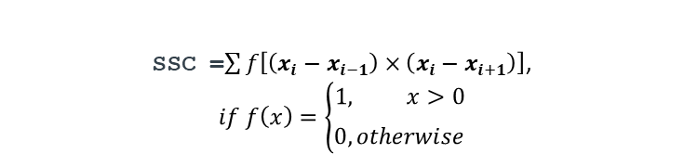
FEATURE MEANINGS
Features — WL and SSC
WL
Waveform Length
SSC
Slope Sign Changes
WL = $Σ\left|x_{i+1}−x_{i}\right|$
SSC =$\sum{f\left[\left(x_{i}−x_{i−1}\right)×\left(x_{i}−x_{i+1}\right)\right]}$,
$$if f\left(x\right)=\left\{\begin{aligned}1, x>0 \\ \begin{matrix} \\ 0, otherwise\end{matrix}\end{aligned}\right.$$
Sum of absolute differences between consecutive samples — the cumulative waveform length. Indirectly measures signal complexity (amplitude + frequency combined).
Counts how many times the slope sign changes (number of peaks/valleys). Estimates the signal's frequency content; higher frequency → more sign changes.
Notes:
WL: sum of consecutive differences → complexity. SSC: number of slope-sign changes → frequency-content estimate. WL and SSC add frequency/shape information.

Slide 15
MODELS
The Six Compared Models
SVM
RBF kernel
RF
Ensemble of 100 trees
MEET
OvO + Extra Trees
CNN
1D convolutional neural network
KNN
k=5 neighbors
MLP
1×128 neural network
Notes:
Six models are compared. The next slides give each model's parameters and selection rationale.

Slide 16
MODEL — HOW IT WORKS
How Does MEET Work?
MEET = Mixture of Experts Extra Trees. It splits the multi-class problem into binary sub-problems and trains a specialized 'expert' for each class pair.
• One-vs-One: a binary classifier per class pair → n(n−1)/2 experts (5 classes = 10 experts)
• Each expert focuses only on separating two classes → a very sharp boundary for that pair
• The experts are built from Extra Trees (extremely randomized trees) → low variance, fast training
• Prediction: the sample is asked to all experts; votes are tallied; the class with the most votes wins
WHAT IS IT GOOD FOR?
• Separates similar, hard pairs (cylindrical↔closed, B1↔B7) far better than a single model
• Gave the most balanced and highest accuracy in this study (> 94% on NinaPro)
• Specialization + randomness = sharp boundary + low variance
5 classes
(gestures)
→
Binary experts
(1–2, 1–3, 2–3, …)
each Extra Trees
→
Combine votes
→ Class
Notes:
MEET: splits the multi-class problem into binary sub-problems via One-vs-One; trains an Extra Trees expert per pair. Each expert separates only two classes → very sharp boundaries on hard pairs. Votes are combined. Good for: separating similar pairs like cylindrical–closed best; most balanced and highest accuracy (>94%).

Slide 17
MODEL DETAIL
SVM — Support Vector Machine
SVM (RBF)
WHY THIS CHOICE?
RBF kernel: the EMG feature space is not linearly separable → a non-linear boundary is needed
C=10: balances margin width vs. error penalty; a mid-high value that works well for sEMG
gamma='scale': auto-scales the kernel width by feature variance
Scaling is essential: SVM is distance-based and sensitive to standardization
CHOSEN PARAMETERS
kernel
RBF (radial)
C
10
gamma
'scale'
random_state
22
Notes:
SVM: RBF kernel because the data is not linearly separable; C=10 balances margin vs. error; gamma=scale is automatic. Scaling is critical.

Slide 18
MODEL DETAIL
Random Forest
Random Forest
WHY THIS CHOICE?
100 trees: enough for a stable ensemble; more adds marginal gain at higher cost
max_depth=None: trees grow fully; the ensemble average offsets overfitting
Bagging + random features → low variance, robust to noise
Also provides feature importance; an interpretability advantage
CHOSEN PARAMETERS
n_estimators
100
max_depth
None
n_jobs
-1
random_state
22
Notes:
RF: 100 trees is enough and stable; full depth + ensemble averaging offsets overfitting; robust to noise, gives feature importance.

Slide 19
MODEL DETAIL
MEET — Mixture of Experts Extra Trees
MEET (OvO + Extra Trees)
WHY THIS CHOICE?
OvO: a separate 'expert' per gesture pair → n(n−1)/2 binary classifiers
Separates hard pairs (B1↔B7, C5↔C14) more sharply than a single model
Extra Trees: extremely randomized trees → lower variance, fast
Adapted from Gehlot et al. (2024)
CHOSEN PARAMETERS
strategy
OneVsOne
base learner
ExtraTrees
n_estimators
100
random_state
22
Notes:
MEET: One-vs-One experts (an Extra Trees per pair). Separates hard pairs well; gives the most balanced and highest accuracy.

Slide 20
MODEL DETAIL
KNN — k-Nearest Neighbors
KNN (k=5)
WHY THIS CHOICE?
k=5: odd (no ties), small enough to capture local structure
Euclidean distance: the vote of the 5 nearest neighbors on standardized features
No training — all computation at prediction time; simple and interpretable
Downside: sensitive to class overlap and noise; high memory/prediction cost
CHOSEN PARAMETERS
n_neighbors (k)
5
metric
Euclidean
training
none (lazy)
scaling
required
Notes:
KNN: k=5 (odd), Euclidean distance, lazy learner. Simple but sensitive to overlap. Scaling required.

Slide 21
MODEL DETAIL
MLP — Multi-Layer Perceptron
MLP (1×128)
WHY THIS CHOICE?
Single hidden layer, 128 neurons: enough capacity for a small feature space
ReLU activation + softmax output → multi-class probability
Adam optimizer: adaptive learning rate, fast convergence
Learns non-linear decision boundaries; standardized input is essential
CHOSEN PARAMETERS
hidden layer
(128,) ReLU
output
softmax
solver
Adam, lr=0.001
max_iter
300 · seed 22
Notes:
MLP: single hidden layer of 128 ReLU, softmax, Adam lr=0.001. Learns non-linear boundaries, competitive with small data. Input standardization essential.

Slide 22
MODEL DETAIL
1D CNN — One Shared Raw Architecture
NinaPro CNN (raw 150×8)
Custom CNN (raw 150×2)
2× Conv1D (64/128) + BatchNorm + MaxPool
Large kernels (10, 5) → temporal patterns
Dense(256/128)+Dropout, output softmax(7)
Same network as NinaPro — only the input channel count differs (2 vs 8).
2× Conv1D (64/128) + BatchNorm + MaxPool
Dense(256/128) + Dropout → softmax(5)
Shared training: Adam (lr=0.001), sparse categorical crossentropy, early stopping (best-weight restore), ReduceLROnPlateau, balanced class weights, seed 22.
Notes:
Two CNNs: NinaPro raw 150×8 time series (2 conv blocks), custom 8 features (tiny net). Shared: Adam, early stopping, LR reduction, class weights.

Slide 23
METHODOLOGY
Evaluation Methodology
1
80% / 20% split
Stratified split preserving class balance
2
Scaling on training only
StandardScaler is 'fit' on training only → no data leakage
3
Within- & cross-subject
Same subjects / entirely unseen subjects (S1, S10)
4
Fixed seed (22)
Reproducibility across all models
5
Metrics
Accuracy, precision/recall/F1, normalized confusion matrix
Notes:
Evaluation: stratified 80/20, scaling on training only, within- and cross-subject, fixed seed 22, normalized confusion matrix.

Slide 24
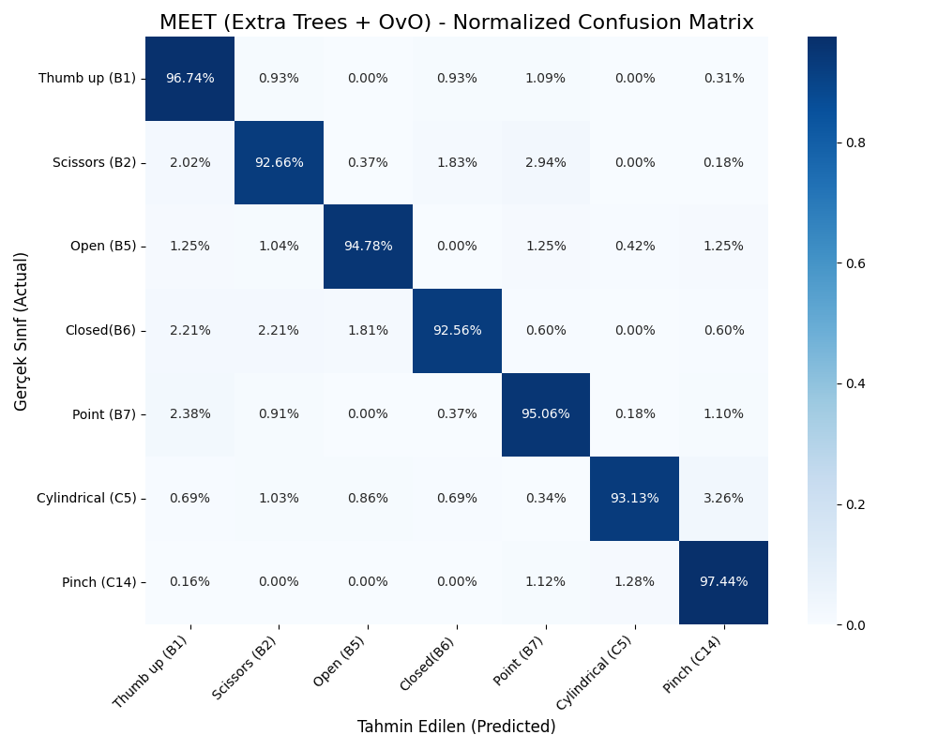
RESULTS
Results — NinaPro (6 Models)
MEET
94.74%
Random Forest
92.88%
SVM (RBF)
87.65%
MLP (1×128)
86.35%
KNN (k=5)
86.06%
1D CNN (raw)
~ 82.7%
MEET — above 92% on almost every class
Notes:
NinaPro: MEET 94.7% and RF 92.9% lead; SVM/MLP/KNN mid (86-88%); CNN last. The MEET matrix is very balanced.

Slide 25
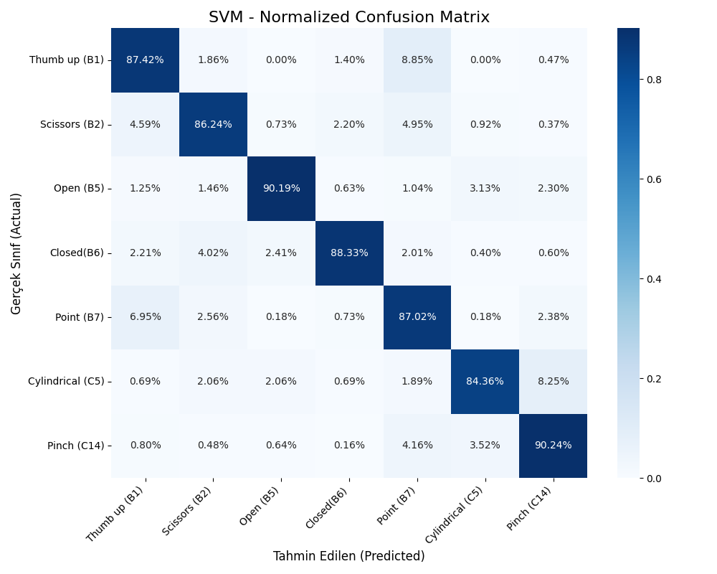

COMPARISON
NinaPro — SVM and RF Matrices
SVM — 87.65% overall; solid but below the ensembles
RF — 92.88% overall; strong on every class

Slide 26
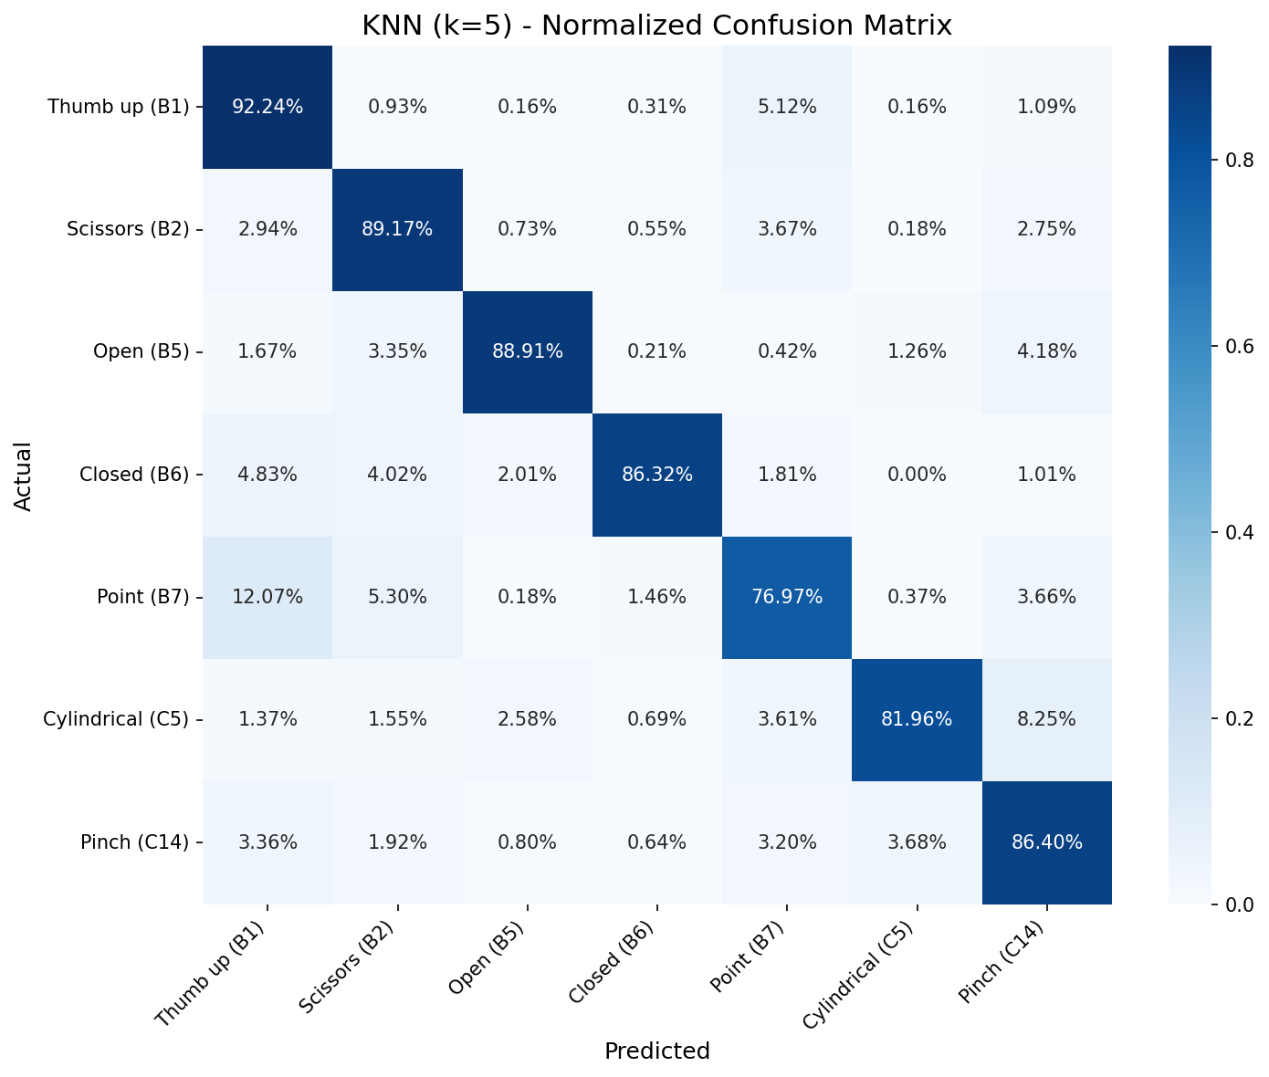

COMPARISON
NinaPro — KNN and MLP Matrices
KNN — Point/B7 is weakest (77%)
MLP — more balanced profile
Notes:
KNN is weak on Point in NinaPro (B1↔B7). MLP is more balanced and beats KNN on the hard classes.

Slide 27
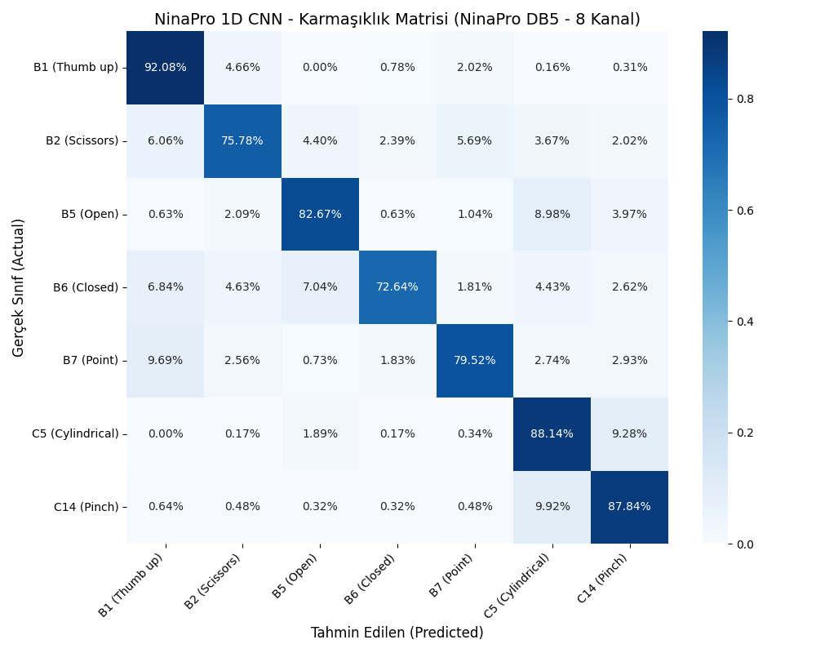
COMPARISON
NinaPro — CNN
CNN — ≈ 82.7% overall (raw 150×8); trails the classical models
Notes:
KNN is weak on Point in NinaPro (B1↔B7). MLP is more balanced and beats KNN on the hard classes.

Slide 28
COMPARISON
NinaPro — Detailed Comparison
INTERPRETATION
RF and MEET (ensemble/expert) are best by far
SVM ≈ MLP ≈ KNN mid-group (~86-88%)
CNN is last (~83%)
Good features make the classical models strong
Notes:
Ranking: MEET > RF > SVM > MLP > KNN > CNN. Ensemble/expert methods lead; with good features the classical models beat the CNN.

Slide 29
COMPARISON
NinaPro — Per-Class Accuracy
Gesture
SVM
RF
MEET
KNN
MLP
Thumb up (B1)
87.4
93.9
96.7
92.2
91.9
Scissors (B2)
86.2
91.9
92.7
89.2
85.9
Open (B5)
90.2
94.6
94.8
88.9
86.2
Closed (B6)
88.3
89.9
92.6
86.3
83.3
Point (B7)
87.0
92.0
95.1
77.0
80.8
Cylindrical (C5)
84.4
90.4
93.1
82.0
85.4
Pinch (C14)
90.2
96.8
97.4
86.4
89.3
Values are % accuracy (recall). MEET leads on every class; KNN's weakest is Point (77%).
Notes:
Per-class accuracies of the six models. MEET is best on every class. KNN is weak on Point (B1↔B7). Detailed comparison in this table.

Slide 30
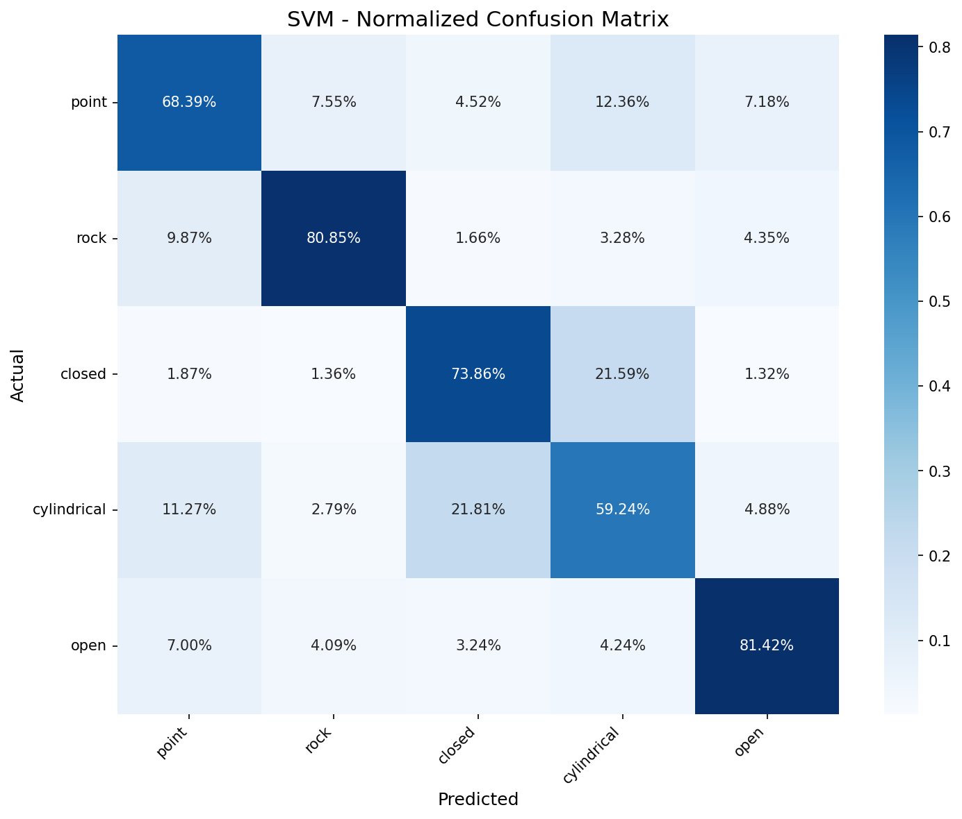
RESULTS
Results — Custom Data
Five feature-based models sit in a narrow ~70–73% band. The 1D CNN — retrained on the raw 2-channel signal instead of the 8 hand-crafted features — breaks out to ~92.5% and even resolves the cylindrical↔closed confusion that limits every feature model.
1D CNN (raw)
92.5%
Random Forest
72.98%
MLP (1×128)
72.92%
SVM (RBF)
72.75%
MEET
72.46%
KNN (k=5)
69.68%
Notes:
Custom data (no tip, 5 classes, 6 models): all ~70-73%, KNN 70%. The CNN (72.6%) is on par with the classical models. Cylindrical–closed is the common bottleneck.

Slide 31
COMPARISON
Effect of Removing Cylindrical
Removing cylindrical lifts every FEATURE-BASED model by ~+10 points (they cannot separate cylindrical↔closed). The raw-signal CNN is the exception: it already separates cylindrical (94%), so dropping it changes almost nothing.
Model
5 classes (with cyl)
4 classes (without cyl)
Change
KNN (k=5)
69.68%
81.50%
+11.8
MLP (1×128)
72.92%
83.21%
+10.3
1D CNN (raw)
92.5%
92.6%
≈ 0
SVM / RF / MEET
~ 73%
~ 83%
~+10
'closed' recall: KNN 72.5% → 89.4% · MLP 74.4% → 91.4% (feature models need cyl removed).
Raw CNN already reaches closed 90.4% → 97.7% and cylindrical 94% with cyl still in.
Notes:
Removing cylindrical (4 classes): KNN +11.8, MLP +10.3 points; the closed class jumps to ~89-91%. SVM/RF/MEET similar (~83%). The issue is the physical limit of 2 channels.

Slide 32
COMPARISON
Custom Data — 6-Model Comparison (with cyl)
INTERPRETATION
Five feature-based models cluster at ~70–73%
The raw-signal 1D CNN stands apart at ~92.5%
Same 2-channel data — the raw representation, not more channels, unlocks the gain
Notes:
On the custom data (no tip) all five models are ~70-73%; the difference is small. The ceiling is ~73% due to the channel limit. Common problem: cylindrical–closed.

Slide 33
COMPARISON
Custom Data — Per-Class Accuracy (with cyl)
Gestures
SVM
RF
MEET
KNN
MLP
CNN
point
68.4
68.5
69.1
68.6
67.4
89.2
rock
80.9
82.2
81.3
78.5
82.5
92.9
closed
73.9
74.3
75.6
72.5
74.4
90.4
cylindrical
59.2
57.4
55.2
50.9
58.2
94.1
open
81.4
82.5
81.1
77.9
82.1
96.2
For the five feature models the cylindrical row is lowest (~51–61%) — their bottleneck. The raw CNN lifts cylindrical to 94.1% — the opposite pattern.
Notes:
Per-class (with cyl, no tip): all six models (incl. CNN). Cylindrical is lowest in every model (~51-61%). This bottleneck lowers overall accuracy.

Slide 34
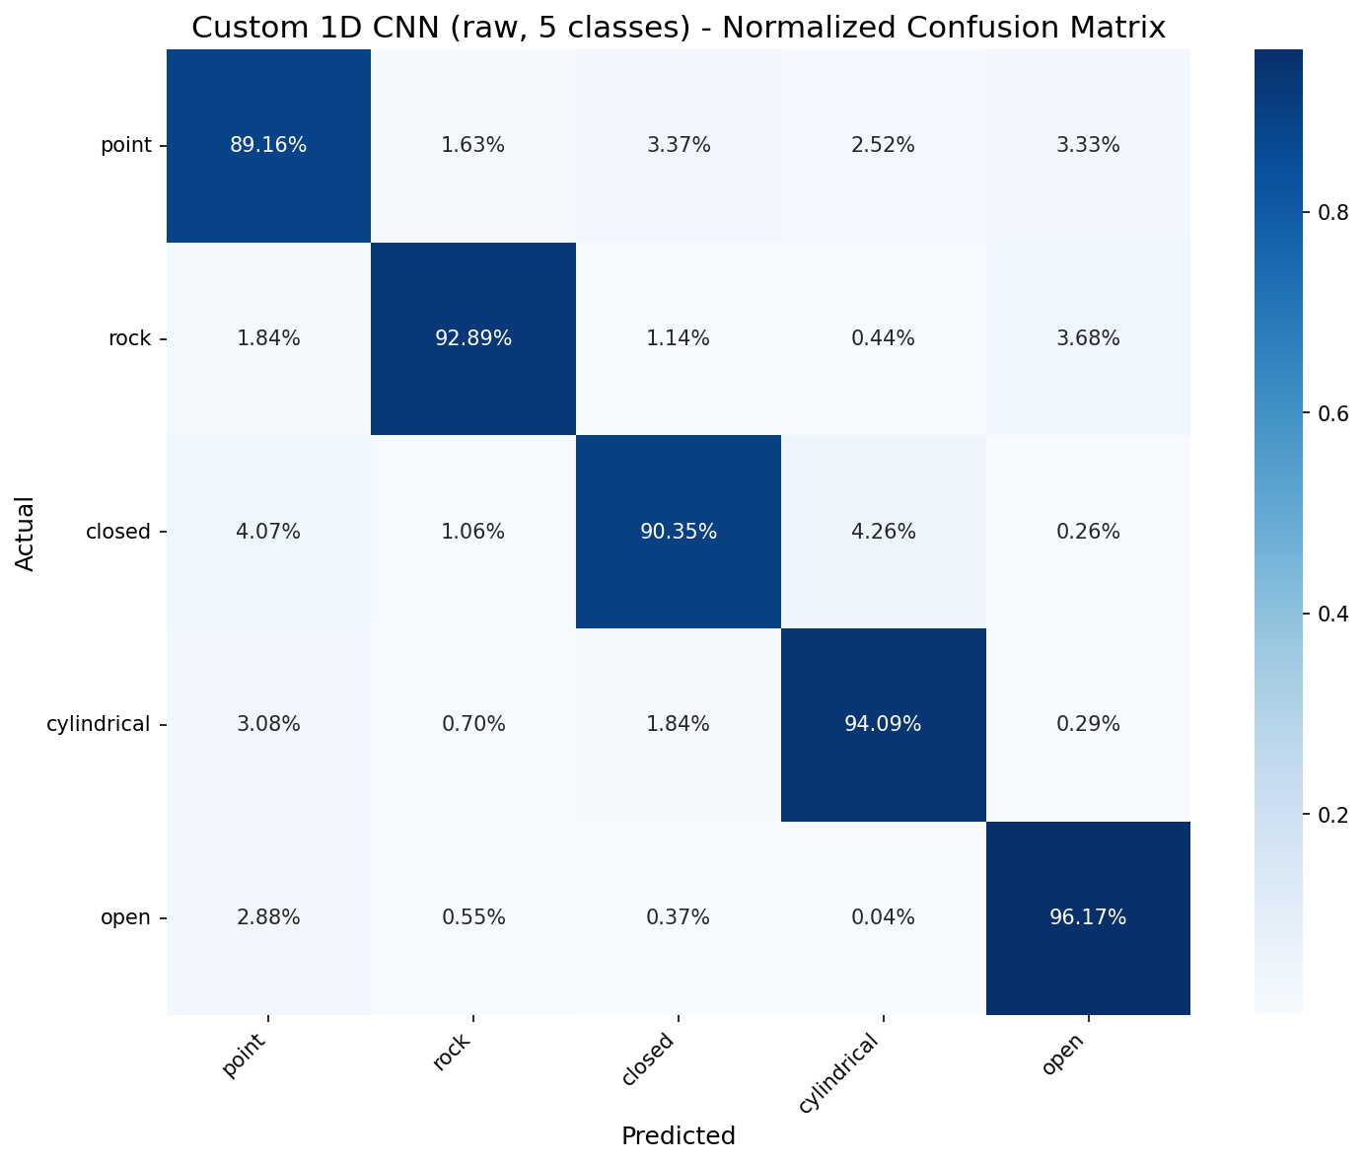
RESULT
Custom Raw CNN — The Breakthrough
Retrained on the raw 150×2 signal, the CNN reaches ≈92.5% (5 classes) — about +20 points over every feature-based model — and raises cylindrical recall from ~55% to 94%.
Per-class recall (raw CNN)
point 89.2% rock 92.9%
closed 90.4% open 96.2%
cylindrical 94.1% ← was ~55% with features
Feature-based models (SVM/RF/MEET/KNN/MLP): ~70–73%
Same 2 channels — a richer (raw) representation, not
more electrodes, delivers the jump.
Custom 1D CNN — raw 150×2, 5 classes · overall ≈ 92.5%

Slide 35
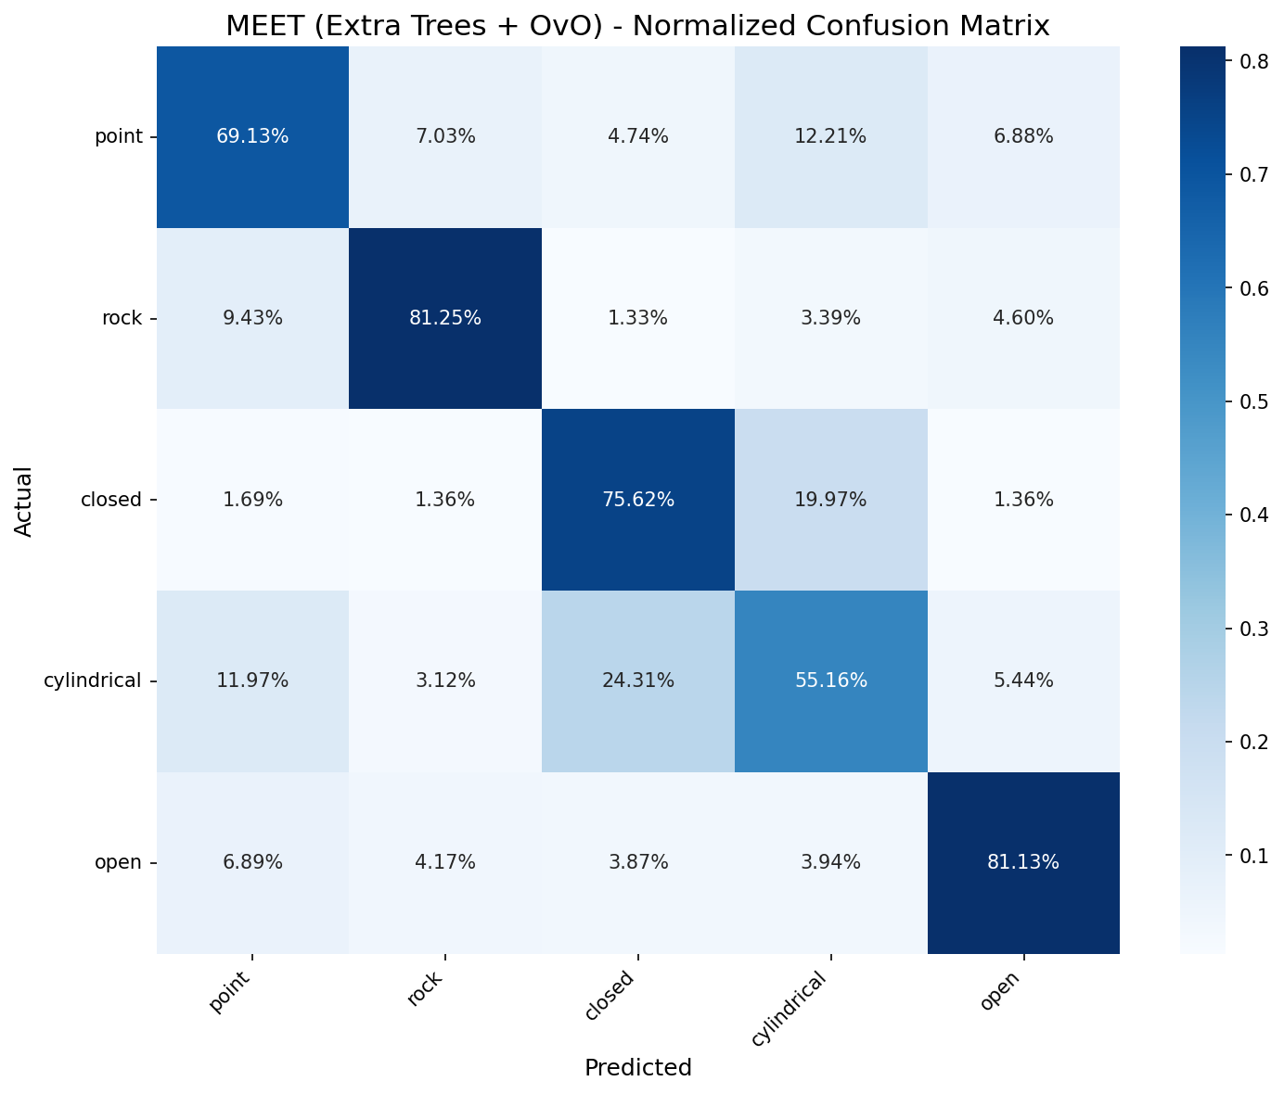
COMPARISON
Custom Data — SVM and MEET Matrices (with cyl)
SVM — cylindrical 59.24%
MEET — cylindrical 55.16%
Notes:
KNN/MLP matrices with cyl: the cylindrical row is low and mixes with closed.

Slide 36
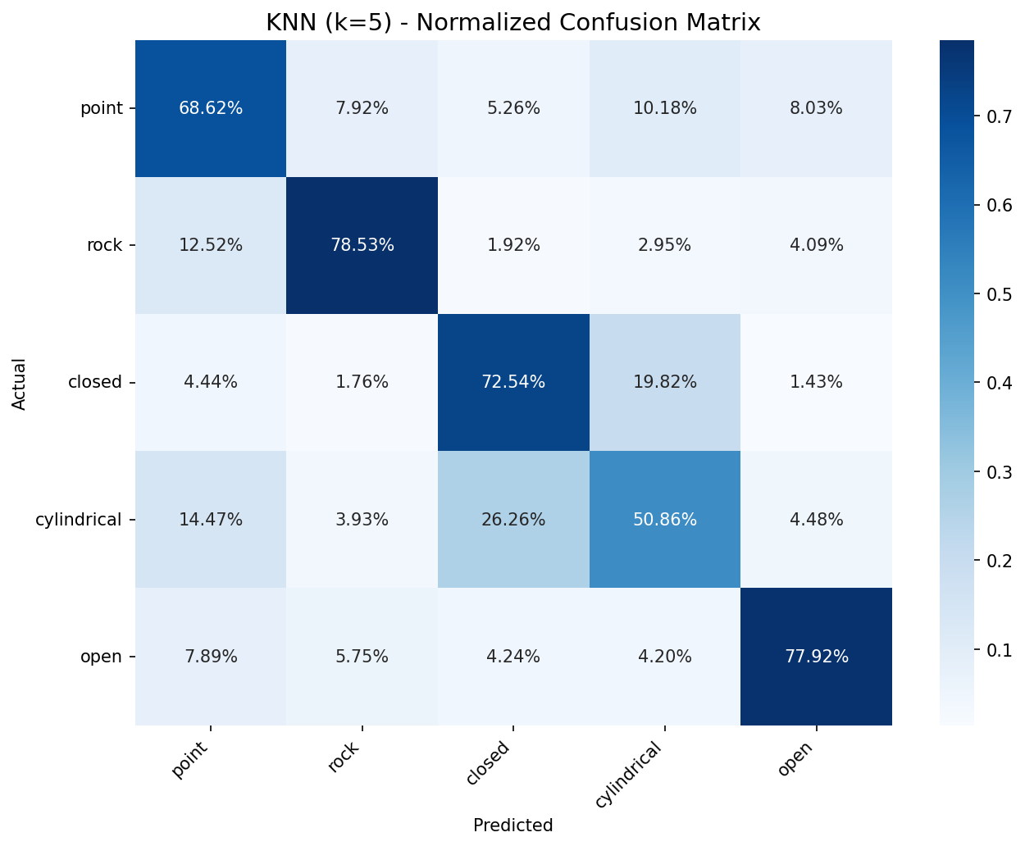
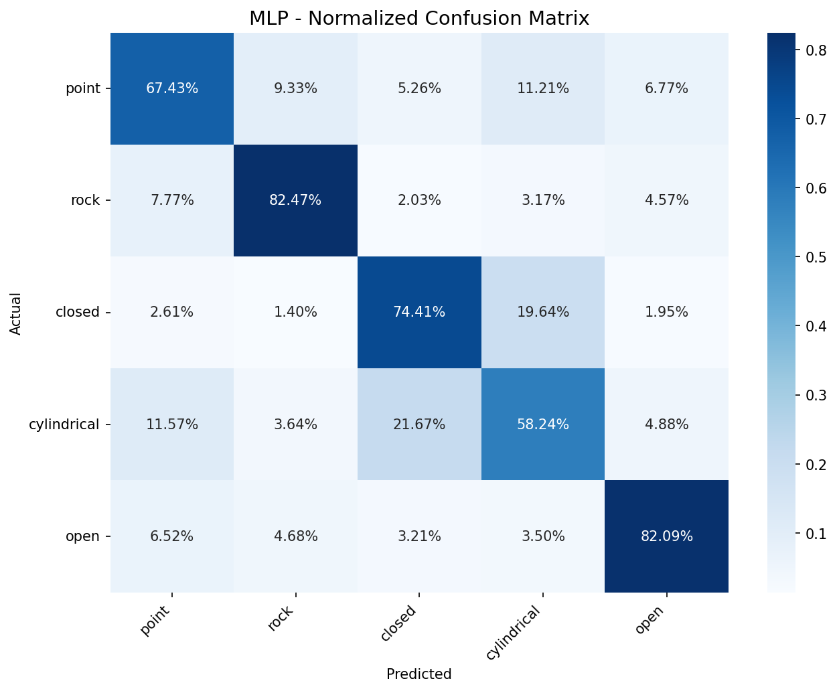
COMPARISON
Custom Data — KNN and MLP Matrices (with cyl)
KNN — cylindrical 50.9%
MLP — cylindrical 58.2%
Notes:
KNN/MLP matrices with cyl: the cylindrical row is low and mixes with closed.

Slide 37

COMPARISON
Custom Data — Random Forest Matrix (with cyl)
Random Forest — cylindrical 57.4%
Notes:
KNN/MLP matrices with cyl: the cylindrical row is low and mixes with closed.

Slide 38
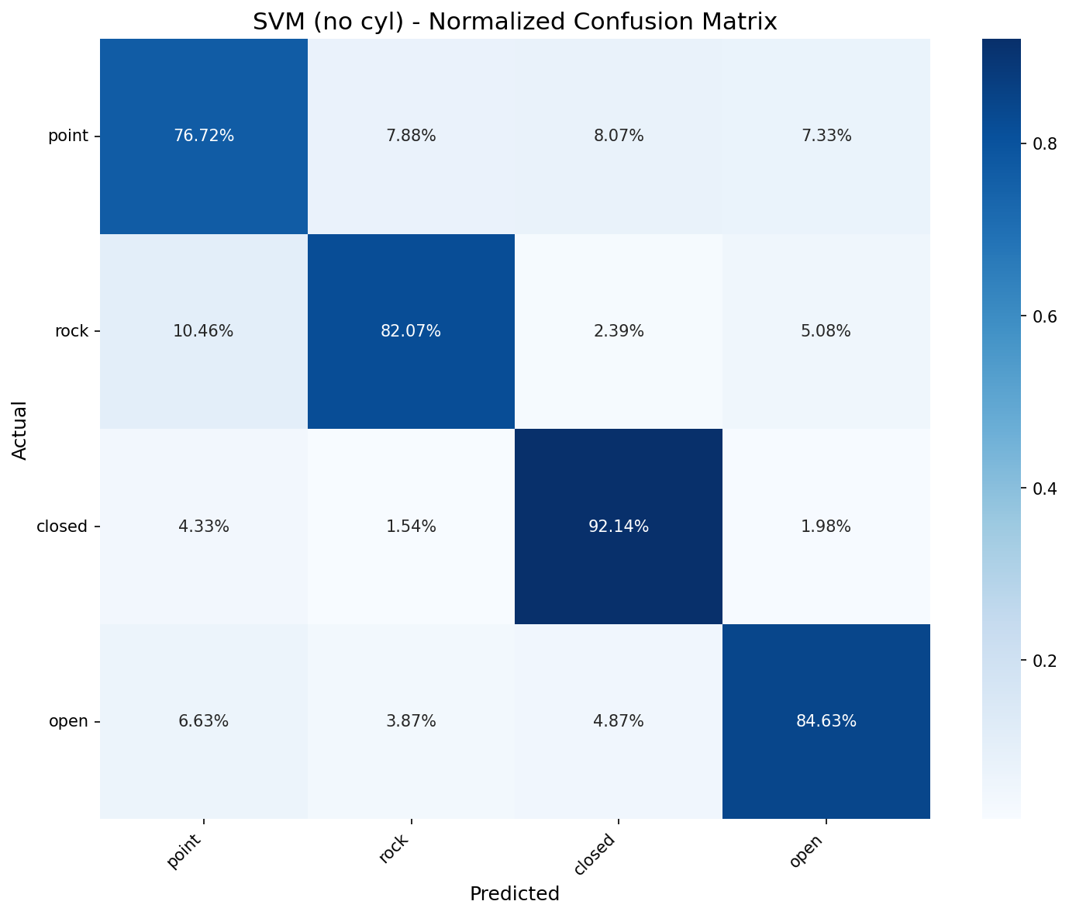

COMPARISON
Custom Data — SVM and MEET Matrices (without cyl)
SVM — 'closed' rises to 92.14%
MEET — 'closed' rises to 92.14%
Notes:
KNN/MLP matrices without cyl: the closed class rises to ~89-90%, the confusion is largely resolved.

Slide 39


COMPARISON
Custom Data — KNN and MLP Matrices (without cyl)
KNN — 'closed' rises to 89.35%
MLP — 'closed' rises to 91.45%
Notes:
KNN/MLP matrices without cyl: the closed class rises to ~89-90%, the confusion is largely resolved.

Slide 40

COMPARISON
Custom Data — Random Forest Matrix (without cyl)
Random Forest — 'closed' rises to 91.85%
Notes:
KNN/MLP matrices without cyl: the closed class rises to ~89-90%, the confusion is largely resolved.

Slide 41
INTERPRETATION
Comparative Analysis
Why NinaPro ≫ Custom data?
With hand-crafted features, yes — 8 channels separate similar grips far better than 2. But a raw-signal CNN closes most of the gap on the 2-channel data (≈ 92.5%).
Why are MEET / RF best?
Ensemble and One-vs-One expert structures separate hard pairs sharply and reduce variance.
MLP vs KNN?
The MLP competes with the classical models via its flexible boundary; KNN, being distance-based, is most fragile to overlap.
When does the raw CNN win?
On the 2-channel custom data it wins decisively (≈92.5% vs ~73%), recovering the cylindrical detail the features discard. On 8-channel NinaPro the features already suffice, so RF/MEET lead and the CNN trails.
Notes:
Analysis: channel count is the main factor; ensemble/expert best; MLP competitive, KNN fragile to overlap; with good features the classical models beat the CNN.

Slide 42
NEXT STEPS
Challenges and Improvement Suggestions
Challenges Faced
Recommendations
Cylindrical ↔ closed confusion (main bottleneck) (resolved by the raw CNN)
Spatial-information limit of 2 channels
Increase channel count
More subjects → generalization
Add frequency-domain features
Optimize CNN for Nina Pro
Notes:
Challenges: cylindrical confusion, channel limit, reproducibility/code organization (fixed). Recommendations: more channels, more subjects, frequency features, k-fold CV, hyperparameters.

Slide 43
CONCLUSION
MEET and Random Forest lead on 8-channel sEMG (> 92%);
on the 2-channel data the raw-signal 1D CNN leads (≈ 92.5%)
Well-designed time-domain features make the classical models strong on rich 8-channel data. But on the 2-channel data the ~73% plateau was a limit of the features, not of the channels: a CNN trained on the raw signal reaches ≈ 92.5% and lifts cylindrical from ~55% to 94%. Takeaway — with few channels, learning from the raw signal beats hand-crafted features.
Thank you • Questions?
Notes:
Conclusion: MEET/RF lead (>92%), good features make the classical models strong, MLP competitive, KNN basic. The custom-data limit is channel count. Thank you.

Slide 44
REFERENCES
References
1. MEET model — Gehlot, N., Jena, A., Kumar, R., Bukya, M. (2024). MEET: Mixture of Experts Extra Tree-Based sEMG Hand Gesture Identification. arXiv:2405.09562.
2. NinaPro database — Atzori, M. et al. (2014). Electromyography data for non-invasive naturally-controlled robotic hand prostheses. Scientific Data 1:140053. — ninapro.hevs.ch
3. NinaPro DB5 — Pizzolato, S. et al. (2017). Comparison of six EMG acquisition setups on hand movement classification tasks. PLoS ONE 12(10):e0186132.
4. Time-domain features (RMS/MAV/WL/SSC) — Hudgins, B., Parker, P., Scott, R. N. (1993). A new strategy for multifunction myoelectric control. IEEE Trans. Biomed. Eng. 40(1):82–94.
5. Random Forest — Breiman, L. (2001). Random Forests. Machine Learning 45(1):5–32.
6. Extra Trees — Geurts, P., Ernst, D., Wehenkel, L. (2006). Extremely randomized trees. Machine Learning 63(1):3–42.
7. scikit-learn (SVM, RF, ET, KNN, MLP) — Pedregosa, F. et al. (2011). Scikit-learn: Machine Learning in Python. JMLR 12:2825–2830.
8. Kaya, Z. E. (2019). Eksik Tahrikli El Protezi Geliştirme Platformu Tasarımı ve Yapay Sinir Ağları Tabanlı Denetimi. Doktora Tezi, Hacettepe Üniversitesi.
Notes:
References: MEET (Gehlot 2024), NinaPro (Atzori 2014 / DB5 Pizzolato 2017), time-domain features (Hudgins 1993), Random Forest (Breiman 2001), Extra Trees (Geurts 2006), scikit-learn (Pedregosa 2011).

