Slide 1
AI-BASED CLASSIFICATION OF EMG SIGNALS FOR
Hand Gesture Recognition Analysis
sEMG • Feature Engineering • SVM · Random Forest · MEET · 1D CNN
Burak Talha Güçlü | MSc Thesis Work
Notes:
Introduction: This talk presents an AI-based study on recognizing hand gestures from surface EMG. We cover two datasets, four models, and a structured comparison. Target duration ~25 minutes.

Slide 2
AGENDA
Presentation Outline
1
EMG signals & motivation
2
Datasets
3
Hand gestures
4
Signal preprocessing
5
Features (RMS/MAV/WL/SSC)
6
Models: SVM · RF · MEET · CNN
7
Evaluation methodology
8
Results & comparison
9
Challenges faced
10
Improvement recommendations
Notes:
Agenda: start with the signal and motivation, detail data, features and models, then compare results and finish with challenges and recommendations.

Slide 3
BACKGROUND
What Is a Surface EMG Signal?
Surface EMG (sEMG) electrodes on the forearm measure the electrical activity generated when muscles contract. Different hand gestures activate different muscle groups, producing distinguishable signal patterns.
KEY IDEA
Rather than feeding the raw waveform directly, we slice it into short windows and compute compact descriptors of muscle activity. A classifier then maps these descriptors to a gesture.
Non-invasive, real-time, low-cost sensing
Signal is noisy and varies across people and trials
Raw waveform is high-dimensional → summarized by features
Time-domain features are cheap and effective for gestures
Notes:
EMG basics: surface electrodes read muscle electrical activity. The signal is noisy and variable, so we window it and extract compact features rather than using the raw waveform directly.

Slide 4
PROBLEM & MOTIVATION
Why EMG Hand-Gesture Recognition?
Decoding which gesture a person performs from forearm muscle signals enables natural, hands-free control — central to several real-world applications.
CORE CHALLENGE
EMG varies between people and even between trials.
Similar power grips (cylindrical ↔ closed) produce very close muscle activation.
So the choice of discriminative features and the right model is decisive.
Prosthetic hand control
Natural control for amputees
Rehabilitation
Muscle-activation tracking & therapy
Human–machine interface
Touchless commands & interaction
Notes:
Motivation: prosthetics, rehab, and HMI. The core challenge is signal variability and the confusion between similar grips — this drives every design decision in the study.

Slide 5
OVERVIEW
Objective and Processing Pipeline
Goal: compare classical machine learning with deep learning on two different EMG datasets, using one identical pipeline for a fair comparison.
1
2
3
4
5
6
›
›
›
›
›
Raw EMG
Windowing
Features
Scaling
Model
Evaluation
.mat signals
150 ms windows
RMS·MAV·WL·SSC
StandardScaler
SVM·RF·MEET·CNN
Accuracy + matrix
The same pipeline is applied to both datasets and all four models → an apples-to-apples comparison.
Notes:
Pipeline: from raw signal through windowing, features, scaling, model, and evaluation — held constant so the models can be compared fairly.

Slide 6
DATASETS
Two Complementary Datasets
NinaPro DB5
Custom (Ecem & Selman)
Open-source benchmark database
Low-cost 2-channel recording
Channels
8 (Myo armband)
Channels
2
Subjects
S1, S2, S5, S10
Subjects
Ecem, Selman
Gestures
7 classes
Gestures
6 classes
Sampling
200 Hz → 1000 Hz
Sampling
1000 Hz
Features
32 dims/window
Features
8 dims/window
Size
19,591 windows
Size
81,275 windows
Notes:
Two datasets: NinaPro is a rich 8-channel open benchmark; the custom set is our own 2-channel recording. This contrast lets us isolate the effect of channel count.

Slide 7
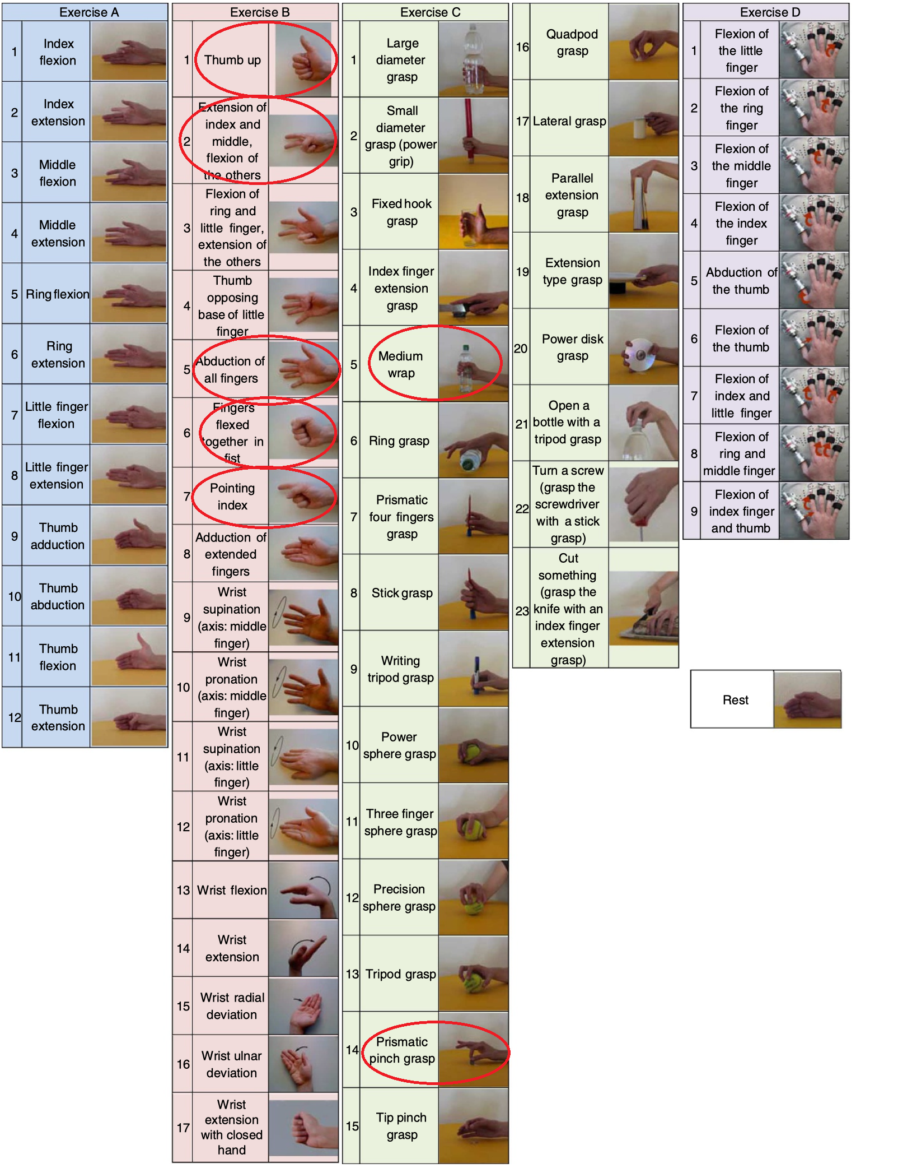
DATASET 1
NinaPro DB5 — Details
A standard sEMG benchmark. The first 8 channels of the forearm Myo armband are used. Since the raw signal is 200 Hz, it is upsampled to 1000 Hz to increase temporal resolution.
8
4
7
19,591
EMG channels
subjects
gestures
windows
Why NinaPro? Standard, reproducible and multi-subject; it makes results comparable with the literature.
Notes:
NinaPro DB5: 8 channels, 4 subjects, 7 gestures, upsampled 200→1000 Hz. Being a standard database makes results comparable with published work.

Slide 8
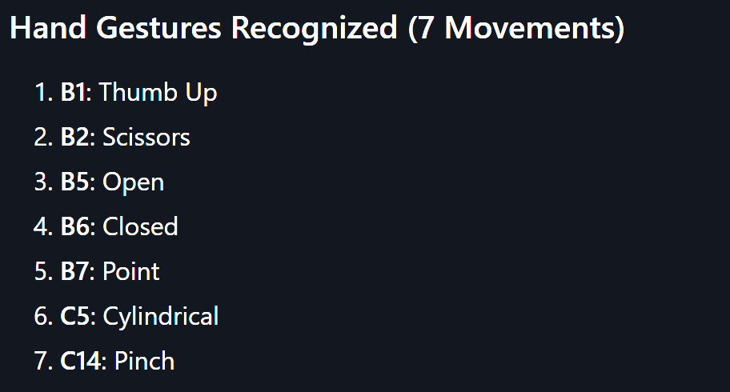
DATASET 2
Custom Dataset — Ecem & Selman
Collected from two subjects with a low-cost 2-channel setup. Signals are stored per channel (ch1, ch2) for each gesture, across four raw .mat files.
2
2
6
81,275
EMG channels
subjects
gestures
windows
Limitation: only 2 channels → limited spatial information to separate similar grips. This is the main reason behind later performance gaps.
Notes:
Custom set: our own 2-channel recording, 6 gestures, 81k windows. The 2-channel limit is the root cause of the cylindrical-vs-closed confusion later.

Slide 9
GESTURES
Selected Hand Gestures — NinaPro (7)
B1
Thumb up
B2
Scissors
B5
Open hand
B6
Closed hand / fist
B7
Point
C5
Cylindrical grip
C14
Pinch / fine grip
Standard B- and C-series movements from the NinaPro protocol; labels 0–6.
Notes:
NinaPro gestures: five B-series (thumb up, scissors, open, closed, point) and two C-series (cylindrical, pinch), from the standard protocol.

Slide 10
GESTURES
Selected Hand Gestures — Custom (6)
0
point
1
tip (fingertip)
2
rock sign
3
closed / fist
4
cyl — cylindrical grip
5
open hand
Note: the 'cyl' (cylindrical) gesture is the most-confused class in this 2-channel set — detailed in the results.
Notes:
Custom gestures: six classes. Cylindrical is highlighted because it becomes the most problematic class in the results.

Slide 11
METHOD
Signal Preprocessing
NinaPro
Custom
Select the repetitions of each gesture
Upsample 200 Hz → 1000 Hz (×5 resample)
150-sample (150 ms) sliding window
30-sample step → 80% overlap
Output: 32-dim feature CSV + raw (150×8) CNN tensor
Onset detection: mean |amplitude| > 435 over a 40 ms window
150 ms windows from the onset
30 ms step → 80% overlap
Per window: 2 channels × 4 features = 8
Output: custom_dataset.csv
Notes:
Preprocessing: 150 ms windows with 80% overlap for both. NinaPro is upsampled; the custom set uses an onset detector to find the start of muscle activation.

Slide 12
FEATURES
Feature Extraction — Time Domain
Four classic time-domain features per channel. At low compute cost they jointly summarize the amplitude and frequency character of muscle activity.
RMS
MAV
WL
SSC
Root Mean Square
Mean Absolute Value
Waveform Length
Slope Sign Changes
Total muscle power / energy
Signal amplitude / intensity
Signal complexity
Frequency-content estimator
Feature size = channels × 4 → NinaPro 8×4 = 32 | Custom 2×4 = 8
Notes:
Four features: RMS (power), MAV (amplitude), WL (complexity), SSC (frequency). Standard, cheap, effective. Dimensionality is driven by channel count: 32 vs 8.

Slide 13
FEATURES
Why Hand-Crafted Time-Domain Features?
Extremely cheap to compute → suitable for real-time / embedded prosthetics
Robust to the small shifts and noise typical of surface EMG
Well established in the sEMG literature for gesture recognition
Compress a 150-sample window into 4 numbers per channel with little information loss
Let simple, data-efficient classifiers reach high accuracy without huge datasets
TAKEAWAY
Good features do much of the work. This is exactly why, later, classical models can match or beat a CNN that must learn everything from the raw signal.
Notes:
Time-domain features are cheap, robust, and literature-proven. They compress each window with little loss, which is why classical models stay competitive with deep learning here.

Slide 14
MODELS
Four Models Compared
SVM
Support Vector Machine
RF
Random Forest
RBF kernel; strong boundary in high-dim space
100-tree ensemble; robust to noise
MEET
Mixture of Experts Extra Trees
CNN
1D Convolutional Net
One-vs-One experts; separates similar pairs
Learns patterns automatically from signal
Notes:
Four models: two classical (SVM, RF), one expert-ensemble (MEET), and one deep model (CNN). The aim is to contrast feature-based classical ML with deep learning.

Slide 15
MODEL DETAIL
SVM and Random Forest
SVM (Support Vector Machine)
Random Forest
RBF (radial basis function) kernel
C = 10, gamma = 'scale'
Effective in high-dimensional feature spaces
Models non-linear decision boundaries
100 decision trees (n_estimators=100)
Unlimited max_depth
Robust to noise and overfitting
Also provides feature importance
Notes:
SVM: RBF kernel, C=10 — a well-performing classical setting for sEMG. Random Forest: 100 trees, robust to noise and gives feature importance.

Slide 16
MODEL DETAIL
MEET — Mixture of Experts Extra Trees
Idea: the multiclass problem is split into binary sub-problems using a One-vs-One strategy. A separate Extra Trees 'expert' is trained for every gesture pair.
WHY STRONG?
Instead of one model handling all classes at once, it uses specialized experts per pair. The hardest pairs are separated more cleanly — giving the most balanced and highest accuracy.
Base learner: Extra Trees (100 trees)
Strategy: One-vs-One — one expert per pair
Separates similar pairs (B1↔B7, C5↔C14) more sharply
Adapted from Xiong et al. (2024)
Notes:
MEET: a One-vs-One architecture with an Extra Trees expert per gesture pair. This is why it handles difficult pairs best and reaches the highest accuracy.

Slide 17
MODEL DETAIL
1D CNN — and Why Two Architectures?
NinaPro CNN (raw 150×8)
Custom CNN (8 features)
Input: raw time series (150 steps × 8 channels)
2× Conv1D (64/128) + BatchNorm + MaxPool
Large kernels (10, 5) → temporal patterns
Input: 8 feature values (8 × 1)
Small Conv1D(32,3) + Dense
No time axis → a tiny network suffices
Can one model do both? The same trained network can't take both (different input shape/channels). But a single parameterized function — build_cnn(input_shape, classes) — gives ONE codebase adapting to each shape.
Notes:
Two CNNs because inputs differ: NinaPro feeds a raw 150x8 time series, the custom set feeds 8 features. One trained model can't span both, but one parameterized builder function can unify the code.

Slide 18
METHODOLOGY
Evaluation Methodology
1
80% / 20% split
Stratified split preserving class balance
2
Scaling on train only
StandardScaler fit only on train → no leakage
3
Within- vs cross-subject
Same subjects / entirely unseen subjects (S1, S10)
4
Fixed seed (seed = 22)
Reproducibility across all models
5
Metrics
Accuracy, precision/recall/F1, normalized confusion matrix
Notes:
Evaluation: stratified 80/20, scaling fit only on train, within- and cross-subject regimes, fixed seed 22, and normalized confusion-matrix metrics.

Slide 19
METHODOLOGY
Within-Subject vs Cross-Subject
Within-subject
Cross-subject
Train and test data share the same subjects
Random 80/20 split over the S2+S5 pool
Measures accuracy on familiar users
Train on S2, S5 — test on unseen S1, S10
Scaler fit on training subjects only
Measures true generalization to new users
Optimistic estimate — the model has 'seen' each user.
Harder and more realistic — the real deployment scenario.
Notes:
Two regimes: within-subject is optimistic (same users in train and test); cross-subject trains on some subjects and tests on completely new ones — the realistic, harder generalization test.

Slide 20
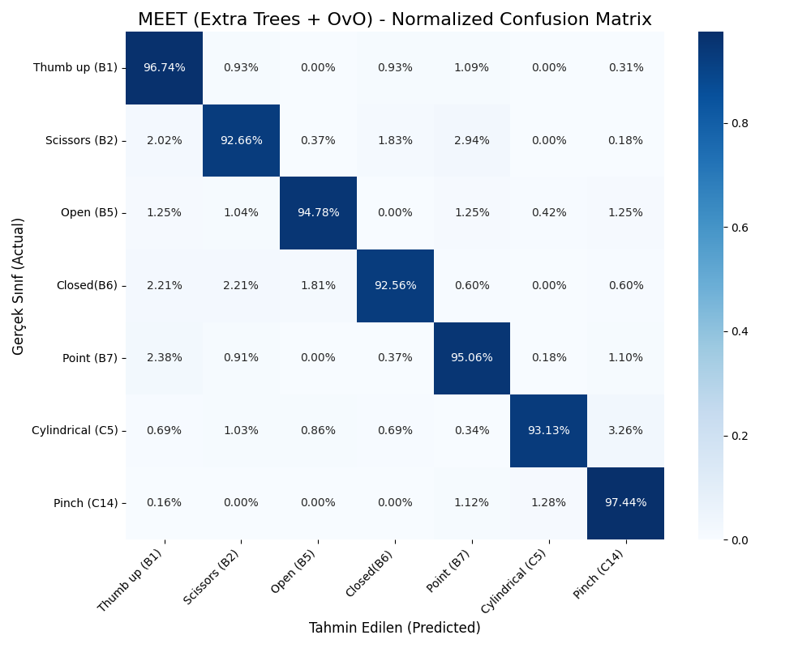
RESULTS
Results — NinaPro DB5 (8 channels)
MEET (Extra Trees + OvO)
> 94.74%
Random Forest
92.88%
SVM (RBF)
87.65%
1D CNN (raw)
~ 82.7%
MEET confusion matrix — above 92% on almost every class
Notes:
NinaPro results: MEET >94.7% is best, RF 92.9%, SVM 87.7%, CNN ~82.7%. The MEET matrix shows every class above 92% — very balanced. Ranking: MEET > RF > CNN ≈ SVM.

Slide 21
RESULTS
NinaPro — Model Comparison
INTERPRETATION
MEET and RF, the feature-based classical methods, scored highest
CNN lagged despite learning from the raw signal
At this data scale, hand-crafted features (RMS/MAV/WL/SSC) are more discriminative than raw
Hardest pairs: B1↔B7 and C5↔C14
Notes:
The bar chart shows model accuracies. Key point: with good features, classical models beat the CNN at this data scale. Hardest pairs are thumb-up/point and cylindrical/pinch.

Slide 22
RESULTS
NinaPro — Per-Class Accuracy
Gesture
SVM
Random Forest
MEET
Main confusion
Thumb up (B1)
87.4%
93.9%
96.7%
B7 (Point)
Scissors (B2)
86.2%
91.9%
92.7%
B7 (Point)
Open (B5)
90.2%
94.6%
94.8%
—
Closed (B6)
88.3%
89.9%
92.6%
B2, B5
Point (B7)
87.0%
92.0%
95.1%
B1 (Thumb up)
Cylindrical (C5)
84.4%
90.4%
93.1%
C14 (Pinch)
Pinch (C14)
90.2%
96.8%
97.4%
B7, C5
MEET leads on every class; C5↔C14 and B1↔B7 remain the only notable confusions.
Notes:
Per-class table: MEET is best in every single class. The remaining confusions are cylindrical/pinch and thumb-up/point — physiologically similar movements.

Slide 23
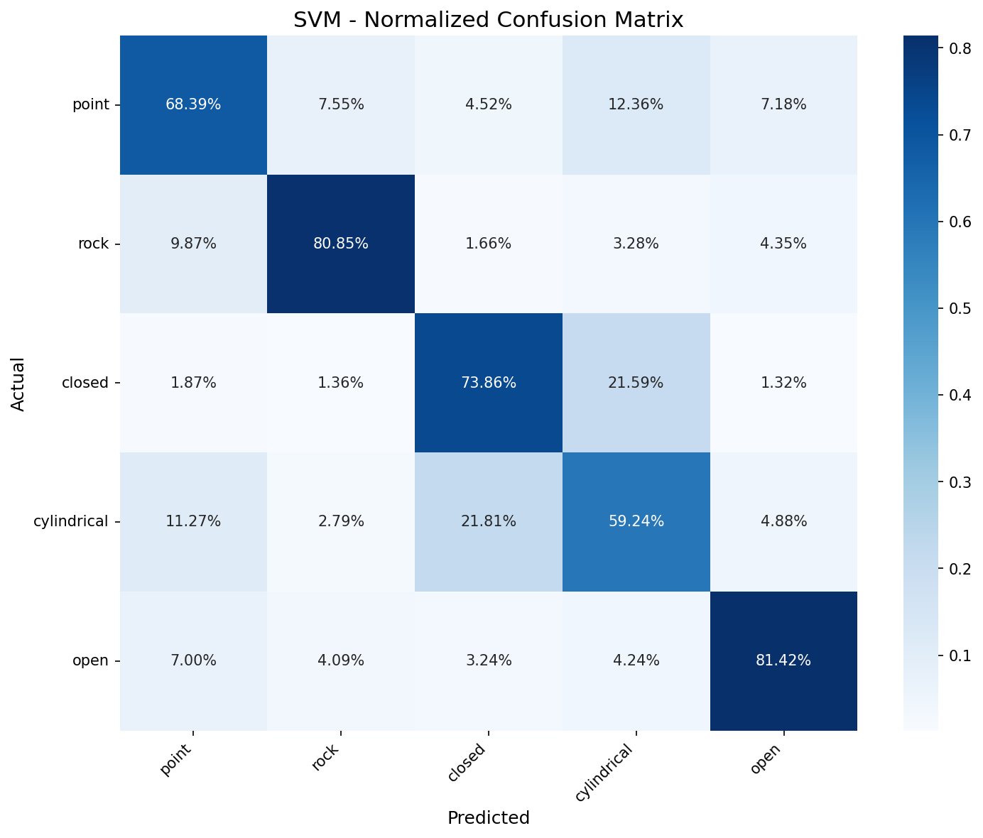
RESULTS
Results — Custom Data (2 channels)
All three classical models stalled at ~71%. The confusion matrix shows why: heavy cylindrical ↔ closed mixing.
SVM
71.19%
Random Forest
71.63%
MEET
70.93%
Remove cylindrical: 'closed' accuracy jumps 73.6% → 91.8%, overall ~80%. The problem isn't the model — it's one inseparable class.
Notes:
Custom results: all ~71%. The matrix shows dominant cylindrical-closed mixing (cylindrical only 57%). Removing cylindrical lifts closed to 92% and overall to ~80% — the issue is one class not separable with 2 channels.

Slide 24
RESULTS
Custom — Effect of Removing 'Cylindrical'
Dropping the single inseparable class (5-class setup) sharply improves the rest — proof that the low score came from one class, not weak models.
Gesture
6-class (with cyl)
5-class (no cyl)
Change
point
67.0%
74.2%
+7.2
tip
75.0%
76.1%
+1.1
rock
76.1%
79.2%
+3.1
closed
73.6%
91.8%
+18.2
open
75.0%
77.1%
+2.1
cylindrical
57.3%
removed
—
The 'closed' gesture gains +18 points once cylindrical is gone — they were the confused pair.
Notes:
Removing cylindrical: closed gains 18 points, others improve modestly, overall ~80%. This isolates the confusion and proves models were fine — the 2-channel setup just can't separate cylindrical from closed.

Slide 25
DISCUSSION
Comparative Analysis
Why NinaPro ≫ Custom?
8 channels give the spatial resolution needed to separate similar grips; 2 channels do not. The ~24-point gap is largely channel count.
Why is MEET best?
One-vs-One experts separate hard pairs (B1↔B7, C5↔C14) sharply; Extra Trees reduces variance → balanced, high accuracy.
Why did the CNN lag?
At this data scale, hand-crafted features already summarize muscle activity tightly, so the CNN's raw-signal advantage is limited.
Notes:
Three takeaways: channel count is the main performance driver; MEET's expert architecture wins on hard pairs; and good features let classical models beat the CNN at this scale.

Slide 26
EXPERIENCE
Challenges Faced
!
Cylindrical ↔ closed mixing
!
Channel-count ceiling
Similar power grips inseparable with 2 channels; the main factor lowering accuracy.
Limited spatial info in the custom set → low performance ceiling.
!
The 'tip' experiment
!
Reproducibility & code order
A separate branch was created to remove one gesture and measure its effect.
Different seeds (42/22), duplicated code and a messy repo → fixed with a shared module + fixed seed.
Notes:
Challenges: cylindrical-closed mixing, the channel-count ceiling, the tip-removal experiment on a branch, and code-side issues (seed mismatch, duplication) fixed with a shared module and fixed seed.

Slide 27
NEXT STEPS
Improvement Recommendations
Increase channel count
Collect more subjects
1
2
4–8 channels in the custom rig → highest-return fix for cyl/closed
Improves generalization and cross-subject performance
Frequency-domain features
k-fold cross-validation
3
4
Mean/median frequency, power spectrum → separate similar grips
Instead of a single split → more reliable, defensible accuracy
Hyperparameter search
Data augmentation for CNN
5
6
Fine-tune SVM (C, gamma) and tree counts
Jitter/scaling + deeper model → strengthen learning from raw
Notes:
Recommendations: the highest-return step is more channels. Also more subjects, frequency-domain features, k-fold CV, hyperparameter search, and CNN data augmentation.

Slide 28
CONCLUSION
With well-designed time-domain features + MEET,
hand gestures are recognized at > 94% on 8-channel sEMG
The lower score on the custom data is not a model weakness but the physical limit of 2 channels — proven by the accuracy jump when cylindrical is removed. The highest-return next step is adding channels.
Thank you • Questions?
Notes:
Conclusion: MEET plus good features give >94% on 8 channels. The custom-data limit is channel count. The most impactful next step is more channels. Thank you — happy to take questions.

