Slide 1
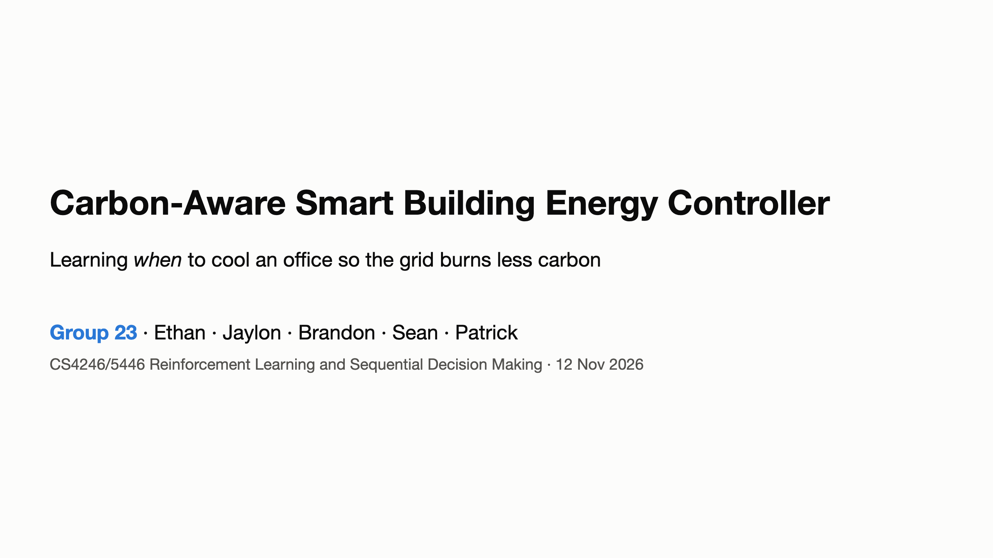

Slide 2
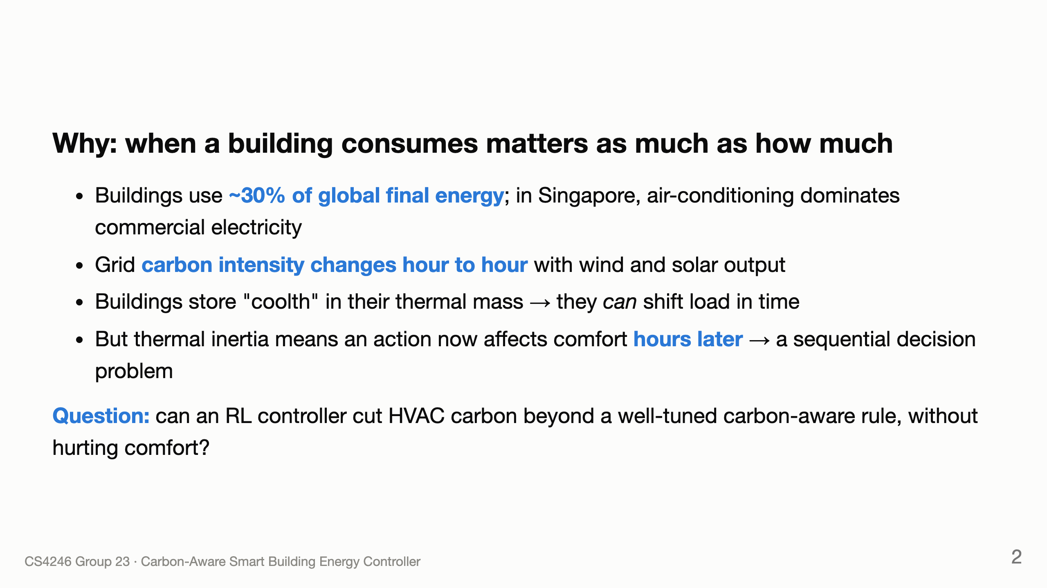
Notes:
Patrick

Slide 3
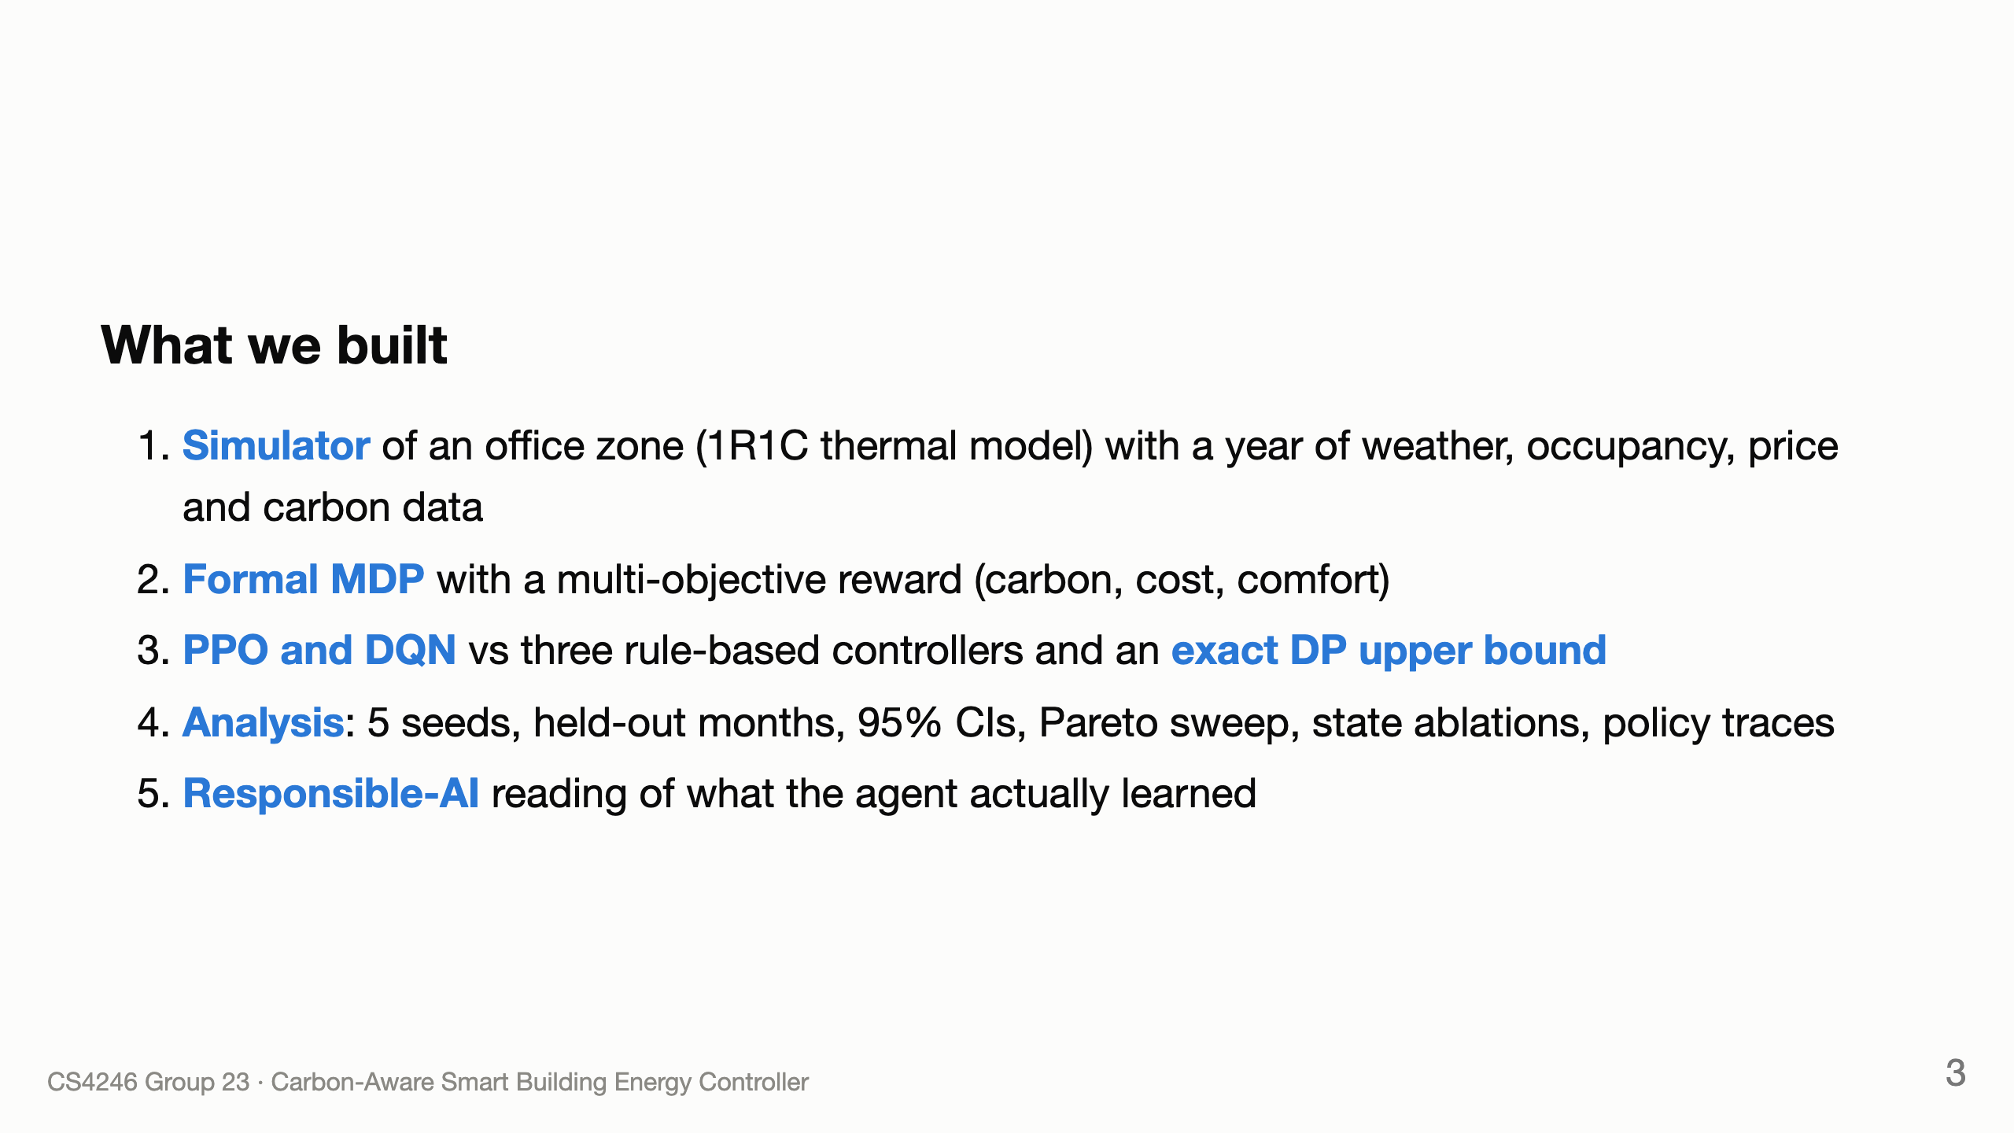
Notes:
Patrick

Slide 4
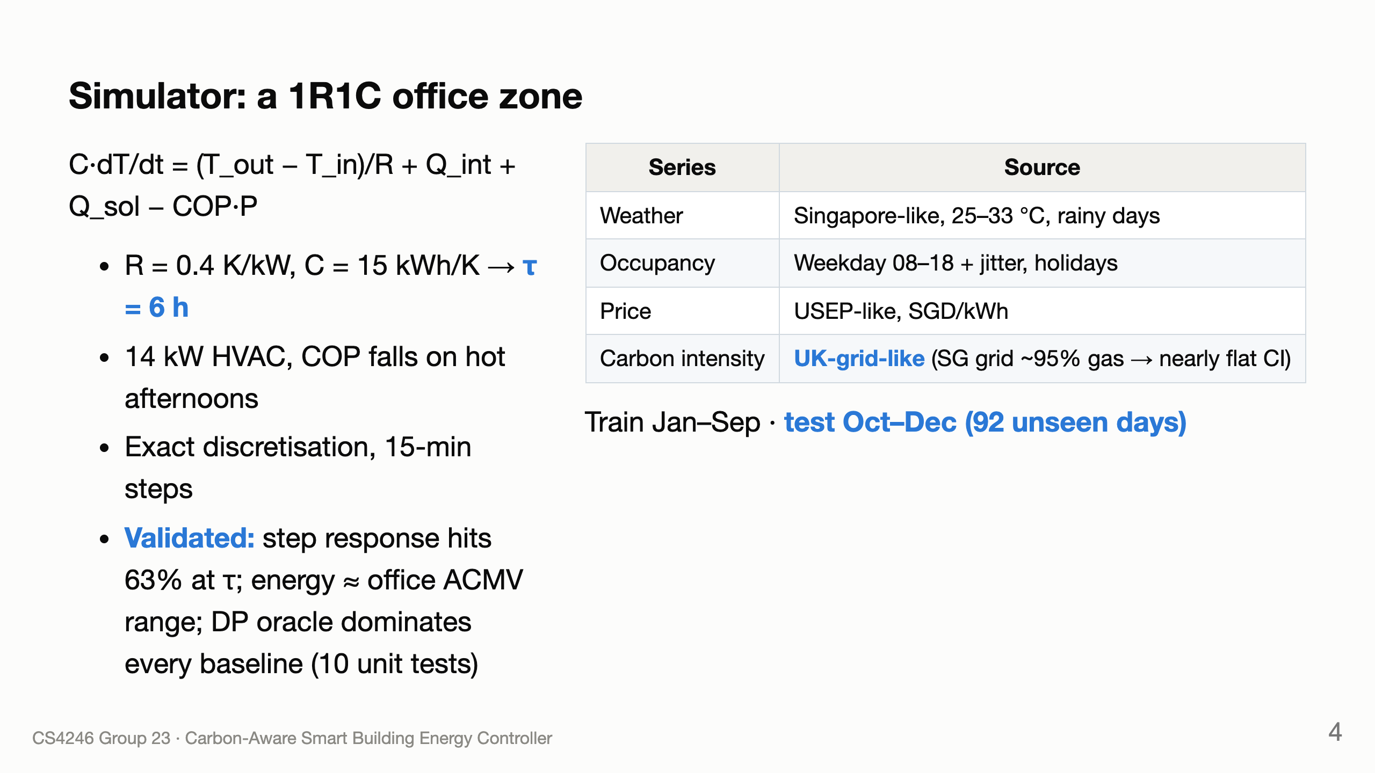
Notes:
Ethan

Slide 5
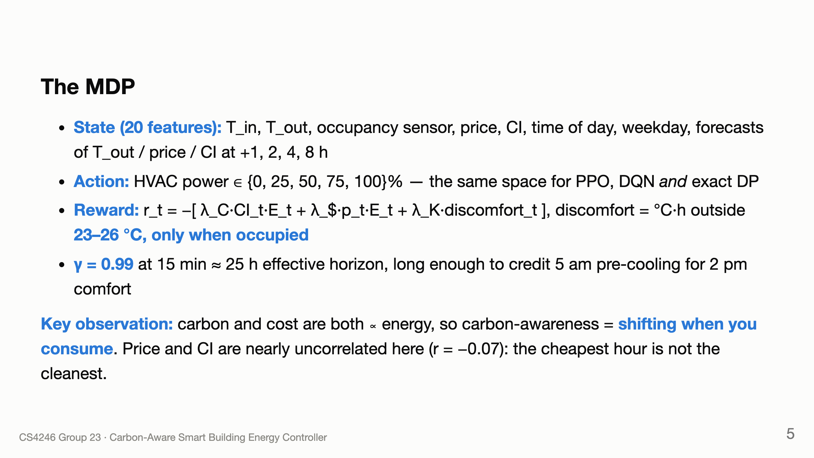
Notes:
Brandon

Slide 6
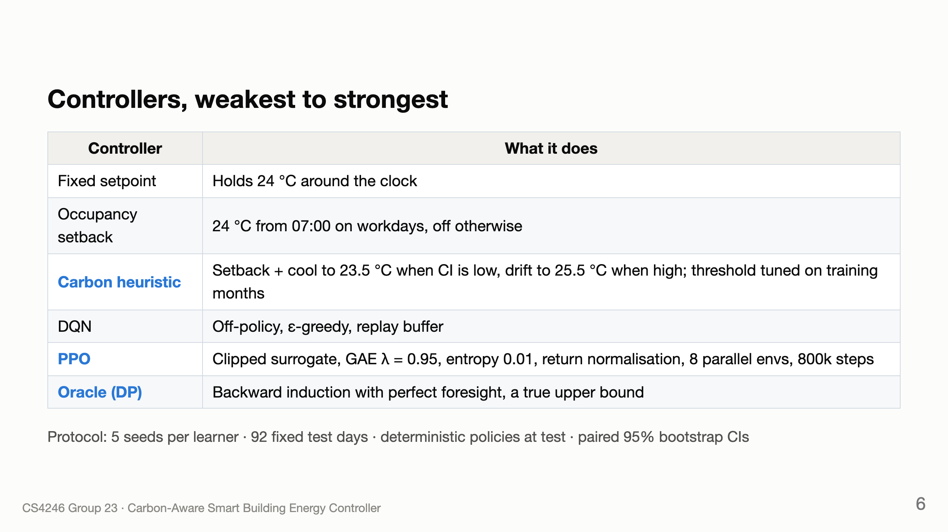
Notes:
Jaylon: baselines + metrics. Brandon: PPO/DQN/oracle row

Slide 7
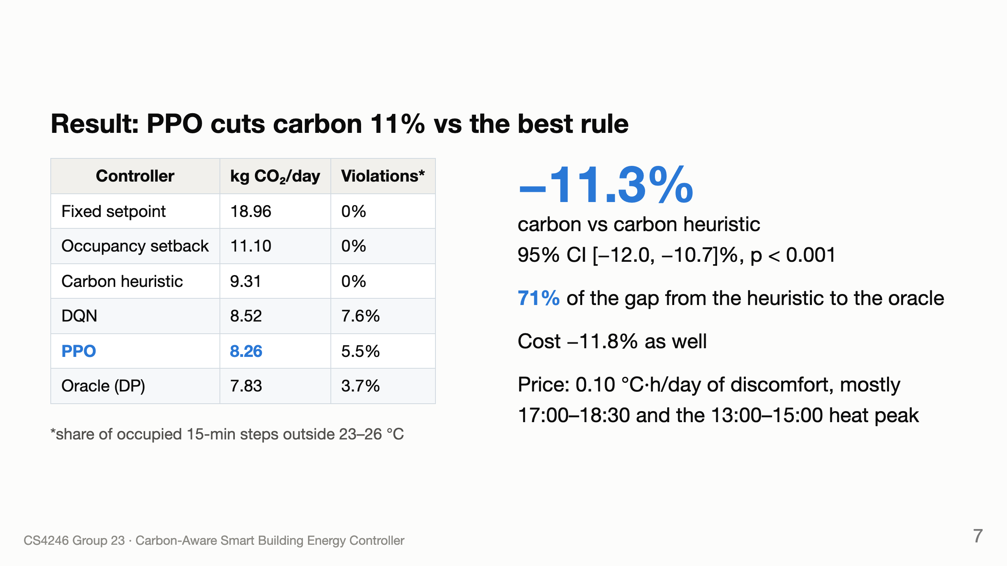
Notes:
Sean

Slide 8
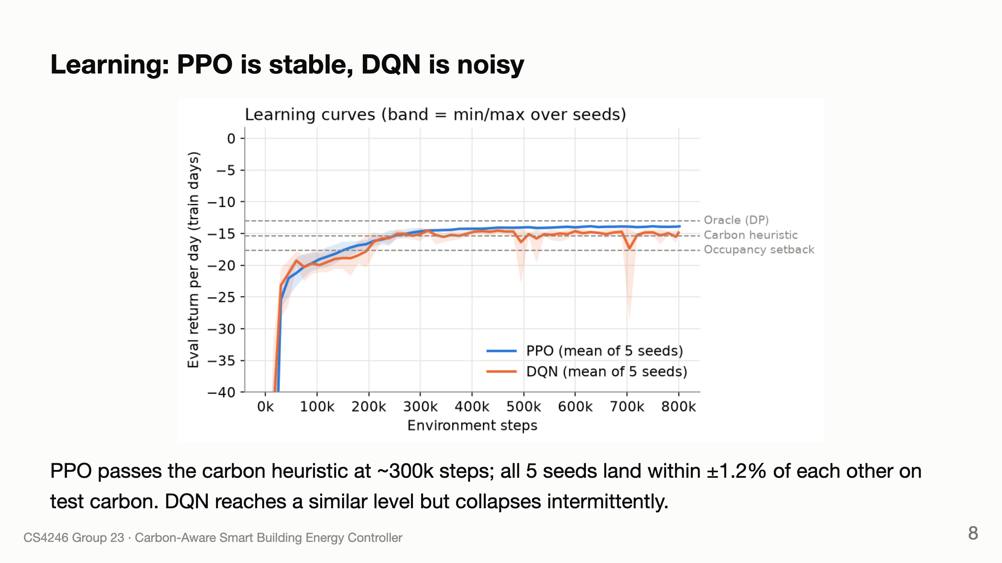
Notes:
Sean (Brandon for PPO stability questions)

Slide 9
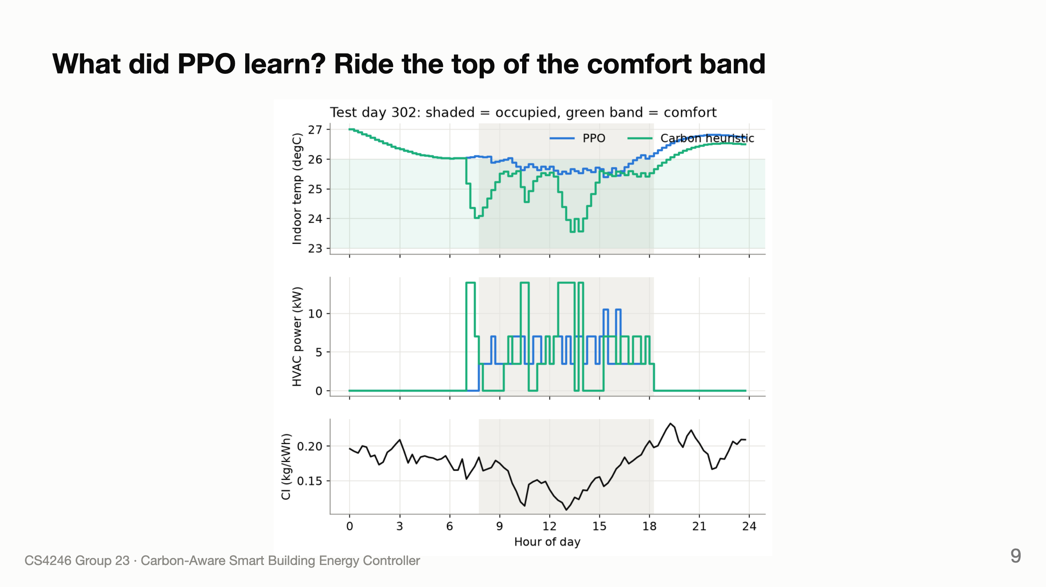
Notes:
Sean: PPO holds ~25.7 °C, no pre-cooling. Heuristic over-cools in low-CI dips; with τ = 6 h that "stored" cooling leaks back through the walls.

Slide 10
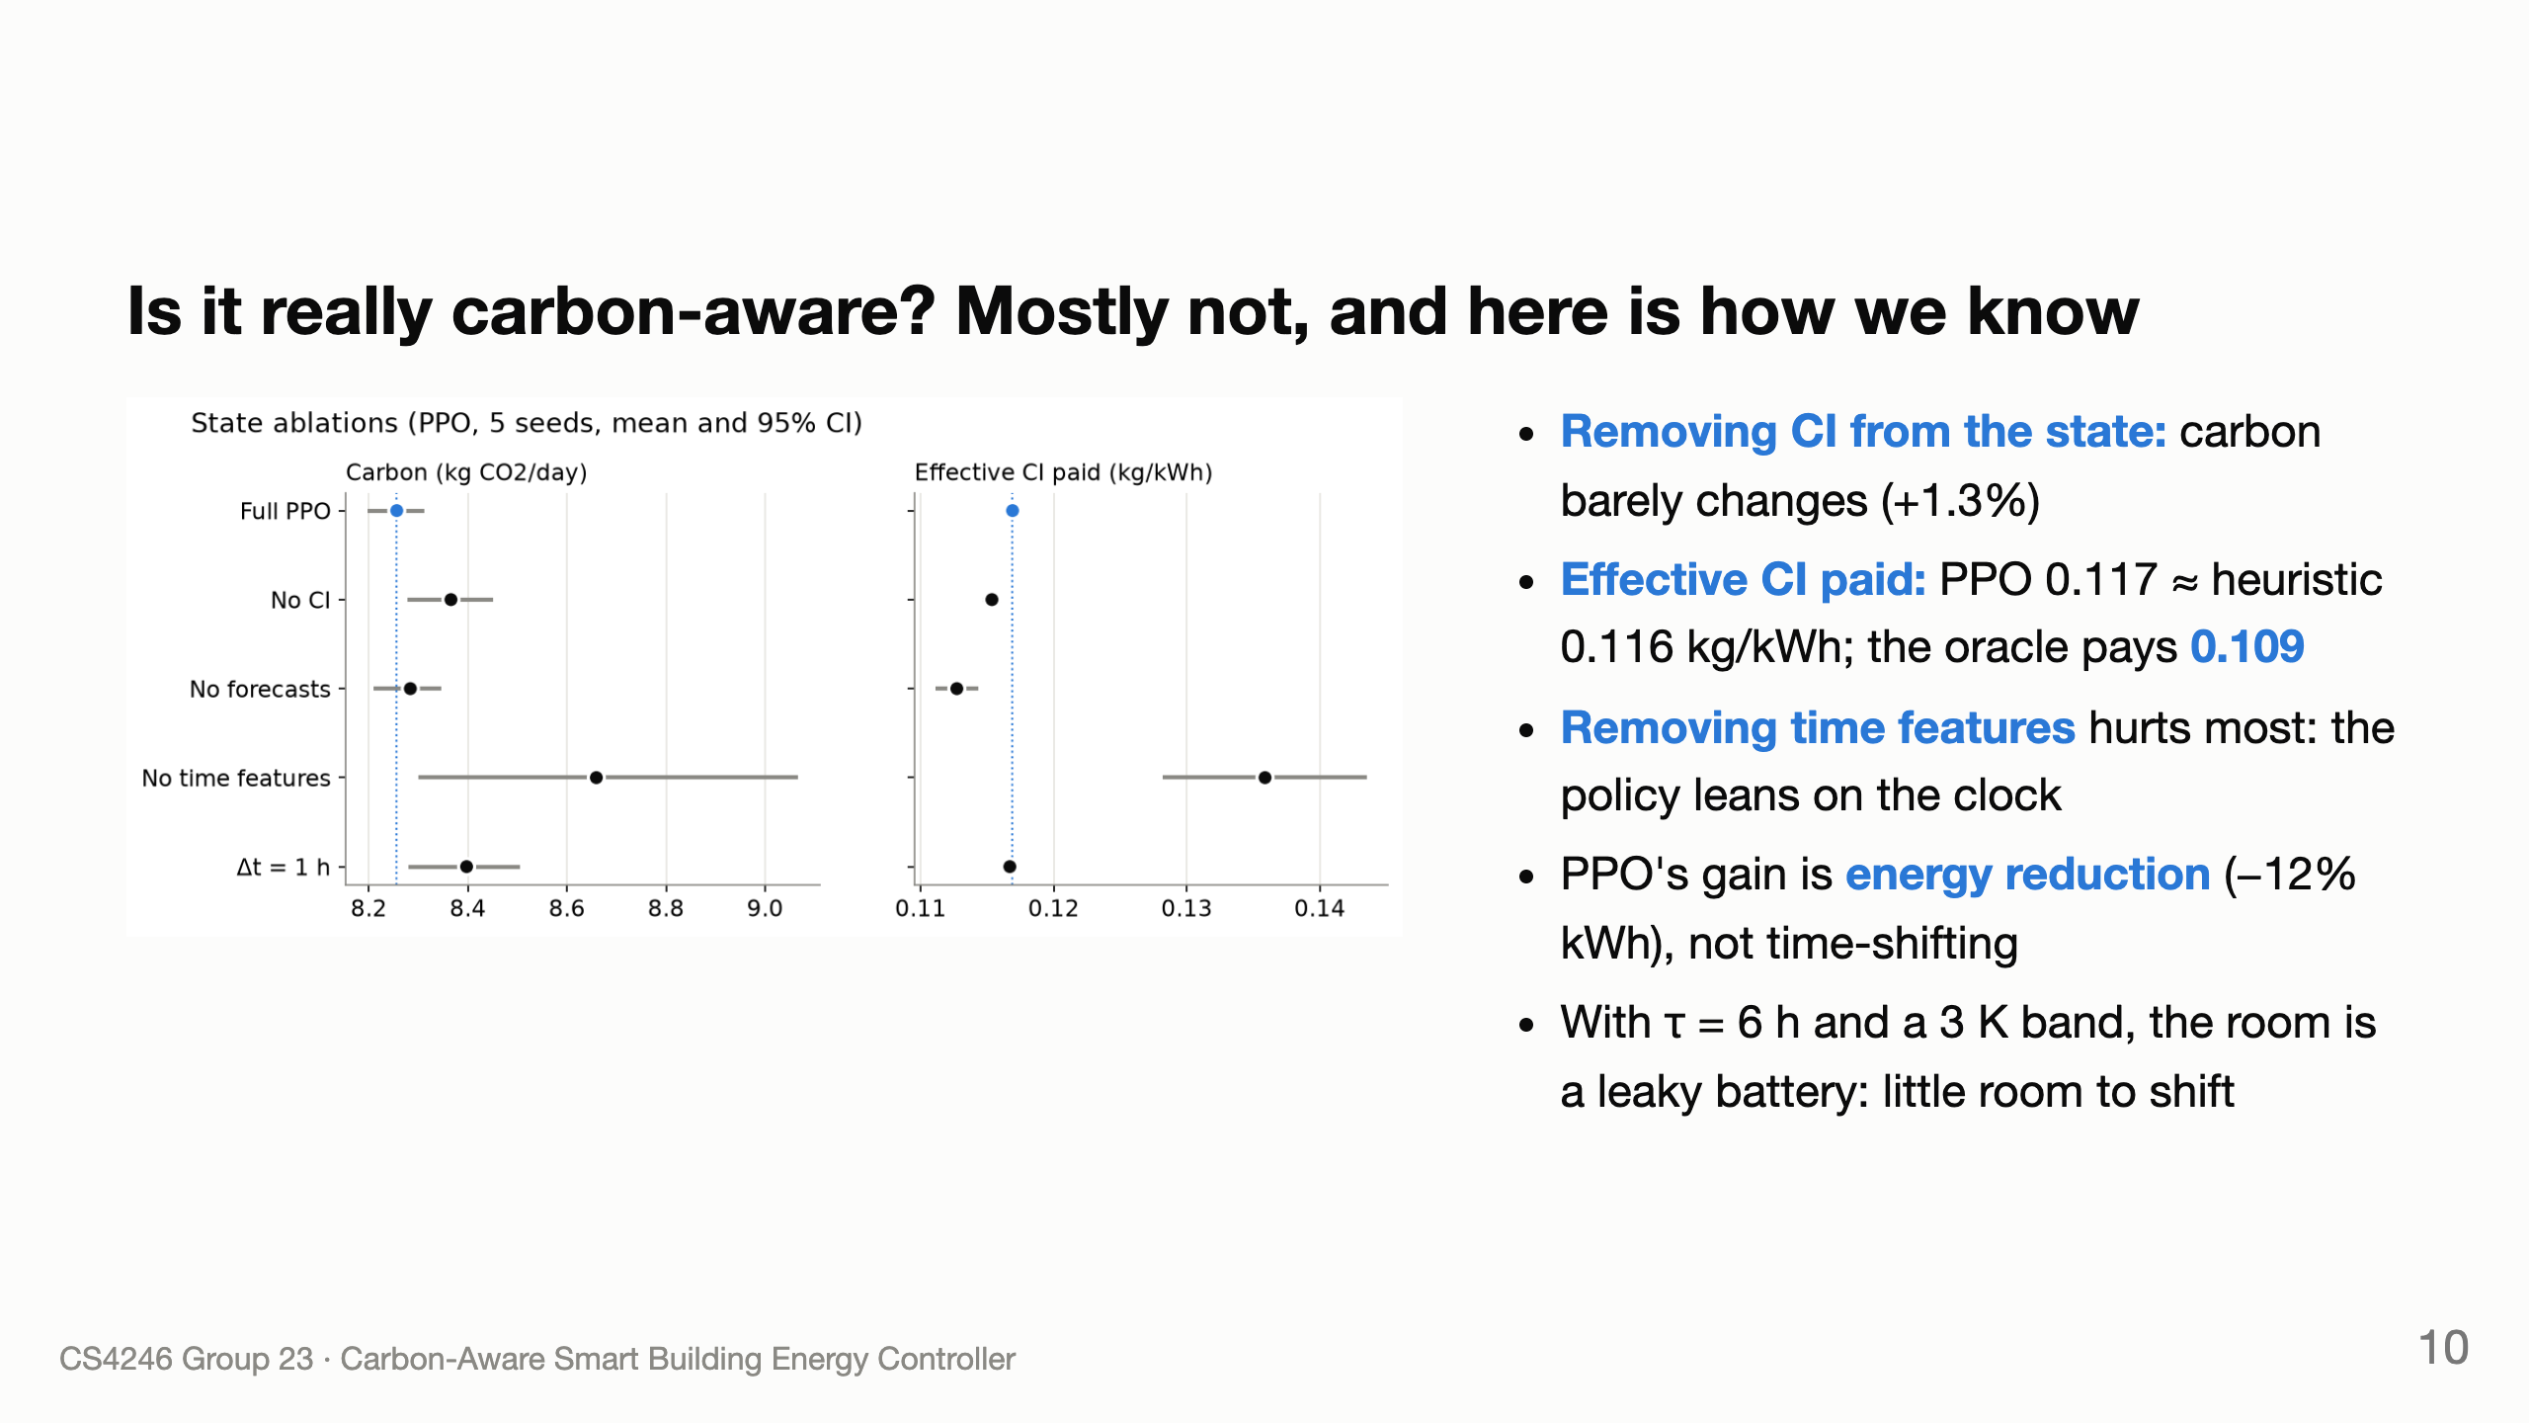
Notes:
Sean, with Brandon

Slide 11
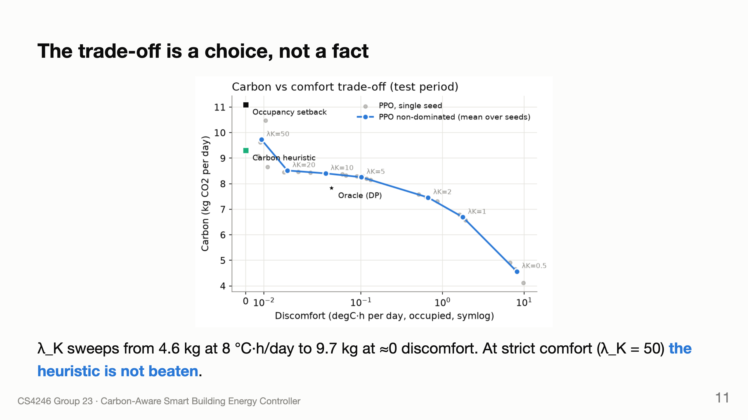
Notes:
Sean presents; Patrick links to RAI

Slide 12
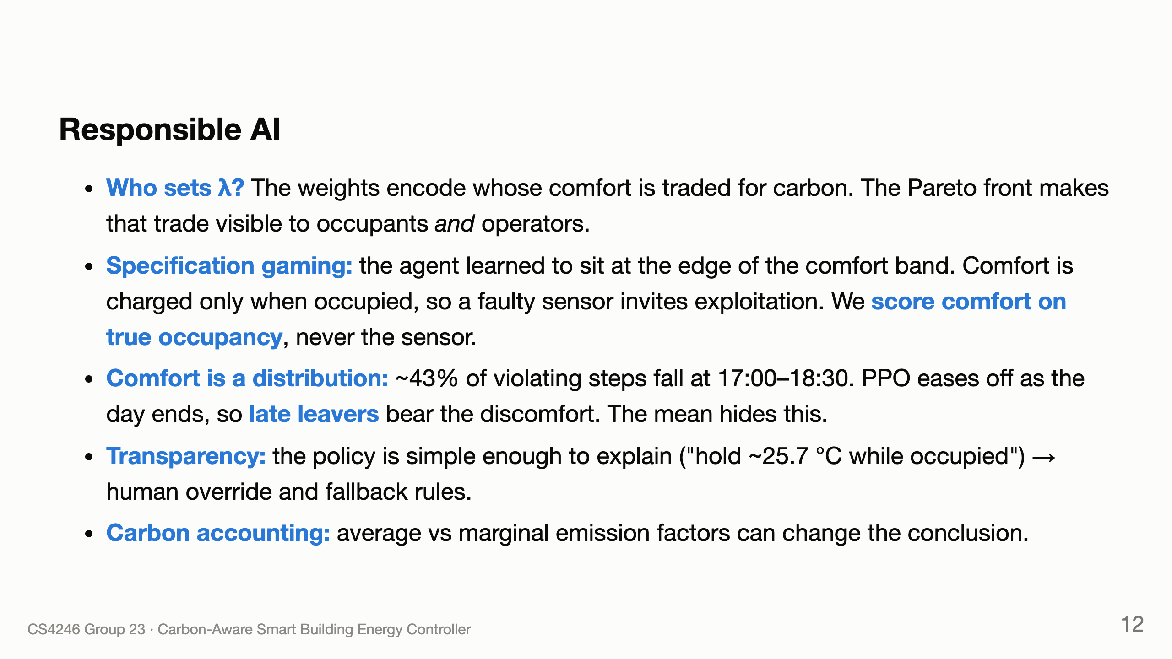
Notes:
Patrick

Slide 13
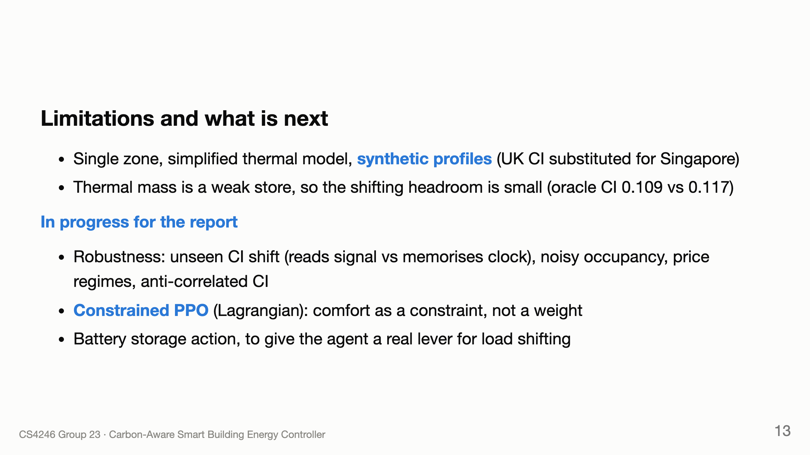
Notes:
Patrick

Slide 14
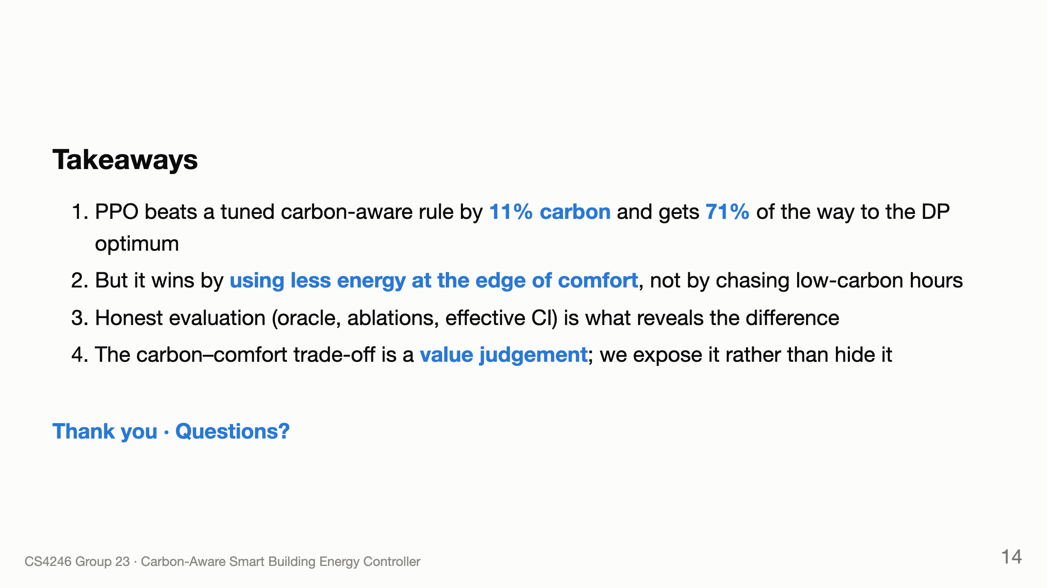
Notes:
Patrick

