Slide 1
A Literature Review on Statistical Models for Healthcare Fraud Detection
Jack Xue & Andrew Hoblitzell
November 14, 2013

Slide 2
We will cover …
What’s a fraud?
History of fraud and fraud detection
Today’s landscaping of fraud detection
Architecture of fraud detection systems
What is a good fraud detection model?
A long list of algorithms in use
Industrial offers
Q&A

Slide 3
What is a fraud?
Criminal deception; the use of false representations to gain an unjust advantage (Concise Oxford Dictionary)
Older than humanity itself.
even animals are known to try to deceive others, such as camouflage
Motivation 1: money
Banking fraud
Telecommunications fraud
Insurance fraud
Health care fraud
Click fraud

Slide 4
How big is the fraud?
“Participants in our study estimate U.S. organizations lose 5% of their annual revenues to fraud.” (Association of Certified Fraud Examiners)
 | Cases | Convictions | Recoveries, $M | Fines, $M
Corporate Fraud | 490 | 124 | 42 | 14
Securities Fraud | 1,165 | 164 | 21 | 81
Health Care Fraud | 2,423 | 534 | 1,600 | 173
Mortgage Fraud | 818 | 204 | 1 | 231
Identity Theft | 1,255 | 405 | 4 | 1
Insurance Fraud | 233 | 54 | 3 | -
Marketing Fraud | 147 | 44 | - | 87
Money Laundering | 473 | 95 | 3 | -
Total | 7,004 | 1,624 | 1,674 | 587

Slide 5
Overview
With national health care spending topping $2.7 trillion, the FBI estimates health care fraud costs the country an estimated $80 billion a year.
The Government Accountability Office estimated for 2012 estimated improper payments to be more than $44 billion.
During the past four years, the government has recovered $14.9 billion in Medicare fraud money.

Slide 6
Examples
Common fraud includes:
Billing for services that were never rendered-either by using genuine patient information, sometimes obtained through identity theft, to fabricate entire claims or by padding claims with charges for procedures or services that did not take place.
Billing for more expensive services or procedures than were actually provided or performed, commonly known as "upcoding
Performing medically unnecessary services solely for the purpose of generating insurance payments
Misrepresenting non-covered treatments as medically necessary covered treatments for purposes of obtaining insurance payments
Falsifying a patient's diagnosis to justify tests, surgeries or other procedures that aren't medically necessary
Accepting kickbacks for patient referrals.

Slide 7
Examples (contd.)
Nov 12: The owner of a Brooklyn medical clinic was sentenced today to serve 15 years in prison for her leading role in a $77 million Medicare fraud scheme.
Nov 8: Darron A. Suggs, 39, of Washington Park, Illinois, pled guilty to a one-count indictment charging that he engaged in a scheme to commit health care fraud.
Nov 7: A 70-year-old Beaumont orthodontist has been sentenced to federal prison for health care fraud violations in the Eastern District of Texas
Home Health Care, Durable Medical Equipment, Institutions…

Slide 8
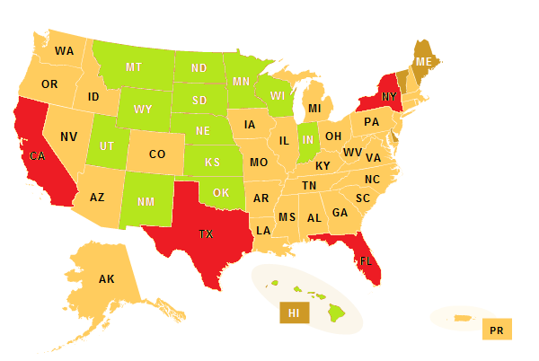
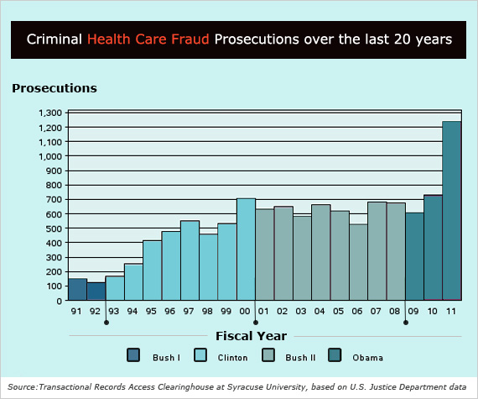
Trends

Slide 9
Fraud Detection
If we cannot outspend the fraudsters we must out-think them
Bring sophisticated advanced technologies to bear to stop them
General problems in fraud detection
May be huge data sets: both d and n
Most variables will be irrelevant
Most cases not fraud: classic DM needle in haystack problem
Evolutionary arms race

Slide 10
What’s a good algorithm?
Goal: Classifies fraudulent transactions as fraudulent, and legitimate transactions as legitimate.
Reality:
Accuracy T₁: max (m_{ff} + m_{ll} ) /Σm..
Stop bleeding T₂: min m_{fl} , s.t. (m_{ff} + m_{lf}) = C
 |  | True class
 |  | Fraud | Legitimate
Predicted class | Fraud | m_{ff} | m_{lf}
 | Legitimate | m_{fl} | m_{ll}

Slide 11
Common algorithms
Rule-base method
Based on expert knowledge
Based on regulation
Supervised classification
Linear/nonlinear discrimination
Neural network, SVM
K-nearest neighbor
Decision Tree and Random Forest
Unsupervised classification
Anomaly analysis
Outliers analysis
New category
Social Network Analysis (SNA)

Slide 12
Industrial solutions
SAS Fraud Framework for Health Care
A category-specific workflow
Rule and analytic model management
Content management
Advanced analytics
Link analysis via SAS Social Network Analysis
Integration with a case management system
Management of model development and deployment (All in one package)

Slide 13
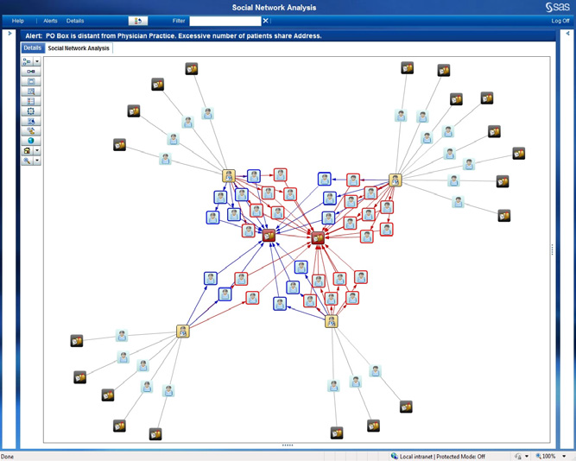
Social Network Analysis

Slide 14
Main References
RJ Bolton and DJ Hand, Statistical Fraud Detection: A Review, Statistical Science, 2002, Vol. 17, No. 3, 235–255
C Phua, V Lee, K Smith & R Gayler, A Comprehensive Survey of Data Mining-based Fraud Detection Research, Computers in Human Behavior, 28-3, May 2012, 1002–1013
J Li & K-Y Huang & J Jin & J Shi, A survey on statistical methods for health care fraud detection, Health Care Manage Sci., Dec. 2007
RJ Pro, Combating Health Care Fraud, SAS Institute Inc., 2010
J Malida , The Changing Face of Health Care Fraud Detection—Predictive Analytics, BNA Health Care Fraud Report, 15-4, Feb 2011
Department of Health & Human Services Centers for Medicare & Medicaid Services, Report to Congress Fraud Prevention System First Implementation Year, Sept, 2012
http://www.fbi.gov/about-us/investigate/white_collar/health-care-fraud
http://www.gao.gov/new.items/d11409t.pdf
http://www.usatoday.com/story/news/politics/2013/06/05/medicare-revoking-providers-billing-fraud/2393561/
http://www.nhcaa.org/resources/health-care-anti-fraud-resources/the-challenge-of-health-care-fraud.aspx
http://oig.hhs.gov/fraud/enforcement/criminal/index.asp

