Slide 1
PMML: Generation & Implementation
Jack Xue & Andrew Hoblitzell

Slide 2
We will cover…
Why we need PMML?
How to output a model in PMML?
Where we can run the model?
How to run the model in Hadoop?
Remarks
Q&A

Slide 3
Why we need PMML?
Predictive Model Markup Language package can exports predictive and descriptive models from R and SAS in standardized format. (http://www.dmg.org/v4-1/GeneralStructure.html).
This format can be imported to different toolsets and runtimes
Write once and run everywhere!
Dr. Alex Guazzelli has been working on this goal for about 20 years.

Slide 4
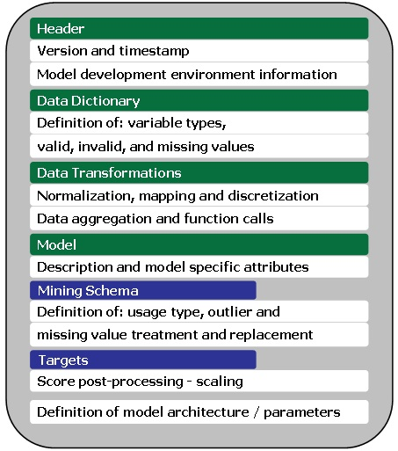
Why PMML is Needed (con’t)?
PMML XSD

Slide 5
PMML Data Transformations
PMML supports data transformations:
Normalization: Maps values to numbers, the input can be continuous or discrete.
Discretization: Maps continuous values to discrete values.
Value mapping: Maps discrete values to discrete values.
Functions: Derive a value by applying a function to one or more parameters.
Aggregation: Summarizes or collects groups of values.

Slide 6
PMML Supported Algorithms
PMML supports the following algorithms:
Association Rules: Items, item sets and rules that relate item sets.
Clustering: Clustering Fields and Clusters
General Regression: Parameter, Factor and Covariate Lists along with matrices that relate parameters to each other.
Model Composition/”Ensemble”: Decision Trees and Regression models that can be used for model sequencing or model selection.
Multiple Models (new in 4.0) : Extends to Model Composition to include segmentation •Naïve Bayes: Counts pairing input values to output values •Neural Network: Neurons and neural layers
Regression: Regression table(s) that relate the input to the predicted values.
Ruleset: Rules combined with a rule selection method
Sequences: Items, Itemsets, Sequences and Sequence Rule that relate sequences.
Support Vector Machines: Support vectors and coefficients along with a kernel function.
Text: Dictionary of terms, corpus of text documents, document-term matrix along with data about the model’s normalization and similarity
Time Series (new in 4.0): Time Series information and Exponential Smoothing coefficients
Trees: Structure of Tree Nodes

Slide 7
How to Output a Model in PMML?
Three Steps:
Load in three libraries
Describe the model in PMML
Save the PMML XML file
Code Example:
library("XML")
library("pmml")
library("pmmlTransformations")
saveXML(pmml(model),file="/TitanicRFPMML.xml")
Live Demo: Titanic, part 2 ☺

Slide 8
Where Can We Run the Model?
Productize models: Integrate our models with many other applications to automatically process millions entries everyday.
PMML powered runtimes:
Zementics ADAPA
IBM InfoSphere, SAP
Microsoft SQL, Microstrategy
Big Data Solution: Pattern/Cascading/Hadoop (Paco Nathan et al., PMML’13, Chicago, June 2013)

Slide 9
How to Run the Model in Hadoop?
Three levels Hadoop Applications:
HDFS for ETL
M/R for Recommendations and anti-fraud
Commercial toolsets with M/R for Internet of Things
Cascading is an API for enterprise dataflow with M/R on Hadoop
Pattern is a package on top of Cascading to host PMML models
Live Demo: Pattern/Cascading/Hadoop – Iris K-Mean model

Slide 10
Remarks
Non-IID pain: Most our models are established by assuming that the random variables are IID. What if not?
Significant benefits to train models with large-scale dataset.
Significant cost benefits for commercial deployment using open-source.
Local mode: provide online web service from PMML/Pattern/Cascading on a single server.

Slide 11
PMML Producers and Consumers
PMML Producers:
Angoss Knowledge Studio
IBM InfoSphere Warehouse
KNIME
Microsoft SQL Server
MicroStrategy Data Mining Services
RapidMiner with PMML Extension
R / Rattle
SAS Enterprise Miner
SPSS Clementine
TIBCO Spotfire Miner 8.1
PMML Consumers:
Augustus (Python, Open Data Group)
Cascading Pattern (Java.. Scala?)
Drools-PMML (Java)
IBM InfoSphere Warehouse
KNIME
SPSS Clementine
Teradata Warehouse Miner
Weka
Zementis ADAPA Predictive Analytics Engine

Slide 12
PMML Benefits and Drawbacks
Benefits:
Allows for different statistical and data mining tools to speak the same language
Once represented as a PMML file, a predictive solution can be operationally deployed right away, without the need for custom code
Supported by all the major data mining tools, commercial and open source
Language itself has reached a great level of maturity and refinement
Drawbacks
PMML supports a finite, though sizable and growing, number of model types
Implementations may vary from tool to tool
Varying PMML support across tools (Versions supported, algorithms supported)
Still lots of work to get things in to and out of your models

Slide 13
Q&A
Thanks for Andrew Hoblitzell
Install pmml packages in VM Fedora 3.6.fc17
$yum install R-XML
>install(pmml)
>install(pmmlTransformation)
Paco’s paper: http://kdd13pmml.files.wordpress.com/2013/07/pattern.pdf

