Slide 1
News
AstroHackWeek at Moore-Sloan Data Science Environment at NYU to try to solve some of astronomy's toughest problems. One of the projects focused on speeding up a dark-matter simulation that required modeling hundreds of universes in a row, and another adapted a technique used in speech recognition to an analysis of star data from the Kepler space telescope (to figure out stars' internal rotation patterns). (http://www.space.com/30762-astro-hack-week-data-science.html)
Microsoft announced the third installment of its Microsoft Ventures Seattle Accelerator on Wednesday, this time focusing on data science and machine learning. Visiting tech hubs like Seattle, Palo Alto, Austin, Boston and Provo, Utah. (http://www.geekwire.com/2015/calling-all-analytics-startups-microsoft-unveils-next-accelerator-program-focused-on-data-science/)
MIT is taking perhaps its biggest step yet to combine free online classes with its traditional on-campus instruction. The university announced Wednesday at its Solve conference that it will allow students to obtain one of its master’s degrees by doing half of the coursework online—from anywhere, for free, without any admissions tests—and then doing the other half in a single semester on campus. (http://www.technologyreview.com/news/542201/take-free-online-classes-get-course-credit-at-mit/?utm_campaign=newsletters&utm_source=newsletter-weekly-computing&utm_medium=email&utm_content=20151008)
Leave a human baby with some toys and it’ll quickly learn to pick them up. Now a robot with deep-learning capabilities has done the same thing. Compared Baxter to a number of approaches, with accuracy of around 62%, none matched Baxter's performance. (http://arxiv.org/abs/1509.06825)
At 'Machine Learning: Prospects and Applications' conference in Berlin (sponsored by Yandex), Vladimir Naumovich Vapnik discussed knowledge transfer from an intelligence teacher. Vlapnik also offered a few counterpoints to deep learning and big data: the ad-hoc approach, the brute-force approach, mathematical underpinnings/model interpretability, deep engineering rather than deep learning. Vlapnik argued a baby doesn't need billions of samples to learn and that God is clever, while the devil prefers brute force. (http://www.kdnuggets.com/2015/10/deep-learning-vapnik-einstein-devil-yandex-conference.html)

Slide 2
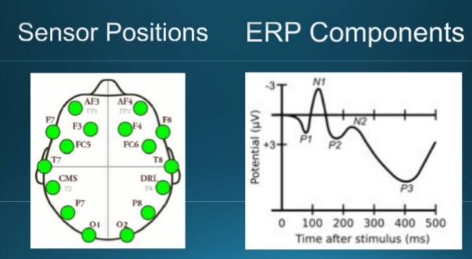
MLConf Summary
Jennifer Marsman, a Principal Developer Evangelist at Microsoft tried to find a way to read minds
Using an Emotiv headset, captured the big data stream of EEG coming out of our heads
Used Azure Machine Learning to build a classifier for individualized lie detection
http://www.slideshare.net/SessionsEvents/jennifer-marsman-principal-developer-evangelist-microsoft-at-mlconf-atl-91815

Slide 3
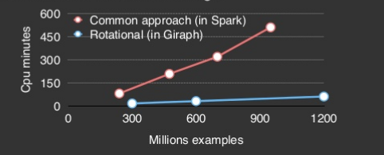
MLConf Summary
Maja Kabiljo, Software Engineer, from Facebook Inc. discussed the use of Apache Giraph, which utilized Bulk Synchronous Parallel
Scale Stochastic Gradient Descent and Alternating Least Squares to scale our implementation to over a billion users and tens of millions of items
Claim up to 10x faster than some of the leading open source implementations in this domain (e.g. Spark MLlib) on the Amazon benchmark data while maintaining the same output quality
http://www.slideshare.net/SessionsEvents/maja-kabiljo-software-engineer-facebook-inc-at-mlconf-atl-91815

Slide 4
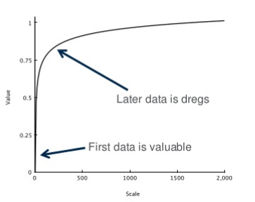
MLConf Summary
Ted Dunning, Chief Application Architect, MapR says it is often possible to solve green field problems using simple techniques at scale
Warns techniques which aren't well founded still have problems (hueristic frequency ratios still fail, coincidences are everywhere in the data)
Details it working well for document classification, movie searches, etc.
http://www.slideshare.net/SessionsEvents/ted-dunning-chief-application-architect-mapr-at-mlconf-atl-91815

Slide 5
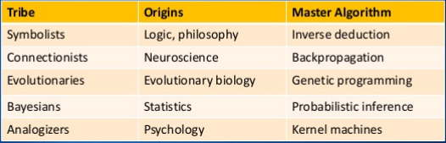
MLConf Summary
Pedro Domingos, Professor at University of Washington/Coursera, 2014. ACM SIGKDD Innovation Award detailed five tribes
Symbolists, Connectionists, Evolutionaries, Bayesians, and Analogizers each have their own technique which excel at different types of problems
The development of a 'Master Algorithm' will require borrowing from each school and ideas from new researches in a still infant field
http://www.slideshare.net/SessionsEvents/pedro-domingos-professor-university-of-washington-at-mlconf-atl-91815

Slide 6
Upcoming events
H2O WORLD 2015 Computer History Museum November 9-11 | Mountain View, CA
ICDM 2015: IEEE Int. Conference on Data Mining, November 14-17 Atlantic City

