Slide 1
Introduction to Deep Learning
Andrew Hoblitzell

Slide 2
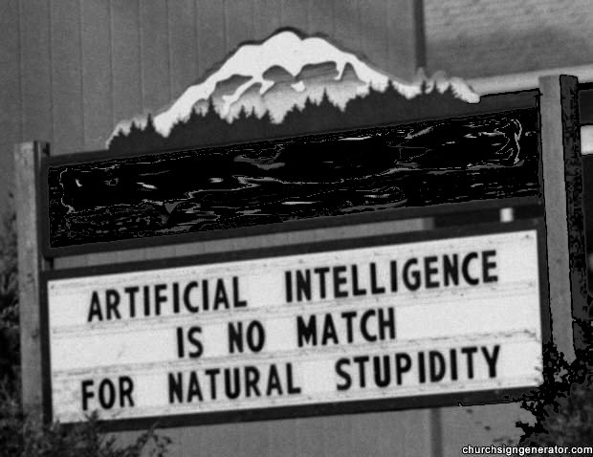

Slide 3
The Neural Net Strikes Back
An artificial neural network is inspired by the central nervous system
Work started in the 1940s and developed through the 1960s
Became popular in the 1980s under the "connectionist" label
Fizzled in the 1990s due to the popularity of simpler classifiers such as support vector machines (SVMs)
Neural nets became popular again at the end of the 2000s thanks to Deep Learning

Slide 4
Some Vocabulary
Support vector machine: a representation of data as points in space, mapped so that the examples of the separate categories are divided by a clear gap from a hyperplane that is as wide as possible
Generative: a generative model is a model for randomly generating observable data, typically given some hidden parameters
Stochastic system: state is non-deterministic (i.e., "random") so that the subsequent state of the system is determined probabilistically
Restricted Boltzmann machine: a generative stochastic neural network that can learn a probability distribution over its set of inputs
Neural Network: "neurons" with sets of adaptive weights, i.e. numerical parameters that are tuned by a learning algorithm and are capable of universal approximation/non-linear approximation (think polynomials, exponents, trigonometric functions, etc.)
Feed forward artificial network: an artificial neural network where connections between the units do not form a directed cycle
Backpropagation: abbreviation for "backward propagation of errors", is a common method of training artificial neural networks (developed in 1960s, refined in 1970s by Hinton and others)

Slide 5
Some vocabulary (continued)
Hidden layer: A layer in a neural network between the input and output layer
Shallow learning: training a neural network with input and output layers
Deep learning: training a neural network with hidden layers. Recent significance has been attached to techniques which use more hidden layers.
Autoencoder: an artificial neural network used for learning efficient codings
Convolutional neural network: type of feed-forward neural network where the individual neurons are tiled in such a way that they respond to overlapping regions in the visual field
Deep belief network: a generative graphical model, or alternatively a type of deep neural network, composed of multiple layers of latent variables ("hidden units"), with connections between the layers but not between units within each layer
Contrastive divergence: a method for training deep learning networks proposed by Geoffrey Hinton
Kolmogorov’s theorem: essentially says any continuous function of many variables can be restated as a composition/superposition of functions of one variable. Useful for showing universal approximation in neural networks, but practically accuracy and performance degrade after two hidden layers.

Slide 6
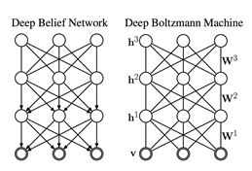
Deep Learning: What is it?
Deep Learning tries to model abstractions in data (image, etc.) by using architectures composed of multiple non-linear transformations. Some examples of these include:
deep neural networks
convolutional deep neural networks
deep belief networks (coined by Hinton)
It has seen application in language processing, speech recognition, computer vision, etc.
Rapidly evolving

Slide 7
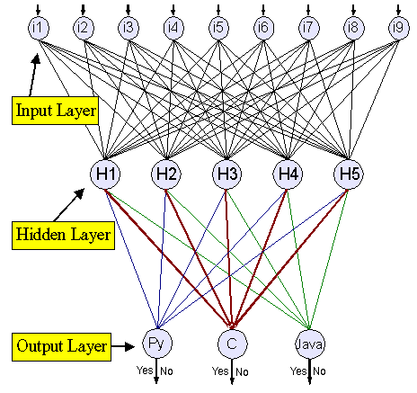
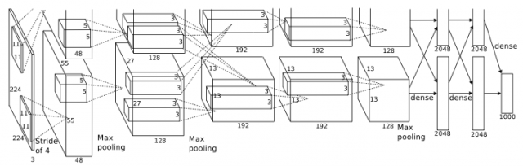
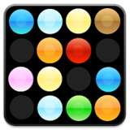
Architecture (thanks to Bengio and Ng)

Slide 8
What is it used for?
Applications:
Speech recognition
Image recognition
Dimensionality reduction
Information retrieval
Feature learning
Collaborative filtering
Regression
Natural Language Processing
Modeling texture and motion
Where’s it used:
AT&T/Lucent/NCR
Vidient Inc.
NEC Labs
Google
Microsoft
France Telecom
…

Slide 9
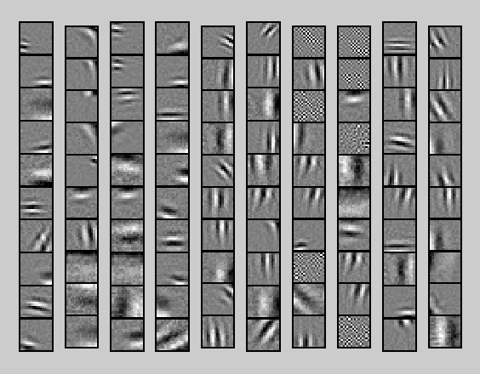
Why?
Neural nets (reading your mail since 1995!)
Need enough Labeled Training Data
Slow with lots of hidden layers
Stuck in poor local optima
Deep learning might be used to
lessen the chance to be stuck in local minima
improve training performance
Historically, multi-layer neural networks with more than 2 hidden layers provided only diminishing effects
Hidden layers are too far from output and may not train as well to the data

Slide 10
Seriously, why?
Ability to ‘learn’ artificial concepts or features
“semisupervised representation learning”/“unsupervised feature learning”
Stackable/recursive learning
Deep Learning has won
the 2012 Brain Image Segmentation Contest
the ImageNet 2012 Challenge
Kaggle's Merck Contest
Kaggle’s Dogs versus Cats contests
And more
The market says
Google reportedly paid $400 million to acquire DeepMind Technologies, as well as Geoffrey Hinton’s DNNresearch
Peter Lee, head of Microsoft Research, asserts deep learning experts command the same types of seven-figure salaries as some first-year NFL quarterbacks

Slide 11
Deep convolutional neural network
Feed-forward network where neurons are tiled for overlapping regions in the visual field to minimize preprocessing
Introduced in a 1980 paper by Kunihiko Fukushima
Recently used with less parameters, and are easier to train
Popular in image recognition for high accuracy

Slide 12
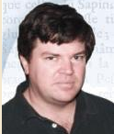
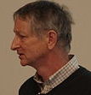
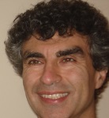

Some active researchers
Yann LeCun – NYU Professor who moved to head Facebook’s AI Lab
Geoffrey Hinton – Distinguished Professor at University of Toronto, Distinguished Researcher at Google (winner of ImageNet 2012 and more challenges)
Yoshua Bengio – Professor at University of Montreal
Andrew Ng – Professor at Stanford and co-founder of Coursera
Jeff Dean, Samy Bengio, Jeff Hawkins, Quoc Le, Kai Yu, Jason Weston, …

Slide 13
Common issues to watch for
Lack of causal reasoning (integration with other methods)
“Black box” approach (integration with other methods)
Domain tuning (leads to new techniques like max pooling, local receptive fields ICA, sparse coding, autoencoder, Dropout (averaging many neural networks, then drop), etc.)
Overfitting (early stop, L1 and L2 regularization, etc.)
Time to train (somewhat solved with lots of GPUs)
Complexity (somewhat solved with convolutional deep neural networks)
Potential lack of optimality with contrastive divergence (gradient descent/acceptance of non-optimality)

Slide 14
Where are they headed
Scaling up
Distribution/Parallelization over GPUs for handling more data
Speeding up
Convolutional Networks-Ng, Yu
Tiled Networks-Hinton, Ng
Randomized/Fast parameter search-Dicarlo,Ng
Massive embedding models-Bengio,Hinton
GPU, FPGA, and ASIC Implementations-Dean,Ng

Slide 15
If you really want to understand…
Hinton, Geoffrey E., and Ruslan R. Salakhutdinov. “Reducing the dimensionality of data with neural networks.” Science 313.5786 (2006): 504-507.
“Improving neural networks by preventing co-adaptation of feature detectors.” Hinton, Geoffrey E., et al. arXiv preprint arXiv:1207.0580 (2012).
Learning Deep Architectures for AI (Foundations and Trends(r) in Machine Learning) by Yoshua Bengio (Oct 28, 2009)
Representation Learning: A Review and New Perspectives, Yoshua Bengio, Aaron Courville, Pascal Vincent, Arxiv, 2012.
Deep Machine Learning – A New Frontier in Artificial Intelligence Research – a survey paper by Itamar Arel, Derek C. Rose, and Thomas P. Karnowski.
http://deeplearning.net/reading-list/

Slide 16
Demo
Demo

Slide 17
