Slide 1
Introduction to Mathematical Optimization
Andrew Hoblitzell
May 11, 2016

Slide 2
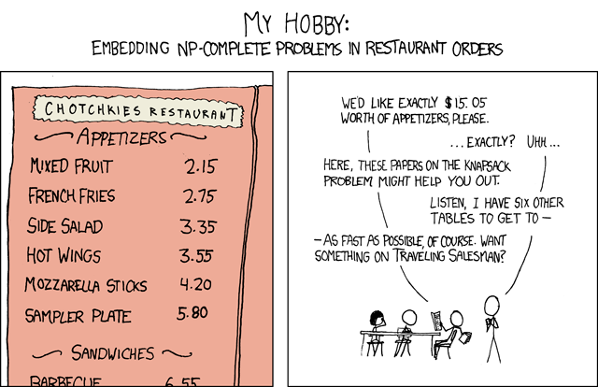
https://xkcd.com/287/

Slide 3
Overview
Diverse branch of applied mathematics involving computer science, operations research, and mathematics itself
The selection of a best value (per some defined evaluative function) from some set of available inputs
Given: a function f : A → R from some set A to the real numbers
Goal: X0 in A such that f(X0) ≤ f(x) for all x in A OR
X0 in A such that f(X0) ≥ f(x) for all x in A

Slide 4
Why should I care?
Can be used for:
Architecture
Chemistry/Molecular Modeling
Ecology/Civil Engineering
Economics
Electrical Engineering
Mechanics
Nutrition
Operations Research
Transportation
…

Slide 5
Brief History
1600s: Fermat works on calculus based formulas for optima (some of many theorems), Newton proposed iterative methods for moving towards optimum (Newton’s method, Newton+Leibniz-differential calculus)
1700s-1800s: Lagrange continues work on calculus based methods (multipliers), Gauss continues work on iterative methods, Cauchy develops steepest descent method
1900s: George Dantzig coins the term linear programming and publishes the simplex algorithm. John von Neumann develops theory of duality. Nash develops game theory. Karush, Kuhn, Tucker and KKT Theorem

Slide 6
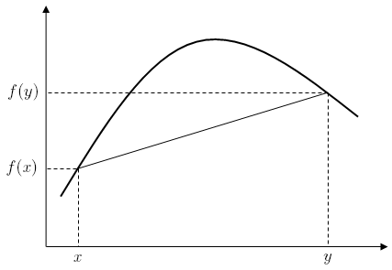
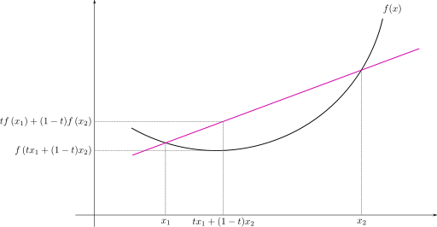
Brief vocabulary
Concave: Derivative is monotonically decreasing
Convex: Derivative is monotonically increasing
Derivative: Rate of change of a function w.r.t. one dimension (gradient is more than one dimension)
Extreme value theorem: If function is closed and bounded, must have at least one minimum and maximum
Jacobian: matrix of all first order partial derivatives (Hessian is second order partial derivatives)

Slide 7
Brief vocabulary
Lagrange multipliers: Method for finding extrema subject to equality constraints
Karush–Kuhn–Tucker conditions: generalization of the method of Lagrange multipliers for inequality constraints
NP-hard: class of algorithms where polynomial run time algorithms are not known to exist
Satisfiable: possible to find a model satisfying formula
Stationary points (similar to critical point): Fermat theoem to find local extrema based on fact that derivative is zero at extremum
Validity: If premises true, conclusion must be as well

Slide 8
Examples
K-means
Linear classification
Maximum likelihood

Slide 9
Subdomains
Convex programming: minimizing convex functions over convex sets (very well-studied)
Linear programming: method to achieve best outcome when linear relationships involved
Integer: optimization problem where inputs must be integer (NP-hard problem)
Quadratic: method to achieve best outcome when quadratic functions involved

Slide 10
Subdomains
Nonlinear: method to achieve best outcome when non-linear relationships involved
Stochastic: optimization problems involving uncertainty
Multi-objective: more than one objective or criterion to optimize simultaneously
Multi-modal: obtaining many or all good solutions
…

Slide 11
List of methods
Too many to capture:
Alpha-beta pruning
Branch and bound technique
Brute force
Dynamic programming
Evolutionary algorithms
Frank-Wolfe algorithm
Gauss-Newton algorithm
Greedy algorithm
Karmakar’s algorithm
KKT conditions
Lagrange multipliers
Minimax
Simplex algorithm
Simulated annealing
Stochastic gradient descent/ascent
…

Slide 12
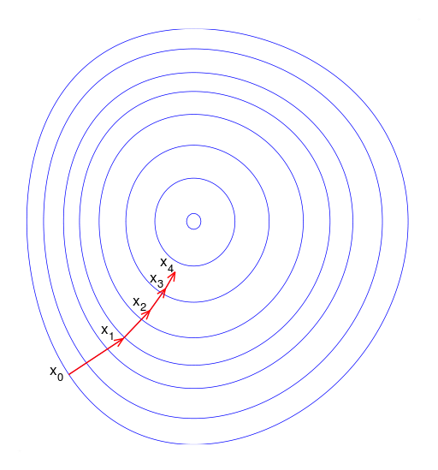
Classical method: Stochastic gradient descent
Stochastic approach to gradient descent method for minimizing an objective function
Based on idea that fastest way to extremum is given by the negative gradient of function F at point P

Slide 13
Classical method: Stochastic gradient descent
Discussion:
Stochastic implementation meant to handle noisy functions which are not perfectly continuous or differentiable
Can work with any number of dimensions
Modifications include using momentum to overcome local extrema
Applications:
Backpropagation training for artificial neural networks
Optimization of objective function for many other machine learning techniques: support vector machines, logistic regression, etc.

Slide 14
Limitations
Relatively slow close to the minimum, asymptotic behavior near extrema
May infinitely hop over extrema for ill posed problems
Only guaranteed to find a local extrema
may not be able to say much about how far away in time global extrema are
may not be able to quantify the difference between the discovered extrema and the global extrema
may not be able to provide a certificate of optimality if a global extrema is found

Slide 15
Optimization in R
Classical packages:
NLS
Optim
Problems are very sensitive to starting values, paramterization, etc. Convergence could be less than trivial for complex problems

Slide 16
Optimization in R (continued)
CRAN Task View: Optimization and Mathematical Programming
Optimization Infrastructure Packages
General Purpose Continuous Solvers
Semi-definite and convex solvers
Global and stochastic optimization
Mathematical programming solvers
Interfaces to external optimizers
…
95 currently documented packages, many more undocumented or under development

Slide 17
Optimization in Python
scipy.optimize
Uncontrained and constrained minimization
Global optimization
Least-squares minimization
Root finders
Equation solvers
Other packages: APMonitor, pyOpt, CVXOPT, …

Slide 18
Optimization in Matlab
Optimization Toolbox:
Nonlinear optimization
Linear programming, Mixed-Integer Linear Programming
Quadratic Programming
Least Squares
Non-linear equations
Many more packages available on the File Exchange

Slide 19
Many open challenges
Efficient search of large feature spaces
High dimensionality space
Hard to define objective functions
Multiple objective functions

Slide 20
References
Wikipedia: Optimization Category (https://en.wikipedia.org/wiki/Category:Mathematical_optimization)
CRAN: Optimization Task (https://cran.r-project.org/web/views/Optimization.html)
Matlab Optimization Toolbox (http://www.mathworks.com/help/optim/index.html)
SciPy Optimization (http://docs.scipy.org/doc/scipy/reference/tutorial/optimize.html)

