Slide 1
The Master Algorithm How the Quest for the Ultimate Learning Machine Will Remake Our World
Pedro Domingos
University of Washington

Slide 2
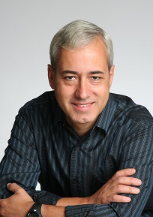
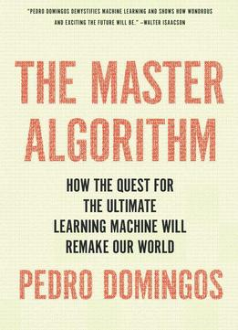
Master Algorithm: About the author
Pedro Domingos is a professor at the University of Washington known for Markov Logic Networks. He is a winner of the SIGKDD Innovation Award, the highest honor in data science. He is a fellow of the Association for the Advancement of Artificial Intelligence and teaches on Coursera.

Slide 3
Master Algorithm: Basic Idea
Traditional Programming
Machine Learning
Data
Computer
Output
Algorithm
Data
Master
Algorithm
Algorithm
Output

Slide 4
The Five Tribes of Machine Learning
Tribe | Origins | Master Algorithm
Symbolists | Logic, philosophy | Inverse deduction
Connectionists | Neuroscience | Backpropagation
Evolutionaries | Evolutionary biology | Genetic programming
Bayesians | Statistics | Probabilistic inference
Analogizers | Psychology | Kernel machines

Slide 5
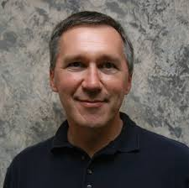
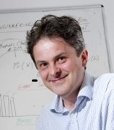
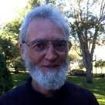
Symbolists
Tom Mitchell,
Chair at CMU,
Learning
Language
Steve Muggleton,
Bioinformatics@
IC London
Ross Quinlan,
ID3, C4.5, C5.0
Inventor
Based on high-level "symbolic" (human-readable) representations of problems,
logic, and search.

Slide 6
Inverse Deduction
Addition
Subtraction
2
+ 2
―――
= ?
2
+ ?
―――
= 4
――
――

Slide 7
Inverse Deduction
Deduction
Induction
Socrates is human
+ Humans are mortal .
―――――――――――
= ?
Socrates is human
+ ?
―――――――――――
= Socrates is mortal
――――――――――
――――――――――

Slide 8
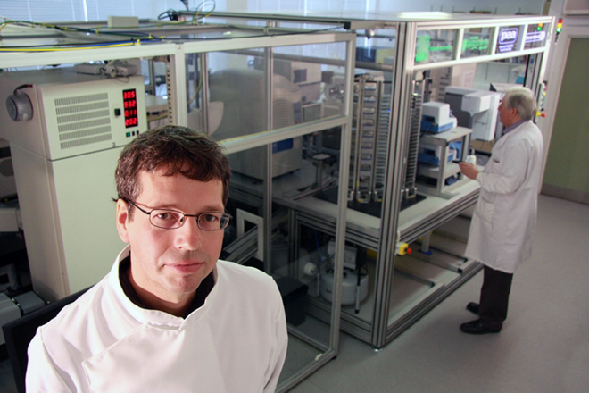
Spot the Biologist in this Picture

Slide 9
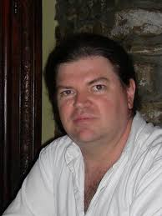
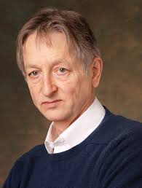
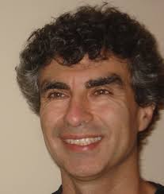
Connectionists
Yann LeCun
NYU, Facebook
Geoff Hinton
University of
Toronto, Google
Yoshua Bengio,
Universite de
Montreal
models mental or behavioral phenomena as the emergent processes of
interconnected networks of simple units

Slide 10
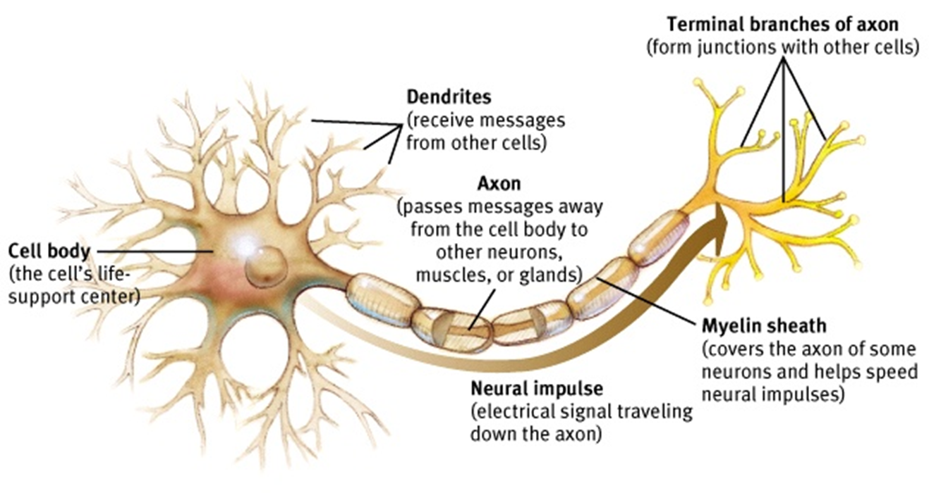
A Neuron
Biologically inspired

Slide 11
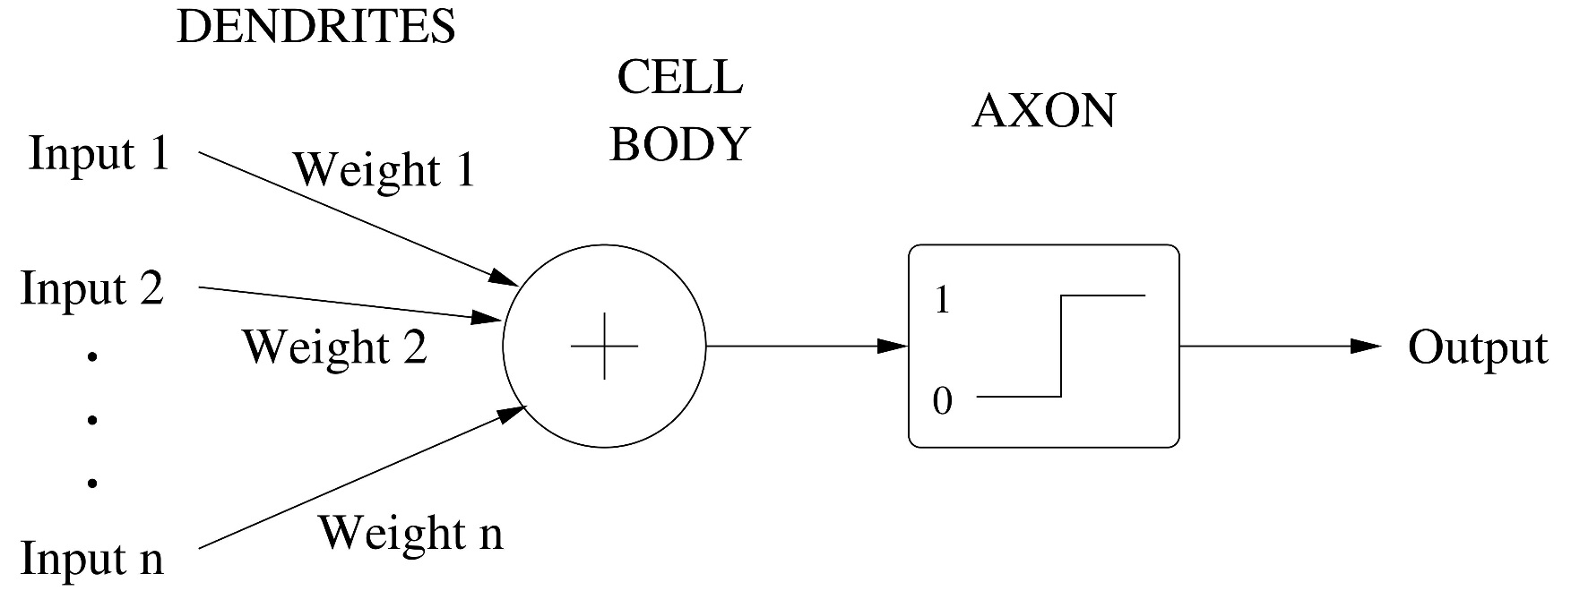
An Artificial Neuron
Mathematically modelled

Slide 12
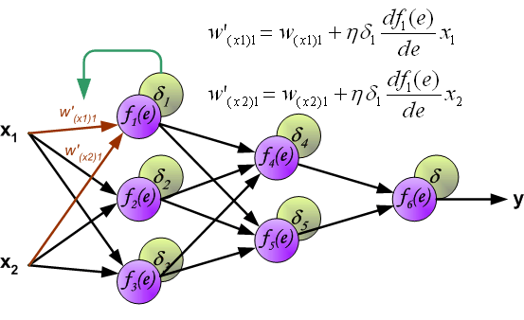
Backpropagation

Slide 13
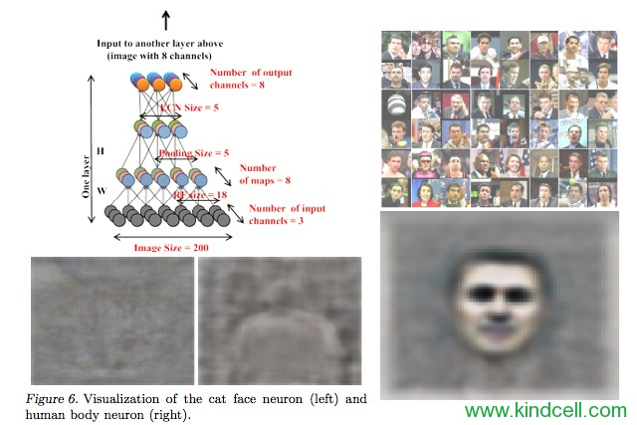
The Google Cat Network

Slide 14
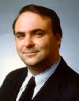
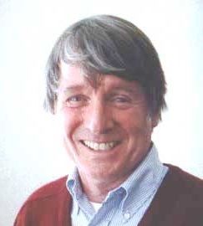
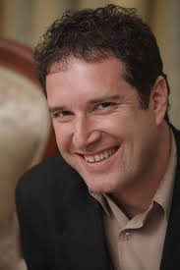
Evolutionaries
John Koza,
Pioneer of
genetic
programming
John Holland (RIP),
Pioneer of
genetic
programming
Hod Lipson,
Cornell University
Evolutionary
robotics
Trial and error optimization algorithms based on adopting Darwinian principles,

Slide 15
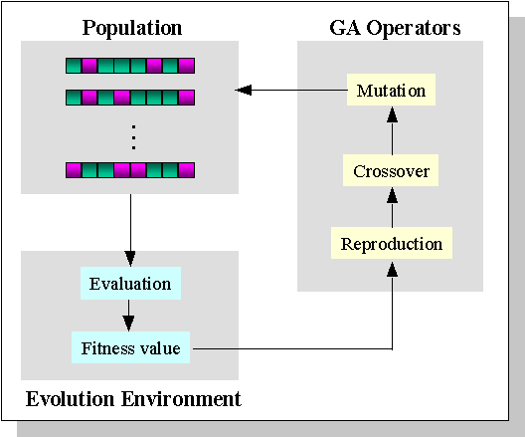
Genetic Algorithms
Search heursitic using inheritance, mutation, selection, and crossover

Slide 16
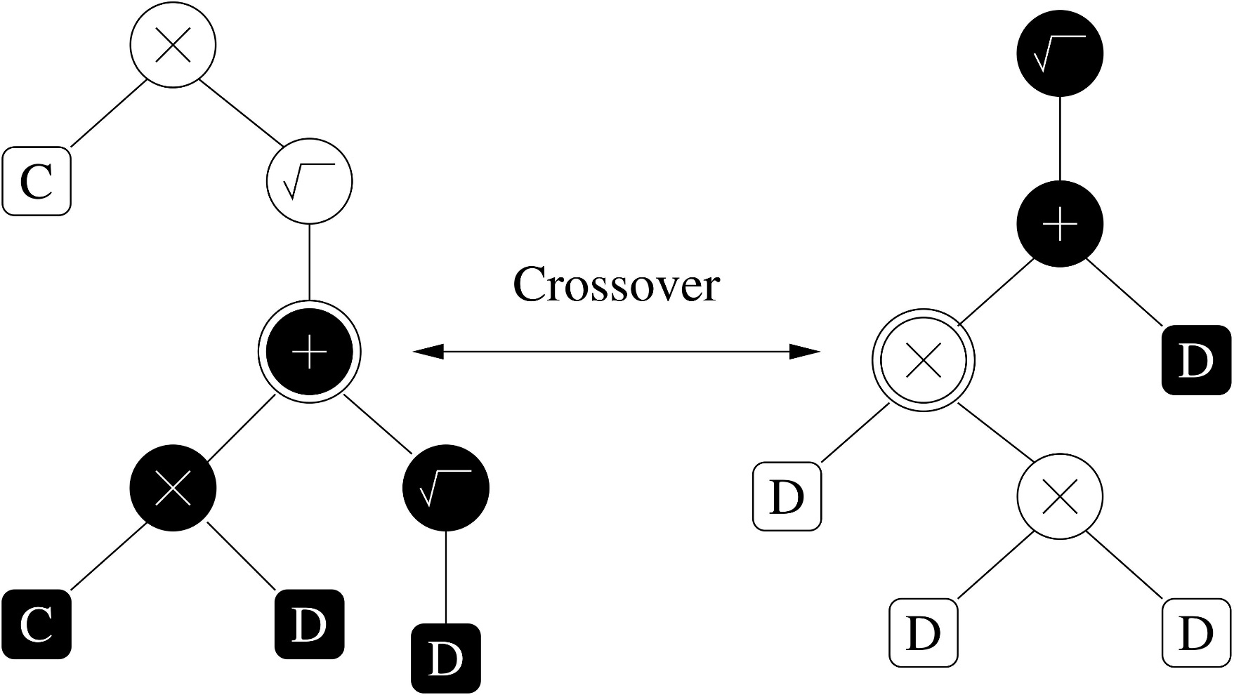
Genetic Programming
Genetic algorithms with a focus on naturally selecting computer programs

Slide 17
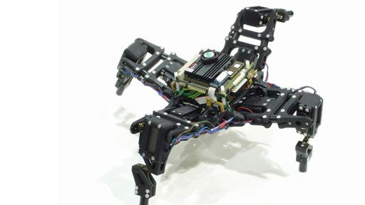
Evolving Robots
Developing controllers for robots via natural selection

Slide 18
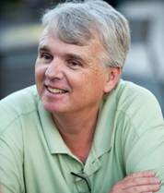
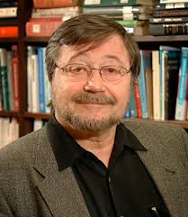
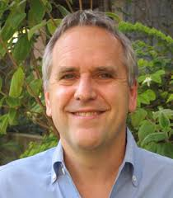
Bayesians
David Heckerman,
Microsoft Research,
Causal Learning
Judea Pearl,
UCLA, Bayesian
Networks
Michael Jordan
Chicago Bulls
Berkeley, EM,
Bayesian Networks
Bayes’ theorem is used to update the probability for a hypothesis as evidence

Slide 19
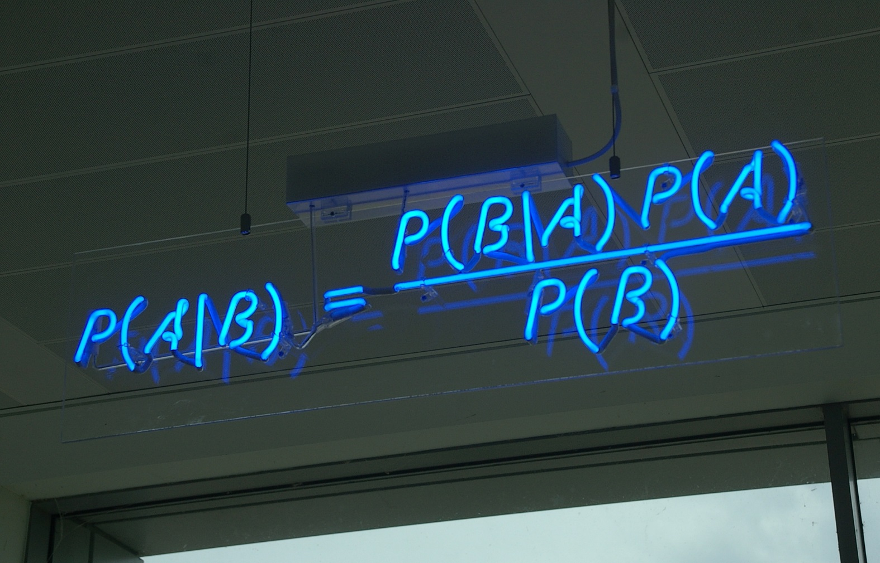
Probabilistic Inference

Slide 20
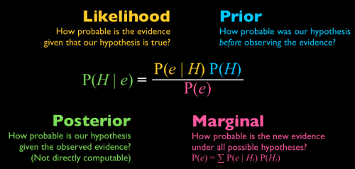
Probabilistic Inference

Slide 21
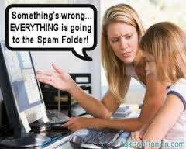
Spam Filters

Slide 22
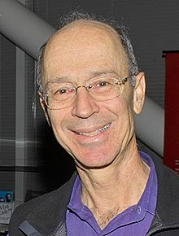
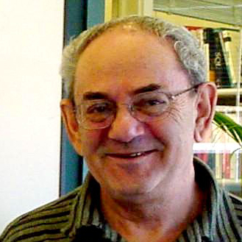
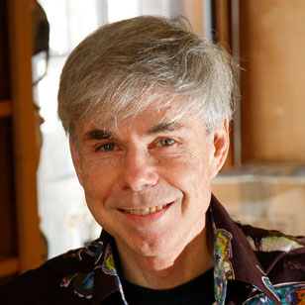
Analogizers
Peter Hart
A* Pruning,
Robotics
Vladimir Vapnik,
AT&T, NEC,
Facebook
Co-inventor of SVM
Douglas Hofstadt
IU Bloomington
Cognitive Science
Less cohesive group, use similarity judgements as the basis for learning

Slide 23
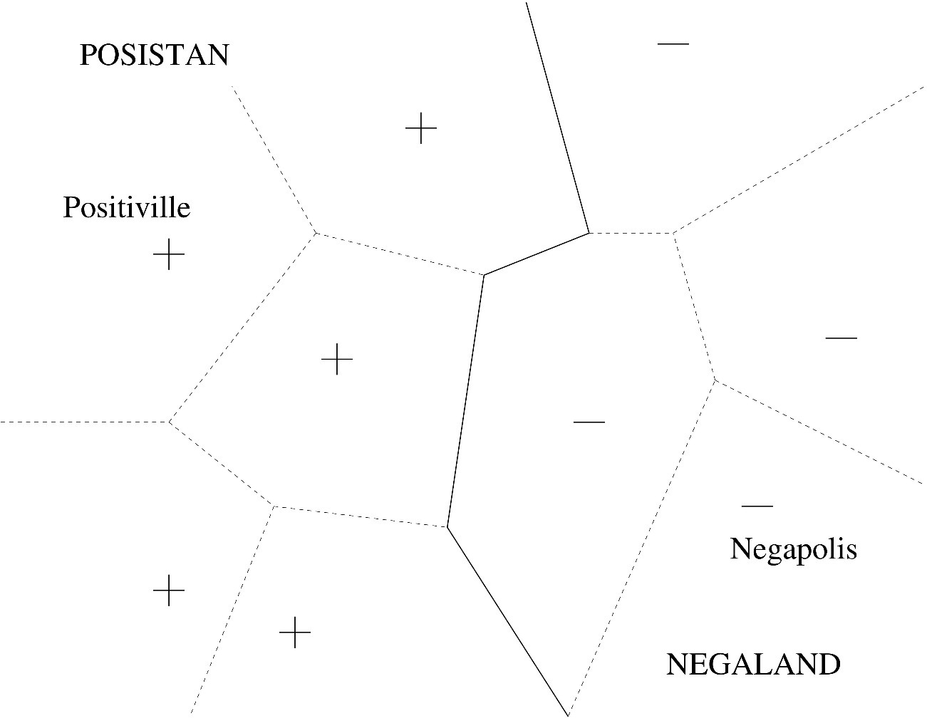
Nearest Neighbor

Slide 24
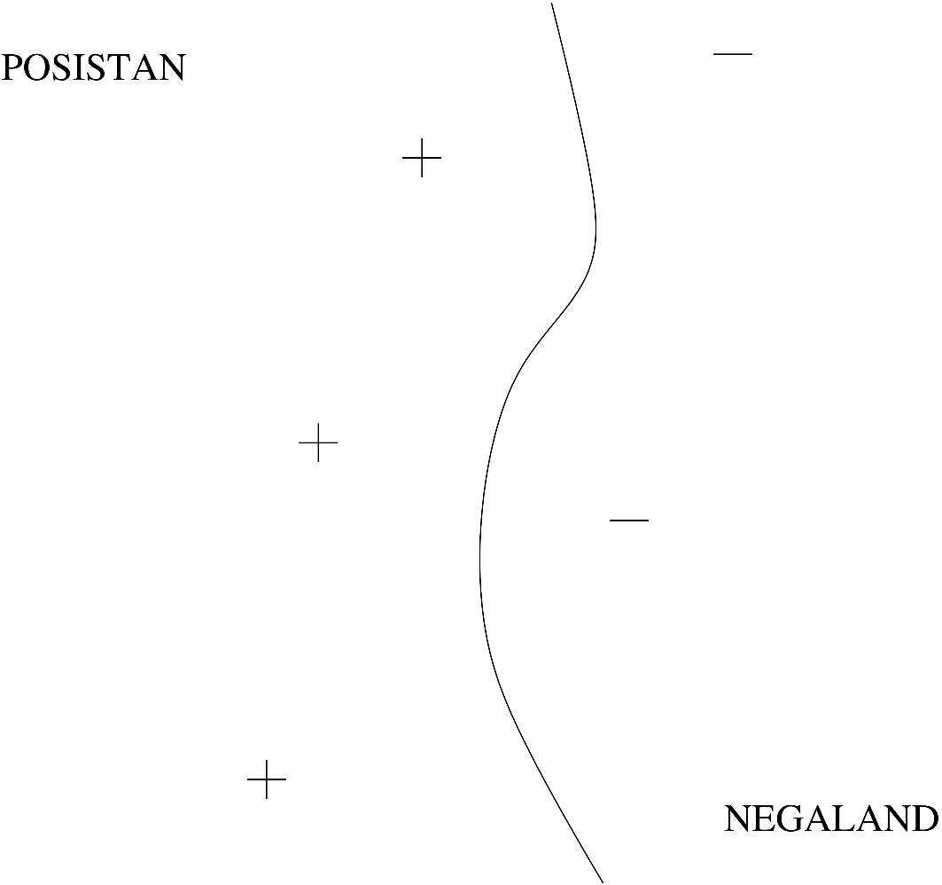
Kernel Machines

Slide 25
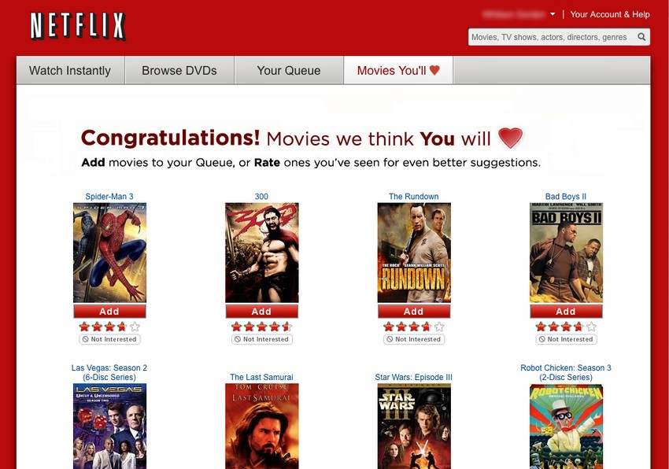
Recommender Systems

Slide 26
Summary: The Big Picture
Tribe | Problem | Solution
Symbolists | Knowledge composition | Inverse deduction
Connectionists | Credit assignment | Backpropagation
Evolutionaries | Structure discovery | Genetic programming
Bayesians | Uncertainty | Probabilistic inference
Analogizers | Similarity | Kernel machines
But what we really need is
a single algorithm that solves all five!

Slide 27
Conclusion: Putting the Pieces Together
Representation
Probabilistic logic (e.g., Markov logic networks)
Weighted formulas → Distribution over states
Evaluation
Posterior probability
User-defined objective function
Optimization
Formula discovery: Genetic programming
Weight learning: Backpropagation

Slide 28
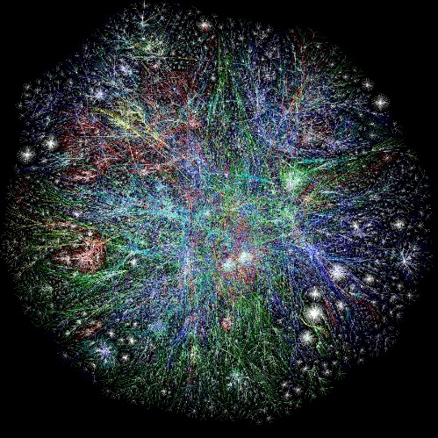
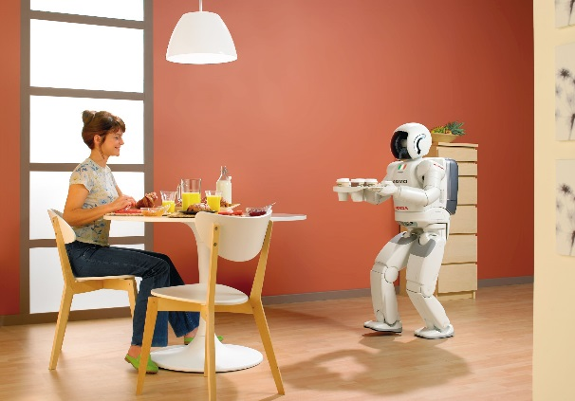
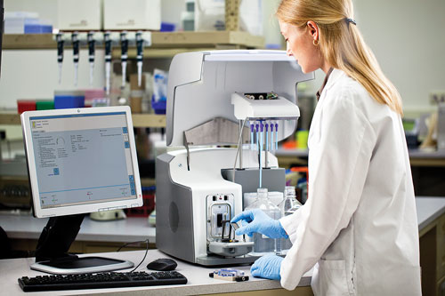

What a Universal Learner Will Enable
Home Robots
World Wide Brains
Cancer Cures
360º Recommenders

Slide 29
Sources
http://ocw.smithw.org/2015fall/mgt458-13227/master-algorithm-domingos-mstralg2.pptx
http://www.amazon.com/The-Master-Algorithm-Ultimate-Learning/dp/0465065708
https://www.youtube.com/watch?v=UPsYGzln-Ys
http://www.kdnuggets.com/2015/11/domingos-5-tribes-machine-learning-acm-webinar.html

