Slide 1
TreeHopper
A graph(ical) explorer for distributed version control source repositories
Pradeep Gowda
<pgowda@iupui.edu>
and
Mehmet Kilicarslan
<mkilicar@indiana.edu>
CSCI 54100 – Fall 2013
CSCI 54100 – Fall 2013

Slide 2
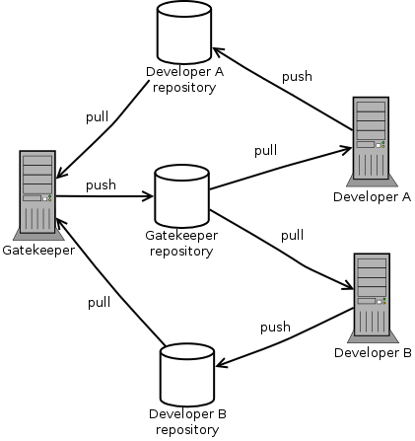
A Distributed Version Control System
Image courtesy: http://zakalwe.fi/~shd/articles/git/thoughts_on_distributed_version_control_and_git.html

Slide 3
Distributed Version Control System
Git / Mercurial / Bazaar / fossil etc.,
Git was developed by Linus Torvalds in 2005
Used by thousands of organizations worldwide.
Currently the most popular DVCS
See – github.com, bitbucket.org, git.apache.org

Slide 4
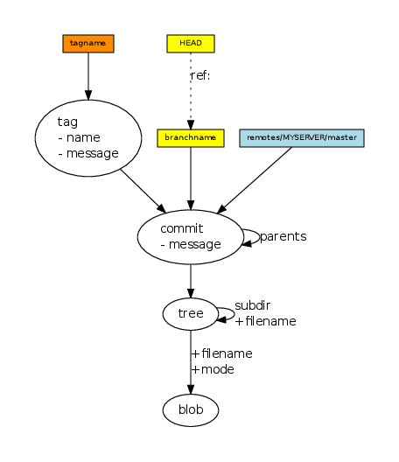
Git internal representation

Slide 5
Repository
Name
url
SourceType
name
CHILD_OF
Commit
hexsha
message
summary
ctime
Date
tag
BELONGS_TO
MODIFIED_BY
File
path
IS_A
COMMITTED_BY
Committer
Name
email
Nodes and their relationships

Slide 6
Technologies used
Neo4j - graph Database
  Py2Neo - python client library for neo4j
  NeoModel – Object Graph Model (OGM) library
Gitpython – python client library for git
Django – Python web application framework
Zurb Foundation – front end HTML/CSS framework.
D3.js – Javascript library for visualisation

Slide 7
How the application works
Neo4j
graphdb
load_git
Git repo
Query
Engine
Browser
(Web UI)
response
View
template
Controller
request
Router
/repo/{name}

Slide 8
Outcome
Application demo

Slide 9
Future Work
Support other DVCS systems – eg: Mercurial.
Handle multiple branches
Add “User” page
Add advanced visualisation techniques.

