Slide 1


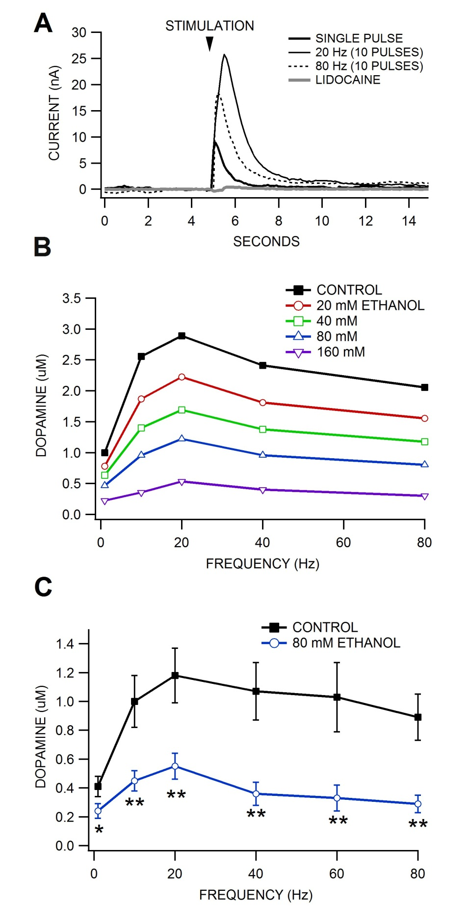
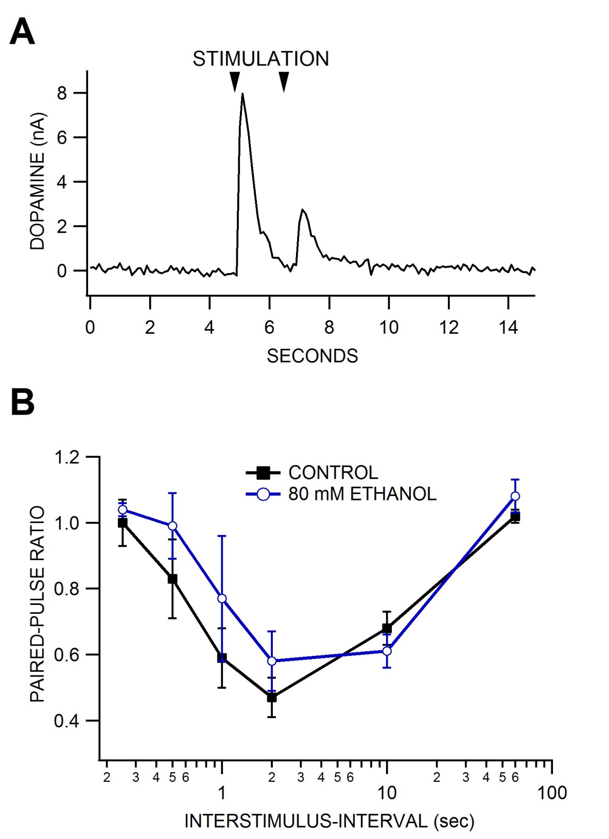
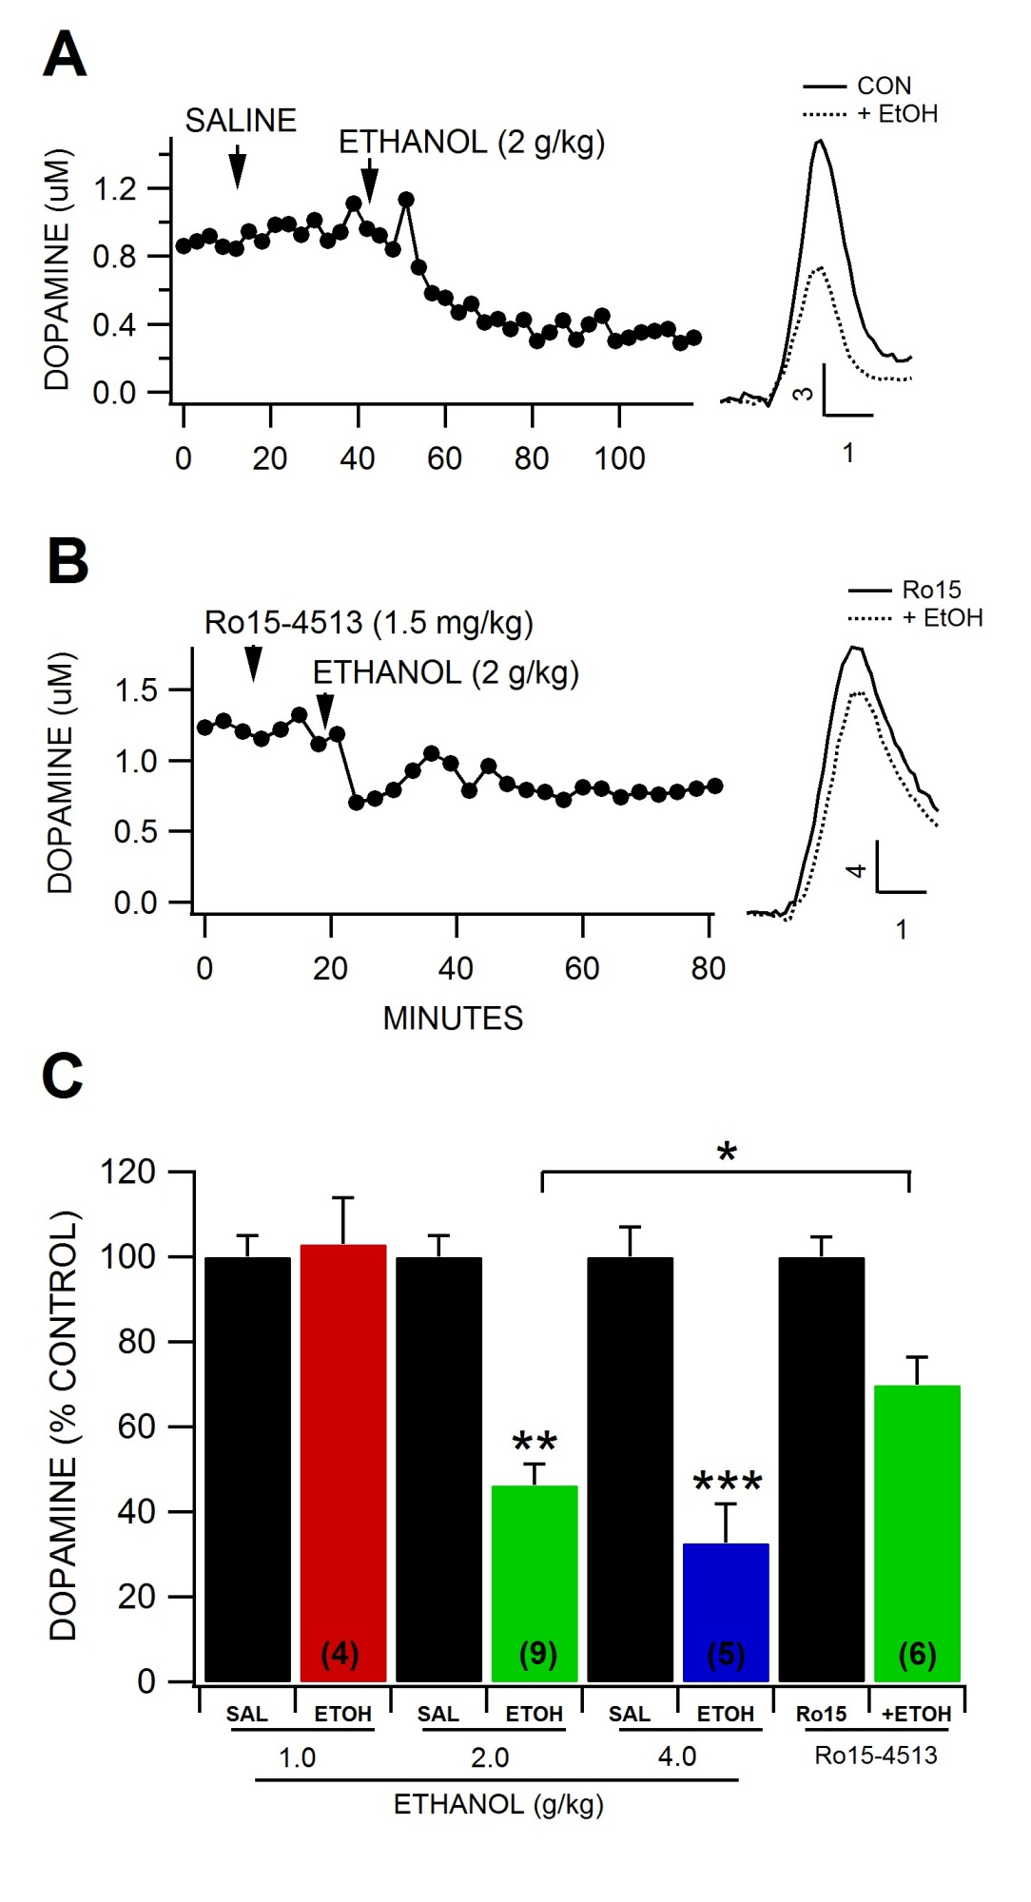
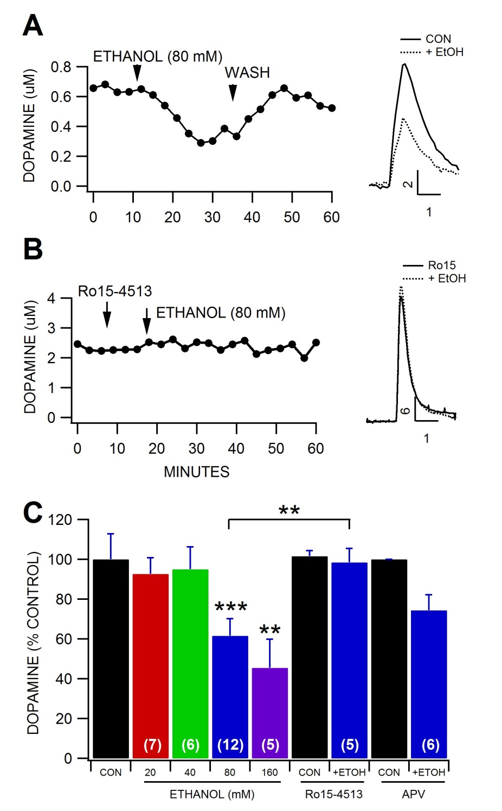
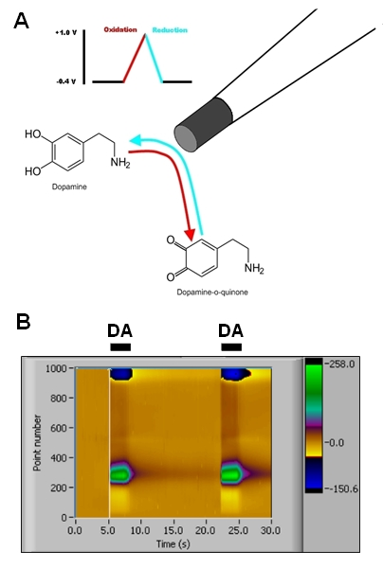
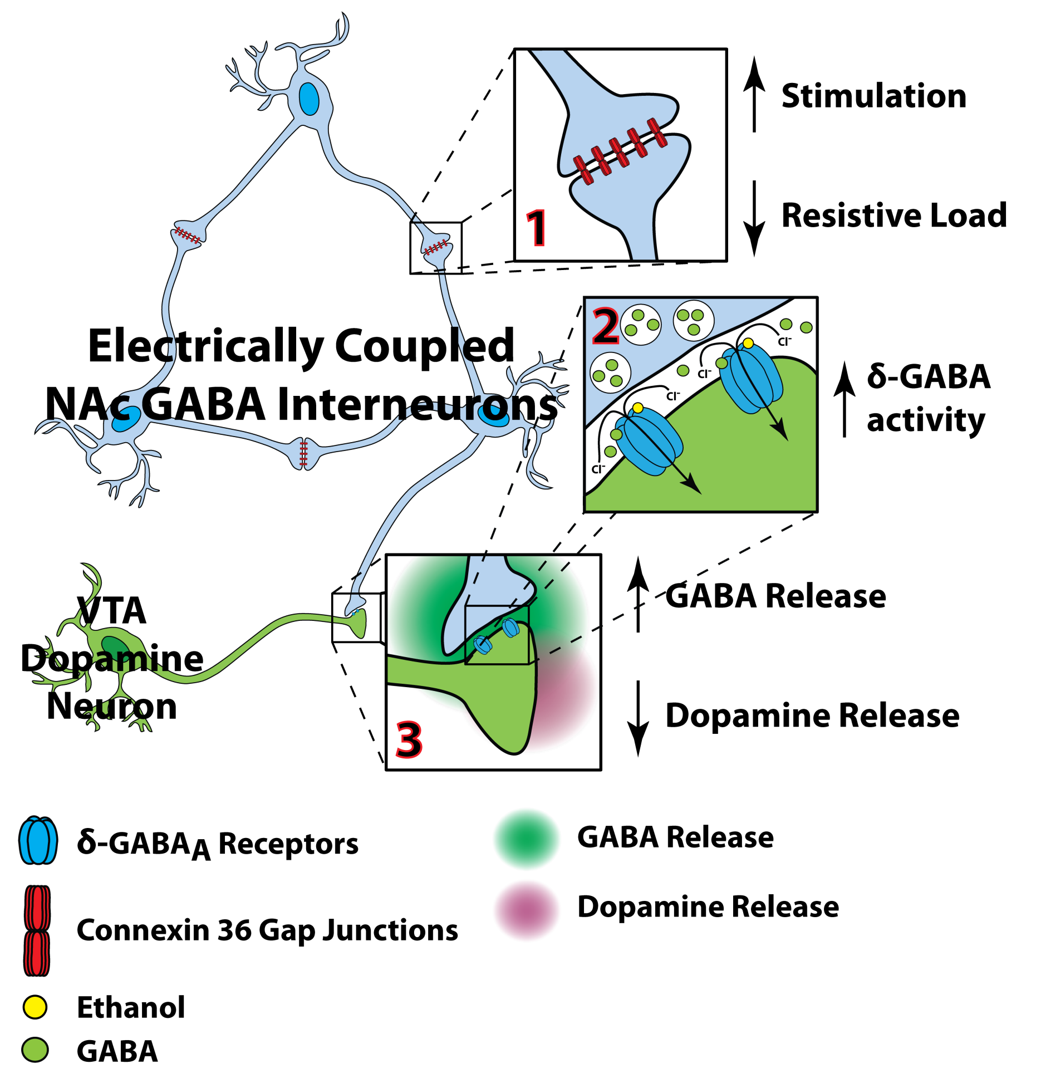
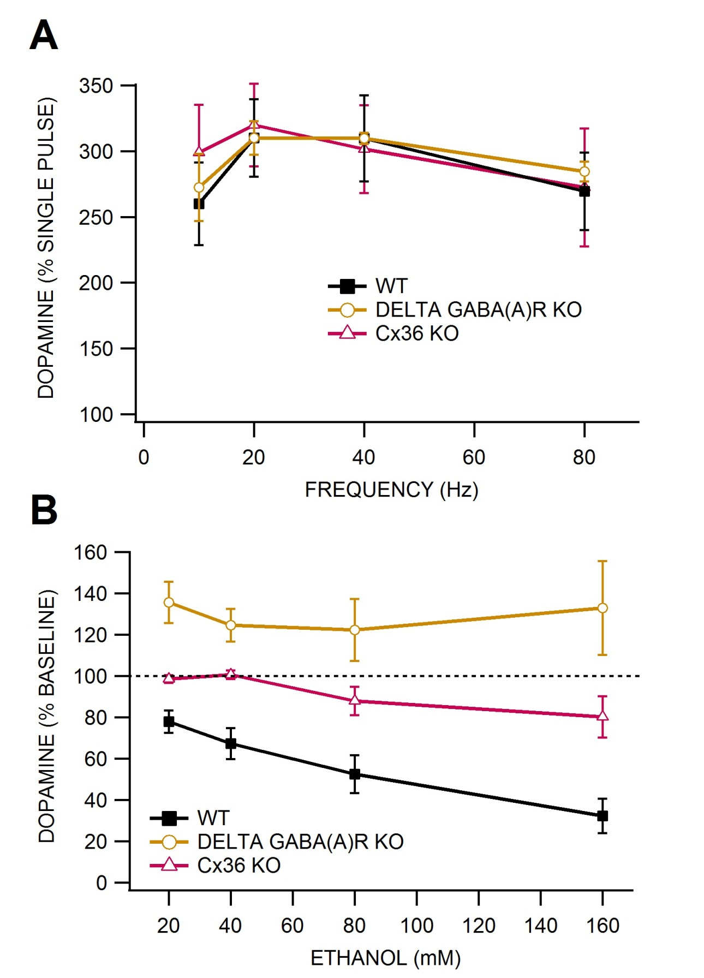
Pharmacology of Ethanol-induced Inhibition of Dopamine
Release in the Nucleus Accumbens
Samuel I. Shin, Benjamin T. Carter, Andrew A. Welch, Ronald C. Lopez, Jordan L. Davies, and Scott C. Steffensen
Introduction
The dopamine (DA) projection from the midbrain ventral tegmental area (VTA) to the nucleus accumbens (NAc) has been implicated in the rewarding properties of ethanol (ETOH). The prevailing view is that ETOH’s rewarding properties are due, in part, to its ability to enhance mesolimbic DA neurotransmission. Electrophysiologic and microdialysis studies have provided compelling evidence that moderate-to-high ethanol concentrations enhance dopamine (DA) neurotransmission in the mesolimbic DA system originating in the VTA and projecting to the nucleus accumbens (NAc). However, using fast scan cyclic voltammetry, another story is emerging, demonstrating that acute, moderate-to-high doses of ethanol decrease evoked DA release at terminals in the NAc. GABA neurons in the VTA that regulate the excitability of DA neurons appear to be important substrates mediating the acute intoxicating properties of ETOH. Although it is well known that NAc GABA neurons project to the VTA, it is not widely appreciated that VTA GABA neurons project to the NAc, similar to DA neurons. Moreover, both VTA and NAc GABA neurons are interconnected via Cx36 gap junctions, at least within their respective areas, and possibly between areas. We have previously demonstrated that GABA neurons in the VTA are inhibited by ETOH (Gallegos et al., 1999; Stobbs et al., 2004; Steffensen et al., 2009) with an IC₅₀ of 1.0 g/kg, a moderately intoxicating dose of ETOH. The aim of this study was to evaluate the involvement of γ-aminobutyric acid (GABA) receptors and connexin-36 gap junctions between NAc GABA neurons in mediating ethanol inhibition of DA release in the NAc.
Results
♦In vitro studies in mice: Ethanol reduces dopamine release in the nucleus accumbens core: Frequency response.
♦In vitro studies in mice: Effects of ethanol on paired-pulse dopamine release responses.
Summary and Conclusions
ETOH reduced DA neurotransmission in vivo and in vitro in CD-1 and C57Bl6 mice. The IC50 for ethanol inhibition of DA release in vitro was 80 mM while the IC50 for ethanol inhibition of DA release in vivo was 2.0 g/kg, consistent with what has been reported by others in rats and mice. These findings support the emerging view that ethanol reduces DA release at terminals in the NAc moderate-to-high doses of ethanol.
Ethanol had no effect on paired-pulse responses, suggesting that it is not affecting release via the DAT or DA autoreceptors
The GABA(A) receptor antagonists bicuculline and Ro15-4513 blocked ethanol inhibition of DA release in vitro and Ro15-4513 significantly attenuated it in vivo, while NMDA receptor antagonists had no effect on ethanol inhibition of DA release, suggesting that ethanol inhibition of DA release at terminals is mediated by delta GABA(A) receptors.
Ethanol did not alter DA release in delta GABA(A) receptor or Cx36 KO mice, providing further support that GABA, and in particular delta GABA(A) receptors are involved in ethanol inhibition of DA release at terminals in the NAc.
Our data support, in part, the emerging story that acute ethanol decreases DA signals in the NAc (Budygin et al., 2001, Jones et al., 2006). Future studies will evaluate the role of the VTA in mediating EtOH reduction of DA neurotransmission, as measured by FSCV.
The diagram below illustrates the synaptic hodology that might underly ethanol effects on DA release at terminals in the NAc.
►Figure 5: Lack of effects of ethanol on paired-pulse dopamine release responses. (A) This is a representative recording of DA release associated with two single pulse stimulations. Note that the second response is a fraction of the first (i.e., paired-pulse inhibition) (B) This graph summarizes the effects of ethanol on paired-pulse ratio (PPR). Surprisingly, unlike in vivo studies, it had no effect on DA release either with single-stim or high frequency stimulation. Ethanol did not alter paired-pulse inhibition.
◄Figure 3: Ethanol reduces Dopamine release in the core of the nucleus accumbens: Frequency response in vitro. (A) These are representative, superimposed currents measured via FSCV and evoked in the core by local stimulation with a single pulse, and with 10 pulses at 20 and 80 Hz. Note that the FSCV current release is maximal at 20 Hz. The sodium channel blocker lidocaine (100 uM) abolished the current indicating that the response obtained by local stimulation was action potential. (B) FSCV currents were calibrated to a known concentration of DA (3 uM) in order to determine DA concentrations. This is a representative experiment wherein an ethanol dose-response was performed in the same slice. Ethanol (20-160 mM) decreased DA release across frequencies. (C) This graph summarizes the effects of ethanol on DA release at one dose (80 mM) across stimulation frequencies (pulse number held constant).
♦In vivo studies in mice: GABA pharmacology of ethanol inhibition of dopamine release in the nucleus accumbens core
◄Figure 6: Ro15-4513 reduces ethanol inhibition of dopamine release in vivo. (A) This graph shows the time course of saline and IP 2.0 g/kg ethanol effects on a representative recording of DA release in the NAc of an Isoflurane-anesthetized mouse. In this animal, ethanol inhibited the DA signal approximately 50%. The inset shows superimposed I vs t plots before and 30 min after 2.0 g ethanol. (B) Ro15-4513 mildly reduced the typical inhibitory effect of ethanol on DA release in this animal. The inset shows superimposed I vs t plots before and 30 min after Ro15-4513 + 2.0 g ethanol. (C) This graph summarizes the pharmacology of ethanol inhibition of DA release in vivo. Ethanol (2.0-4.0 g/kg) significantly inhibited DA release in the NAc. Ro15-4513 significantly reduced the typically inhibition produced by ethanol on DA release. Values in parentheses represent n values. Asterisks *,** represent significance levels P<0.05, P<0.01, respectively. Calibration bars in A-B represent nA and sec.
♦In vitro studies in mice: GABA and glutamate pharmacology of ethanol inhibition of dopamine release in the nucleus accumbens core
Methods
♦Dopamine release measured in vivo and in vitro via fast scan cyclic voltammetry
◄Figure 1: Dopamine Fast Scan Cyclic Voltammetry. (A) Dopamine is oxidized and reduced at specific voltages. The oxidation/reduction of the chemical is measured by a respective change in current. A triangular voltage waveform is applied to a carbon fiber electrode which oxidizes DA to DA-o quinone. (B) The change in current when DA is released is proportional to the concentration of DA. This graph shows the oxidation and reduction currents associated with two boluses of DA in vitro.
♦In vitro studies in mice: Lack of ethanol inhibition of dopamine release in delta GABA(A) receptor and Cx36 KO mice compared to C57Bl6 WT mice
►Figure 2: Dopamine Fast Scan Cyclic Voltammetry in the Nucleus Accumbens core. (A) These are oxidation/reduction currents associated with application of the voltage waveform to a carbon fiber electrode recorded in the NAc core following local stimulation (20 Hz, 10 pulses, 0.27 mA). This is called a Current/Voltage or C/V plot and is sampled 10X/sec. (B) When the C/V plot is plotted over time you can see the DA signal during the stimulation. (C) This graph plots the DA current over time once the carbon fiber electrode is calibrated to a known DA concentration. Both amplitude and kinetic data can be obtained from this data.
▲Figure 4: GABA, but not glutamate, antagonists prevent ethanol inhibition of DA neurotransmission in vitro. (A) This graph shows the time course of 80 mM ethanol effects on a representative recording of DA release in the NAc. In this example, ethanol reduced the DA signal approximately 50 %. The inset shows superimposed I vs t plots before and 15 min after 80 mM ethanol. (B) This graph shows the time course of 80 mM ethanol on a representative recording of DA release after superfusion the α4β3δ subtype GABA(A)R antagonist Ro15-4513. Ro15-4513 (1 uM) reduced the typical inhibition of DA release by ethanol in this neuron. The insets show superimposed I vs t plots before and 15 min after Ro15-4513 + 80 mM ethanol. (C) This graph summarizes the effects of ethanol on DA release as well as the effects of Ro15-4513 on ethanol inhibition of DA release in the NAc. The IC₅₀ for ethanol inhibition of DA release was approximately 80 mM. Ethanol (80 mM) failed to reduce DA release in the NAc in the presence of Ro15-4513. Superfusion of APV did not significantly alter ethanol inhibition of DA release. Values in parentheses represent n values. Asterisks *,**,*** represent significance levels P<0.05, P<0.01, P<0.001, respectively. Calibration bars in A,B represent nA and sec.
▲Figure 7: Lack of ethanol inhibition of dopamine release in delta GABA(A)R and Cx36 KO mice. (A) This graph compares the baseline frequency response in WT vs delta GABA(A)R KO and Cx36 KO mice. There was no significant difference in frequency response between these mice. (B) This graph illustrates the effects of 20-160 mM ethanol on DA release in the NAc of WT mice compared to GABA(A)R and Cx36 KO mice. While ethanol markedly inhibited DA release in WT mice, it did not significantly affect DA release in delta GABA(A)R KO or Cx36 KO mice.
ACKNOWLEDGEMENTS
This work was supported by PHS NIH NIAAA grant AA020919 to SCS

