Slide 1


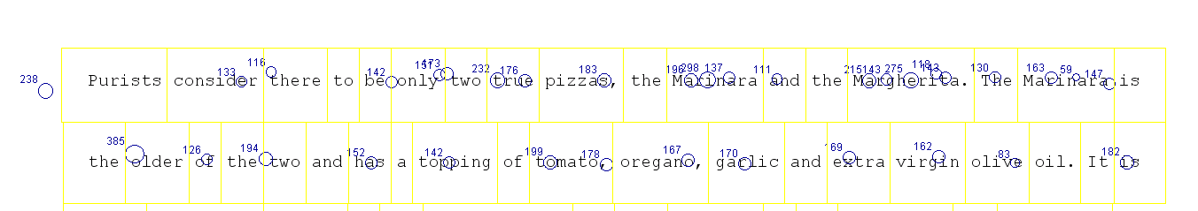
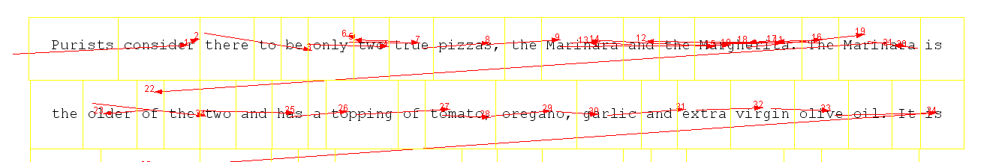
Individual Differences in Eye Movements are Consistent Across Time in Reading
Steven G. Luke, Benjamin T. Carter
What did we find?
Why is this important?
What does this mean?
Eye tracking is fast becoming an important modality in both basic research and clinical practice.
It has been used to investigate:
Reading (Rayner, 2009)
Language (Tanenhaus, 1995)
Memory (Hannula, 2010)
Attention (Reichle, 2010)
Decision making (Orquin, 2013)
Development (Huestegge, 2009)
Schizophrenia (Hutton 2004)
Dementia (Burrell, 2012)
TBI (Samadani 2015)
Stroke (Dong, 2013)
Dyslexia (Huettig, 2015)
ADHD (Loe, 2009)
Eye tracking modalities are being used to study changes in eye movements longitudinally.
Despite greater reliance on these methods little has been done to ensure eye movement behaviors are stable within a healthy individual across time, casting doubt on test reliability.
The reliability of these tests must be established.
We have shown eye movements are consistent within individuals across:
Trials
Lexical variables
Time
This establishes eye tracking as a reliable measure of behavior.
Future efforts should:
Study the stability of these measures in other cohorts (such as the adolescent or elderly).
Determine if these measures are stable over greater spans of time.
 | Cross-session participant correlations |  | Cronbach’s alpha for the means |  |  | Cronbach’s alpha for the standard deviations across trials
Measure | Means | Standard Deviations | All Trials | Session 1 | Session 2 | All Trials | Session 1 | Session 2
Fixation Duration | 0.94* | 0.87* | 0.99 | 0.99 | 0.98 | 0.96 | 0.94 | 0.93
Saccade Amplitude | 0.90* | 0.89* | 0.99 | 0.98 | 0.98 | 0.96 | 0.94 | 0.92
First Fixation Duration | 0.93* | 0.87* | 0.99 | 0.98 | 0.98 | 0.96 | 0.94 | 0.93
Gaze Duration | 0.91* | 0.77* | 0.99 | 0.97 | 0.97 | 0.94 | 0.89 | 0.91
Total Time | 0.72* | 0.6* | 0.95 | 0.9 | 0.93 | 0.92 | 0.85 | 0.9
Go-Past Time | 0.65* | 0.62* | 0.93 | 0.88 | 0.92 | 0.91 | 0.85 | 0.87
Skipping Probability | 0.91* | 0.92* | 0.97 | 0.94 | 0.94 | 0.97 | 0.95 | 0.94
Refixation Probability | 0.93* | 0.91* | 0.98 | 0.95 | 0.96 | 0.97 | 0.95 | 0.93
Regression Probability | 0.83* | 0.87* | 0.98 | 0.95 | 0.96 | 0.97 | 0.95 | 0.96
Cross-session participant correlations for the slope of the function of the influence of length, frequency, and predictability on the various eye-movement measures.
 | Length | Frequency | Predictability
First Fixation Duration | 0.6* | 0.67* | 0.78*
Gaze Duration | 0.73* | 0.71* | 0.69*
Total Time | 0.48* | 0.59* | 0.71*
Skipping Probability | 0.51* | 0.58* | 0.55*
Refixation Probability | 0.58* | 0.58* | 0.03
Regression Probability | 0.54* | 0.55* | 0.64*
References
Ashby, J., et al. (2005). "Eye movements of highly skilled and average readers: Differential effects of frequency and predictability." Quarterly Journal of Experimental Psychology Section A-Human Experimental Psychology 58(6): 1065-1086.
Burrell, J. R., et al. (2012). "Saccadic abnormalities in frontotemporal dementia." Neurology 78(23): 1816-1823.
Dong, W., et al. (2013). "Ischaemic stroke: the ocular motor system as a sensitive marker for motor and cognitive recovery." Journal of neurology, neurosurgery, and psychiatry 84(3): 337-341.
Samadani, U., et al. (2015). "Eye Tracking Detects Disconjugate Eye Movements Associated with Structural Traumatic Brain Injury and Concussion." Journal of Neurotrauma 9: 150206092348005-150206092348005.
Hannula, D. E., Althoff, R. R., Warren, D. E., Riggs, L., Cohen, N. J., & Ryan, J. D. (2010). Worth a glance: using eye movements to investigate the cognitive neuroscience of memory. Frontiers in human neuroscience, 4(166).
Huestegge, L., Radach, R., Corbic, D., & Huestegge, S. M. (2009). Oculomotor and linguistic determinants of reading development: A longitudinal study. Vision Res, 49(24), 2948-2959.
Huettig, F. and S. Brouwer (2015). "Delayed anticipatory spoken language processing in adults with dyslexia - Evidence from eye-tracking." Dyslexia 21(2): 97-122.
Hutton, S. B., et al. (2004). "The relationship between antisaccades, smooth pursuit, and executive dysfunction in first-episode schizophrenia." Biological Psychiatry 56(8): 553-559.
Loe, I. M., et al. (2009). "Oculomotor performance identifies underlying cognitive deficits in attention-deficit/hyperactivity disorder." J Am Acad Child Adolesc Psychiatry 48(4): 431-440.
Orquin, J. L., & Loose, S. M. (2013). Attention and choice: A review on eye movements in decision making. Acta psychologica, 144(1), 190-206.
Rayner, K. (2009). Eye movements and attention in reading, scene perception, and visual search.
Reichle, E. D., et al. (2010). "Eye Movements During Mindless Reading." Psychological Science 21(9): 1300-1310.
Tanenhaus, M. K., Spivey-Knowlton, M. J., Eberhard, K. M., & Sedivy, J. C. (1995). Integration of visual and linguistic information in spoken language comprehension. Science, 268(5217), 1632
What did we do?
First session
Second session
Gaze trigger
Text presented after a stable fixation.
Each participant read 20 new paragraphs in the following fashion.
Each participant read 20 paragraphs in the following fashion.
Once finished the participant answered a yes/no question via button press.
Gaze trigger
Text presented after a stable fixation.
Once finished the participant answered a yes/no question via button press.
*Significant following Bonferroni correction for multiple comparisons
*Significant following Bonferroni correction for multiple comparisons

