Slide 1

Money On The Go (MOG) Smart Phone Application
Investment Mobile App
Prepared by MOG Team:
Ayodeji Ojo Issac Osobu
Awad Albalawi Rotimi Oduntan
Blandine Meillon (Team Leader) Teko Folligan

Slide 2
Introduction
Purpose of this presentation
The aim of this presentation is to visually present our project through graphics, charts and links.
To highlight specific figures/data
Team:
Team in scrum is self-organizing and consists of people with cross-functional skills who do the actual work.
Product manager (owner) : Prof. Kirova V.
Scrum Master: Blandine M.
Team member (Developer): The rest of the team.

Slide 3
Agenda
Project Overview (Issac)
Competitive Landscape (Ayo)
System Functionality (Awad)
Extra Functional Requirements (Teko)
UI – Prototype (Blandine)
Future Enhancements (Blandine)
Project Management (Rotimi)
Conclusions (Teko)

Slide 4
Project Overview

Slide 5
Project description
Money on the Go is a Data-Driven Financial Planner.
The aim of this project is to design an App that will act like an investment advisor and show hidden fees.
To track and/or manage investments the user owns across every device of choice.
Enable users get high return on investment & forecast.
Market Research Studies & Customer Problem Identification
Lack of access to multiple and competitive Investment Consult Institutions and Investment Brokerage Institutions
Profit reductions due to hidden fees and unaware taxes from financial exchange activities
Insufficient real time mobile access to financial news, market predictions and sound investment advices and recommendations
Lack of “anytime” access to investment activities that will enable ideal investment management

Slide 6
Target Domain
Mobile application is a framework for whole integration of critical business systems and their direct connection to key constituencies via web through mobile devices.
Key players are
Users or Investors
Banks or Financial Institutes
Stock Markets
Project Status
Delivery of designed and tested prototype that demonstrates web-application capabilities that addresses:
Customer needs
Meet Project Goals
Meet corporate project objectives and enhance business activities
Satisfy projected timeline
Addresses project constraints with sound solution
Provide solution to Product Backlog Emphasis
Maximize product functional efficiency through Strength and Opportunity utilization so as to reduce influences of Weakness and Threats (SWOT-Solution)

Slide 7
Competitive Landscape (Markets – Product – Competitors)

Slide 8
Competitors & Key Features
 | Money On The Go | SigFig.com | Wealthfront.com | WikiInvest
iPhone & iPad app | Yes | No | No | Yes
Android apps | Yes | Yes | No | Yes
Tablets, desktops & laptop | Yes | No | Yes | Yes
401(k)s, IRAs, Mutual Personal funds, etc. | Yes - All | Yes – no personal funds | Yes – no personal funds | Yes – no personal funds
Traditional IRA | Yes | No | Yes | No
Trading, Stocks, etc. | Yes | Yes | Yes | Yes
Read-only (free version) | Yes | Yes | No | No
Non read-only (charge) | Yes | No | Yes | Yes
Expose & eliminate hidden fees | Yes | Yes | No | No
Projection | Yes | Yes | No | Yes
Weekly reports | Yes | Yes | No | Yes

Slide 9
Competitors & Key Features (1)
Interface | Ultra-simple | Less simple | Simple | Not that simple
Minimum account size | None | None | $5,0000 | $5,0000 +
Advice on how to save | Free | Free | Fees | Fees
Investment advise | Yes | Yes | No | Yes
Risk tolerance | Yes | No | Yes | Yes
Ease of use | Easiest | Easier | Easy | Not Easy
High level security | Yes | Yes | Yes | Yes
Portfolio Management | Yes | Yes | No | No
Portfolio comparison | Yes | No | No | No
Push Alerts | Yes | Yes | Yes | Yes
Recommendations | Yes | No | No | No
Transactions handled | Yes – Premium only | No | No | No
Prediction | Yes | No | No | Yes
Getting News | Yes | No | No | No

Slide 10
SWOT Analysis
Strengths
Highly skilled group members
Web 2.0 environments
Weaknesses
Integration with other brokerage companies
Advance adaptable software
Revenue model generation for the company
Customized security layer
Market research to meet customer objectives
Opportunities
Improved customers satisfaction
Huge growth opportunity
Threats
Information security
Piracy issues
Identify the key features of your target/future product
Improved investment forecasting
The company can diversify future business strategy
Internal
External

Slide 11
System Functionality

Slide 12
System Functionality – Use Case Diagram

Slide 13
System Functionality – Use Cases
Name: Login to MOG App
Goal in Context: User/Investor wants to login to MOG App
Scope: Home Page of MOG
Primary Actor: User/Investor
Secondary Actors: None
Preconditions:
User/Investor has an active MOG account
Success End Condition:
User/Investor has successfully logged into MOG account
Failed End Condition:
User/Investor can’t login to MOG account
Scenario: Step 1: App prompts for username and password
Step 2: User/Investor enters username and password
Step3: User/Investor has successfully logged into MOG account

Slide 14
System Functionality – Use Cases (1)
Extensions:
Step 2a: User/Investor enters wrong/mismatch username and password
Step 2a1: App notifies User/Investor for invalid or wrong/mismatch username/password.
Step 2a2: User/Investor asks for forgot/reset password
Step 2a3: App prompts for an email address
Step 2a4: User/Investor enters the email address
Step 2a5: App asks for security questions
Step 2a6: User/Investor answers all questions
Step 2a7: App sends current/temporary username/password to the User/Investor‘s email address.
Step 2a8: User/Investor retrieves or resets username/password and enters them.
Step 2a9: App continues with Step 3

Slide 15
System Functionality – Use Cases (2)
Variations:
Step 2: User/Investor enters username and password
Step 2a: using username
Step 2b: using an email address
Step 2c: using touch screen
Step 2d: using non-touch screen
Step 2a5: App asks for security questions
2a5-1: using variation type of questions and answers
Related Information:
Priority: High
Performance Target: From 30sec + or depending of the user/investors skills and outside forces.
Frequency: Many times
Superordinate: None
Subordinate: None
Schedule:
Due Date: March 27th, 2013

Slide 16
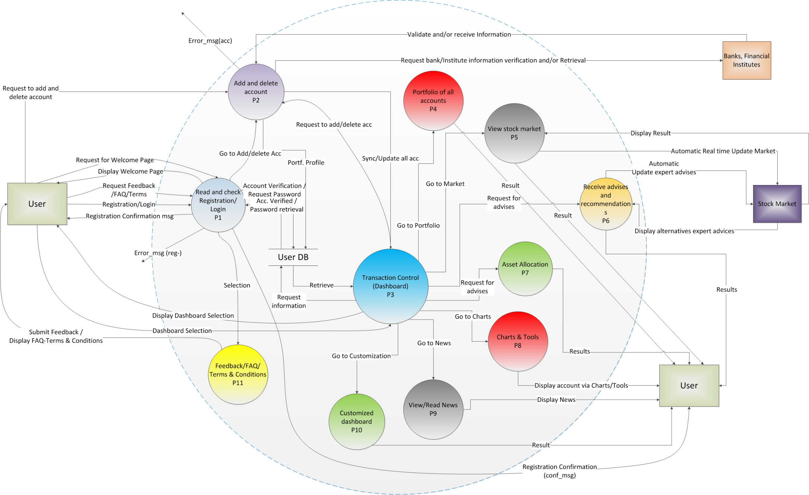
System Functionality – DFD L1 MOG APP

Slide 17
Extra Functionality Requirements
Performance
Availability
24/7
Any Devices
Security
Between User/Investor & their MOG Account (fist level):
VeriSign, security Token of 256-bit SSL, Trustee
Password Credentials
Security Authentication
Between MOG App & Banks/Financial Institutes (second level):
VeriSign, security Token of 256-bit SSL, Trustee
Password & Portfolio Credentials
Certificate Credential
Security Authentication
Portfolio Data Exchange
Federal Regulations For Info Exchange
USA Patriot Act (Section 326)
Federal Financial Institutions Examination (FFIEC)
Title V, Subtitle A of the Gramm-Leach Bliley Act (GLA)

Slide 18
UI – Prototype & Future Enhancements

Slide 19
UI – Prototype
Preconditions:
Interest of using the app
Valid Bank and/or financial investments account(s)
Valid username and password of the above account(s)
Valid email address
Download the application via www.moneyonthego.com or through your apps store
Application prototype via web
MOG Mobile App (View this through Chrome for better result)
copy & paste: http://blandinetchanque.com/Portfolio/NJIT/IS663/

Slide 20
Future Enhancements
Premium-version Application
Current characteristic of the “free-version”
Not a read-only app
Investment management functionality
More dashboard customization templates
Run on all browsers and devices
Sample app prototype via other devices
MOG App on other devices (View this through Chrome)
Or copy & paste the link: http://blandinetchanque.com/Portfolio/NJIT/IS663/OtherDevices_MOG_prototype.html

Slide 21
Project Management

Slide 22
Project Organization
It focuses on the software process model which is a set of correlated actions.
Scrum Agile method is used as the process model for this project.
The iteration process will have the following iteration planning, development work and iteration review.
Project teams:
Product Manager, Scrum Master & the Developers.
Resources:
MOG architectures: is design using Microsoft Databases and Amazon Multidimensional Data Storage (Data Repository)
Data will be transfer using protocol technologies like HTTP, WEB Service and TCP
Java script and ASP .NET MVC

Slide 23
Risk Analysis
Risk Type | Possible Risks | Effects | Probability | Strategy | Potential indicators
Technology (1) | Security breach and data loss can emerge when customers’ accounts are hacked by malwares and viruses and connect to MOG network Possible security breach when syncing with customer financial institutes | Catastrophic | High | Encrypted the system with 256-bit SSL security Use SSO (Single Sign On) which is a blind verification process what will authenticate the user inputs and link it to the appropriate financial institute. Use a 60 seconds timer that will verify all authorized processes constantly running on the MOG network | Three unsuccessful attempts to login into customers’ account Unexpected shut down of the system IDM (Intrusion Detection Monitor) detect malicious software or unauthorized access to the network
People (2) | Key programmers and decision makers are sick and unavailable during critical time Skilled personals are hard to find for a short period of time | Serious | Moderate | Reorganize team and decision makers so there is more overlap of work and people therefore understand each other’s job function | Poor communication and relationship among team members High staff turnover
Estimation (3) | The time required to release the software application is underestimated The size of the software is underestimated | Tolerable | Moderate | Alert customers and stake holders of potential difficulties and possibility of delays Provide assistance to all developers falling behind Investigate bringing in qualified consultants for short period of time | Failure to deliver PBL during iteration Failure to clear reported defects Failure to meet agreed dead line

Slide 24
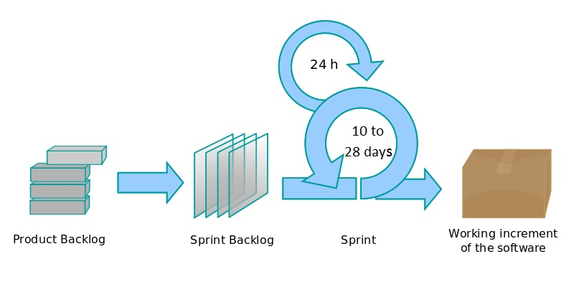
Work Breakdown
Scrum Agile Diagram Representation

Slide 25
Work Breakdown & Schedule
 | Level 1 | Level 2 to 3 | Time Est. (Days)
Money On The Go App | Phase I | 1.1 Evaluation & Analysis of Requirements 1.2 Gather Data – Functionality 1.3 Design the Module 1.4 Create Code & Design for 1.4.1 User Login and Registration 1.4.2 Add account to Profile 1.4.3 Sync all account to a single dashboard 1.4.4 See all hidden fees 1.1.5 Code Review & Unit Testing 1.1.6 Rework if Any SPRINT 1 | 2 2 2 - 7 2 5 3 2 2 27
 | Phase II | 2.1 Verify & Analysis User Requirements 2.2 Gather Data – Functionality 2.3 Coding & Design 2.3.1 Update accounts 2.3.2 Real time update 2.3.3 Receive recommendation 2.3.4 View investments via charts/tools 2.3.5 Read more about the app’s features 2.4 Code Review & Unit Testing 2.5 Rework if Any SPRINT 2 | 1 2 - 2 5 7 4 3 2 2 28
 | Phase III | 3.1 Verify & Analysis User Requirements 3.2 Gather Data – Functionality 3.3 Coding & Design 3.3.1 Weekly summary 3.3.2 Select automatic update 3.3.3 Rate/view feedback 3.5 Code Review & Unit Testing 3.6 Rework if Any SPRINT 3 | 1 2 - 2 2 4 2 2 15
 | Phase IV | 4.1 Verify & Analysis all User Requirements 4.2 Install Live System on Mobile 4.3 Overall Code Review & Unit Testing 4.4 User Acceptance Testing 4.5 Rework if Any 4.6 App Code Documentation 4.7 Formal Acceptance 4.8 GO LIVE & Support SPRINT 3 | 1 1 2 1 1 2 1 1 10

Slide 26
Project Reporting Activities
Report Type | Prepared by | Responsibility | Preparation Frequency/Period | Submission | Format
Progress Report | Technical Lead | Product Manager/ Scrum Master | Daily | Project Manager | Email/Stand-up meeting
Final Report | Technical Lead/QA | Product Manager/ Scrum Master | Weekly | Project Manager | Email & Class Review
Product Evaluation | Testers/Product Owner | Product Manager/ Scrum Master | Iteration process/Each deployment stages | Product Owner Cc: Project Manager | Project SharePoint Link/Production Server / Moodle(NJIT)
Project Monitoring Breakdown
Weekly review/feedback meeting with the Product Owner
Weekly Skype meeting
Using Wiggio.com for file sharing
Using Google doc for file sharing/update
Release deliverables weekly

Slide 27
Conclusions

Slide 28
Team Work:
Participants
Challenging - Didn’t go as planned
Broken communication among members
Participations
Members met everyday, weekly to keep track of daily progress
Feedback from Scrum Master and Project Owner
Timeline
PBL stated clearly to meet the deliverables
Members difficulties to submit work
Meetings & Discussions
Skype - Wiggio - Google Docs - Emails - Cell phones - Physical meetings (library and/or after class)
Open Issues
Some key features of the free version where left of this release due to time constraint.
Standards
Code
Latest PCI Data Security Standard (DSS)
256–bit SSL encryption

Slide 29
Questions & Answers

