Slide 1
Comparing Imputation Methods II
Modelling Uncertainty in ICU mortality
Ben Cooper – 5th March 2021

Slide 2
Aims and objectives
Develop datasets and models using mortality measures as response variables
Assess the performance of imputation methods on real missing data
As before, use the APACHE-II score as the primary predictor of mortality
Continuous and longitudinal variables

Slide 3
Defining mortality outcome: Two approaches
Outcome measure: | 30 day mortality | In-unit mortality
Predictor: | APACHE-II score at discharge (worst values within 24h) | APACHE-II score at admission (worst values within 24h)
Total patients: | 6,968 | 7,398
Deaths: | 319 (4.58%) | 430 (5.81%)
Missing APACHE-II data: | 689 (9.89%) | 934 (12.6%)
Median APACHE-II score: | 13 ± 6 | 24 ± 8

Slide 4
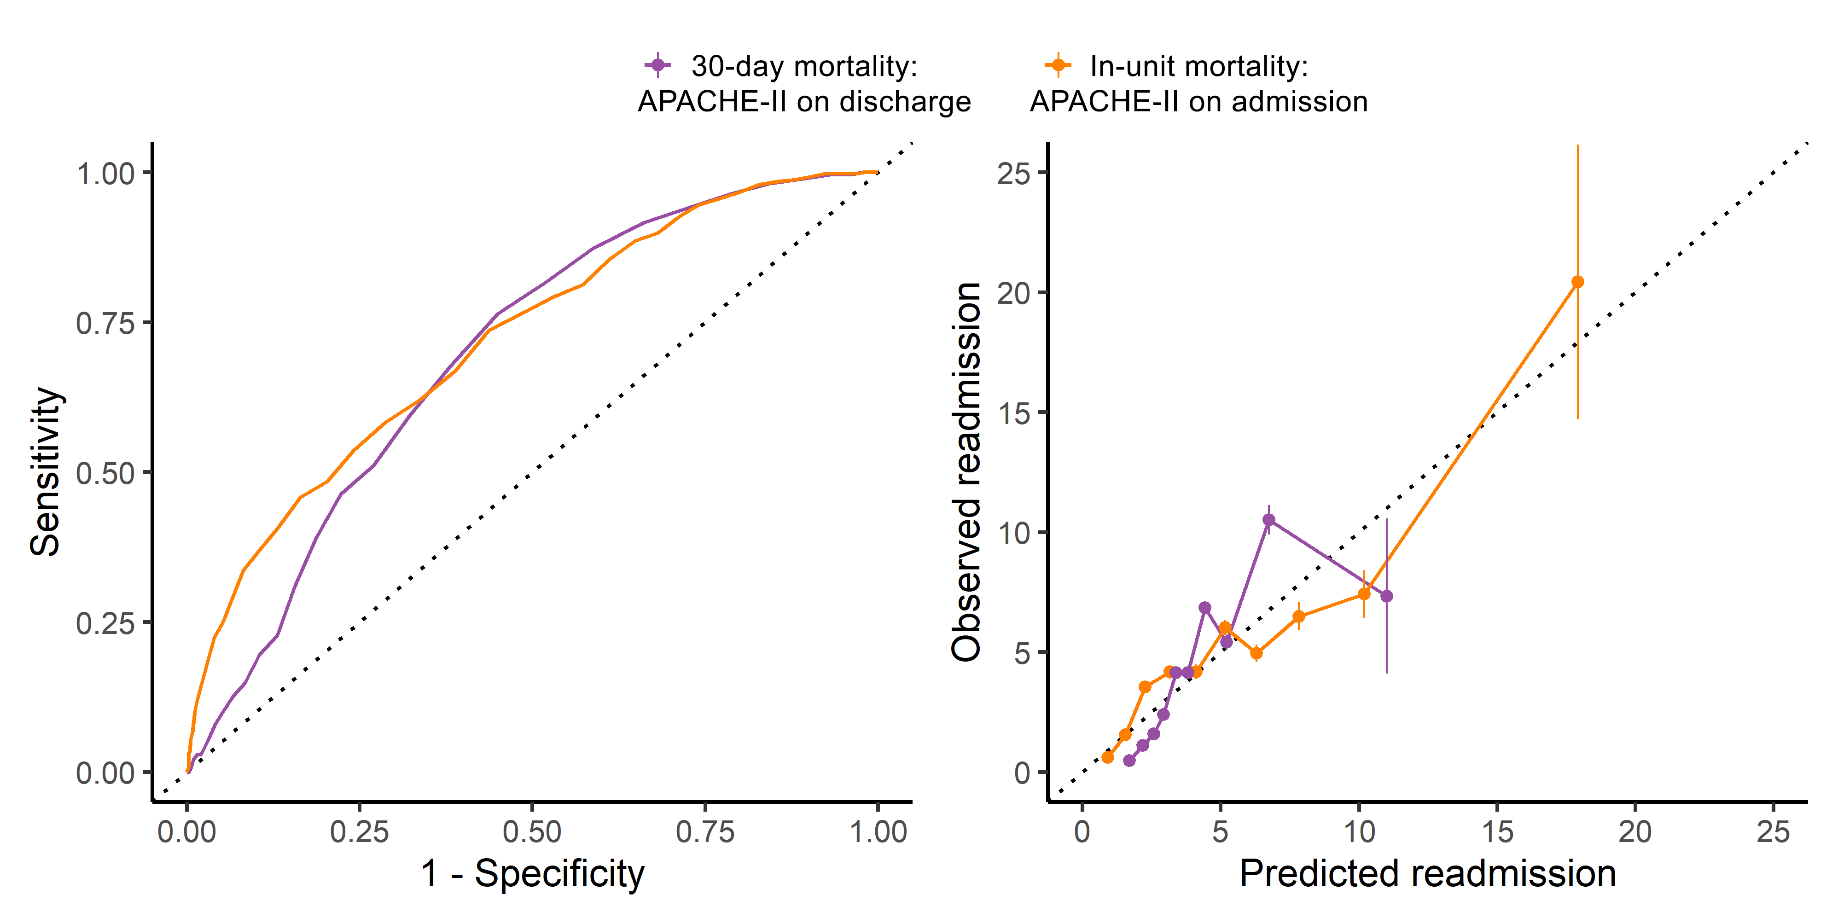
Both approaches show decent predictive performance
AUC = 0.719
AUC = 0.694

Slide 5
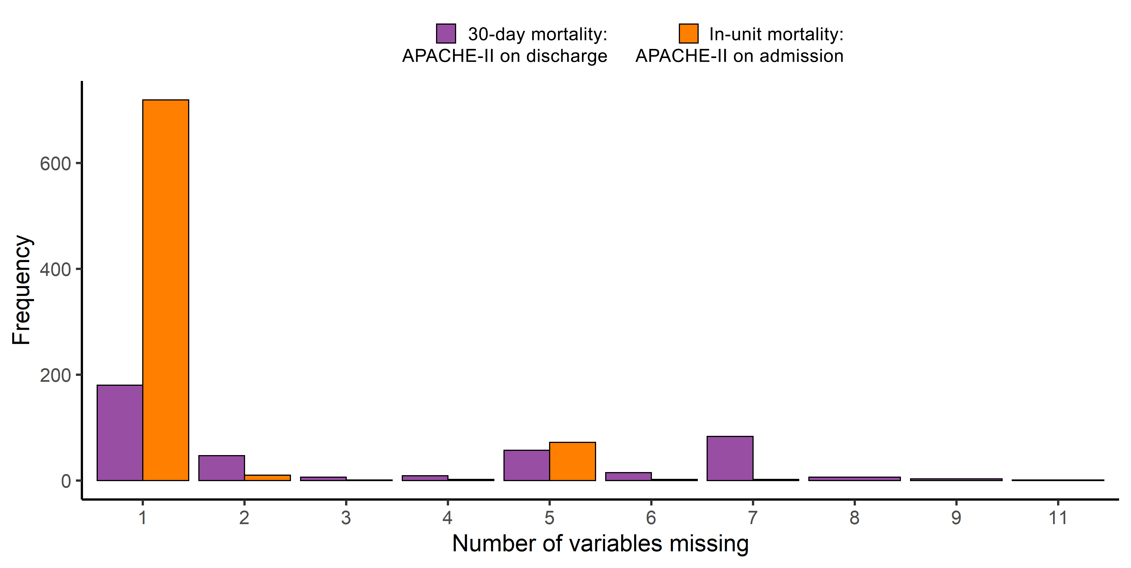
Datasets differ in the structure of data missingness

Slide 6
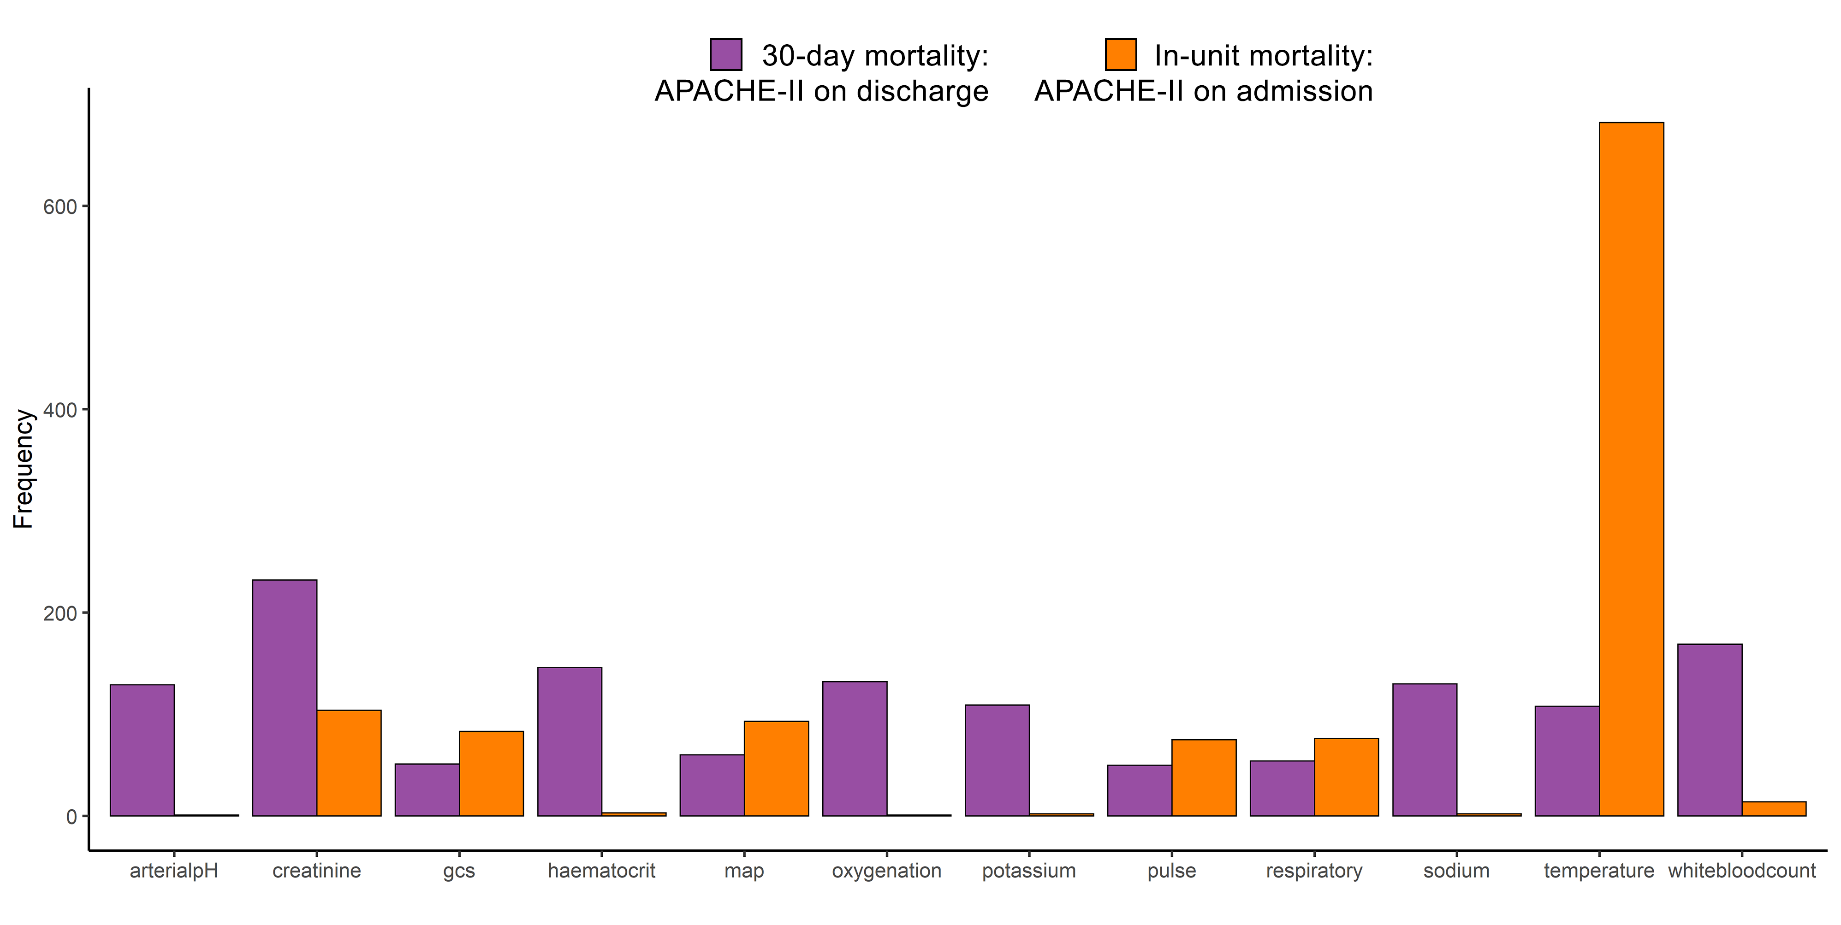
Datasets differ in the structure of data missingness

Slide 7
Methodological approach
Take mean and sd of discrimination and calibration
Impute data with a given method
Missing cases
Sample 10%
Repeat x10,000
Full dataset
Measure discrimination & calibration
Predict mortality
Complete cases
Train mortality model

Slide 8
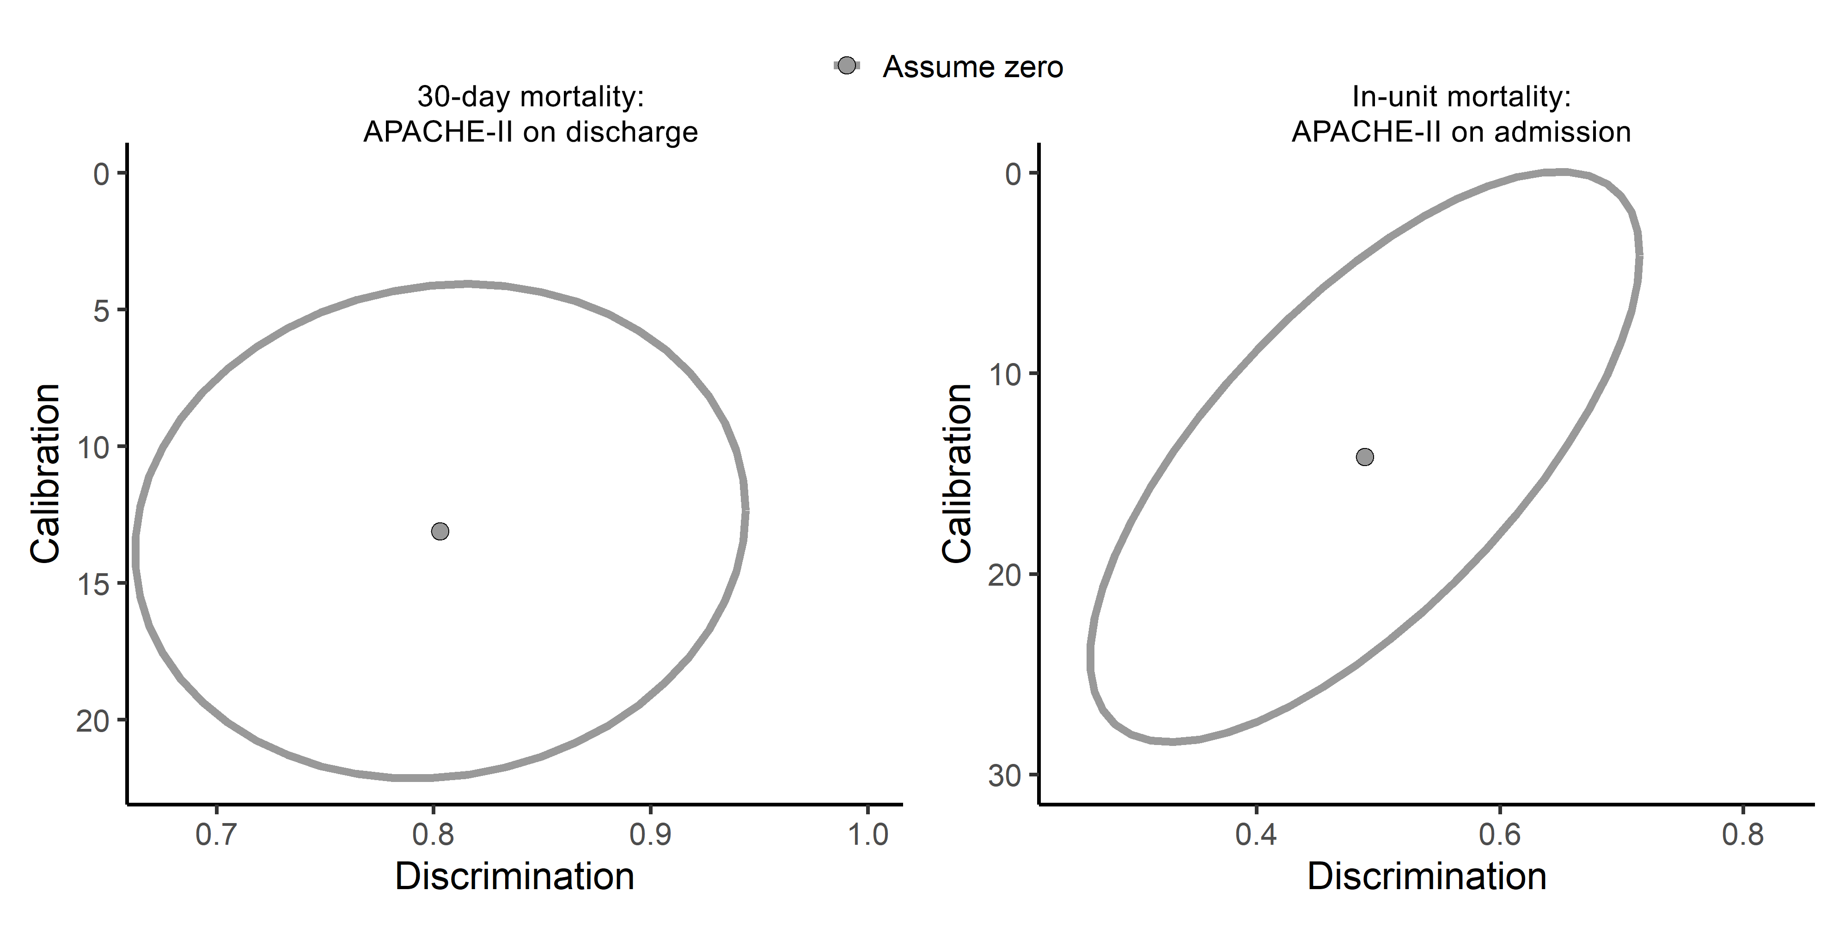
Assuming zero works for discharge scores, but not admission scores

Slide 9
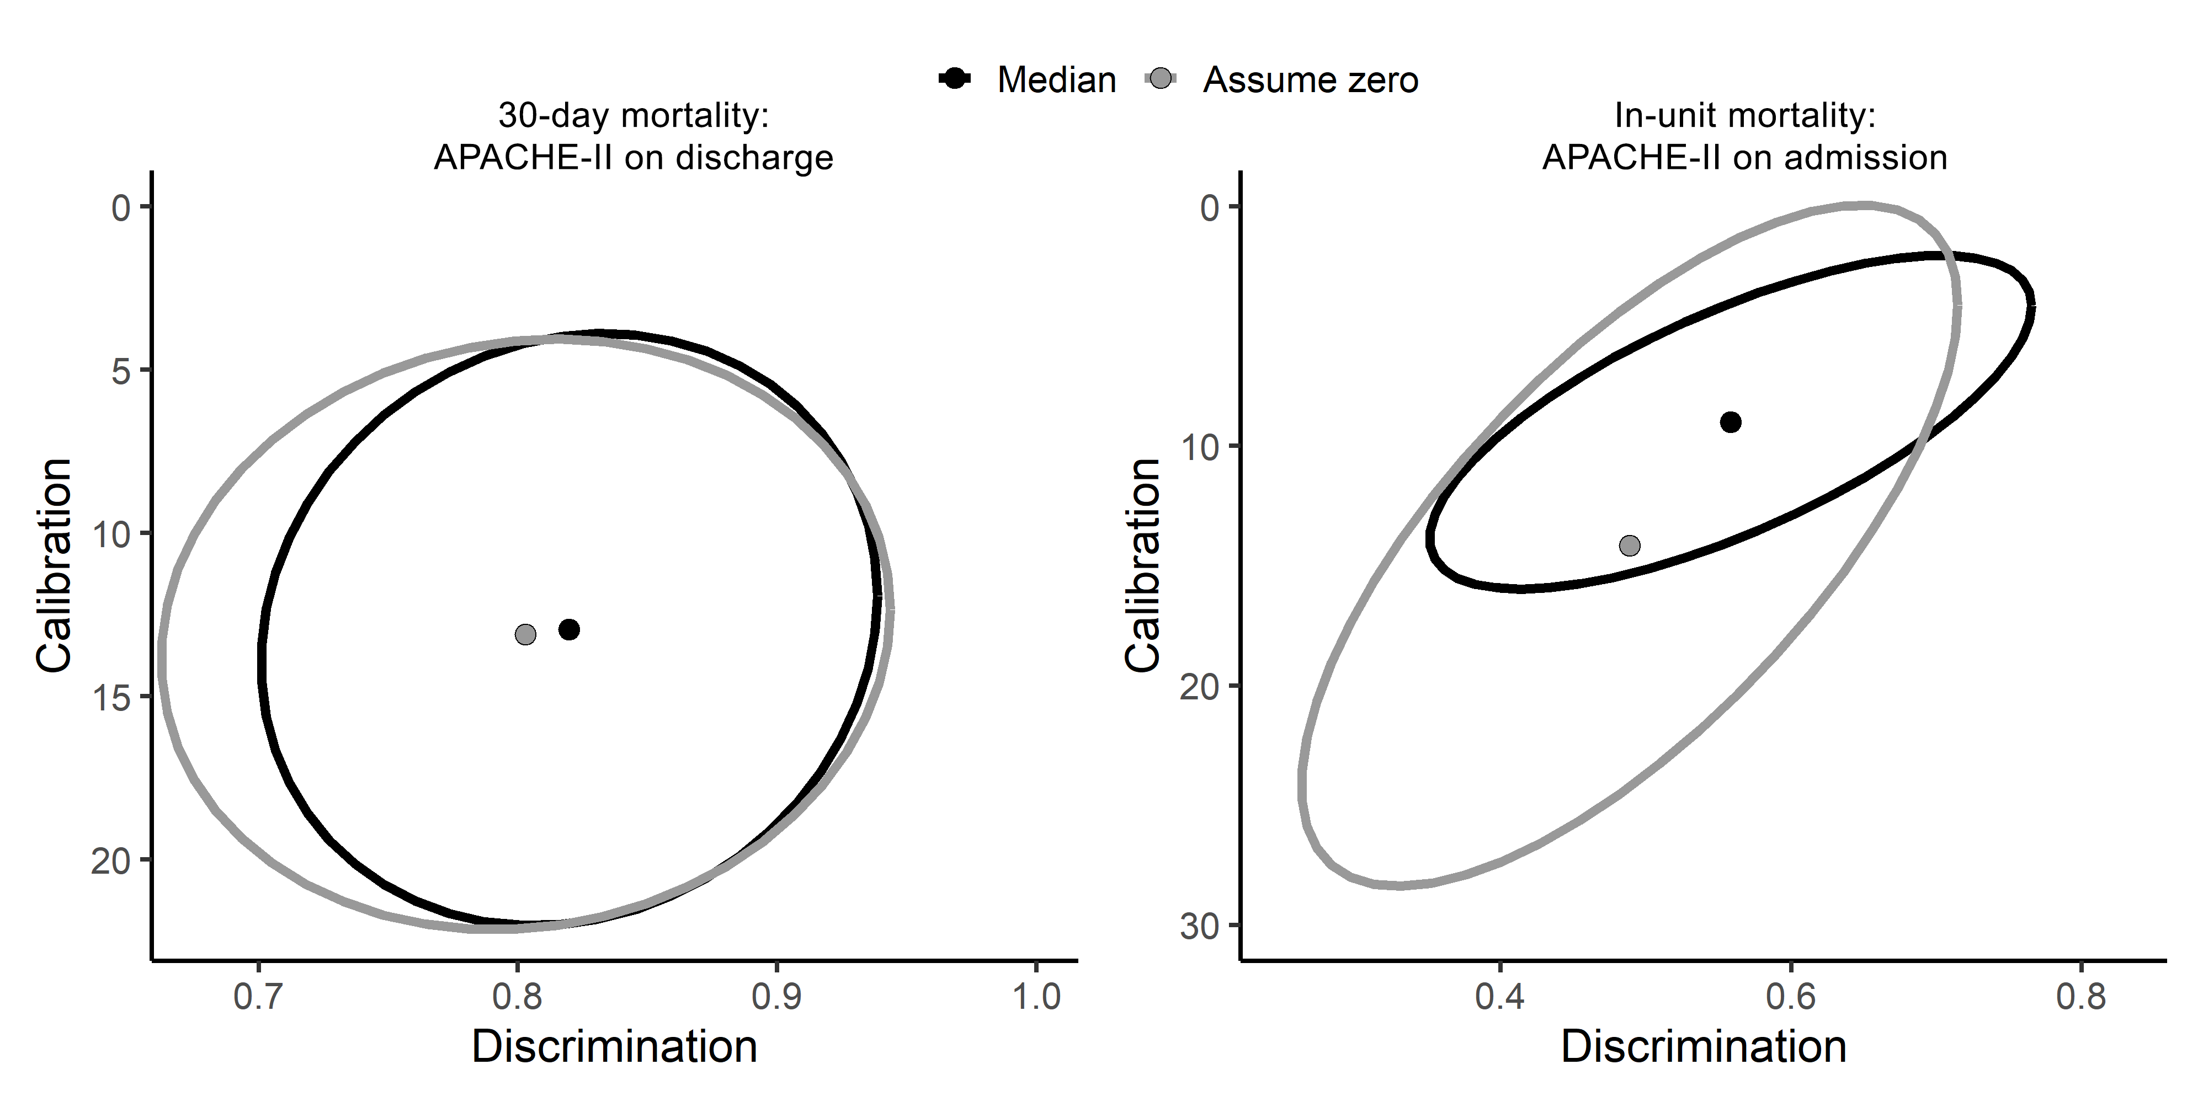
Using the median works better for admission scores

Slide 10
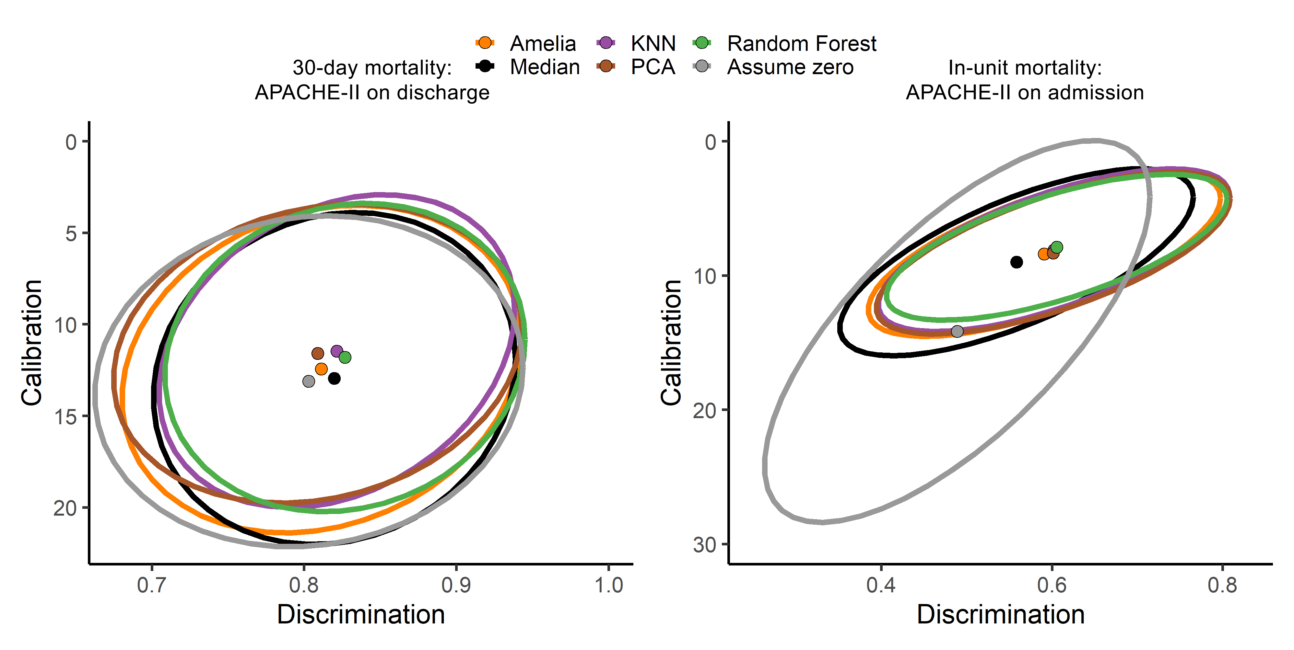
Cross-sectional imputation methods perform equally well

Slide 11
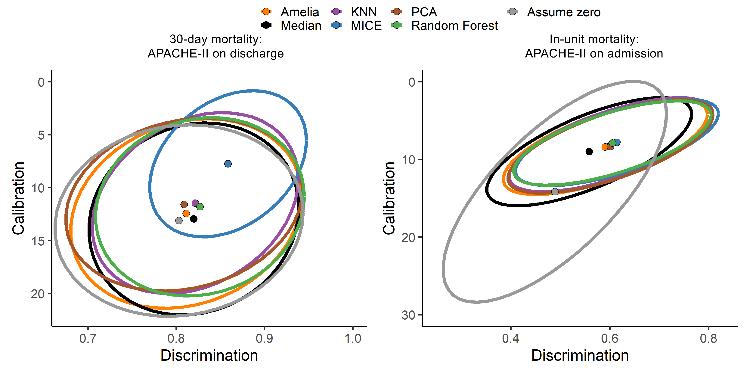
MICE performs particularly well on discharge scores

Slide 12
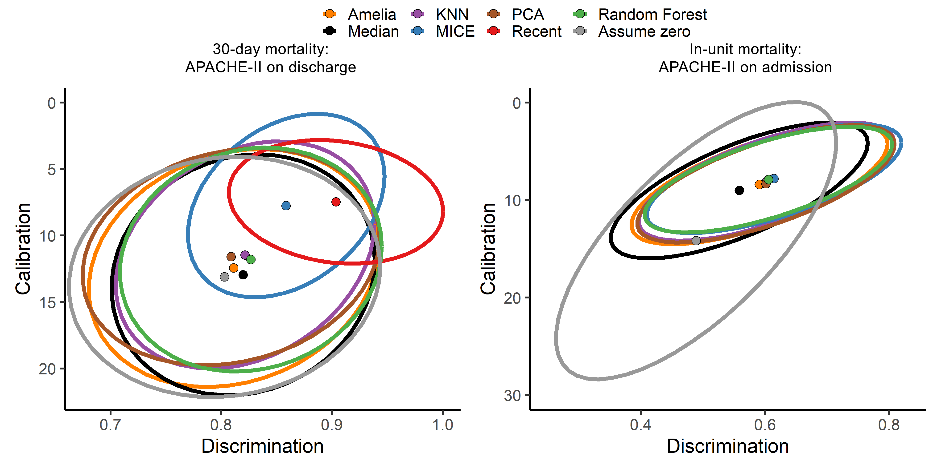
Even simple longitudinal methods perform very well

Slide 13
Caveats to longitudinal measures
Some (18%) still missing
Only possible for discharge score without violating causality
Next steps
Implement fancier longitudinal methods
Combine with MICE when longitudinal data missing?
Final write-up!

