Slide 1
Handling missing data in critical care risk prediction
Ben Cooper
LIDA Seminar Series – 8th April 2021
Supervised by Alwyn Kotzé, Simon Howell,
David Wong and Peter Tennant
Notes:
-Critical care & risk scores
-Problem of missing data
-Our work to address it

Slide 2

Risk scores in critical care
Patients in most dire need treated in ICU
Most resource-hungry and high-risk part of hospitals
Risk models exist to predict probability of outcomes
Improve clinical decision-making processes
Identify patients at risk of unexpected outcomes
Notes:
£1,300 per day, 23% die
Not usually key elements of treatment

Slide 3

The problem of missing data
~10-20% of electronic health record data estimated to be missing
Affects model building, validation, and prediction
Multiple mechanisms of missingness
Notes:
MCAR, MAR w/ examples

Slide 4
The APACHE-II score
Temperature | Blood pressure
Heart rate | Respiratory rate
Arterial pH | White cell count
Sodium | Potassium
Creatinine | Haematocrit
Oxygenation | Coma status
12 continuous physiological variables
Each scored from 0 to 4
Total score from 0 to 71
Higher scores = more severe illness
Correlates well with mortality measures
Notes:
>25 = 50% mortality
>35 = 80% mortality

Slide 5
Two datasets of ICU mortality
Outcome measure: | In-unit mortality | 30 day mortality
Predictor: | APACHE-II score at admission (worst values within 24h) | APACHE-II score at discharge (worst values within 24h)
Total patients: | 7,398 | 6,968
Deaths: | 430 (5.81%) | 319 (4.58%)
Missing APACHE-II data: | 934 (12.6%) | 689 (9.89%)
Aim: Determine best imputation methods in two differently-structured electronic health records

Slide 6
Take mean and sd of discrimination and calibration
Impute data with a given method
Missing cases
Sample 10%
Repeat x10,000
Full dataset
Measure discrimination & calibration
Predict mortality
Complete cases
Train logistic regression model

Slide 7
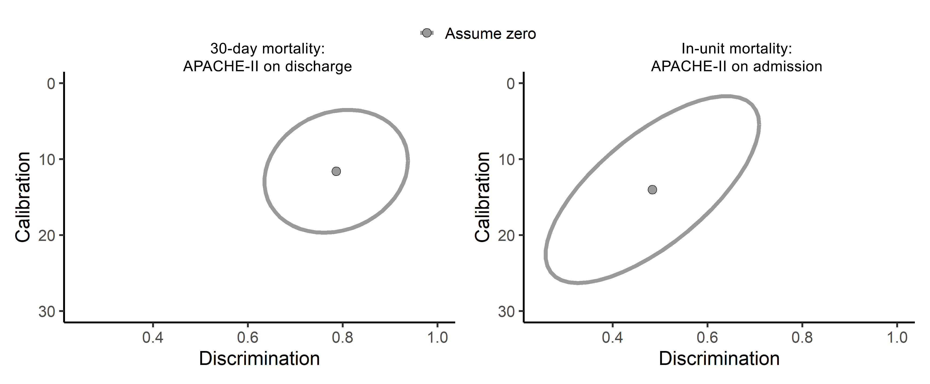
Assuming zero works well for discharge scores, but not admission scores
Notes:
Top left == better

Slide 8
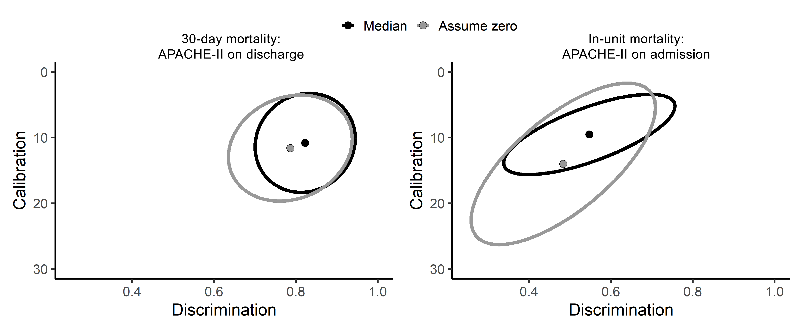
Using the median works better for admission scores
Notes:
Average must be sensible – critically ill patients not normal!

Slide 9
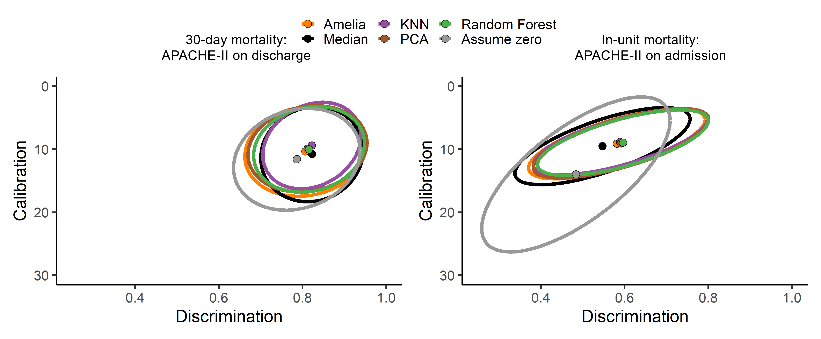
Cross-sectional imputation methods perform equally well

Slide 10
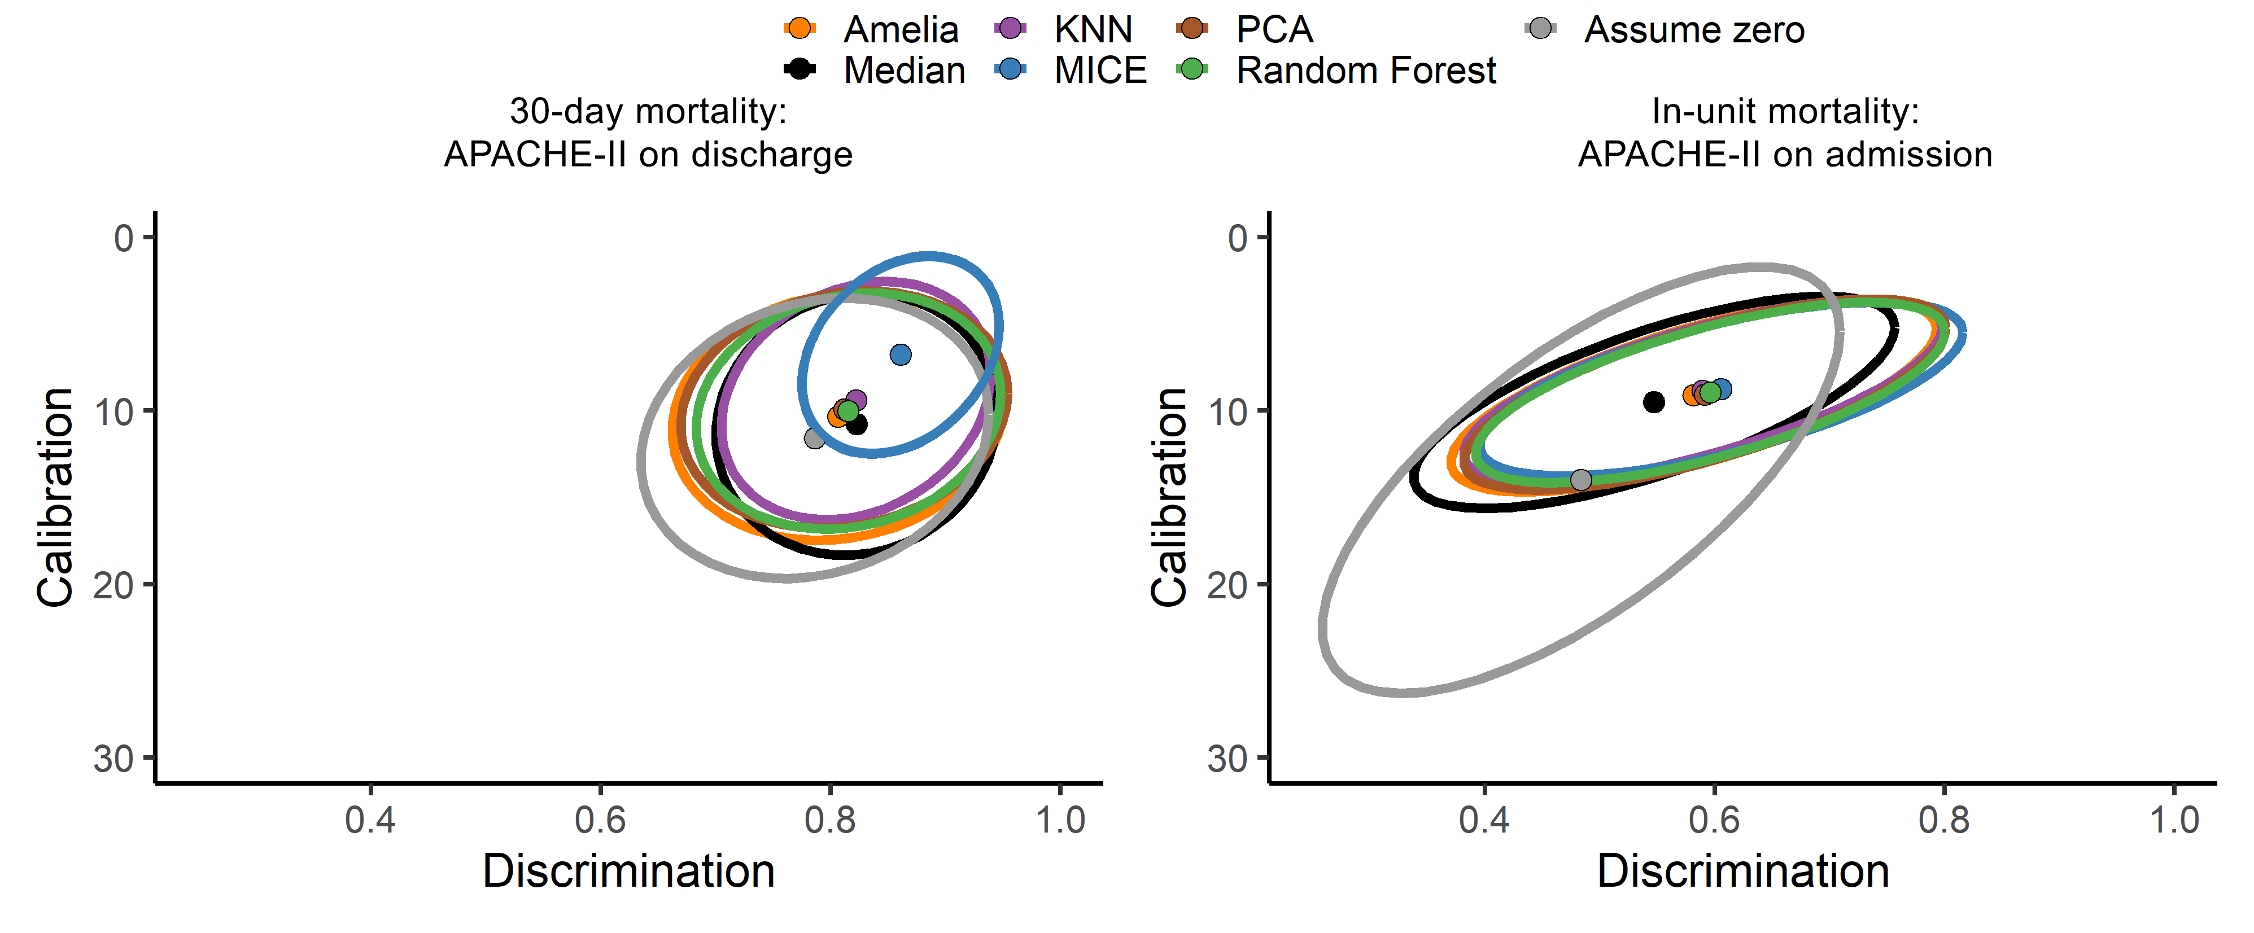
MICE performs particularly well on discharge scores
Notes:
Explain mice – cross correlations, multiple imputation

Slide 11
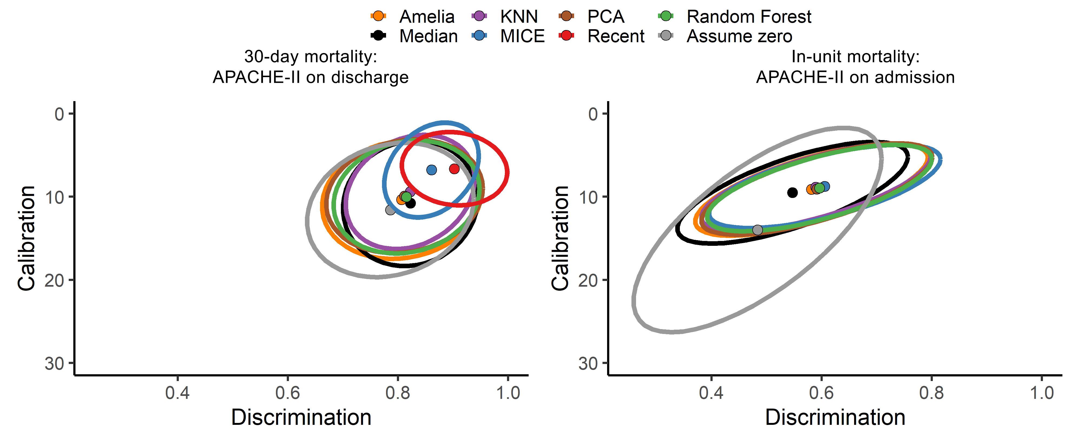
Even simple longitudinal methods perform very well
Notes:
Worst measurement of last 5
Still relies on that data existing
Impossible for admission

Slide 12
Conclusions
Complex imputation methods don’t necessarily perform better
Assuming “average” works fine if a sensible average is chosen
Any information from the patient’s history is better than cross-sectional methods
Next steps
Preparing work for publication
Use to prepare cohort data for future model-building
Improve clinical use of models
Notes:
Next steps – publication to advise future work in model building or clinical use

Slide 13





Thank you for your time!
Twitter: @b_t_cooper
Email: b.cooper@leeds.ac.uk
Acknowledgements
Alwyn Kotzé
David Wong
Peter Tennant
Simon Howell
MIMIC-III team at MIT

