Slide 1
Handling missing data in critical care risk prediction
Ben Cooper
LIDA Seminar Series – 8th April 2021
Supervised by Alwyn Kotzé, Simon Howell,
David Wong and Peter Tennant

Slide 2

The problem of missing data
~10-20% of electronic health record data estimated to be missing
Affects model building, validation, and prediction
Multiple mechanisms of missingness
Notes:
MCAR, MAR w/ examples

Slide 3
Two datasets of ICU mortality
Outcome measure: | 30 day mortality | In-unit mortality
Predictor: | APACHE-II score at discharge (worst values within 24h) | APACHE-II score at admission (worst values within 24h)
Total patients: | 6,968 | 7,398
Deaths: | 319 (4.58%) | 430 (5.81%)
Missing APACHE-II data: | 689 (9.89%) | 934 (12.6%)

Slide 4
The APACHE-II score
Temperature | Blood pressure
Heart rate | Respiratory rate
Arterial pH | White cell count
Sodium | Potassium
Creatinine | Haematocrit
Oxygenation | Coma status
12 continuous physiological variables
Scored from 0 to 4
Higher scores = more severe illness
Correlates well with mortality measures
Notes:
>25 = 50% mortality
>35 = 80% mortality

Slide 5
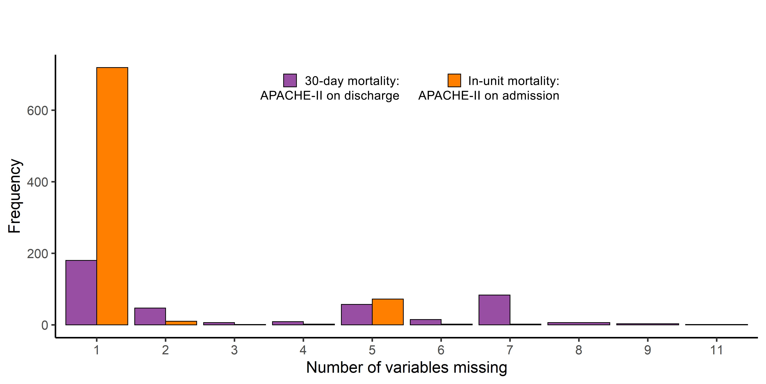
Datasets differ in the structure of data missingness

Slide 6
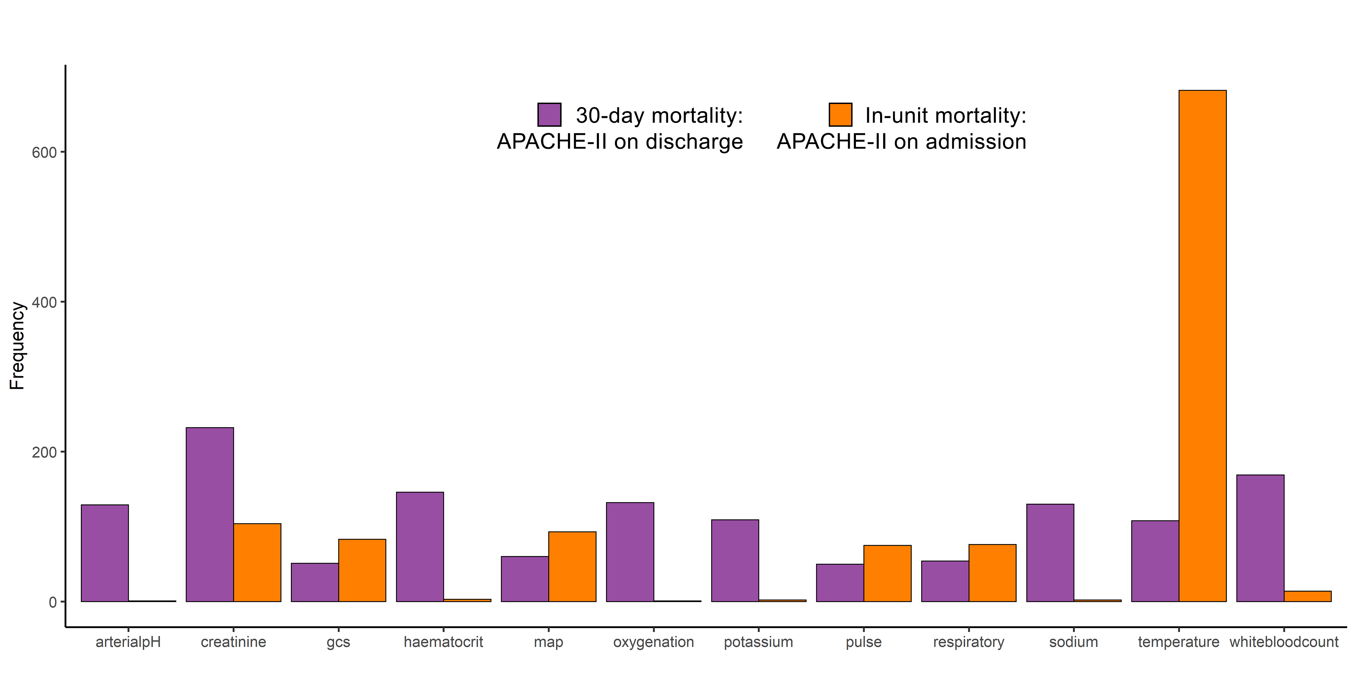
Datasets differ in the structure of data missingness

Slide 7
Take mean and sd of discrimination and calibration
Impute data with a given method
Missing cases
Sample 10%
Repeat x10,000
Full dataset
Measure discrimination & calibration
Predict mortality
Complete cases
Train mortality model

Slide 8
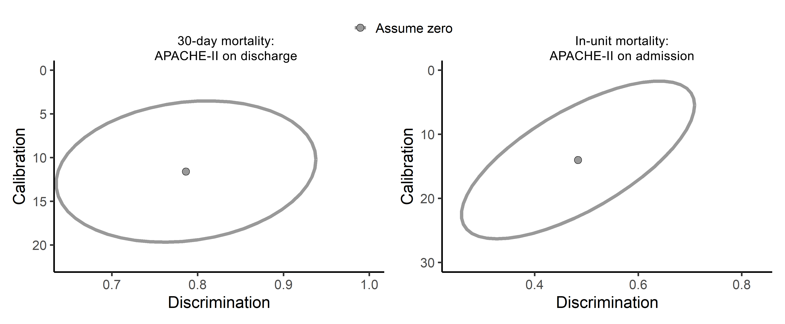
Assuming zero works for discharge scores, but not admission scores

Slide 9
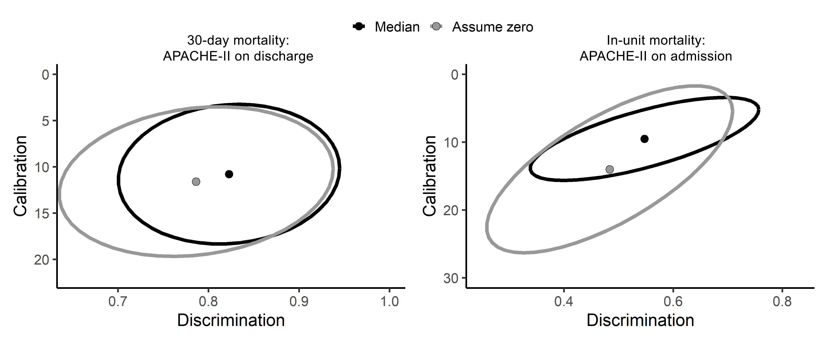
Using the median works better for admission scores

Slide 10
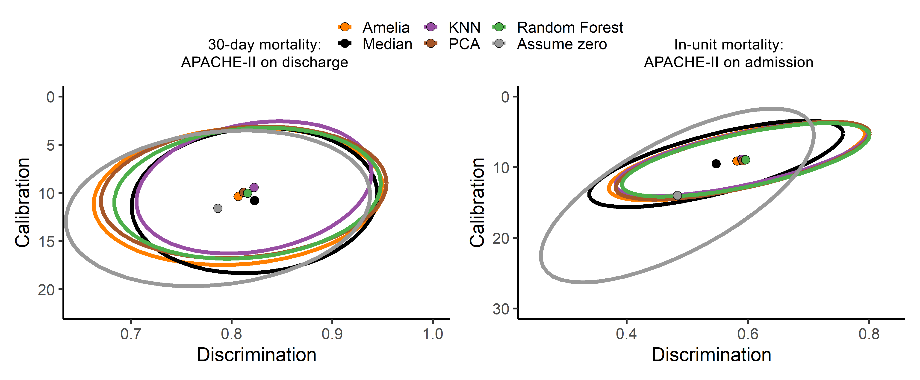
Cross-sectional imputation methods perform equally well

Slide 11
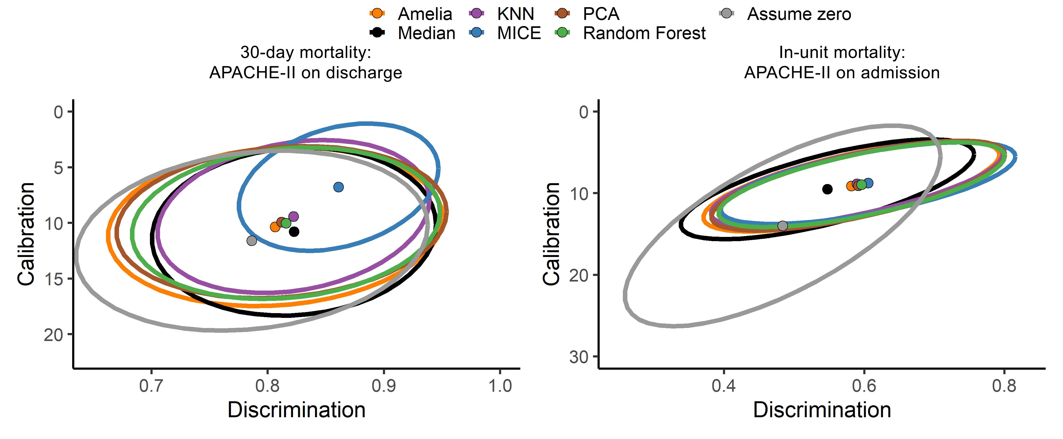
MICE performs particularly well on discharge scores

Slide 12
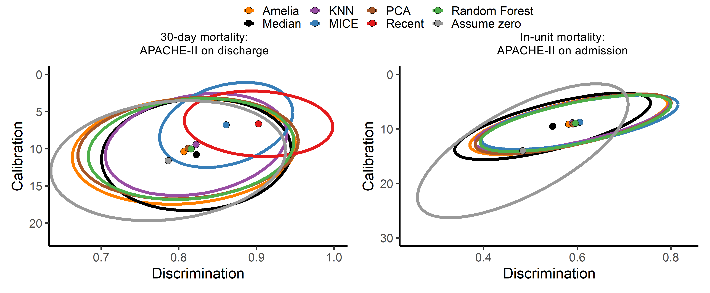
Even simple longitudinal methods perform very well

Slide 13
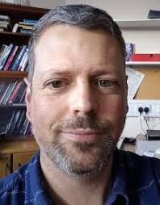


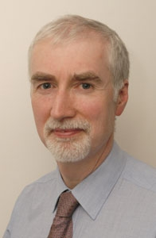

Conclusions
Complex imputation methods don’t necessarily perform better
Assuming “average” works fine if a sensible average is chosen
Any information from the patient’s history is better than cross-sectional methods
Acknowledgements
Twitter: @b_t_cooper
Email: b.cooper@leeds.ac.uk
Alwyn Kotzé
David Wong
Peter Tennant
Simon Howell
MIMIC-III team at MIT

