Slide 1

BTCPay Server
Britt Kelly & RockstarDev

Slide 2
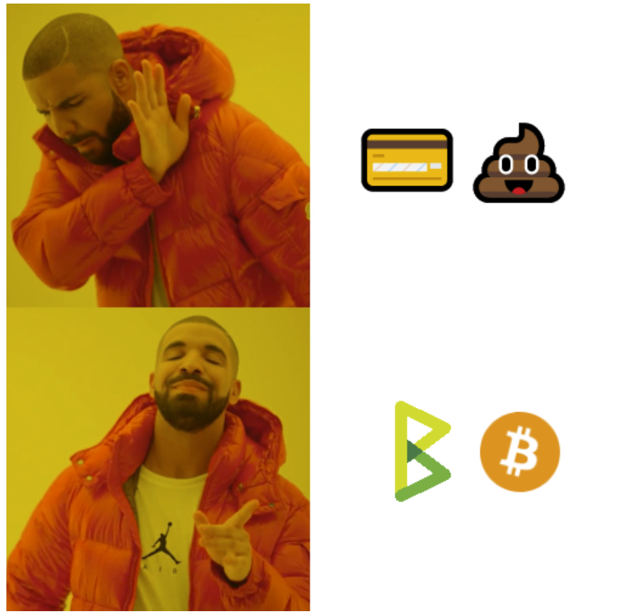
What is BTCPay?
Free open-source Bitcoin payment processor
Allows anyone to accept Bitcoin as a form of payment
Includes a full node
Trustless validation
Self-hosted server
Censorship-resistant

Slide 3
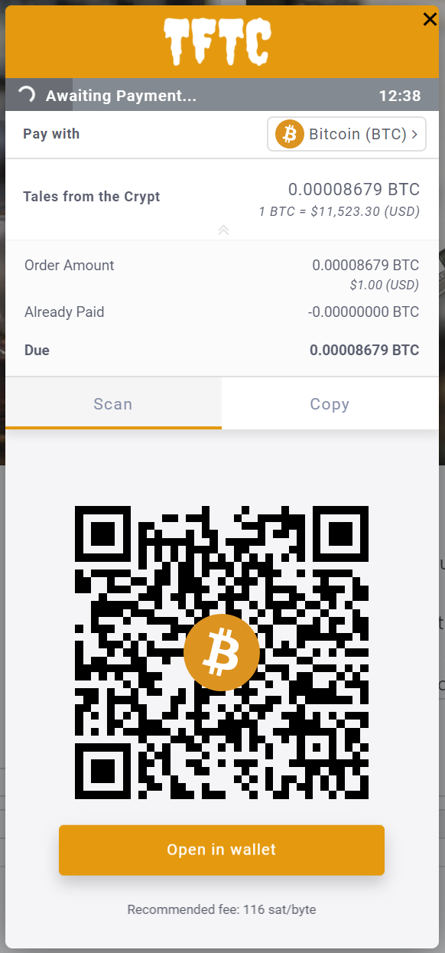
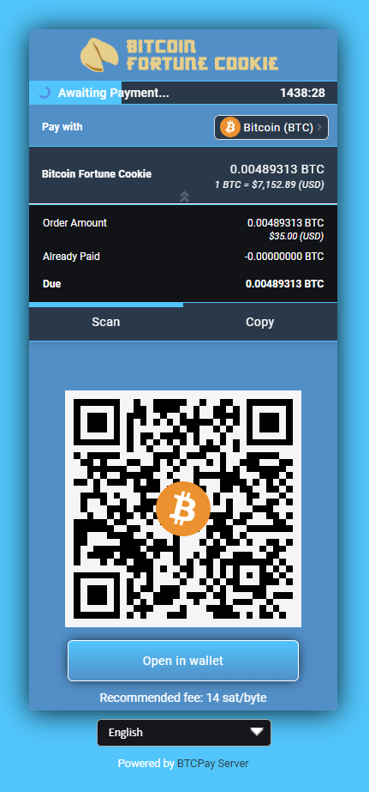
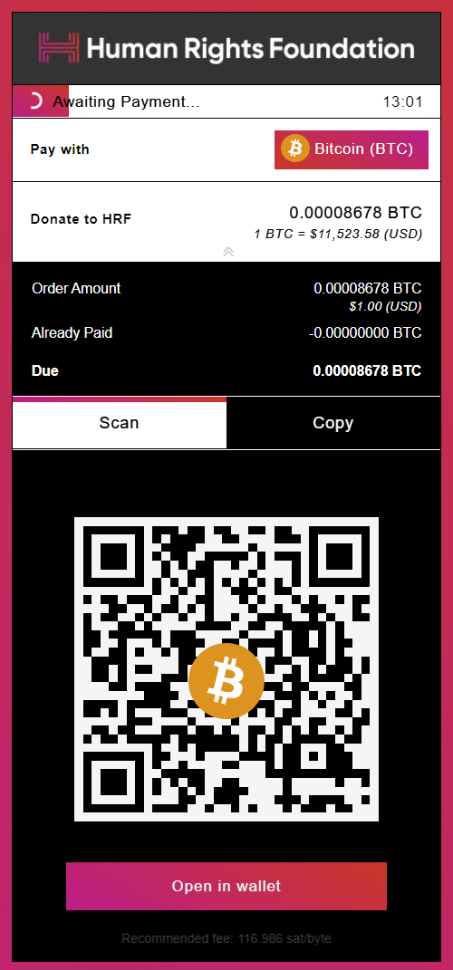
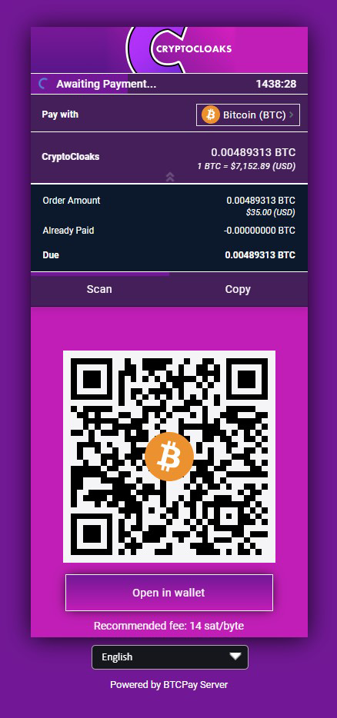
Don’t buy Bitcoin. Earn it using BTCPay...

Slide 4
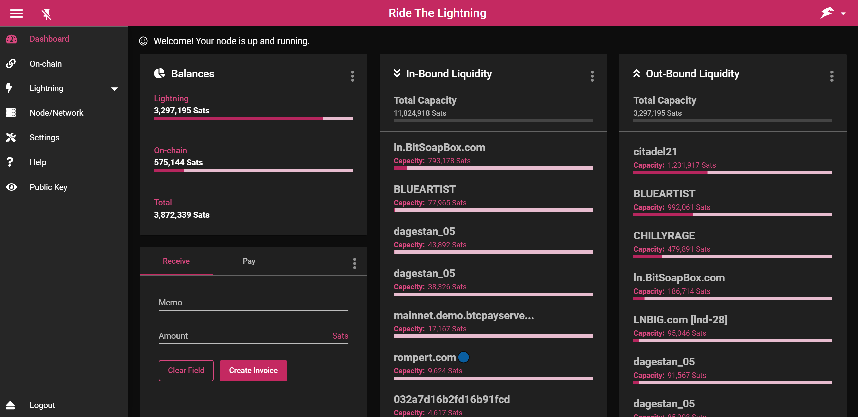
Lightning Management

Slide 5
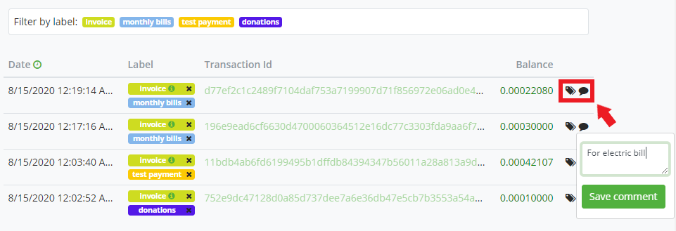
Manage Payments. Be your own bank…

Slide 6

Why should you join the BTCPay community?
More than

Slide 7
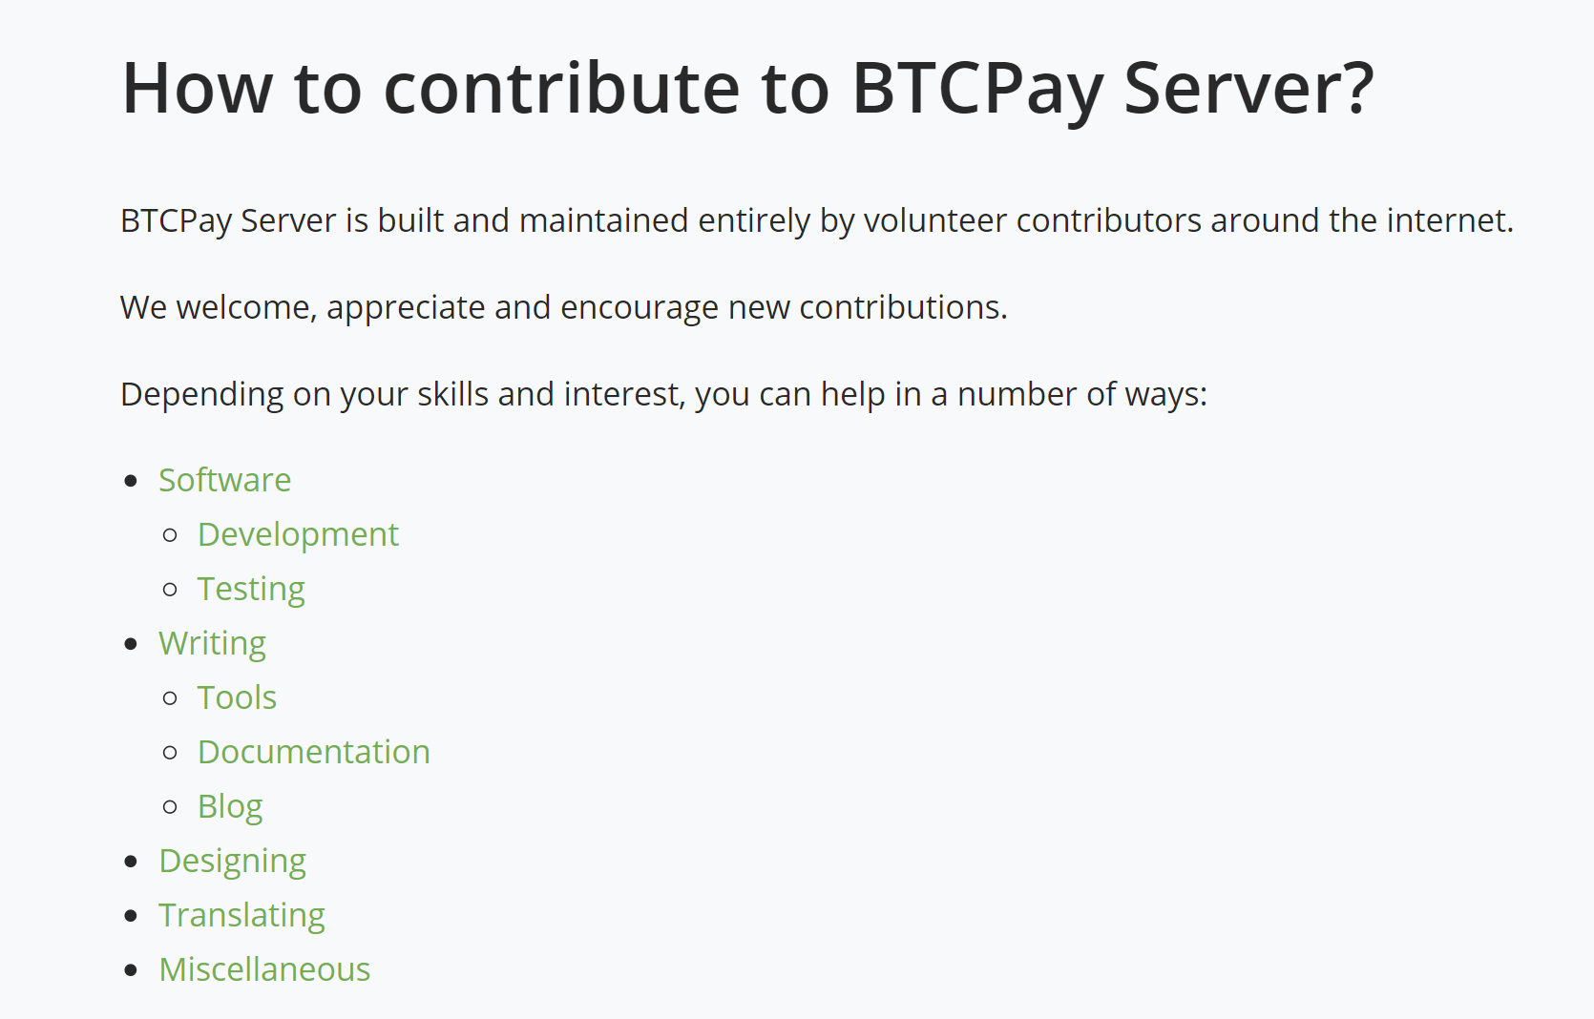

Slide 8
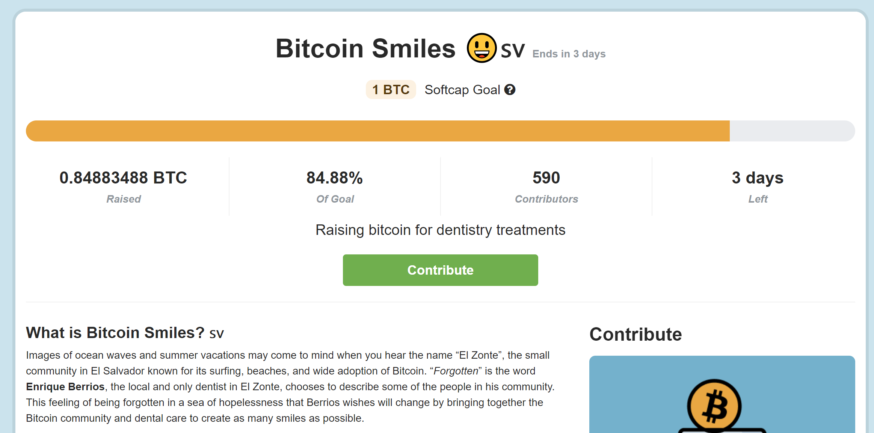
Community Crowdfunding
BitcoinSmiles.org

Slide 9
Thanks to our 2020 BitBlockBoom sponsors!
[Video Removed]

Slide 10
Find out more…
Updates & Announcements: BTCPay Server Twitter ☺
Documentation: https://docs.btcpayserver.org/
Blog articles: https://blog.btcpayserver.org/
Online Community: https://chat.btcpayserver.org/
Merchant Directory: https://directory.btcpayserver.org/
Videos & Demos: BTCPayServer YouTube

Slide 11
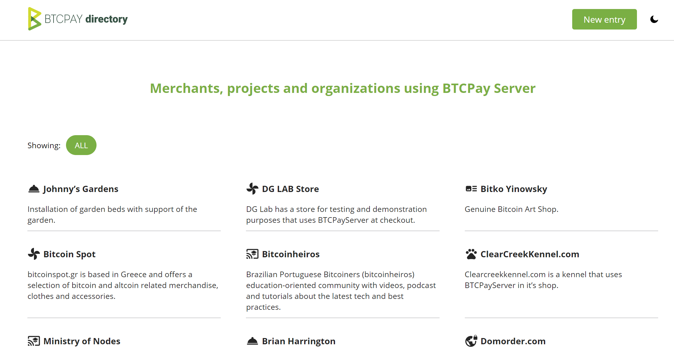

Slide 12

Q & A

