Slide 1

BTCPay – For anyone, Not for everyone.
Presented by: Britt Kelly

Slide 2
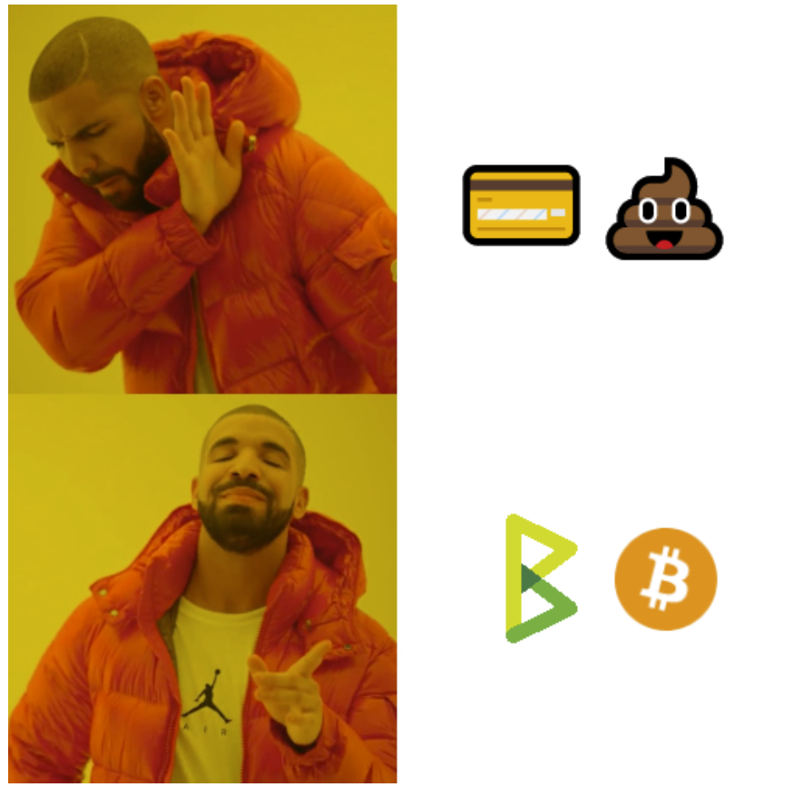
What is BTCPay?
Free open-source Bitcoin payment processor
Allows anyone to accept Bitcoin as a form of payment
Includes a full node
Trustless validation
Self-hosted server
Censorship-resistant

Slide 3

BTCPay Server ELI5
☺ Create a node
☺ Connect your wallet
Create apps
Produce invoices
Payments go to wallet

Slide 4
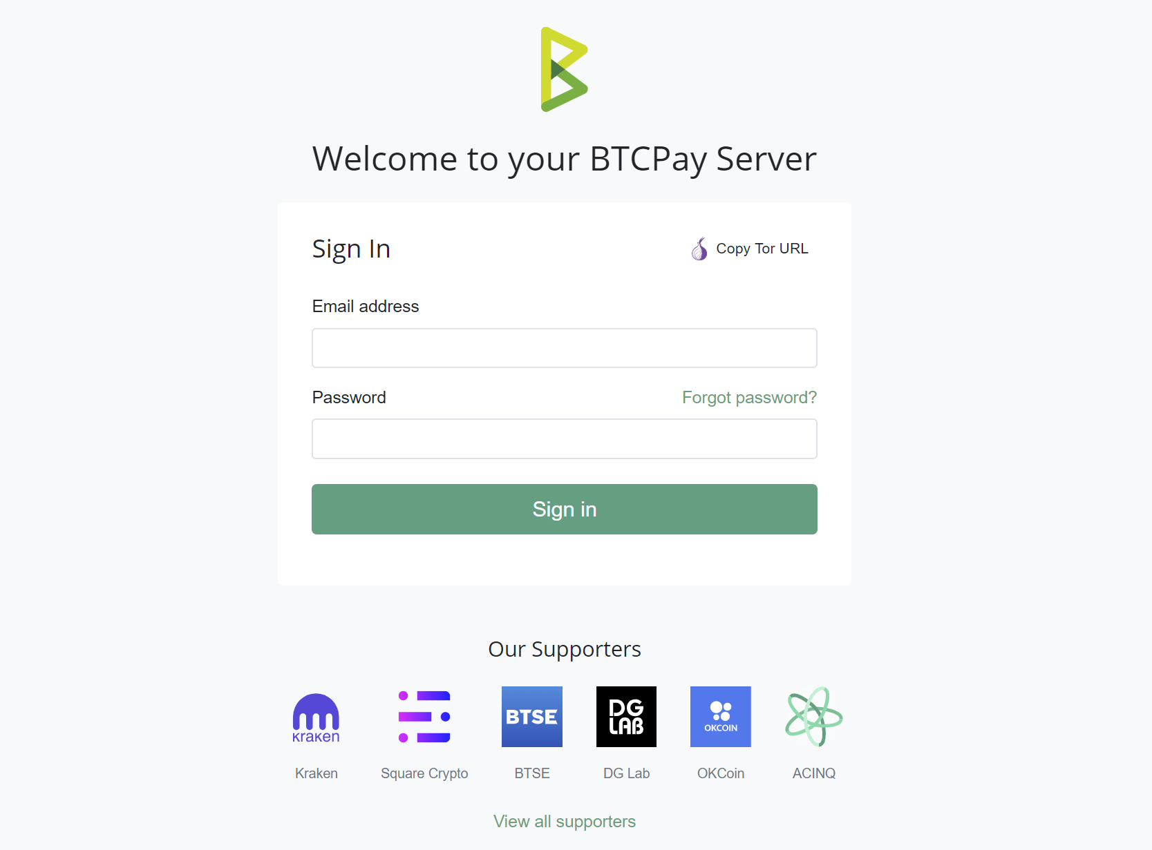

Slide 5
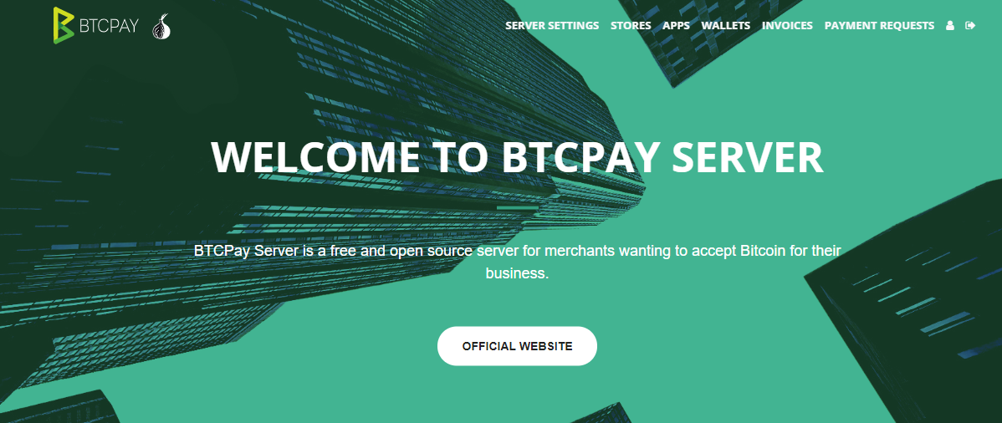

Slide 6

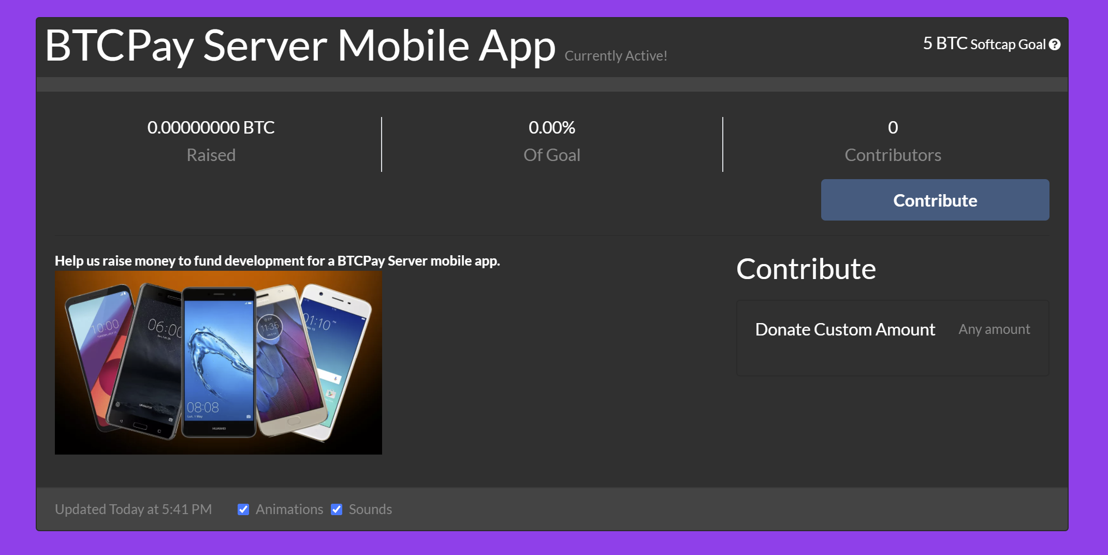
Crowdfunding App

Slide 7
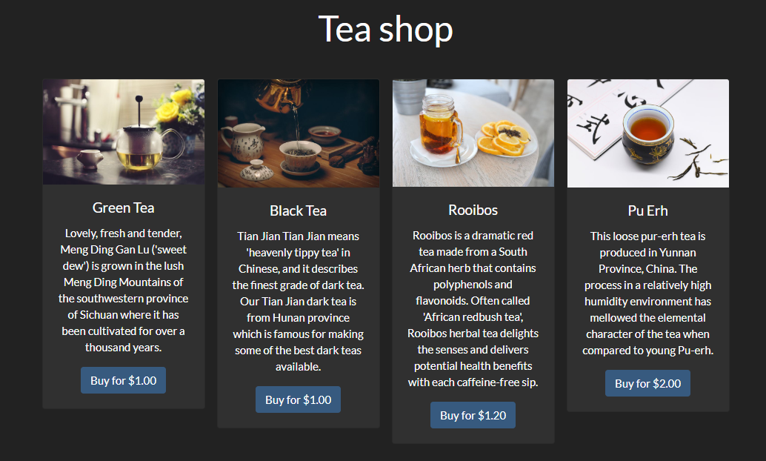
Point of Sale App

Slide 8

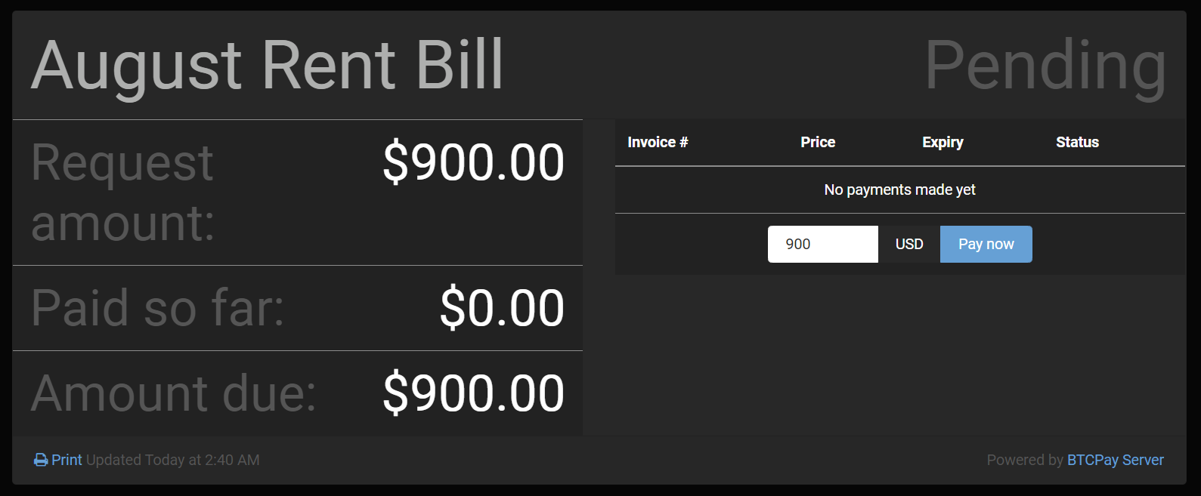
Payment Request

Slide 9
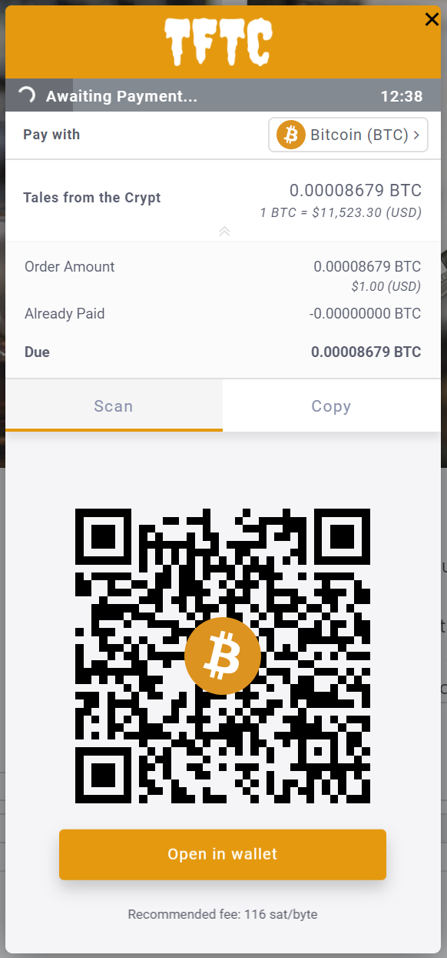
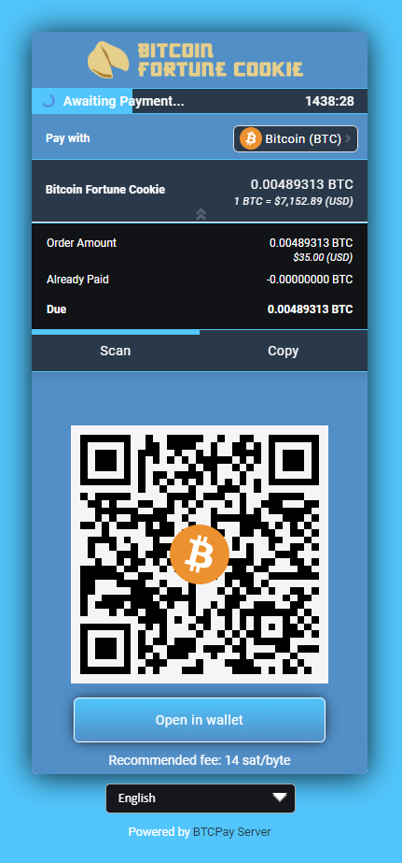
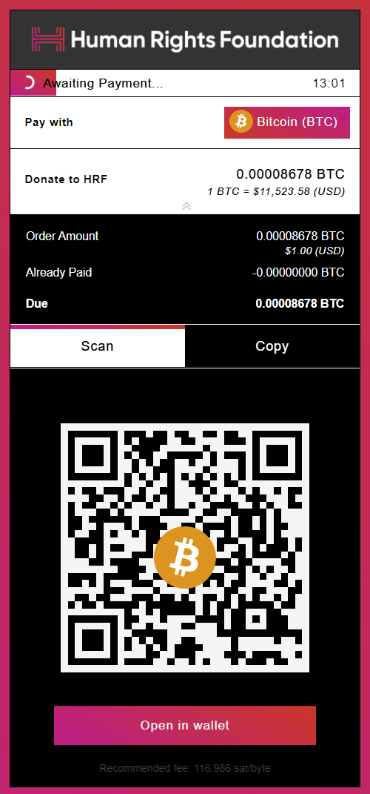
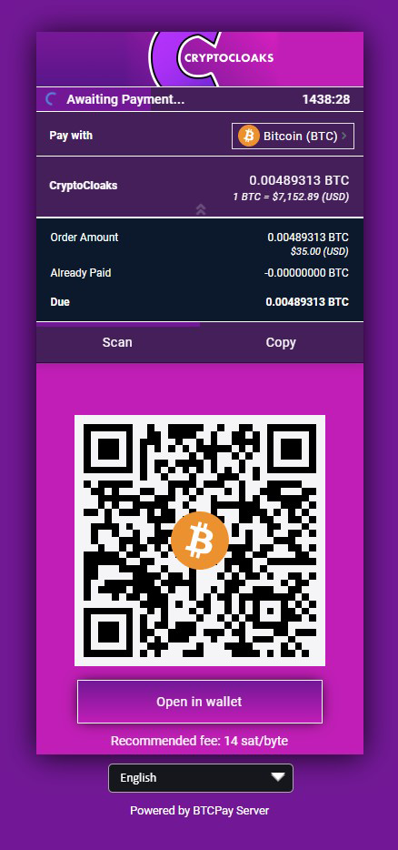
Don’t buy Bitcoin. Earn it using BTCPay...

Slide 10
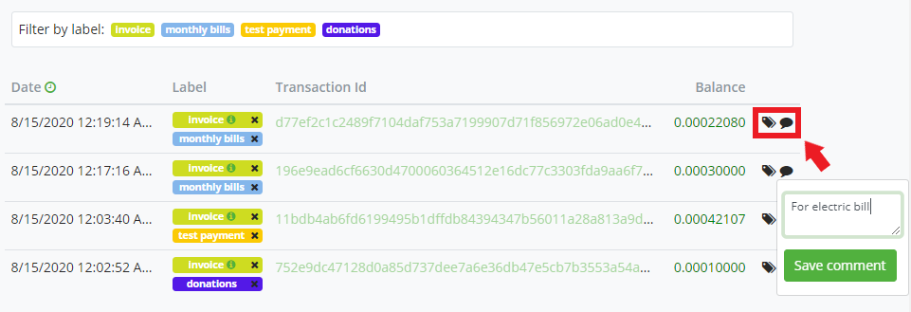
Manage Payments. Be your own bank…

Slide 11
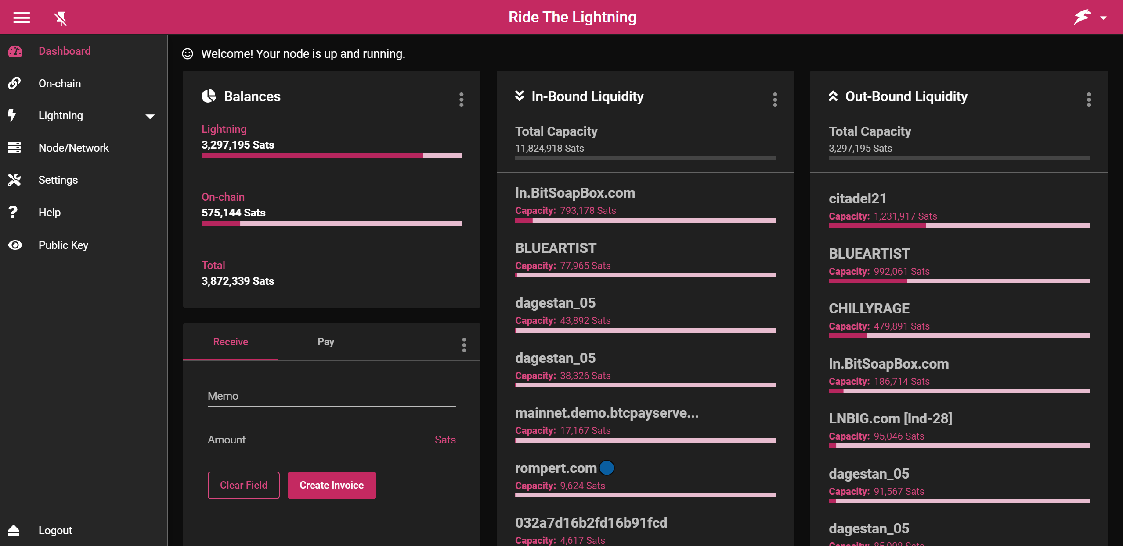
Lightning Management

Slide 12
So why is BTCPay not for everyone?
You don’t know or don’t care about:
You prefer someone to do it for you:
What an XPUB key is
Learning about software
The command line
DNS and domain names
Paying fees, KYC, AML
Validating txs, privacy
Censorship resistance
Key & Wallet Management
Read docs to figure out use case
Restart and update the server
IP and hostname setup
You need something ASAP
You trust someone else’s node
You trust you wont be cancelled

Slide 13
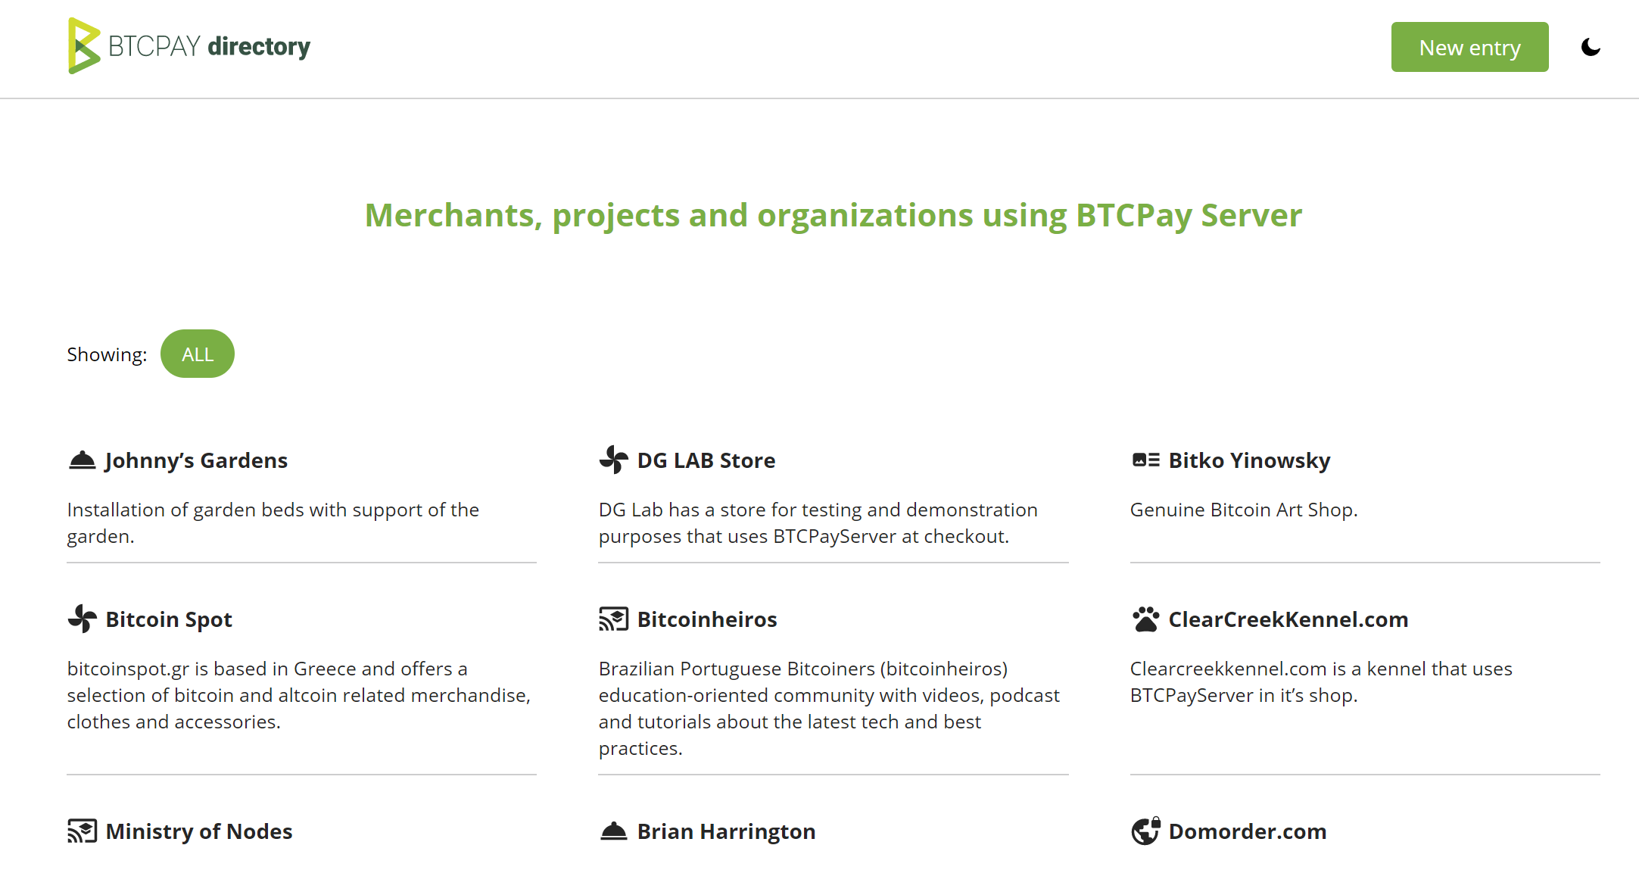

Slide 14
I’m not a merchant, why do I care?
For Yourself:
For Others:
BTC node, no command line
LN node, no command line
Learn about Bitcoin
Learn about software & web dev
Learn about e-commerce
Get paid in Bitcoin
Start a consulting business
Contribute to Bitcoin OSS
Process payments for others
Community & networking
Contribute to circular economy

Slide 15
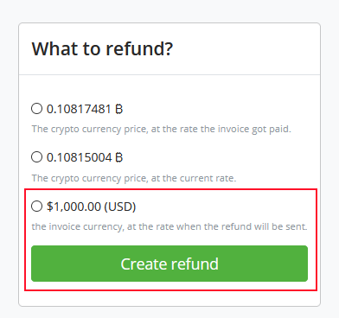
Already using BTCPay? New Feature to Watch For… Pull Payments
Subscription services
Freelancer billing
Patronage
Batch payments
Refunds

Slide 16
Find out more…
Documentation: https://docs.btcpayserver.org/
Blog articles: https://blog.btcpayserver.org/
Online Community: https://chat.btcpayserver.org/
Merchant Directory: https://directory.btcpayserver.org/
Videos & Demos: BTCPayServer YouTube

