Slide 1
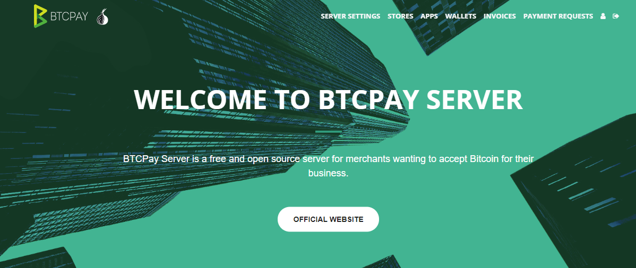

Slide 2
BTCPay Server – Be Your Own Bank
www.mybtcpay.com – Unlimited Accounts (logins)
Each Account – Unlimited Stores (1 xpub per store)
Each Store – Unlimited Apps
Each App – Unlimited Invoices

Slide 3
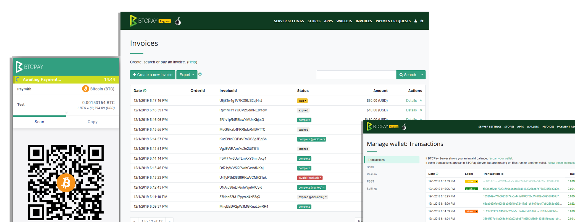
Money Management with BTCPay

Slide 4
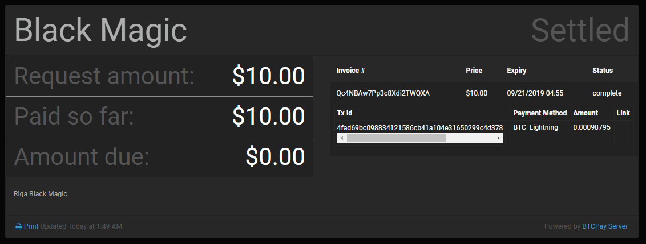
Payment Requests

Slide 5
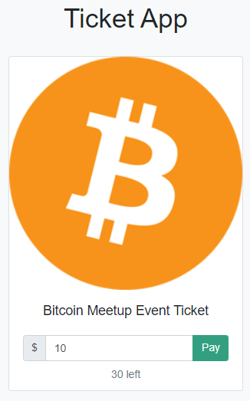
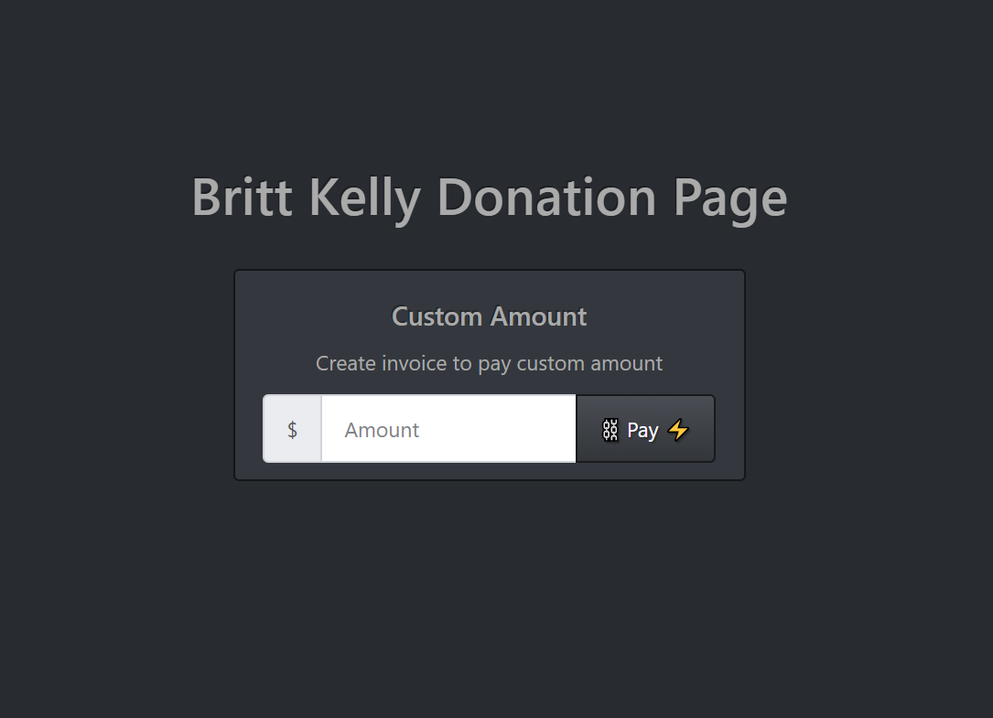
Point of Sale

Slide 6
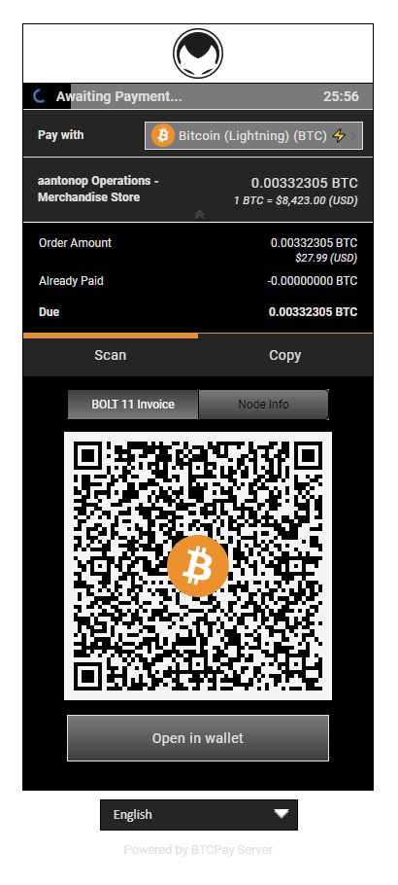
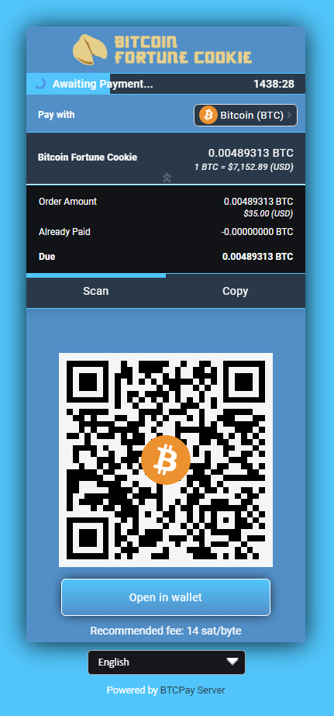
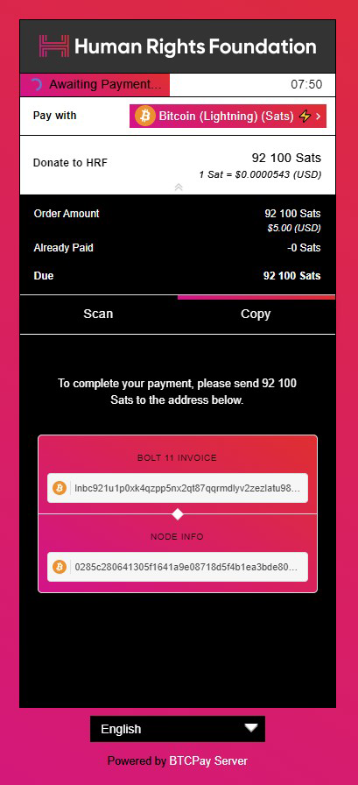
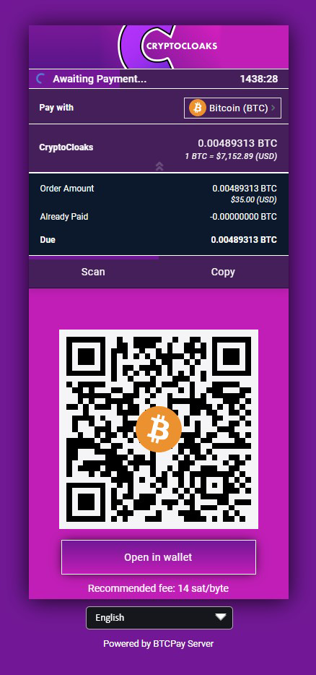
Customize Your BTCPay @artdesignbySF

Slide 7
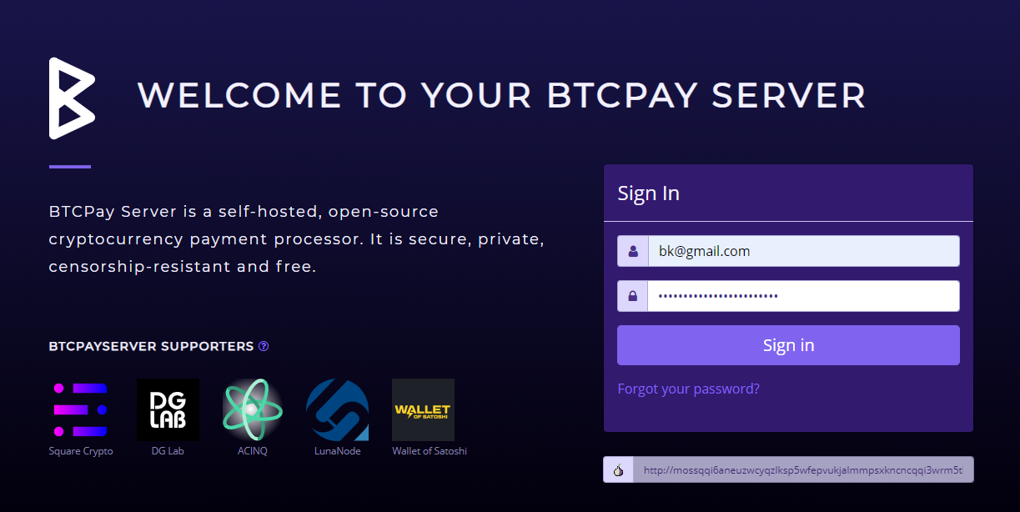

Slide 8
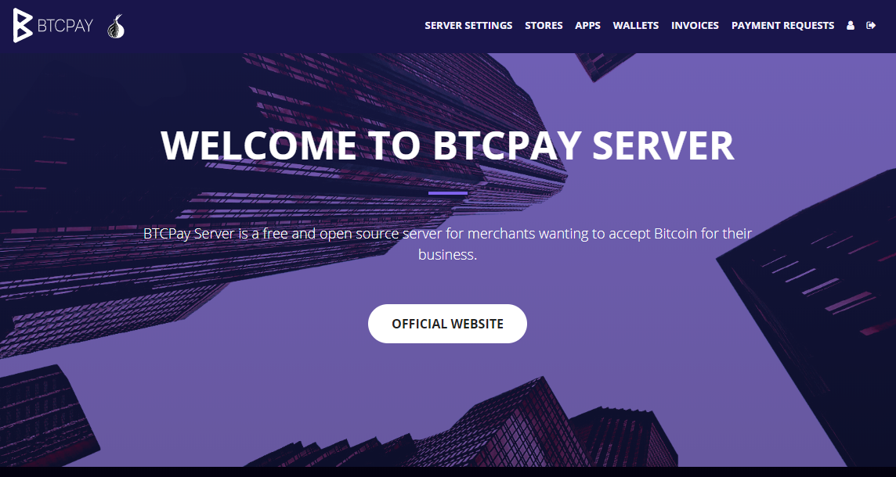

Slide 9
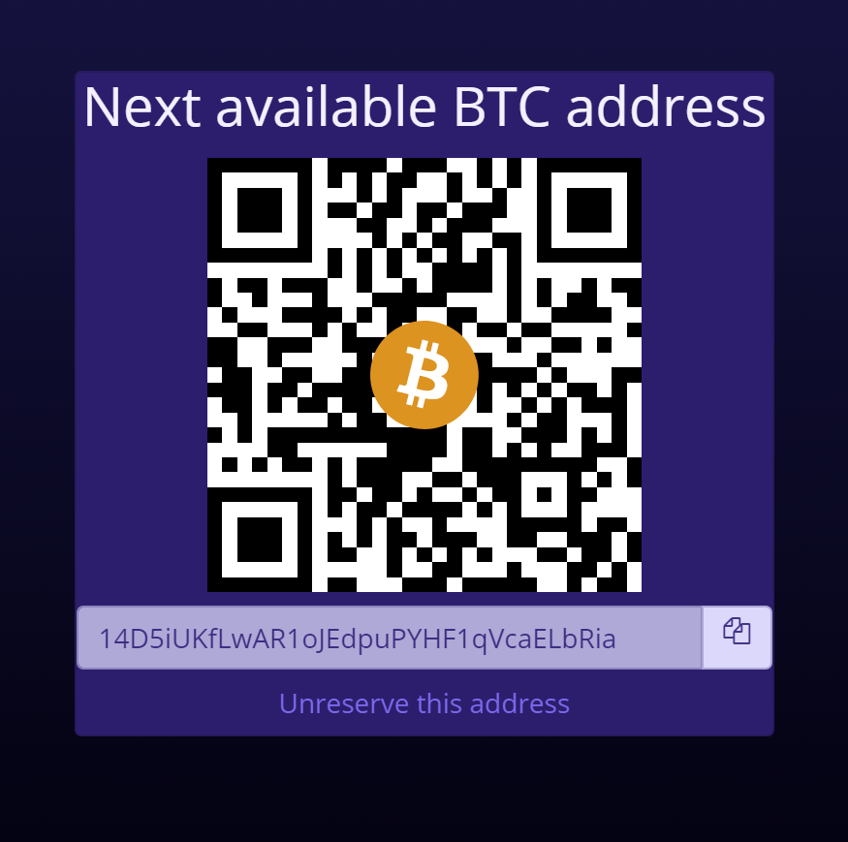

Deposits
Deposit directly to any of your connected wallets

Slide 10

Money Automation - Transmuter

Slide 11
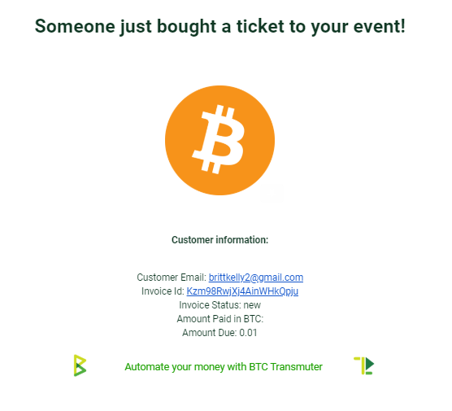
Payment Email Receipts
Email Yourself Payment Info:
Customer Email
Payment Amount
Denomination
Invoice Status
Items Purchased
etc.

Slide 12
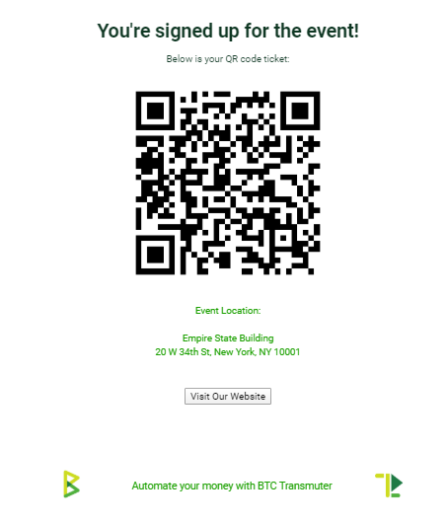
Purchase Email Receipts
Email Your Customer:
Payment Details
Shipping Details
Event or Service Info
etc.

Slide 13
Additional Features
Wallets
Vault (HWI) – Import Xpub & sign transactions with most HW wallets
PSBT – Sign transactions with wallets supporting PSBT
HD private key or mnemonic signing
Generate Wallets (hot wallets, from seed, etc)
Add-Ons
Liquid (LBTC)
Connect to Wasabi Wallet (Full node P2P)
Connect to ElectrumX or Electrum Personal Server
Tor for BTCPay and your lightning node
File Server to store miscellaneous files

Slide 14
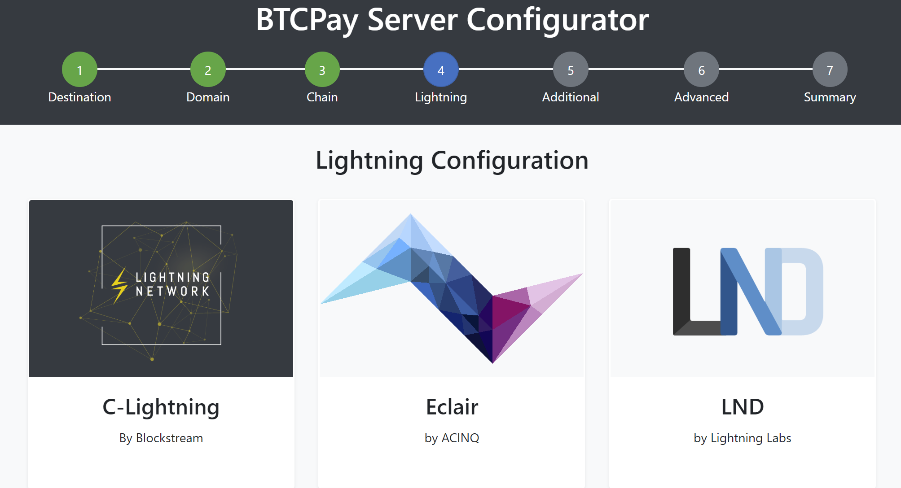
New Features To Watch For
New API
PayJoin
Configurator
Transmuter

