Slide 1

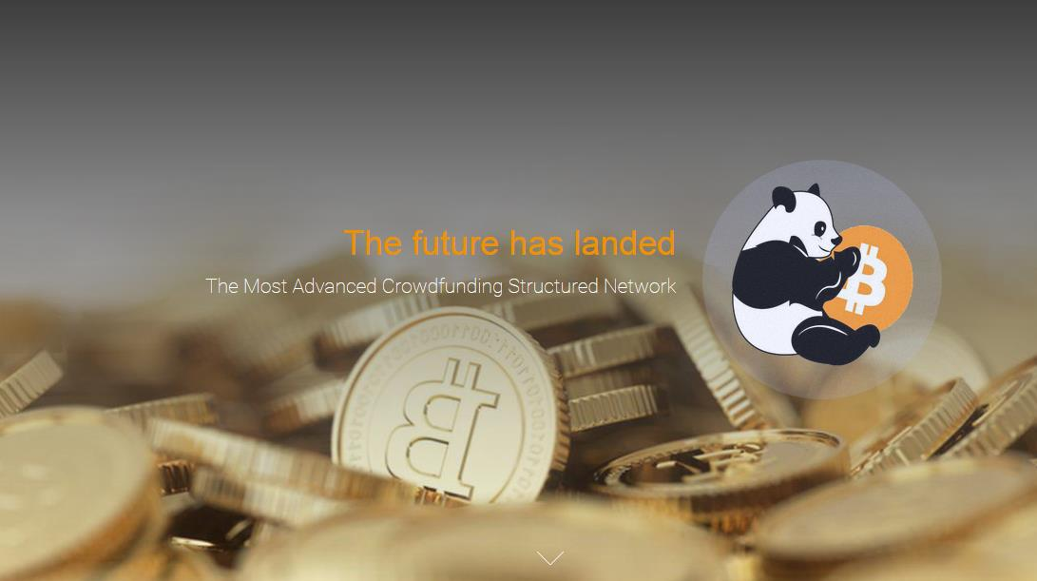





BTCPANDA.COM
Marketing Plan 2016

Slide 2
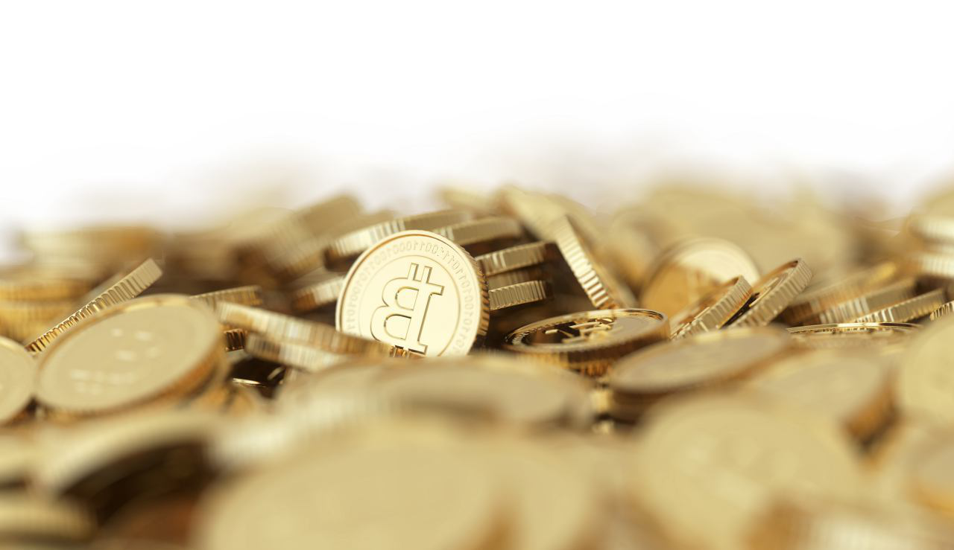

Direct Sponsor Bonus
Level | % Bonus | Direct Sponsor | Personal PH Limit | Direct Sponsor Volume (DSV)
1 | 5 % | 1 – 5 | 15 BTC | 0 BTC
2 | 6 % | 6 – 10 | 20 BTC | 0 BTC
3 | 7 % | 11 – 15 | 25 BTC | 10 BTC
4 | 8 % | 16 – 20 | 30 BTC | 15 BTC
5 | 9 % | 21 – 25 | 40 BTC | 20 BTC
6 | 10 % | 26 - 30 | 50 BTC | 25 BTC

Slide 3
Manager Title Qualification
% Bonus | Helper (H) | Fundraiser (F) | Charity Helper (CH) | Angel Helper (AH) | Venture Helper (VH) | Philanthropist (P)
Personal PH | 0 BTC | 1 BTC | 3 BTC | 5 BTC | 10 BTC | 15 BTC
Active Direct Sponsor | 0 | 10 | 15 | 20 | 25 | 30
Direct Sponsor Volume | 0 BTC | 10 BTC | 30 BTC | 60 BTC | 75 BTC | 90 BTC
Managers by Separate Line | NA | NA | 3 FR | 3 CH + 3 FR | 4 CH + 4 FR | 5 CH + 5 FR

Slide 4
Unilevel Bonus for Managers
 | Helper (H) | Fundraiser (F) | Charity Helper (CH) | Angel Helper (AH) | Venture Helper (VH) | Philanthropist (P)
Bonus by Manager Level | NA | L1 = 3% | L1 = 3% | L1 = 3% | L1 = 3% | L1 = 3%
 |  | L2 = 2% | L2 = 2% | L2 = 2% | L2 = 2% | L2 = 2%
 |  |  | L3 = 1.5% | L3 = 1.5% | L3 = 1.5% | L3 = 1.5%
 |  |  | L4 = 1% | L4 = 1% | L4 = 1% | L4 = 1%
 |  |  |  | L5 = 1% | L5 = 1% | L5 = 1%
 |  |  |  | L6 = 0.5% | L6 = 0.5% | L6 = 0.5%
 |  |  |  |  | L7 = 0.5% | L7 = 0.5%
 |  |  |  |  | L8 = 0.5% | L8 = 0.5%
 |  |  |  |  | L9 = 0.5% | L9 = 0.5%
 |  |  |  |  |  | L10 = 0.5%
 |  |  |  |  |  | L11 = 0.5%
 |  |  |  |  |  | L12 = 0.5%

