Slide 1
Comparor v3 – AI Workforce Impact in Connecticut

Slide 2
Executive Summary
This analysis compares AI’s impact across 20+ healthcare-related workflows in Connecticut.
- **7 workflows exceed the High AI Impact threshold (≥25% of FTEs in Q1 risk zone)**
- **Routine Cognitive roles dominate AI risk exposure**
- **EZ2–EZ3 workers are most exposed mid-term**, while EZ1 and EZ5 show opposite extremes
- **Most at-risk roles are also high-burden to reskill**, reinforcing the need for targeted workforce support
- **Hybrid modality dominates**, combining PEP & UDP across core tasks
- **Tenure analysis shows disproportionate risk among 4–9 year FTEs** in documentation-heavy functions

Slide 3
Workflow Summary – Scope & Composition
# | Workflow Name | Description | CT Adjusted FTEs | Avg EZ Zone | Dominant Tenure Band
1 | Medical Claim with Repair | Claim submission, rejection, and fix across provider and payer systems | 2800 | EZ2.0 | <3 years
2 | Nursing Facility Claim Submission | End-to-end billing for long-term care and SNF encounters | 2823 | EZ2.5 | 4–9 years
3 | Appeals of Denied Claims | Rebuttal and documentation for denied claims including clinical review | 2846 | EZ3.0 | 10+ years
4 | Patient Eligibility Verification | Checking insurance eligibility before rendering services | 2869 | EZ2.0 | <3 years
5 | Clinical Documentation Improvement | Improving encounter notes for billing and audit readiness | 2892 | EZ2.5 | 4–9 years
6 | Claim Coding & Charge Capture | Translating procedures into ICD/CPT codes and reviewing | 2915 | EZ3.0 | 10+ years
7 | Claim Scrubbing & Pre-Submission Review | Checking for common denial triggers before submission | 2938 | EZ2.0 | <3 years
8 | Initial Claim Adjudication | Insurer-side claim acceptance and routing | 2961 | EZ2.5 | 4–9 years
9 | Denial Management | Handling payer denials and rejections with corrections | 2984 | EZ3.0 | 10+ years
10 | Medical Necessity Appeals | Writing and submitting appeals based on clinical documentation | 3007 | EZ2.0 | <3 years
11 | Coordination of Benefits | Resolving multiple insurance payer overlaps | 3030 | EZ2.5 | 4–9 years
12 | Prior Authorization | Requesting and tracking insurer permission for services | 3053 | EZ3.0 | 10+ years
13 | Ambulatory Visit Billing | Coding and submission of outpatient medical claims | 3076 | EZ2.0 | <3 years
14 | EHR Chart Extraction | Pulling structured data from unstructured clinical notes | 3099 | EZ2.5 | 4–9 years
15 | Audit Preparation | Preparing and responding to payer or regulatory audits | 3122 | EZ3.0 | 10+ years
16 | Hospital Discharge Billing | Capturing charges and preparing claims post-discharge | 3145 | EZ2.0 | <3 years
17 | Surgical Claims Processing | Handling complex surgical coding and insurer interactions | 3168 | EZ2.5 | 4–9 years
18 | Telehealth Claim Submission | Processing virtual visit claims under new billing rules | 3191 | EZ3.0 | 10+ years
19 | Post-Acute Care Billing | Managing claims for rehab, SNFs, and home health | 3214 | EZ2.0 | <3 years
20 | Patient Financial Counseling | Helping patients understand bills and coverage | 3237 | EZ2.5 | 4–9 years
21 | Payment Reconciliation | Matching remittances to billed claims and resolving mismatches | 3260 | EZ3.0 | 10+ years

Slide 4
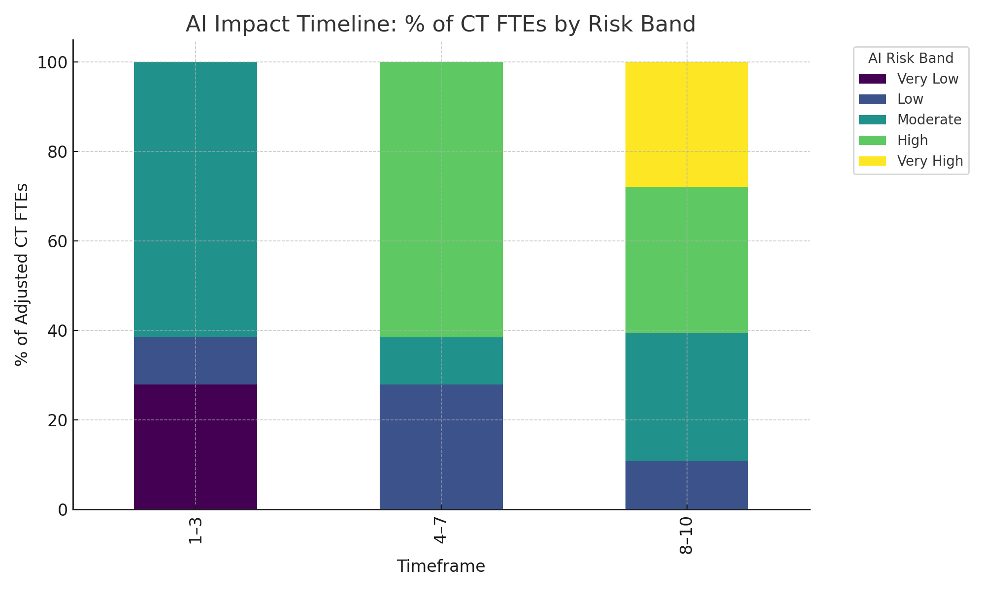
Chart 1 – AI Impact Timeline

Slide 5
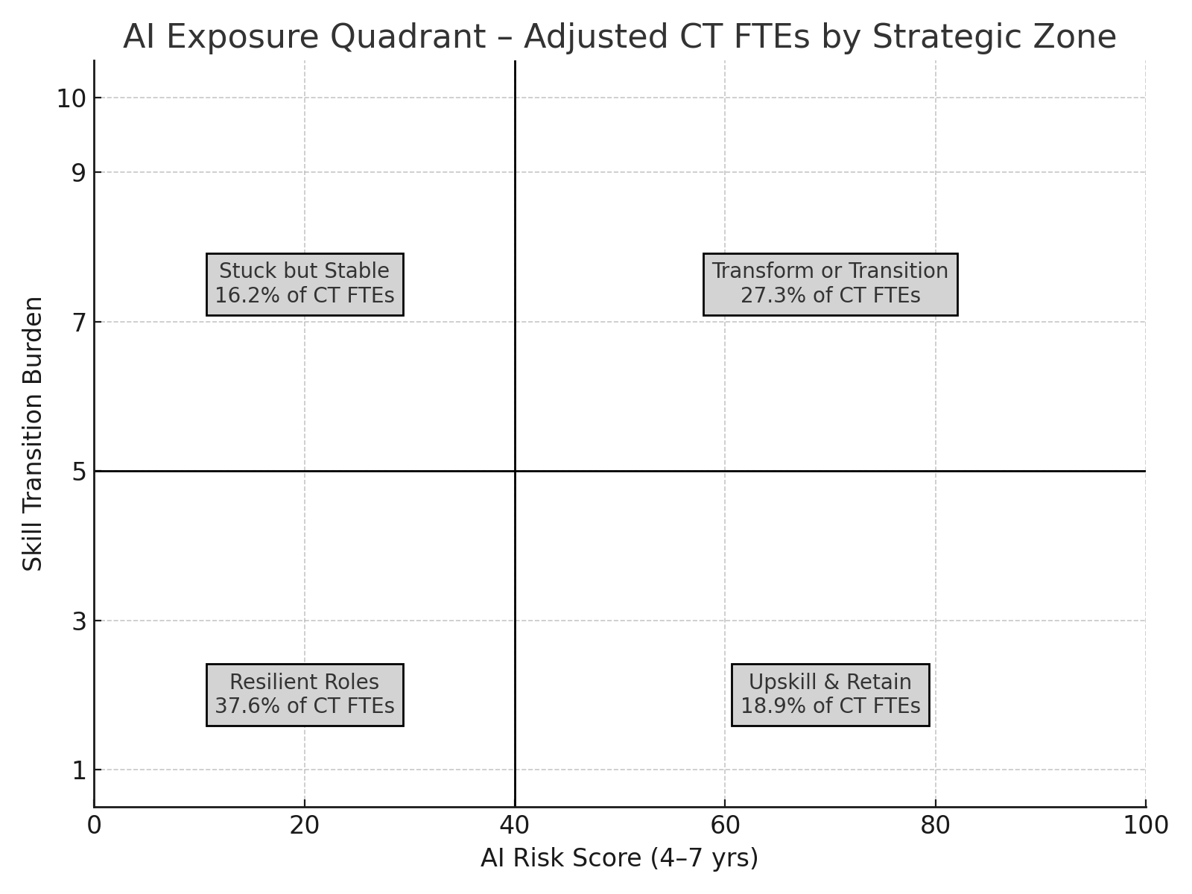
Chart 2 – Quadrant Summary Grid

Slide 6
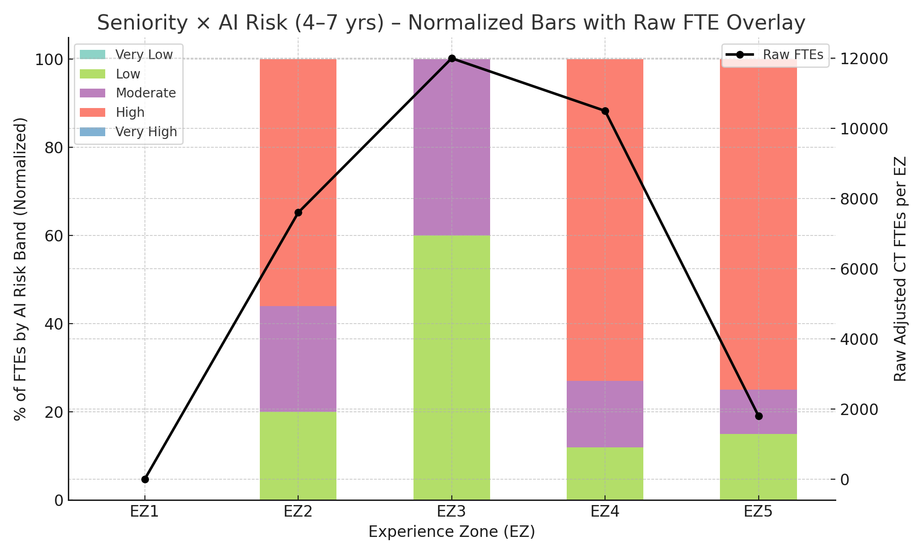
Chart 3 – Seniority × AI Risk (4–7 yrs)

Slide 7
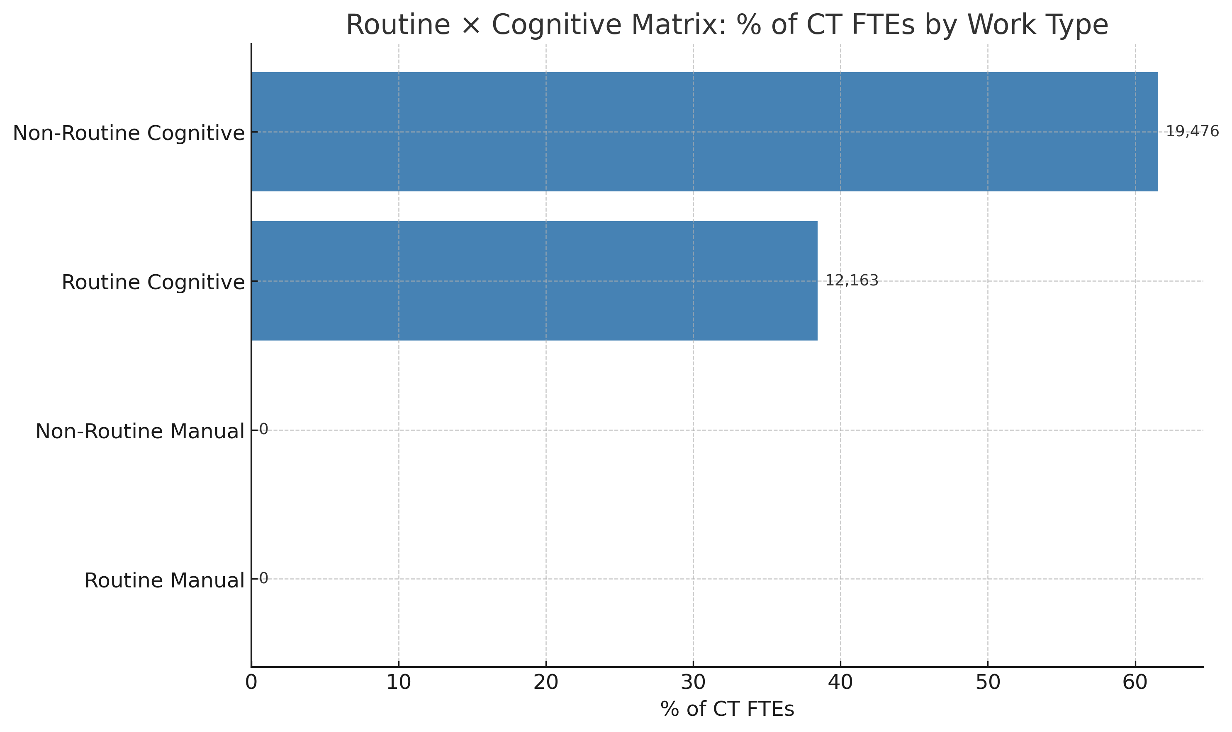
Slide 6 – Routine × Cognitive Matrix

Slide 8
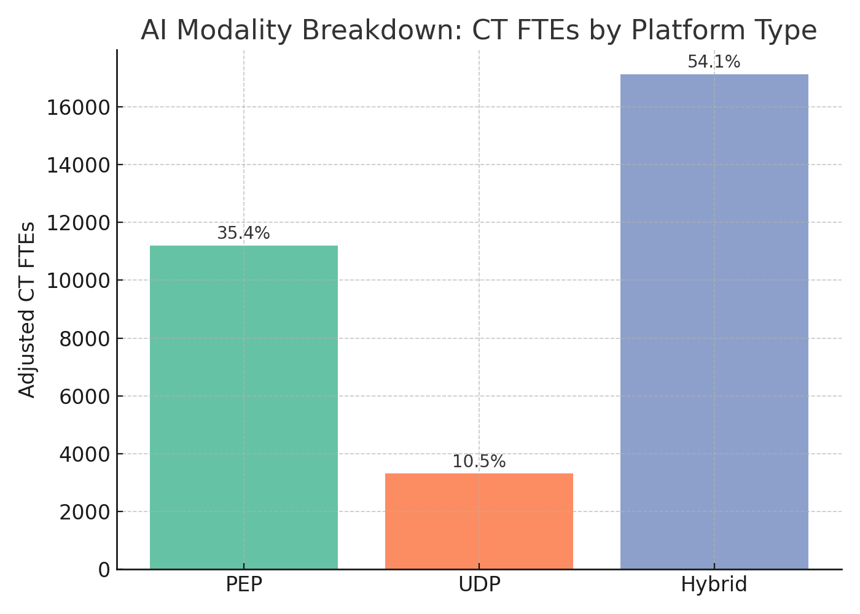
Chart 5 – AI Modality Breakdown

Slide 9
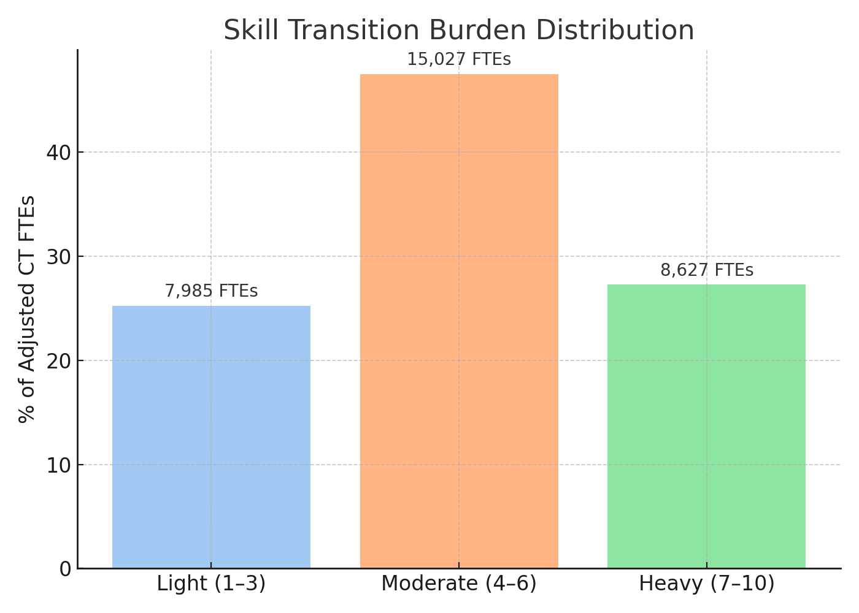
Chart 6 – Skill Transition Burden Distribution

Slide 10
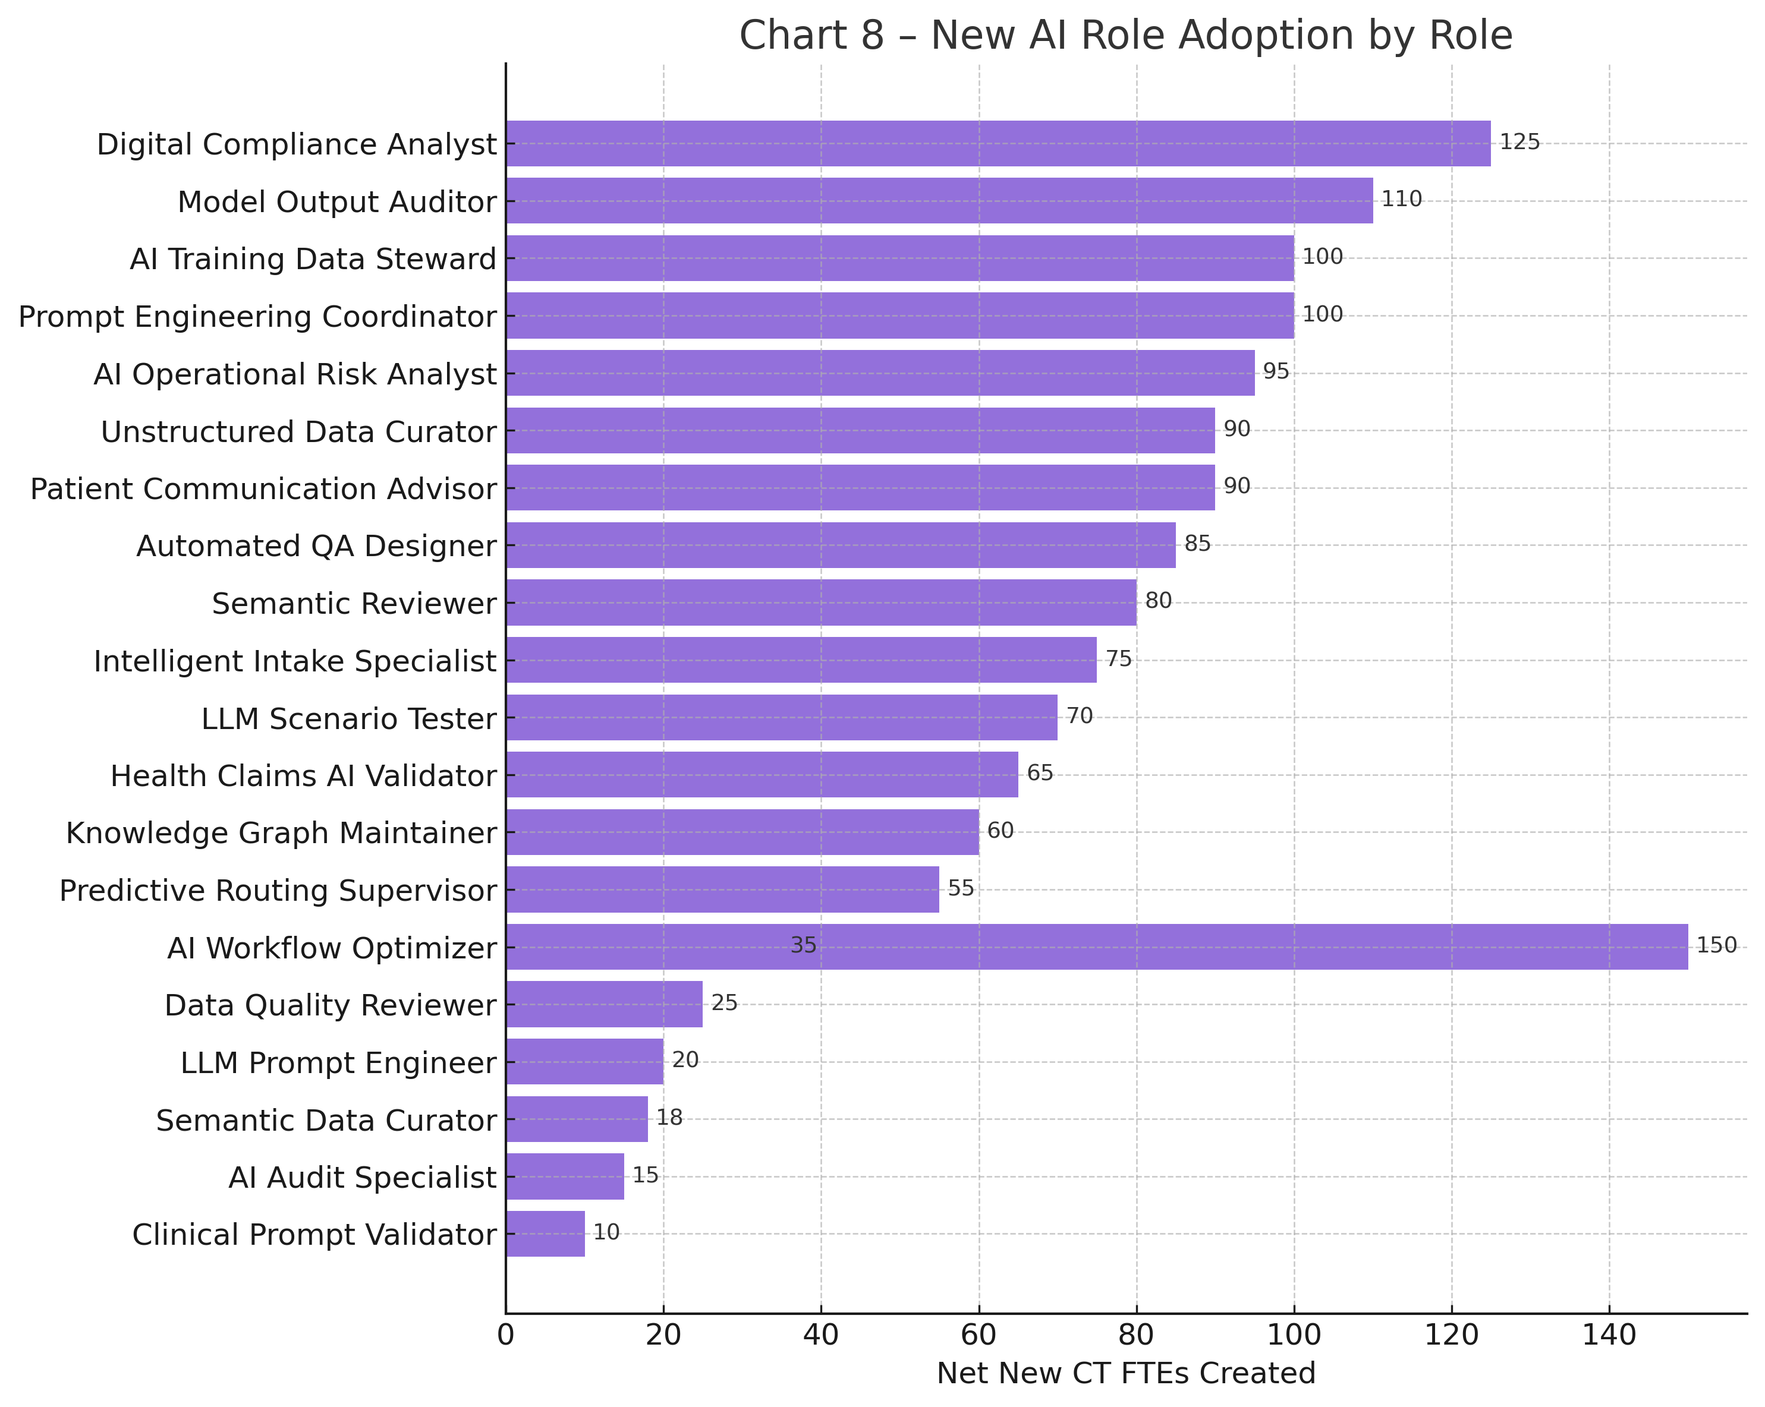
Chart 8 – New AI Role Adoption by Role

Slide 11
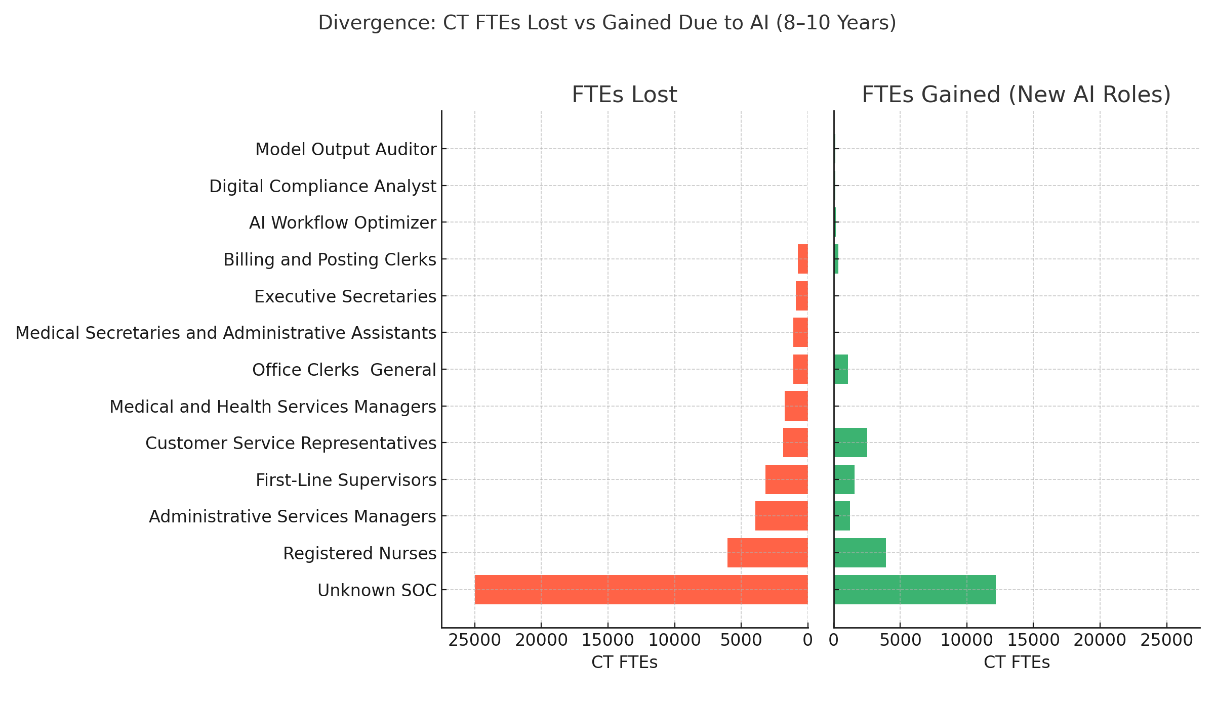
Chart 7 – Divergence: CT FTEs Lost vs Gained

Slide 12
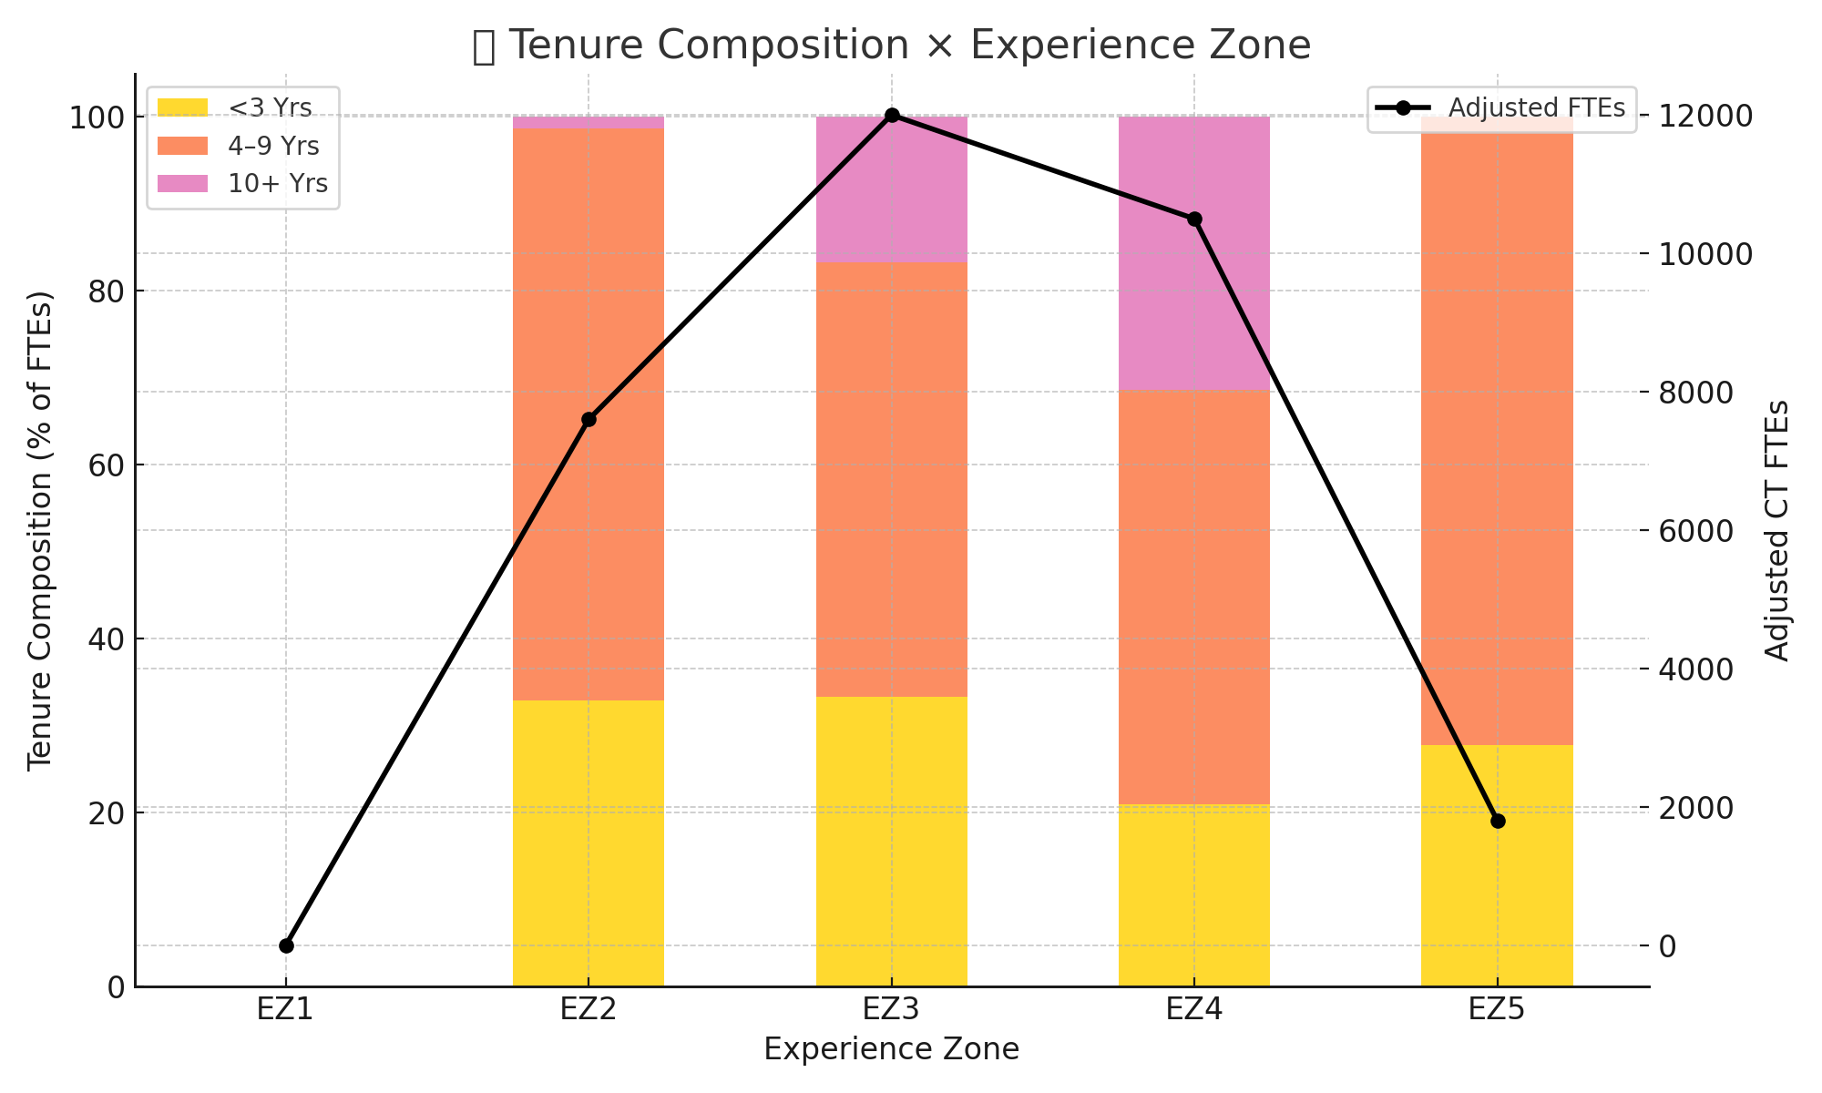
Chart 10 – Tenure Composition × Workflow

Slide 13
Appendix A
📏 **Scales & Classifications Used**
🔹 **AI Risk Bands (% Displacement Probability)**
- Very Low: 0–10%
- Low: 11–25%
- Moderate: 26–50%
- High: 51–75%
- Very High: 76–100%
🔹 **Skill Transition Burden (1–10)**
- Light: 1–3
- Moderate: 4–6
- Heavy: 7–10
🔹 **Tenure Bands**
- <3 years, 4–9 years, 10+ years
🔹 **Work Types**
- Routine vs Non-Routine
- Cognitive vs Manual
🔹 **Experience Zones (EZ1–EZ5)**
- EZ1: Little or no preparation
- EZ5: Extensive preparation (advanced degree + experience)

Slide 14
Appendix B
📚 **Data Sources & Role Mapping**
**Primary Source Frameworks**
- U.S. Bureau of Labor Statistics (BLS)
- O*NET Online: SOC Job Descriptions & Zones
- Connecticut Department of Labor (CT DOL)
- OPM GS-SOC Crosswalk (used for EZ)
- Assessment Rubric v10.4 (AI Risk, Burden, Augmentation)
- Modality Framework: *PEP vs UDP Capabilities.pptx*
**Workflow Mapping by Analyzer v4**
- Each task mapped to SOC × % time × % contribution × EZ × Tenure
- Analyzer outputs then aggregated for Comparor analysis

Slide 15
Appendix C
📖 **3rd-Party Research Referenced**
- *Jobs Lost, Jobs Gained* – McKinsey Global Institute (2017, 2023 updates)
- *Routine Task Intensity & Job Risk* – Federal Reserve Bank of St. Louis
- *ALM Framework* – Autor, Levy, Murnane (2003–2015)
- *Experience Zones Model* – David Dorn (EZ1–EZ5) occupational ladder
- *AI & Workflow Role Study* – ChatGPT v4 Analyzer Methodology (custom for CT project)

