Slide 2

POC: FPR
FPRs: IBOV e DOL
Dados são modelados utilizando um AR(10)-GARCH(1,1)
$$\begin{matrix} & R_{t}=μ+e_{t} \\ & e_{t}∼N\left(0,σ_{t}^{2}\right) \\ & σ_{t}^{2}=ω+αe_{t−1}^{2}+βσ_{t−1}^{2}\end{matrix}$$

Slide 3
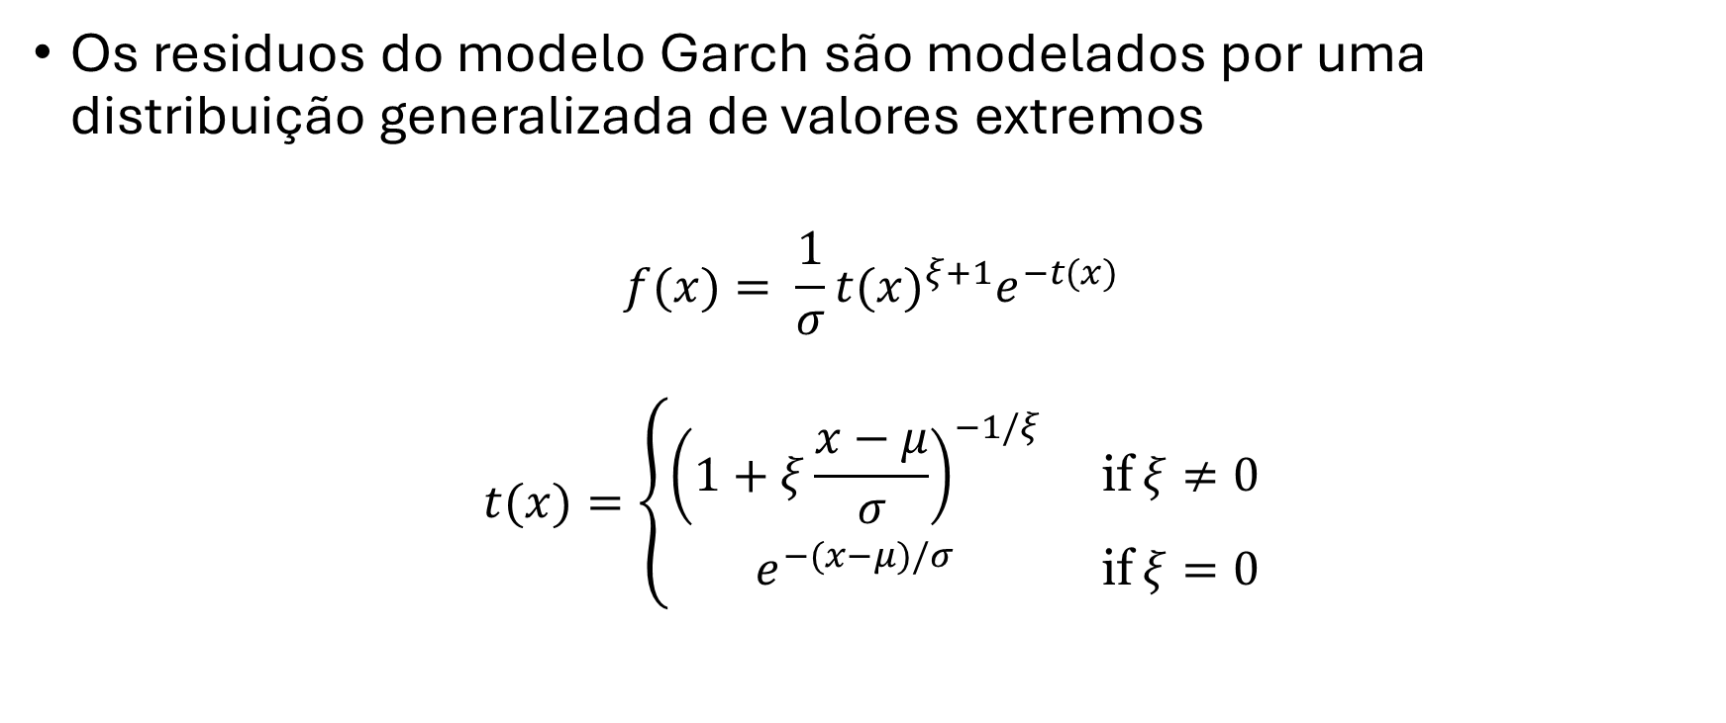
POC: GEV
Os residuos do modelo Garch são modelados por uma distribuição generalizada de valores extremos
$$f(x)= \frac{1}{σ}t(x)^{ξ+1}e^{−t(x)}$$
$$t(x)=\left\{\begin{matrix}{\left(1+ξ\frac{x−μ}{σ}\right)}^{−1/ξ} & \text{if} ξ≠0 \\ e^{−(x−μ)/σ} & \text{if} ξ=0\end{matrix}\right.$$

Slide 4
POC: Monte Carlo
Os choques de GEV são entao utilizados para uma simulacao do AR(10)-GARCH(1,1)
Horizonte de simulação : 10
Burn-in: 250
Número de simulações: 100.000

Slide 5
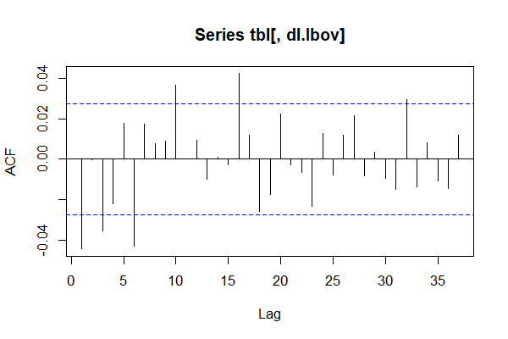
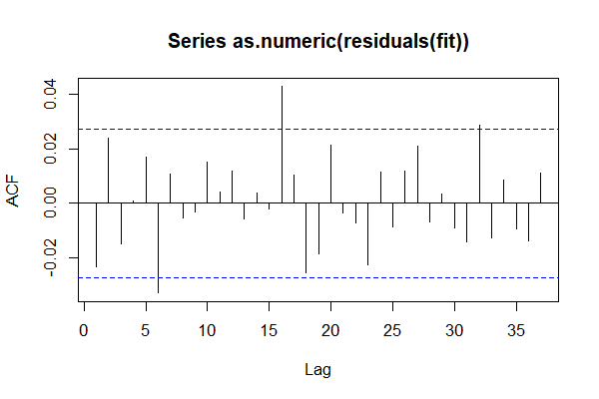
FPR: IBOV

Slide 6
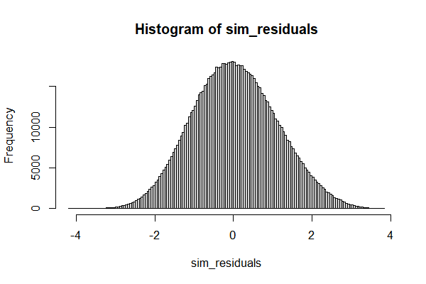
FPR: IBOV

Slide 7
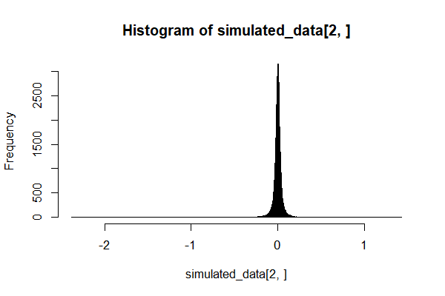
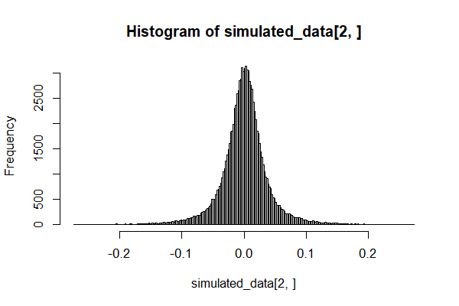
FPR: IBOV

Slide 8
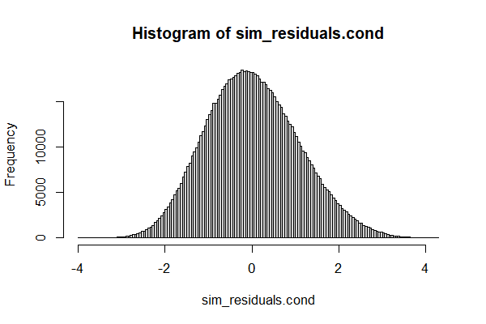
FPR: IBOV

Slide 9
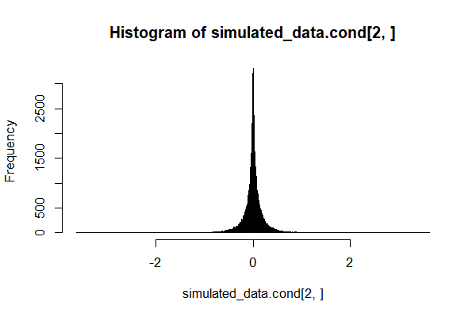
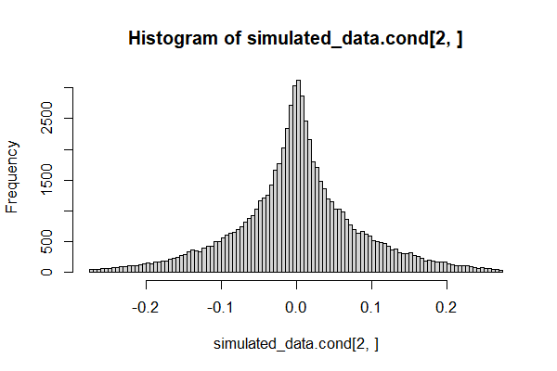
FPR: IBOV

Slide 10
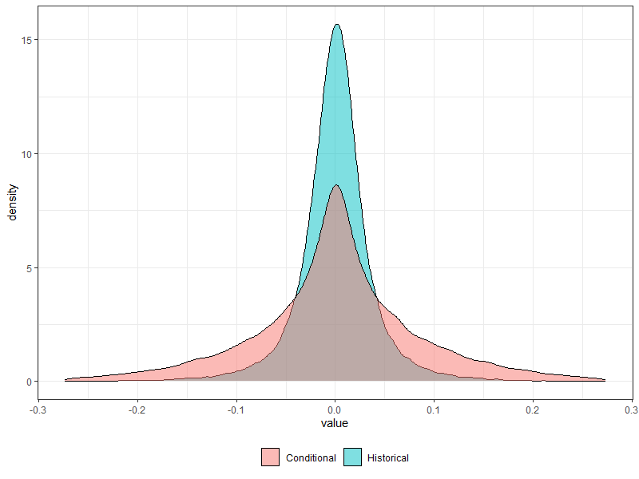
FPR: IBOV

Slide 11
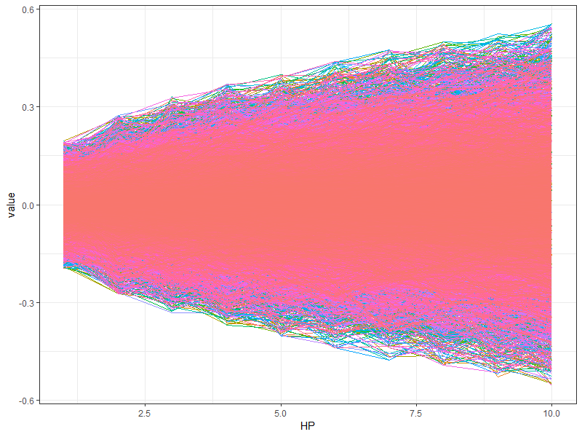
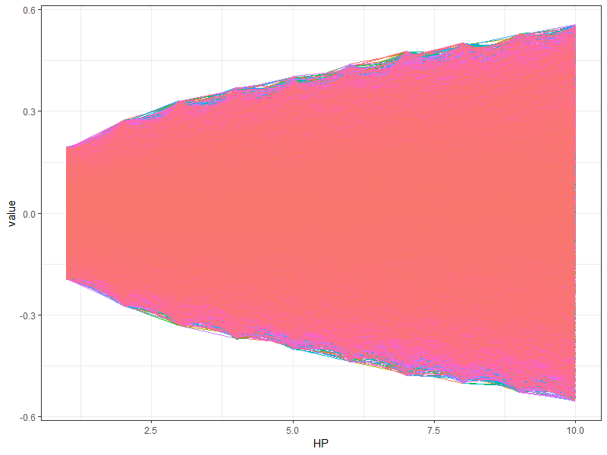
FPR: IBOV

Slide 12
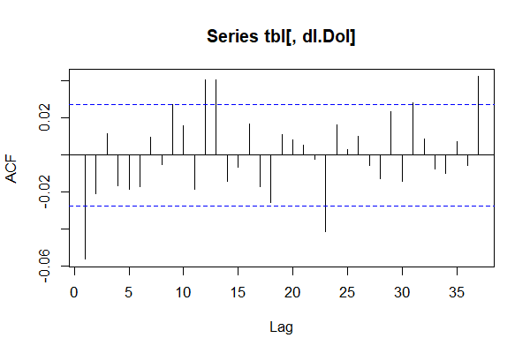
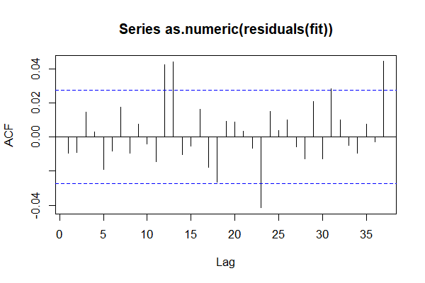
FPR: DOL

Slide 13
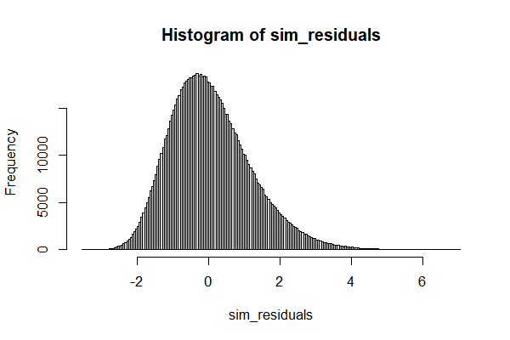
FPR: DOL

Slide 14
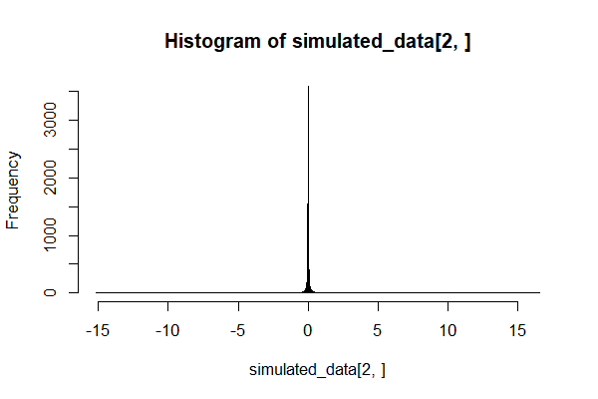
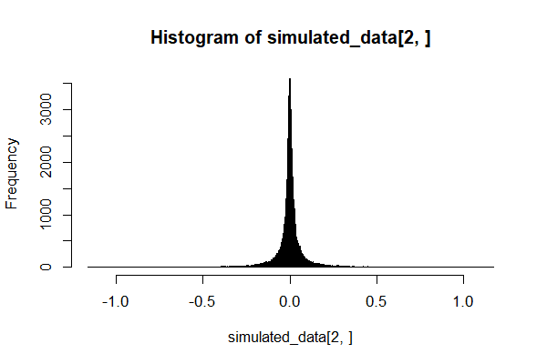
FPR: DOL

Slide 15

FPR: DOL

Slide 16
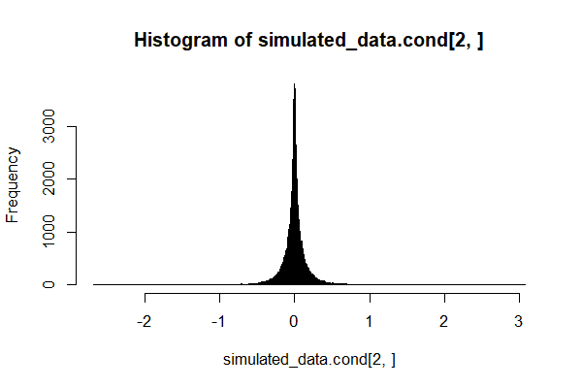
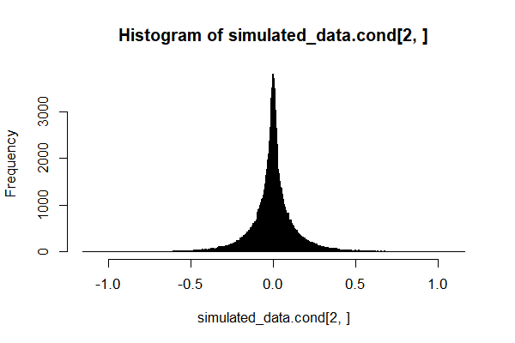
FPR: DOL

Slide 17
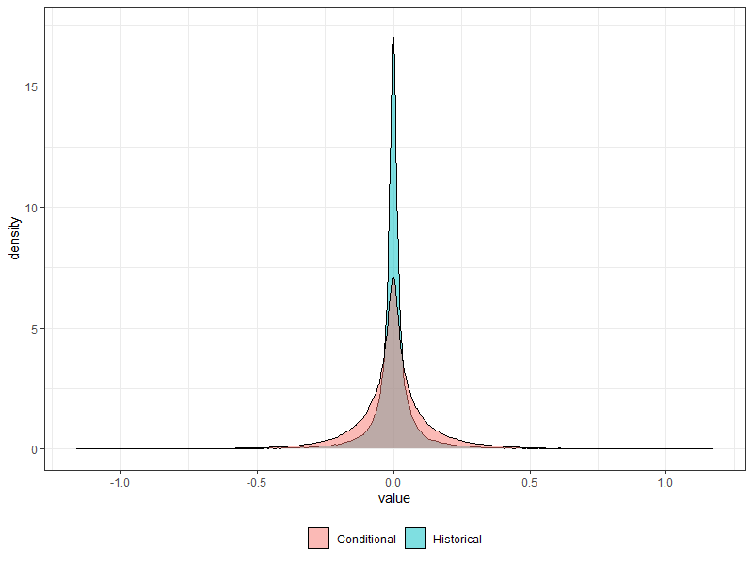
FPR: DOL

Slide 18
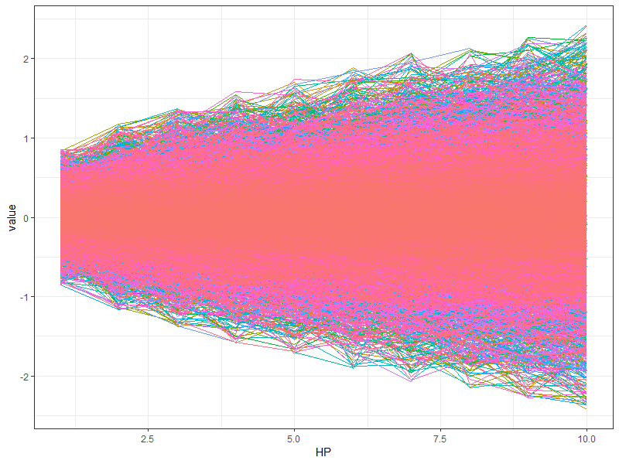
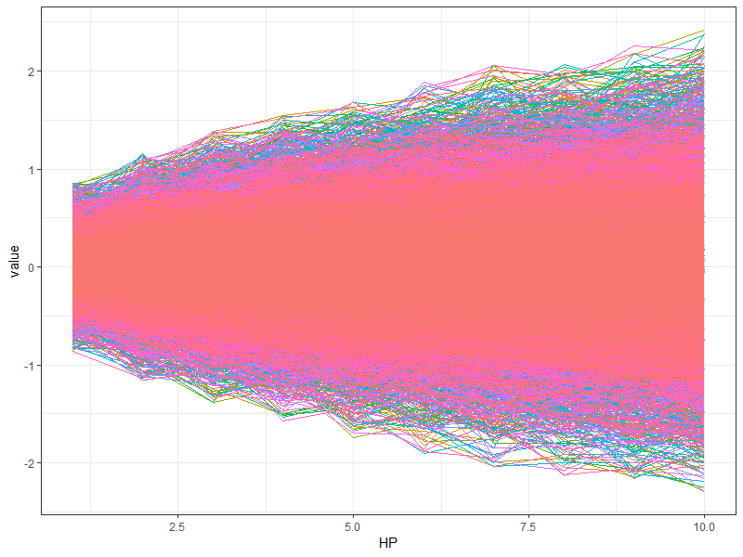
FPR: DOL

Slide 19
Quantiles
Ibov:
> quantile(simulated_data[2,], prob = q)
0.4% 0.5% 1% 99% 99.5% 99.6%
-0.1640115 -0.1547888 -0.1236670 0.1212059 0.1495237 0.1592231
> quantile(simulated_data.cond[2,], prob = q)
0.4% 0.5% 1% 99% 99.5% 99.6%
-0.2497681 -0.2441605 -0.2240989 0.2243753 0.2427233 0.2480287
Dol
> quantile(simulated_data[2,], prob = q)
0.4% 0.5% 1% 99% 99.5% 99.6%
-0.5671269 -0.5193923 -0.3821368 0.3870186 0.5293307 0.5739318
> quantile(simulated_data.cond[2,], prob = q)
0.4% 0.5% 1% 99% 99.5% 99.6%
-0.6076650 -0.5753774 -0.4710774 0.4947995 0.6100771 0.6447082

