Slide 1

Password Cracking
Fun with Erlang Concurrency
Barry Ezell: barrye <at> gmail.com

Slide 2
Er-what?

Slide 3
Er-what?
What: Functional language, not Object- Oriented

Slide 4
Er-what?
What: Functional language, not Object- Oriented
Who: Ericsson Computer Science Laboratory
Notes:
Developed by Ericsson in the late 80’s and open-sourced in 1998.

Slide 5
Er-what?
What: Functional language, not Object- Oriented
Who: Ericsson Computer Science Laboratory
Where: erlang.org. This code: search “erlang_md5crack” on github.com

Slide 6
Why Erlang?

Slide 7
Why Erlang?
Concurrency

Slide 8
Why Erlang?
Concurrency
Distributed

Slide 9
Why Erlang?
Concurrency
Distributed
Designed for failure

Slide 10
Why Erlang?
Concurrency
Distributed
Designed for failure
Hot-upgradable code

Slide 11

Erlang 101

Slide 12

Variables
Start with a Capital letter: X, Myvar, Paulson

Slide 13
Variables
Start with a Capital letter: X, Myvar, Paulson
They don’t vary - really, never

Slide 14
Variables
Start with a Capital letter: X, Myvar, Paulson
They don’t vary - really, never
B = 1 is a statement of fact, not an assignment

Slide 15
Variables
Start with a Capital letter: X, Myvar, Paulson
They don’t vary - really, never
B = 1 is a statement of fact, not an assignment
Mathematically B = B + 1 makes no sense, same in Erlang

Slide 16
Variables
Start with a Capital letter: X, Myvar, Paulson
They don’t vary - really, never
B = 1 is a statement of fact, not an assignment
Mathematically B = B + 1 makes no sense, same in Erlang
B = 2 is similarly illegal

Slide 17
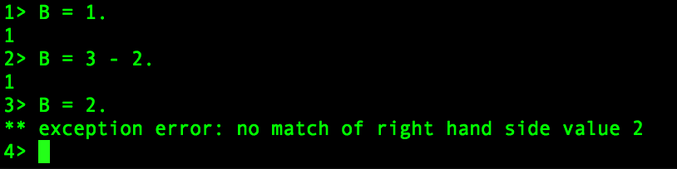

Slide 18
Data types
Number (integer and float)

Slide 19
Data types
Number (integer and float)
Atom (literal):
  hello
  kitty

Slide 20
Lists
X = [1,2,3].
Y = [an_atom,{tuple,tuple},”hello”,9.45].
[Z|Rest] = X.

Slide 21
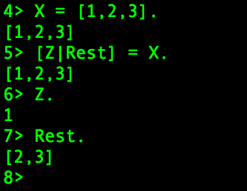

Slide 22
Tuples
{Term1,.....,TermN}
Shape1 = {square,4}
Shape2 = {circle,5}

Slide 23
String: syntactic sugar
An array of integers with ASCII values
Not a data type

Slide 24
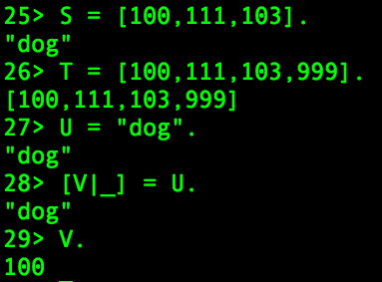

Slide 25
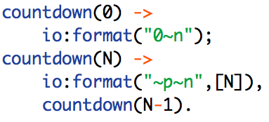
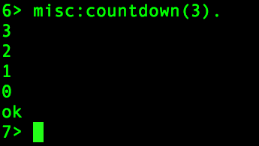
Pattern Matching and Recursion

Slide 26
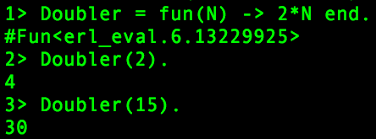
Fun() with anonymous functions

Slide 27
Processes
Pid = spawn(Fun).
Notes:
Neither OS processed nor like threads, but lightweight processes somewhat similar to Java’s original “green threads”. No shared state. Benchmarks up to 20 million demonstrated. 20,000 processes spawned in 9.2 microseconds.

Slide 28
Processes
Pid = spawn(Fun) :spawns new function referenced by Pid
Pid ! Message :sends message to process

Slide 29
Processes
Pid = spawn(Fun) :spawns function as a process referenced by Pid
Pid ! Message :sends message to process
receive...end :block used by process to receive messages

Slide 30
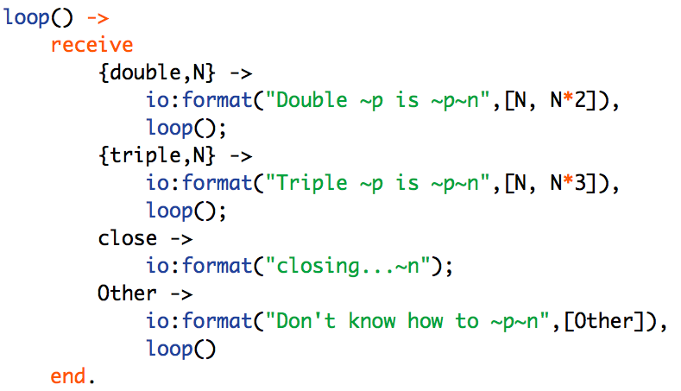

Slide 31
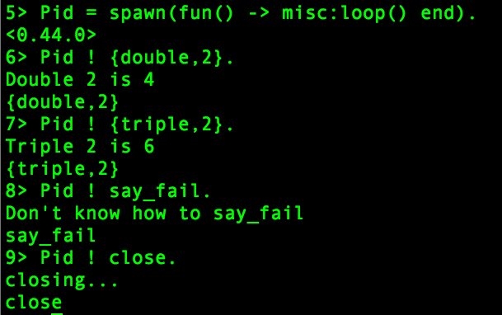

Slide 34
Back to the Passwords

Slide 35
Don’t Be Evil!
For demonstration purposes only
Not production-ready

Slide 36
Problem
Simple, non-reversible password creation by MD5 algorithm

Slide 37
Problem
Simple, non-reversible password creation by MD5
MD5.hexdigest("hi") = 49f68a5c8493ec2c0bf489821c21fc3b

Slide 38
Problem
Simple, non-reversible password creation by MD5
MD5.hexdigest("hi") = 49f68a5c8493ec2c0bf489821c21fc3b
How to determine plaintext when given hash?

Slide 39
Bruteforce Solution
Check the MD5 hash of every possible string. When hashes match, password found.

Slide 40
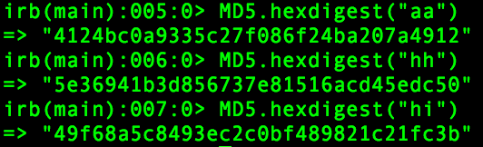
Check all strings between “aa” and “zz”

Slide 41
Exponential Time
Length 1: 26 ^ 1 = 26 possiblities

Slide 42
Exponential Time
Length 1: 26 ^ 1 = 26 possiblities
Length 2: 26 ^ 2 = 676

Slide 43
Exponential Time
Length 1: 26 ^ 1 = 26 possiblities
Length 2: 26 ^ 2 = 676
Length 3: 26 ^ 3 = 17,576
Length 6: 308,915,776
Length 7: 8,031,810,176
Length 8: 5.4 trillion +

Slide 44
Strategy: Divide & Conquer
3-letters, single process = search from ‘aaa’ to ‘zzz’

Slide 45
Strategy: Divide & Conquer
3-letters, single process = search from ‘aaa’ to ‘zzz’
3-letters, 2 processes: ‘aaa’ to ‘mzz’, ‘naa’ to ‘zzz’

Slide 46
Strategy: Divide & Conquer
8 processes:
[{"aaa","dgm"},
{"dgn","gmz"},
{"gna","jtm"},
{"jtn","mzz"},
{"naa","qgm"},
{"qgn","tmz"},
{"tna","wtm"},
{"wtn","zzz"}]

Slide 47
Find first letter for string length
a = 0, z = 25
aa = 26 (not [0],[0])
aaa = 702

Slide 48
Find first letter for string length
a = 0, z = 25
aa = 26
aaa = 702
first(3) = 26^2 + 26^1
recursively calc 26^n-1 until n = 0

Slide 49
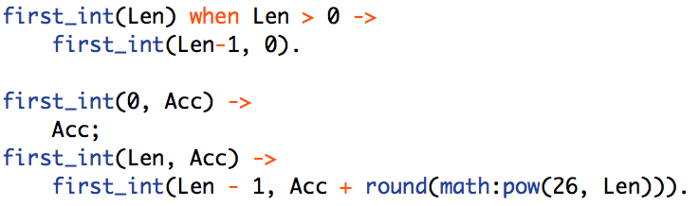
Find first letter for string length

Slide 50
Divide and Conquer II
3 letters, 3 processes:
  17576 / 3 = 5858.667 strings / proc
  [{702, 6560},{6561,12419},{12420,18277}]
  [{"aaa","iri"},{"irj","rir"},{"ris","zzz"}]

Slide 51
Number to Char Array
Use hexavigesimal math

Slide 52
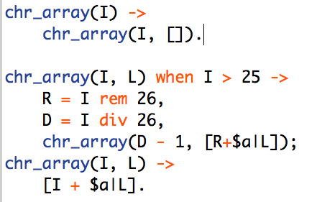
Number to Char Array
Use hexavigesimal math
chr_array(702) = [97,97,97] = “aaa”

Slide 53
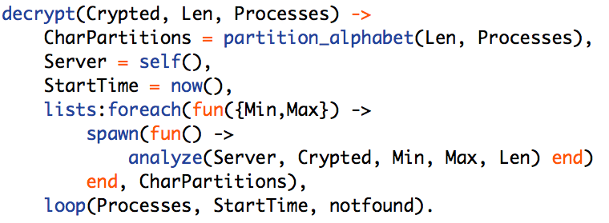
Spawn N processes

Slide 54
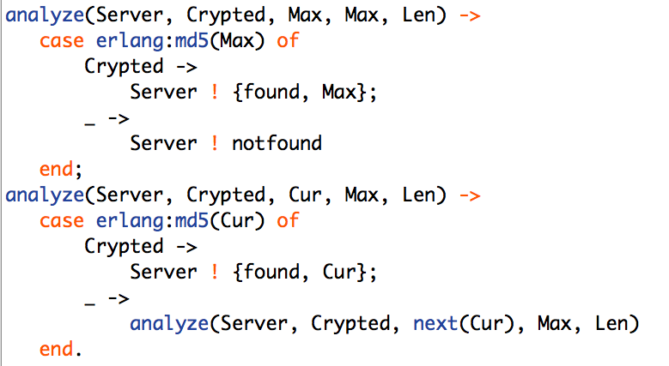
Client analyze function

Slide 55
Client analyze function

Slide 56
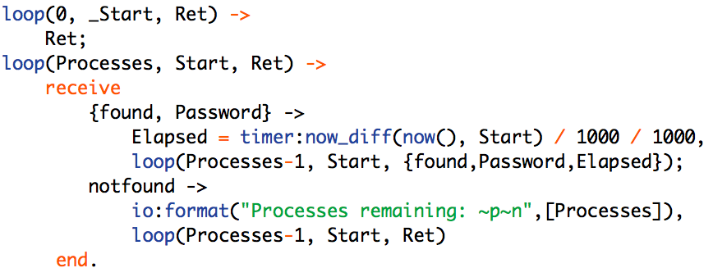
Server function

Slide 57
Testing
Amazon EC2, High-CPU Extra Large Instance
8 cores, 7 GB RAM
Fedora Core 6
Erlang R12B-4, Ruby 1.8.6

Slide 58
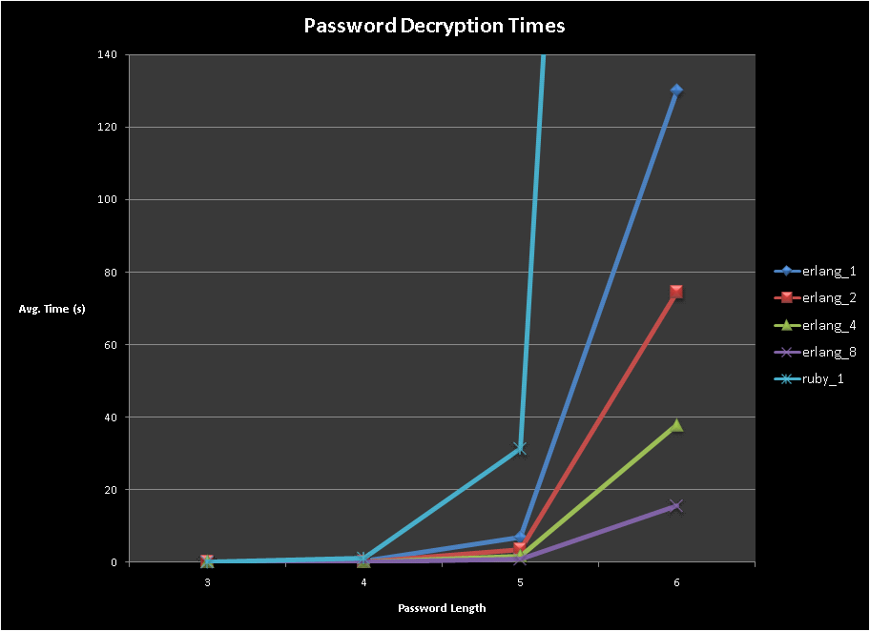

Slide 59
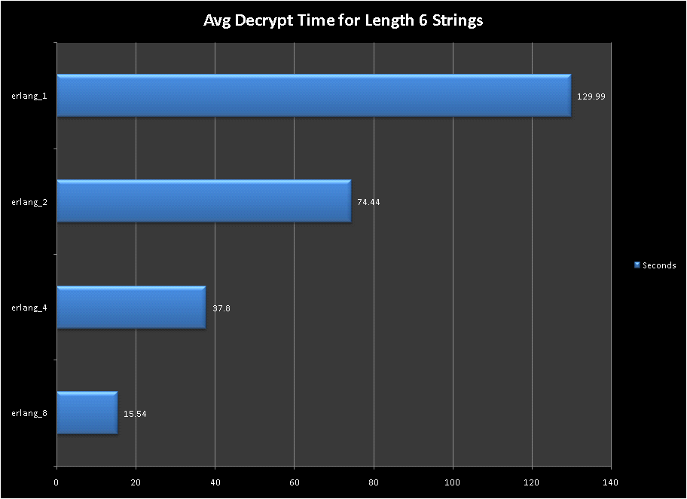

Slide 60
Final Thoughts
Learn: pragmatic programmer at pragprog.com
Look into phofs:mapreduce
Disco: Python functions, Erlang engine at http://discoproject.org/
Notes:
parallel higher-order functions module

