Slide 1
Euro area* headline HICP · Dec 2026 forecast (h = 3 from the Sep 2026 release)
Inflation is seen holding at 3.8% into December
3.8%
point forecast 3.77% · ECB target 2%
68% band 3.4–4.2% · 90% band 3.0–5.1%
−0.11 pp
base effect: last year's monthly changes leaving the window, known today
+0.12 pp
cumulative momentum: new monthly changes to December, forecast
1.52 / 1.30
pp from services and fuels, the largest contributors (fuel prices +32.3% y/y)
27%
probability that December prints above 4%, from the model's own past errors
Actual Forecast 68% band 90% band
Notes:
Lead with the answer. Euro area* headline HICP is forecast at 3.77% y/y for Dec 2026, three months after the Sep 2026 print of 3.77%. The 68% band is 3.4 to 4.2% and the 90% band 3.0 to 5.1%; both come from the model's own out-of-sample errors, not from model assumptions, which is why the fan is skewed up (the model under-predicted in 2021-22).
Why it barely moves: the base effect takes off 0.11 pp, because last year's October to December monthly changes drop out of the window, and new momentum adds 0.12 pp. The two almost cancel.
What carries the level: services 1.52 pp and fuels 1.30 pp, with fuel prices up 32.3% y/y.
Risk framing: a 27% chance that December prints above 4%.

Slide 2
Method and validation
Every number is checked before it is shown
1
Eurostat API, no manual files
2
9 validation gates
9/9
HICP index 2025 = 100 by COICOP ver.2 component and country, item and country weights, official contributions.
8 pass, 1 warning (V8), 0 failures. A failed critical gate stops the run.
data checks without a failure
3
Rebuild Eurostat's headline
4
Bottom-up forecast
Chain-linked Laspeyres, December link: 309 months within 0.030 pp; contributions within 0.009 pp.
Six components, each with its own model, aggregated with the weights known at the forecast date.
0.030 pp
largest error rebuilding Eurostat's headline
5
Pre-registered tests
6
Structured outputs
Rules written and committed before results: 4 model rounds, Diebold-Mariano with Holm correction.
Schema-validated JSON for every result, a hash-chained forecast ledger, one offline dashboard.
217
automated tests (maths, data contracts, engine parity)
Notes:
For validation and structured outputs. Nothing is downloaded by hand: the pipeline pulls Eurostat's HICP index, item and country weights and the official contributions through the API, and records the vintage of every pull.
Before any model runs, 9 gates check the data; 8 pass and V8 is a documented warning, not a failure.
The strongest check is the reconciliation: we rebuild Eurostat's headline from the six components with annual chain-linked Laspeyres weights and a December link. Over 309 months the largest gap is 0.030 pp, and the contributions match Eurostat's within 0.009 pp. If our arithmetic is right there, the forecast's contributions can be trusted.
Every model rule was written and committed before results existed, and every output is schema-validated JSON. 217 automated tests cover the maths and the data contracts.

Slide 3
Forecast accuracy · out of sample, 2010–2026
21% smaller three-month errors than a random walk
0.79
0.016
error ratio vs random walk, 3 months
Diebold-Mariano p (198 origins)
Same gain in calm and in crisis: ratio 0.79 in 2010–19, 0.79 in 2020–23, 0.74 since 2024.
Honest limits
In 2020–23 only 35% of outcomes fell inside the 68% band (79% in 2010–19), and the model under-predicted by 0.37 pp on average.
June 2022: forecast 6.8% from Mar 2022, outcome 8.6% (random walk 7.4%).
Model frozen after 4 pre-registered rounds; the ledger now scores it out of sample.
Notes:
The benchmark that matters at short horizons is the random walk, "y/y stays where it is", which most inflation models fail to beat. Out of sample over 198 forecast origins, our three-month error is 0.63 pp against 0.80 pp, a ratio of 0.79. The Diebold-Mariano test (HLN correction, Newey-West) gives p = 0.016.
The gain is the same before and after 2020, which makes it less likely to be a crisis accident.
Be upfront about the limits: in 2020-23 only 35% of outcomes fell inside the 68% band and the model under-predicted by 0.37 pp on average. In June 2022 it said 6.8% and inflation was 8.6%.
On model choice: there were 4 rounds, each with its rule fixed and committed first. The adopted variant passed narrowly (p 0.016 against a Holm threshold of 0.0167). The model is now frozen, and the hash-chained ledger is the clean out-of-sample test from here.

Slide 4
Shock pass-through · preset scenario
A gas price spike would add up to +1.07 pp to headline
The scenario
Retail electricity & gas +20% across the euro area*, phased in over 6 months from Nov 2026: about a quarter of the 2021–22 rise.
+1.07 pp
4.1%
largest impact, Apr 2027
December instead of 3.8% (+0.33 pp)
Assumptions, always shown
Price-level shock per country × component, on its own profile
Weights at origin prices, held constant
A permanent shock lifts y/y for 12 months, then drops out
Second round optional: estimated, regime-dependent lag
No policy or demand response
Notes:
One preset, with its assumptions on screen. Wholesale gas spikes; retail gas and electricity follow slowly because of regulated tariffs and fixed contracts, so the shock is +20% on the retail level, phased in over 6 months from Nov 2026, about a quarter of the 2021-22 episode.
The engine moves each country and component's price level and re-aggregates with the euro area weights, so the pass-through is exact arithmetic rather than a regression: the impact builds to +1.07 pp in Apr 2027, and December would print 4.1% instead of 3.8%. Because it is a level shock, it lifts y/y for a year and then drops out as a base effect.
The assumptions (A1 to A5) are always visible next to the result. Second-round effects into core are optional, estimated with a regime-dependent distributed lag, and shown separately because they are uncertain.
For oil, the Brent preset goes through an estimated pass-through to fuel prices of 0.31 (s.e. 0.04); +30% Brent peaks at +0.46 pp. The simulator also solves backwards: what size of shock takes December to a target.

Slide 5
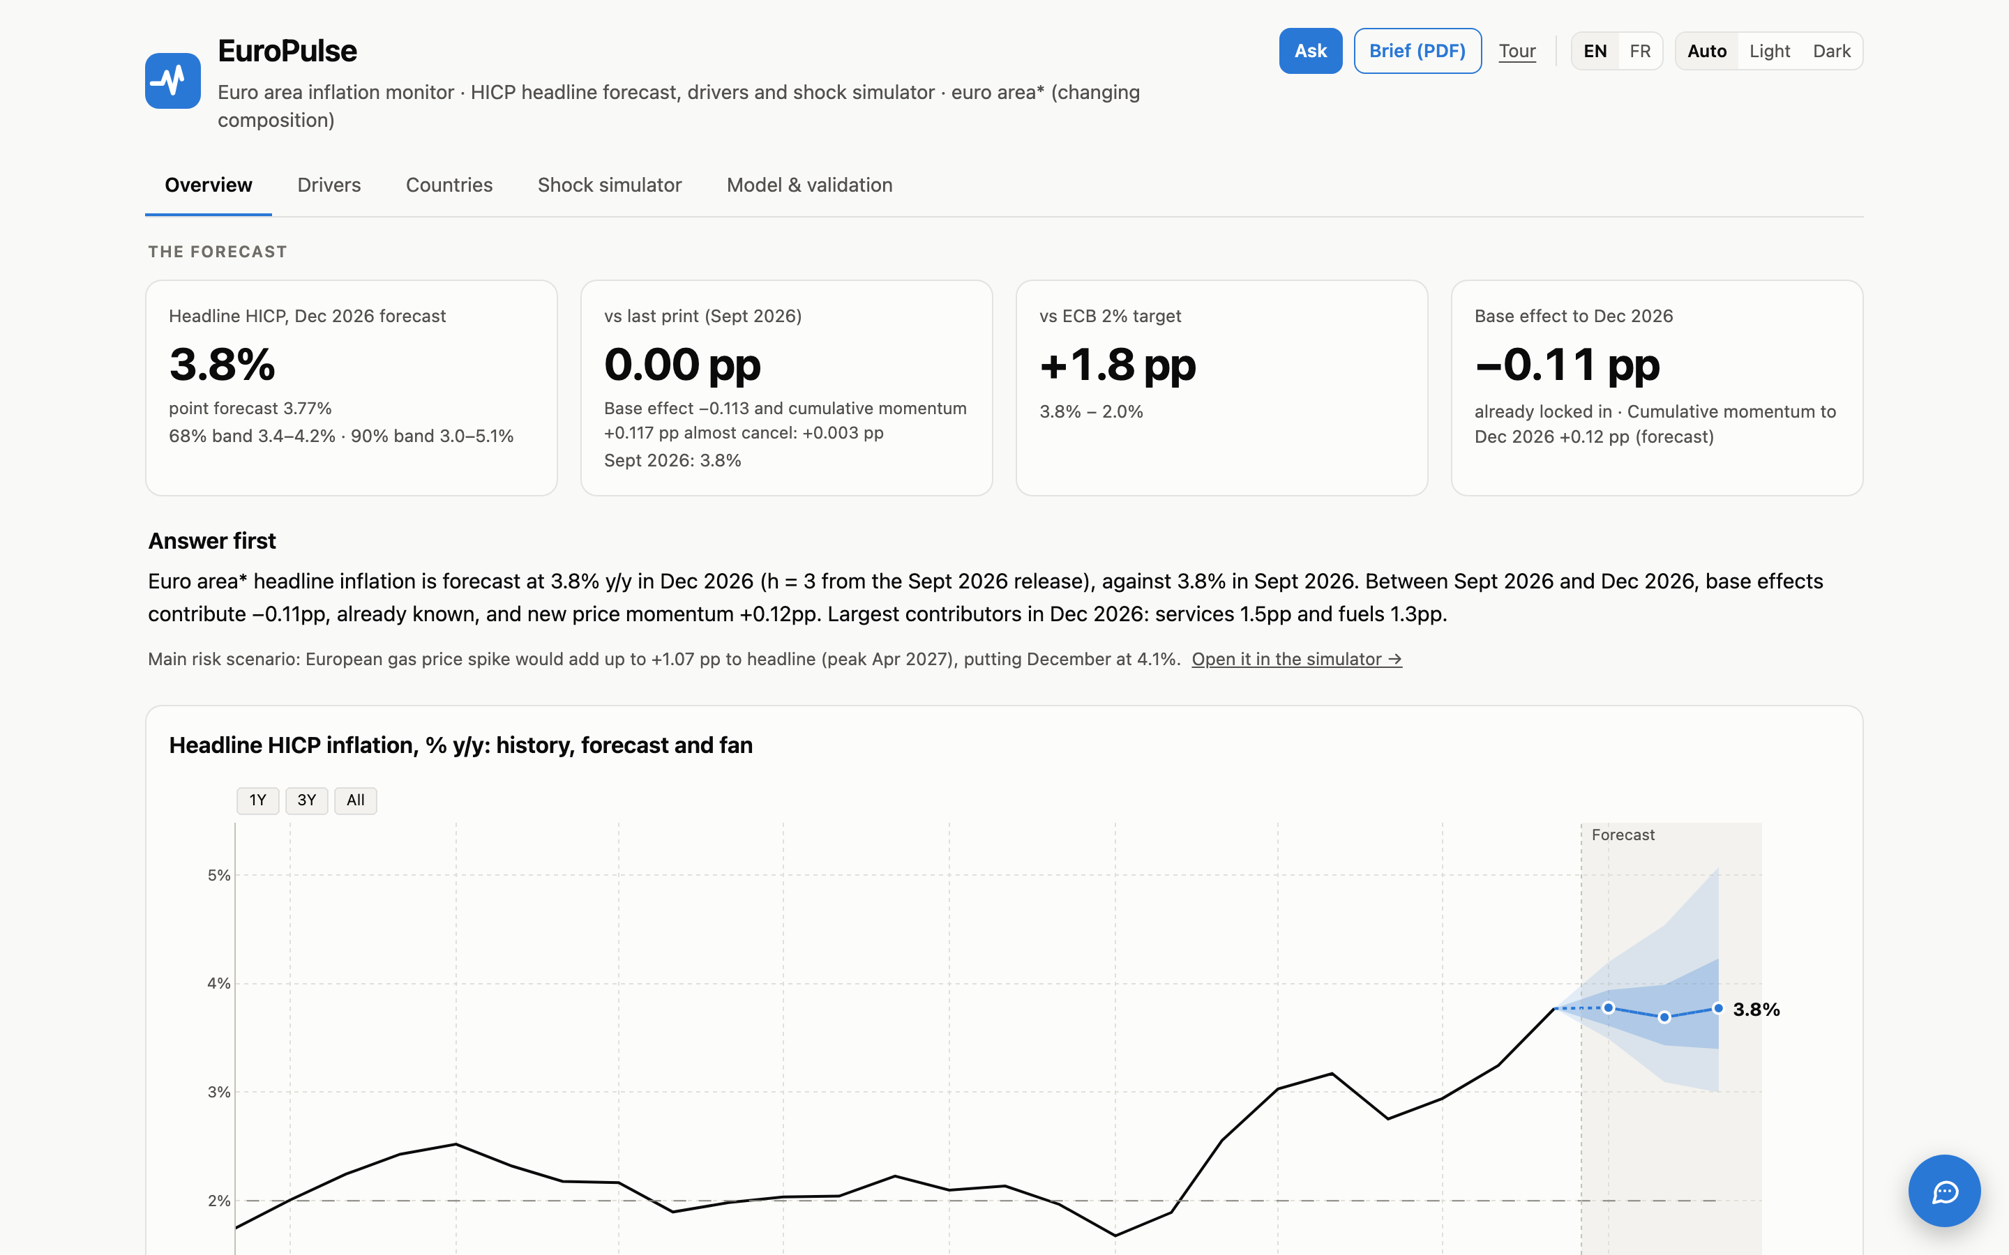
Dashboard and next steps · EuroPulse, live and offline
One page to ask, simulate and check
Ask it anything
Words become shocks
A chatbot answers in EN, FR or Turkish; every number is checked against the page, and it builds and runs scenarios itself.
Describe a shock in a sentence: the language model only fills a validated schema; the engine computes, the reader confirms.
Solve it backwards
Forecasts that keep score
Reverse stress test: the shock size that takes December to a target or probability.
Pre-registered model rounds and a hash-chained ledger scored as Eurostat publishes.
hicpinflationshocksimulator.vercel.app · also one offline HTML file
Next: weekly fuel prices, pre-tax energy, country-level gas and electricity, true real-time vintages. Outputs are schema-validated JSON, ready to feed Power BI or a research platform.
Notes:
Everything on the previous slides is in one dashboard, EuroPulse: live on the web and also a single offline HTML file, in English and French, with a guided tour per page.
What is new: a chatbot that answers questions about the page in English, French or Turkish, where every number in the answer is checked against the figure it cites, and that can run a scenario itself, for example "what if gas rises 30% in Germany from November?". Describing a shock in a sentence works the same way: the language model only fills a validated schema, the engine computes, and the reader confirms before anything runs.
The simulator also works backwards: what shock size takes December to a target. And the forecast keeps score: every published forecast goes into a hash-chained ledger and is scored when Eurostat publishes.
Next steps: weekly fuel prices, pre-tax energy prices, country-level gas and electricity, and true real-time vintages. Every output is schema-validated JSON, so the same results can feed Power BI or a research platform without re-computing anything.

