Slide 1
2024 Artos.ai Technical
Bryan Tor

Slide 2

Overview
Background
Data Exploration
Retrieval Approaches
Generation Approaches
Web Application
Potential Next Steps

Slide 3
Background
“Clinical protocols are one of the most important. A protocol contains detailed information on how the study is going to be run.”
“One other key document is an Informed Consent Form (ICF). This form is meant to inform participants of a clinical trial about the objectives, risks, and potential benefits of participating in the trial and is required in any clinical trial involving human subjects.”
“Your task will be to [build a web application that can] generate an Informed Consent Form (ICF) given a clinical trial protocol.”
Performance is chiefly measured by effectiveness of ICF generation

Slide 4
Data Exploration – ICF and Protocol Overlap
We are interested in the textual overlap between the ICF and Protocols
If there is low textual overlap, then it doesn’t make sense to use the Protocol to create ICFs
We need to account for the size differences: Protocol’s are more complex than ICFs, and likely contain lots of extra language
Approach: take all the sentences in the ICF, calculate their highest possible semantic similarity with a Protocol sentence, average out the results as an “overlap” score
Scrapped ~20 ICF-Protocol document pairs from ClinicalTrials.gov
Quantitative Results
Median Semantic Overlap: ~54.63% Similarity
Average Semantic Overlap: ~78.51% Similarity
Observations
Highest sentence results don’t indicate immediate clustering. Taking top-k sentences could suggest clustering
About 20% of the results had 100% similarity. Often in these cases the ICF is a copy-paste of a 10-page protocol

Slide 5
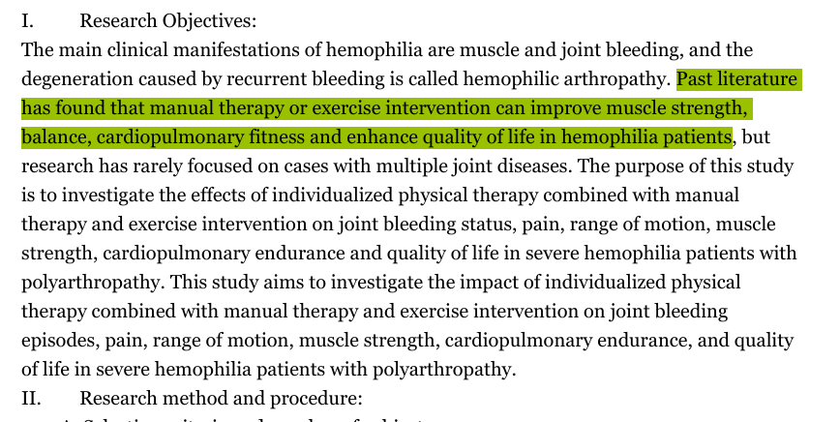
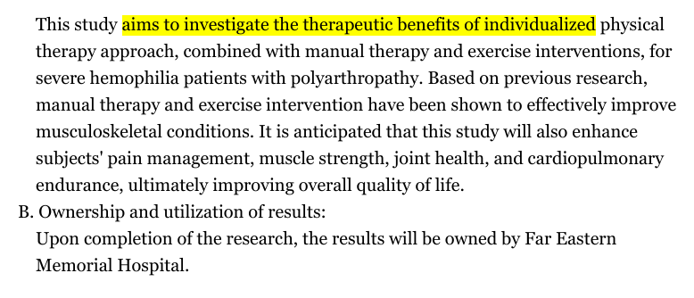
Data Exploration – Upper Quantile Similarity
Effects of individualized exercise intervention combined with manual therapy on musculoskeletal system, cardiopulmonary endurance and quality of life in severe hemophilia patients with polyarthropathy.
ClinicalTrials.gov ID: NCT06535971
Score: (78.51%)
Protocol
ICF

Slide 6
Retrieval Approaches
Sentence Based
Chunk the document by individual sentences
Poor results. Queries like “What are the risks of this study?” closely match text like “We detail the study risks below:” which are semantically similar but useless
Document Outline Segmentation
Chunk the documents by sections as defined by the embedded PDF outline
Middling results. Not all submitted clinical protocols come with PDF outlines. Sections may encompass other sections (1. Risks encompasses 1.2.4 MRI Patient Safety). But the target segments to generate (procedure, purpose, risks, benefits) do closely align with outlines when present.
Recursive Character Text Splitter (langchain)
Chunk the document into chunks of a set character size, respecting paragraphs and words when possible
Middling results. Larger chunk sizes carry more information, but Azure OpenAI token limits make large chunks unusable. Implementation is straight forward.

Slide 7
Generation Approaches
Generally unexplored. Azure OpenAI (LLM) token limitations made it impossible to pass chunks large enough to carry sufficient information from the text to generate meaningful results
Prompt engineering obstacle with getting LLM to answer medical questions without evasion
By default, LLM would evade questions on study risk.
“MRIs are a commonly used in medical practice with low risk.”
Specifying that the LLM was speaking with a medical professional reduced evasive responses
Chain of Thought responses provided more structured feedback
Three steps provided on selecting relevant text, then summarizing, then simplifying for an 8th grader to read
However, experience was based on smaller response sizes on free text results that could only be evaluated holistically

Slide 8
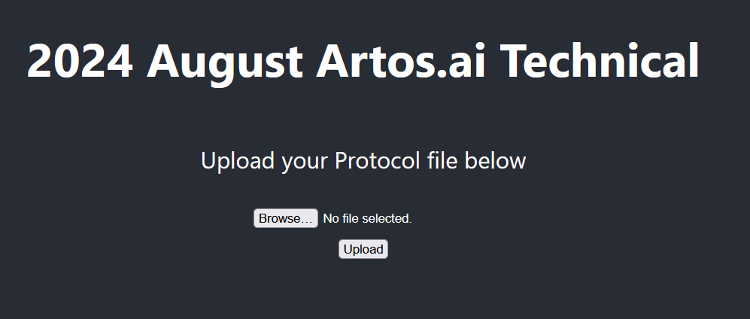
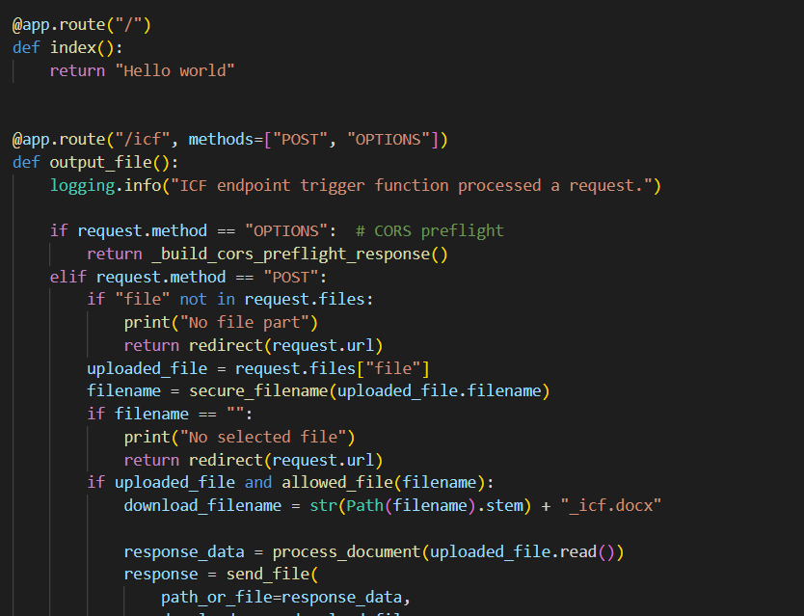
Web Application
Simple React application with an upload button
Hits a Flask REST API which emulates the LLM response
POST call to upload a PDF form as bytes, then send back a DOCX file to be downloaded
DOCX file is formatted according to the provided template
Currently just provides the “retrieved” portions for the RAG pipeline in each segment

Slide 9
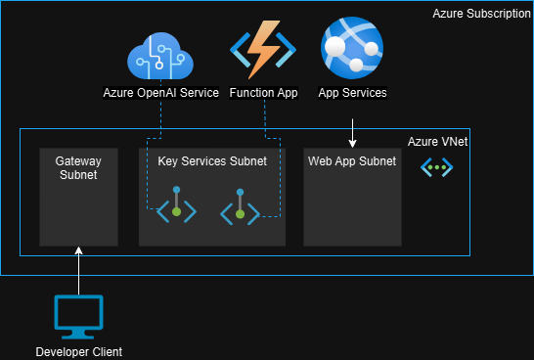
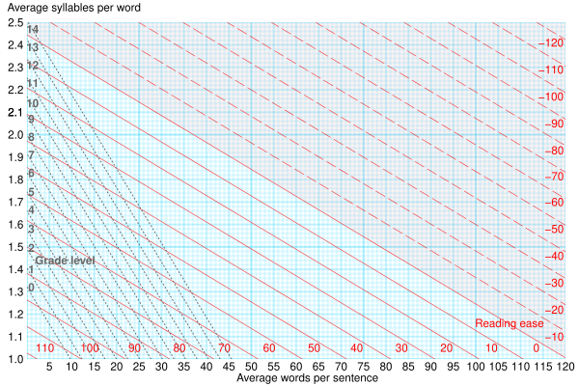
Potential Next Steps
Web Application Improvements
Severless Function App to handle communication between App Service and OpenAI Service
Private Endpoints to secure communication between services
RAG Improvements
Chunk document by predicate-object statements
Comparable to Microsoft’s GraphRAG Entity Extraction prompts
Use quantitative metrics (Flesch–Kincaid test) as feedback tool for generator to get desired readability level

