Slide 1

Fuddle
Baris Tevfik
Matt Lee
David Cheung
Ben Paolillo

Slide 2
Introduction
Our goal at Fuddle is to create one website where visitors are greeted with an abundance of popular images from across the globe submitted by fellow users who share their interests.
Notes:
Image Hosting
Each user has an account and 1 album

Slide 3

Features
Users can upload images
Upvote/downvote
Users will have their own account where they will have access to all the images they uploaded
Users can comment on fellow users’ images
Users can create albums
h

Slide 4


Features (continued)
Tile One
Spam button
If you love an image, cuddle it!
Image searching
Username searching
Ti

Slide 5
Layout
Main page
Most upvoted pictures in a day
Dynamic tiles that resize according to the image’s popularity
More upvotes = larger tile
Account page
Pictures uploaded by user in blog format
User info
Upload your own avatar or use Gravatar
Albums and cuddles
Sign-up page
Register with Fuddle
Email/username and password
Sign-up with Facebook option
Captcha

Slide 6
Layout (continued)
Individual image page
Upvote / downvote count
Comment section (also with upvotes / downvotes for comments)
Hide comments with X amount of downvotes
Error page (404)
This page is shy
Administrator page
Superuser privileges
Ban users
Delete inappropriate content
Upload page
Upload images from your computer
Album page
Show different albums and the images within

Slide 7
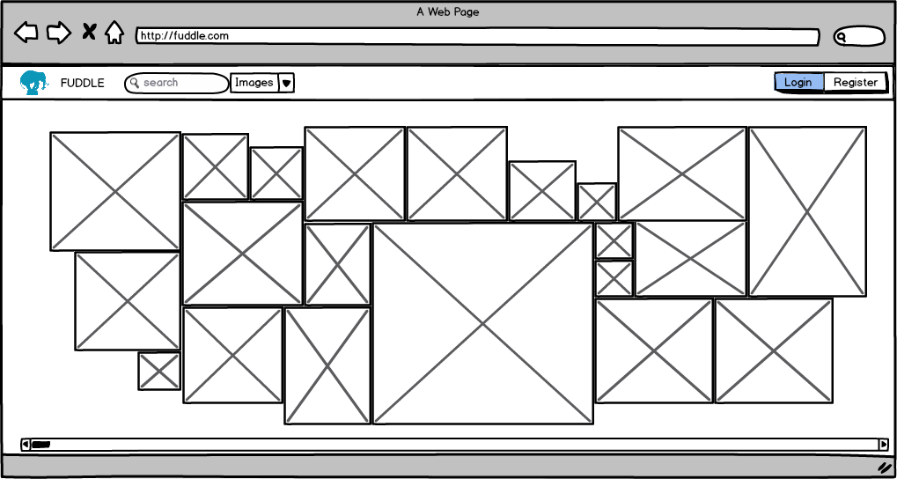
Mockup – Main Page

Slide 8
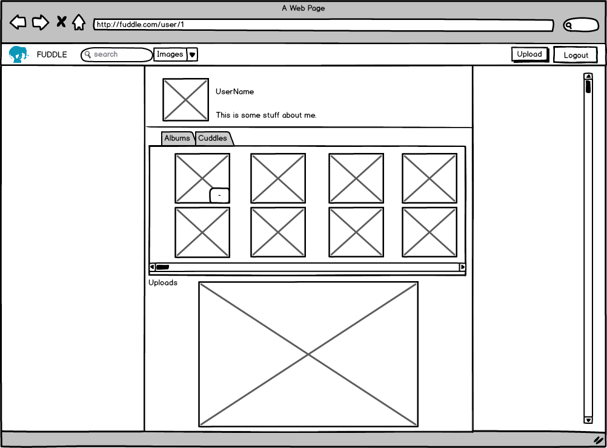
Mockup – Account Page

Slide 9
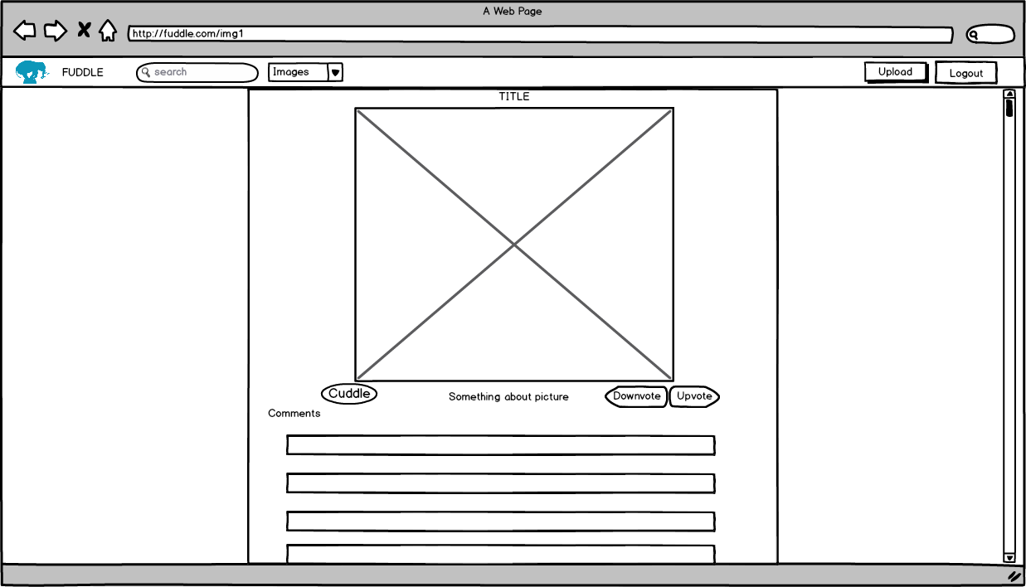
Mockup – Individual Image Page

Slide 10
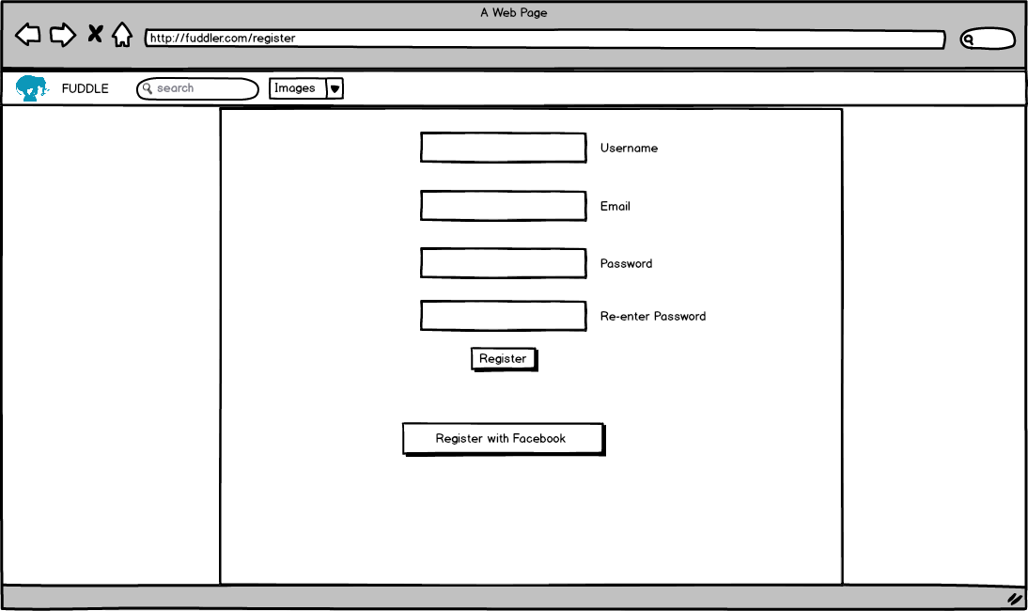
Mockup – Sign-up Page

Slide 11
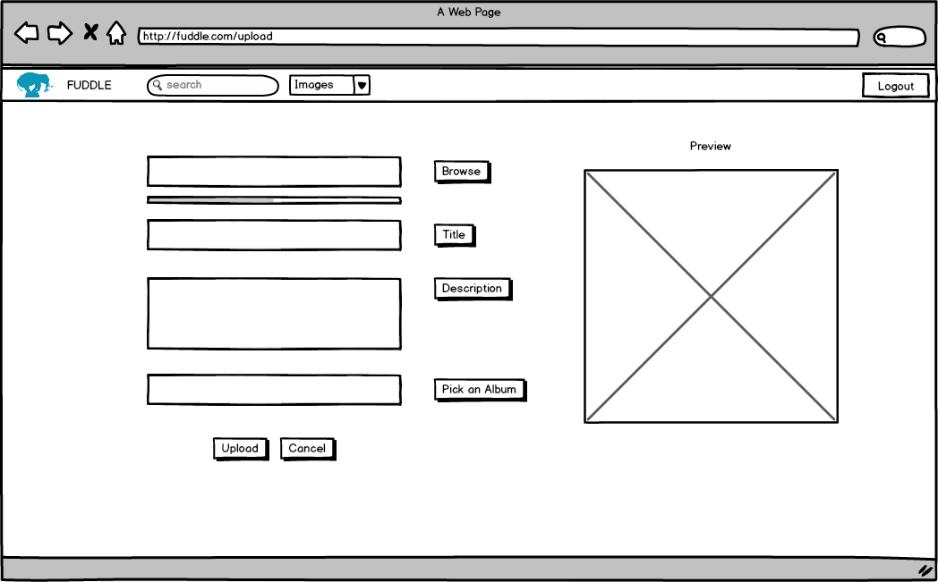
Mockup – Upload Page

Slide 12
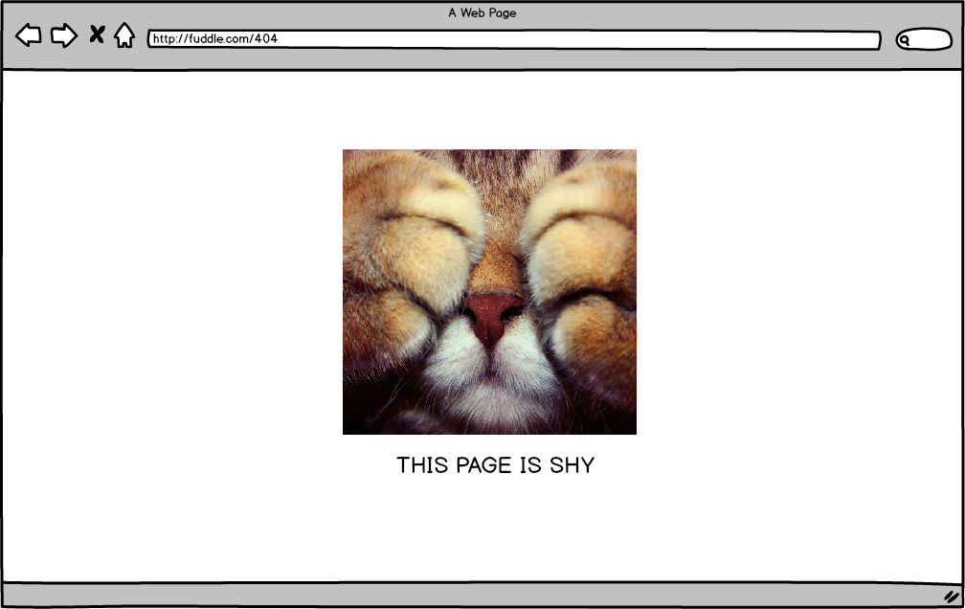
Mockup – Error Page (404)

Slide 13
Technologies Used
ASP.NET
SQL
AJAX
C#
jQuery / JavaScript
Gravatar API
Facebook login API
Captcha

Slide 14
Database Design
User_Table
User_id | Username | User_password | User_email | User_info | User_role | User_verified | User_avatar
User_Content_Table
User_id | Album_id | User_cuddles
Album_Table
Album_id | Album_name | Picture_id

Slide 15
Database Design (continued)
Picture_Table
Picture_id | Comm_Thread_id | Upvote_count | Downvote_count | Picture_title | Picture_desc | Cuddle_count | Flag_count
Comment_Thread_Table
Comment_Thread_id | Comment | Comment_downvote_count | Comment_upvote_count | Username

Slide 16
Questions?

