Slide 1


Cluster I/O Performance On Large Data Files

Slide 2
Specifications
Using CMS3 files trimmed to 2GB
Reads compared:
  local disk
  HDFS through FUSE
  HDFS through C API
  ram cache

Slide 3
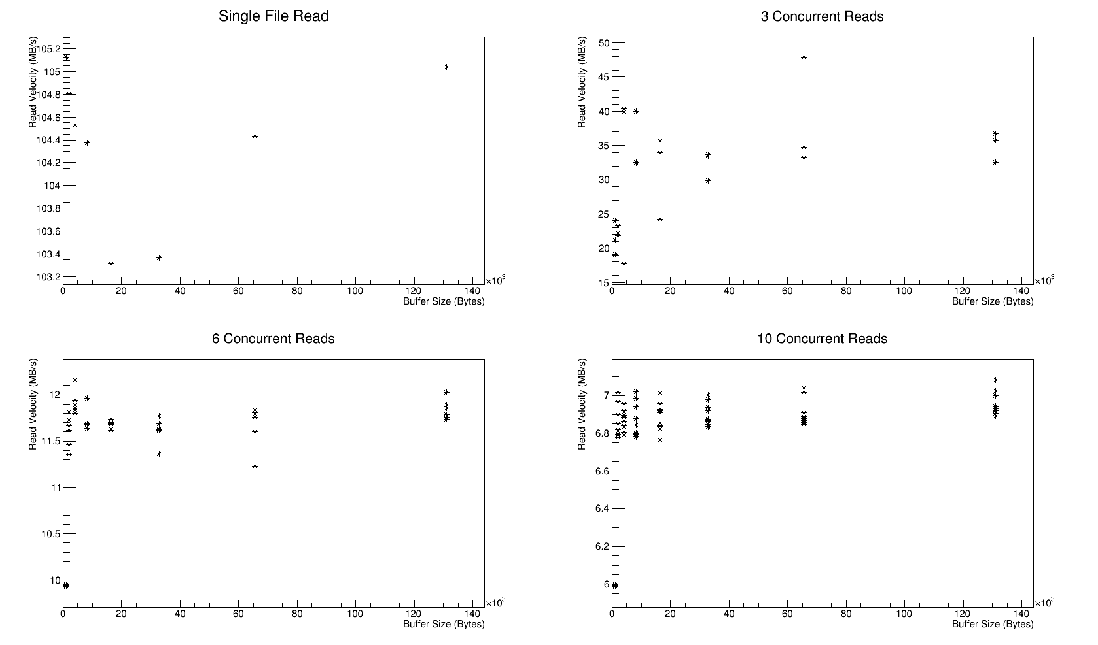
Local Disk Performance

Slide 4
Local Disk Performance
1. No files being written to disk
2. Ram cache dropped after each read
Reproduces conditions for proposed babymaking I/O procedure.
Max Read Velocity ~ 100 MB/s from 1 or 3 files with large buffer size.
30% performance hit when reading from 10 files.

Slide 5
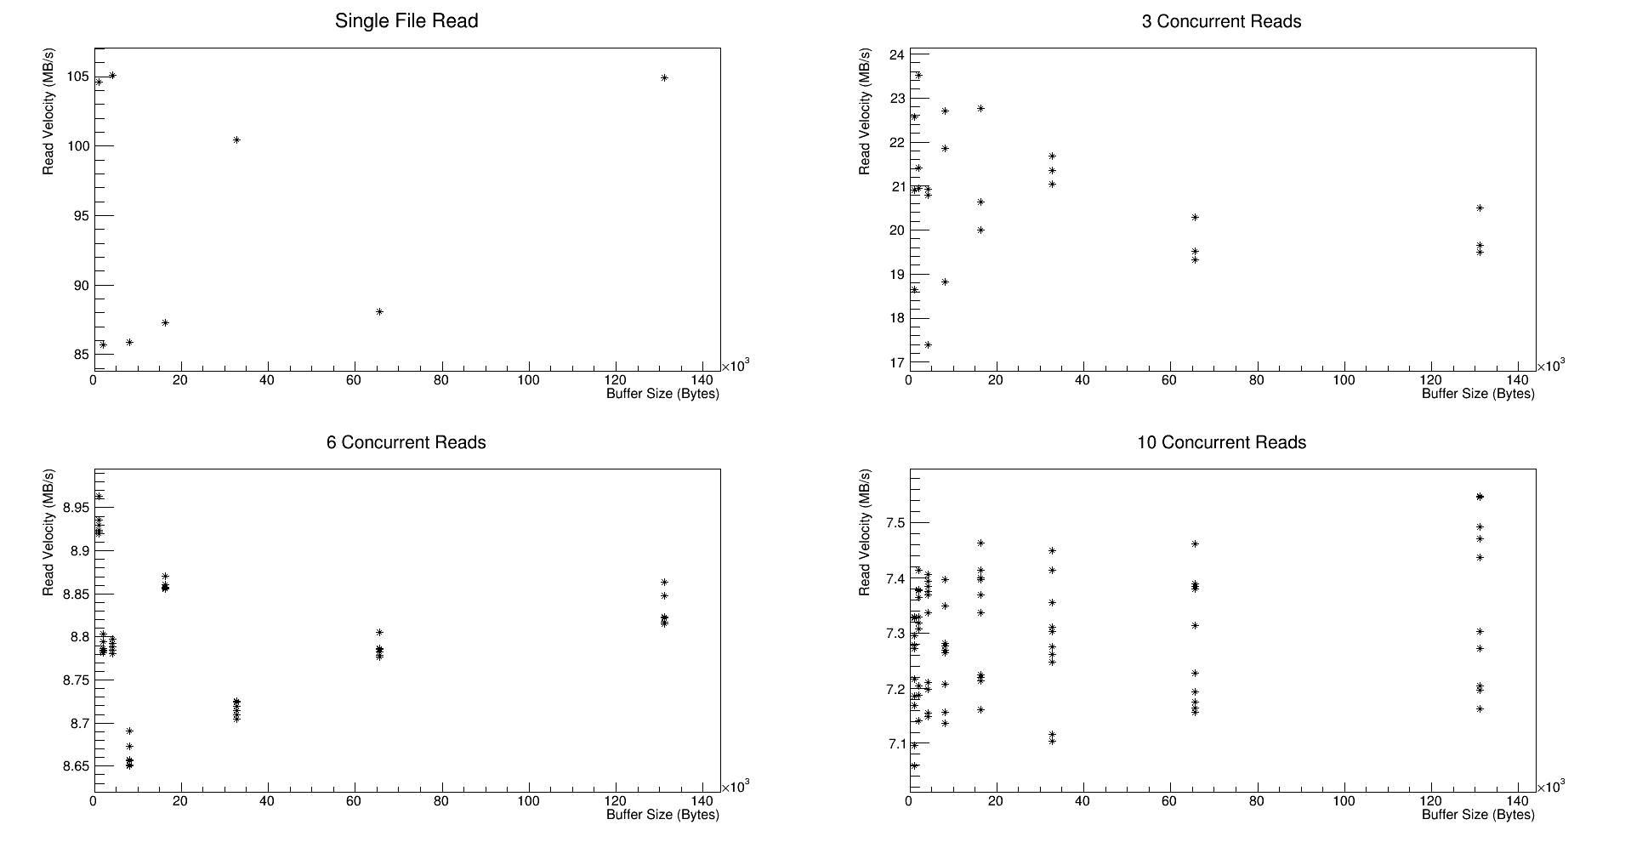
Local Disk Performance (with write)

Slide 6
Local Disk Performance (with write)
1. No files being written to disk
2. Ram cache dropped after each read
3. Continuously writing ~10MB/s to disk
Max Read Velocity ~ 95 MB/s from 1 file, buffer size independent?
30% performance hit when reading from 10 files.

Slide 7
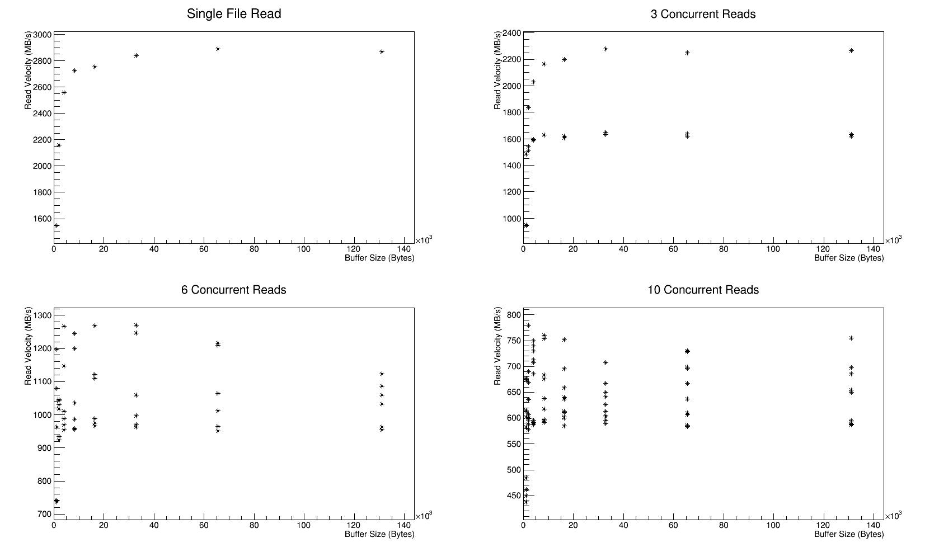
Ram Cache Performance

Slide 8
Ram Cache Performance
No files being written to disk
Max Read Velocity ~ 6 GB/s from 3, 6, or 10 files independent of buffer size.
50% performance hit when reading from 1 file.

Slide 9
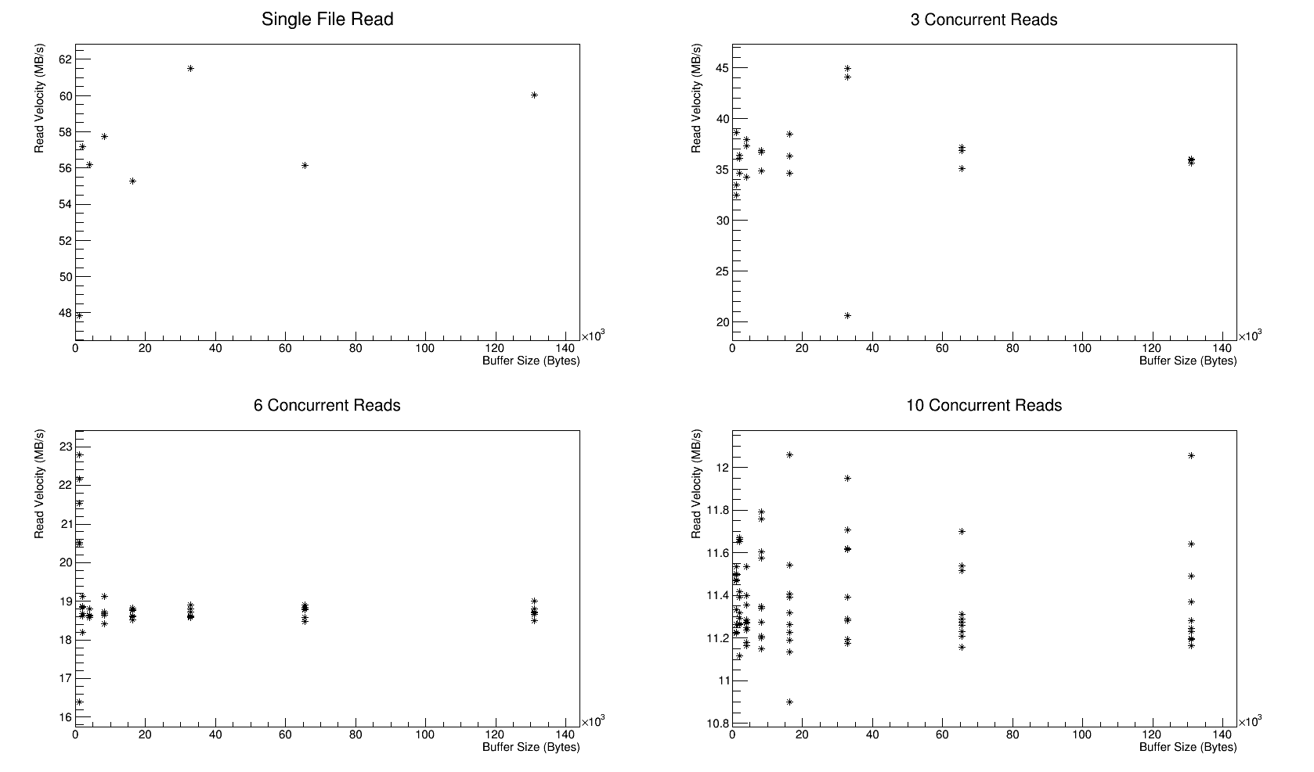
HDFS Performance (FUSE)

Slide 10
HDFS Performance (FUSE)
1. No files being written to disk
2. No attempt to drop ram cache
3. HDFS mounted through FUSE
Reproduces conditions for current babymaking procedure.
Max Read Velocity ~ 115 MB/s from 6 to 10 files with large buffer size.
50% performance hit when reading from 1 file.

Slide 11
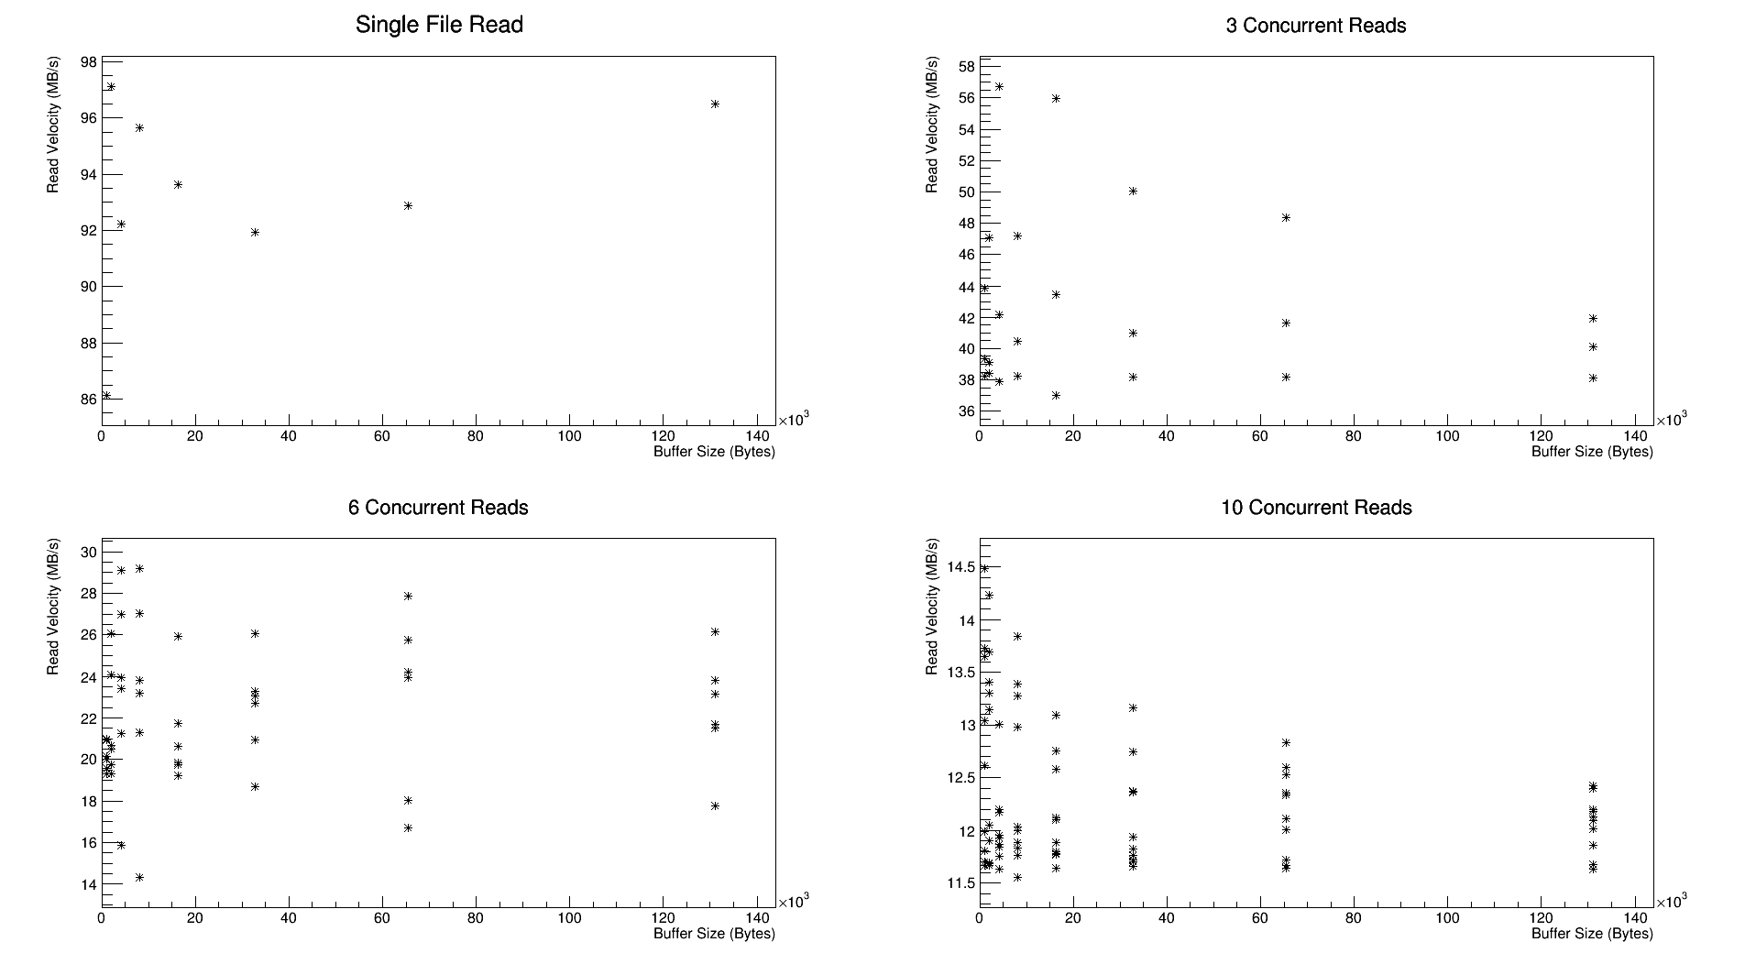
HDFS Performance (C API)

Slide 12
HDFS Performance (C API)
1. No files being written to disk
2. No attempt to drop ram cache
3. HDFS accessed through C API
Reproduces conditions for current babymaking procedure.
Max Read Velocity ~ 130 MB/s from 6 to 10 files with small buffer size.
25% performance hit when reading from 1 file.

Slide 13
Next Steps
Take HDFS reads when the cache has been dropped
Try reads with files spread over multiple disks on the same machine to test possible CPU or bus-speed bottleneck
Convert babymaking code to read from local disk

Slide 14
Conclusions
HDFS read is network limited near 120 MB/s which is approximately equal to the performance of a single drive.
Further testing needed to predict performance increase, but niavely we can expect 10x I/O performance if local disk reads are not bus limited.

