Slide 1


Following up on I/O Performance On Large Data Files

Slide 2
Outline
Last Time:
We considered various read routines and different file storage schemes.
We found that the “file per disk” read did increase net read speeds by approximately 5 times vs hadoop based reads in conservative but loose estimates
This Time:
We run the disk per read test on 9 different machines including one “longrun” which collected 100 times the data for one of the nine.
No attempt was made to control the computing environment, these are live machines which

Slide 3
Read Specifications
Reader Program Psuedocode:
Start Timer
Open File (C “fopen” call)
While file has unread data
Read BLOCK_SIZE of data (C “read” call)
End Timer
Get File Statistics (namely filesize)
Compute read velocity

Slide 4
Read Specifications
Test Psuedocode:
For (Buffer Size, Concurrent Read Number) Pairs:
Drop Ram Cache
Instantiate the proper number of read programs on proper files
Wait for programs to finish

Slide 5
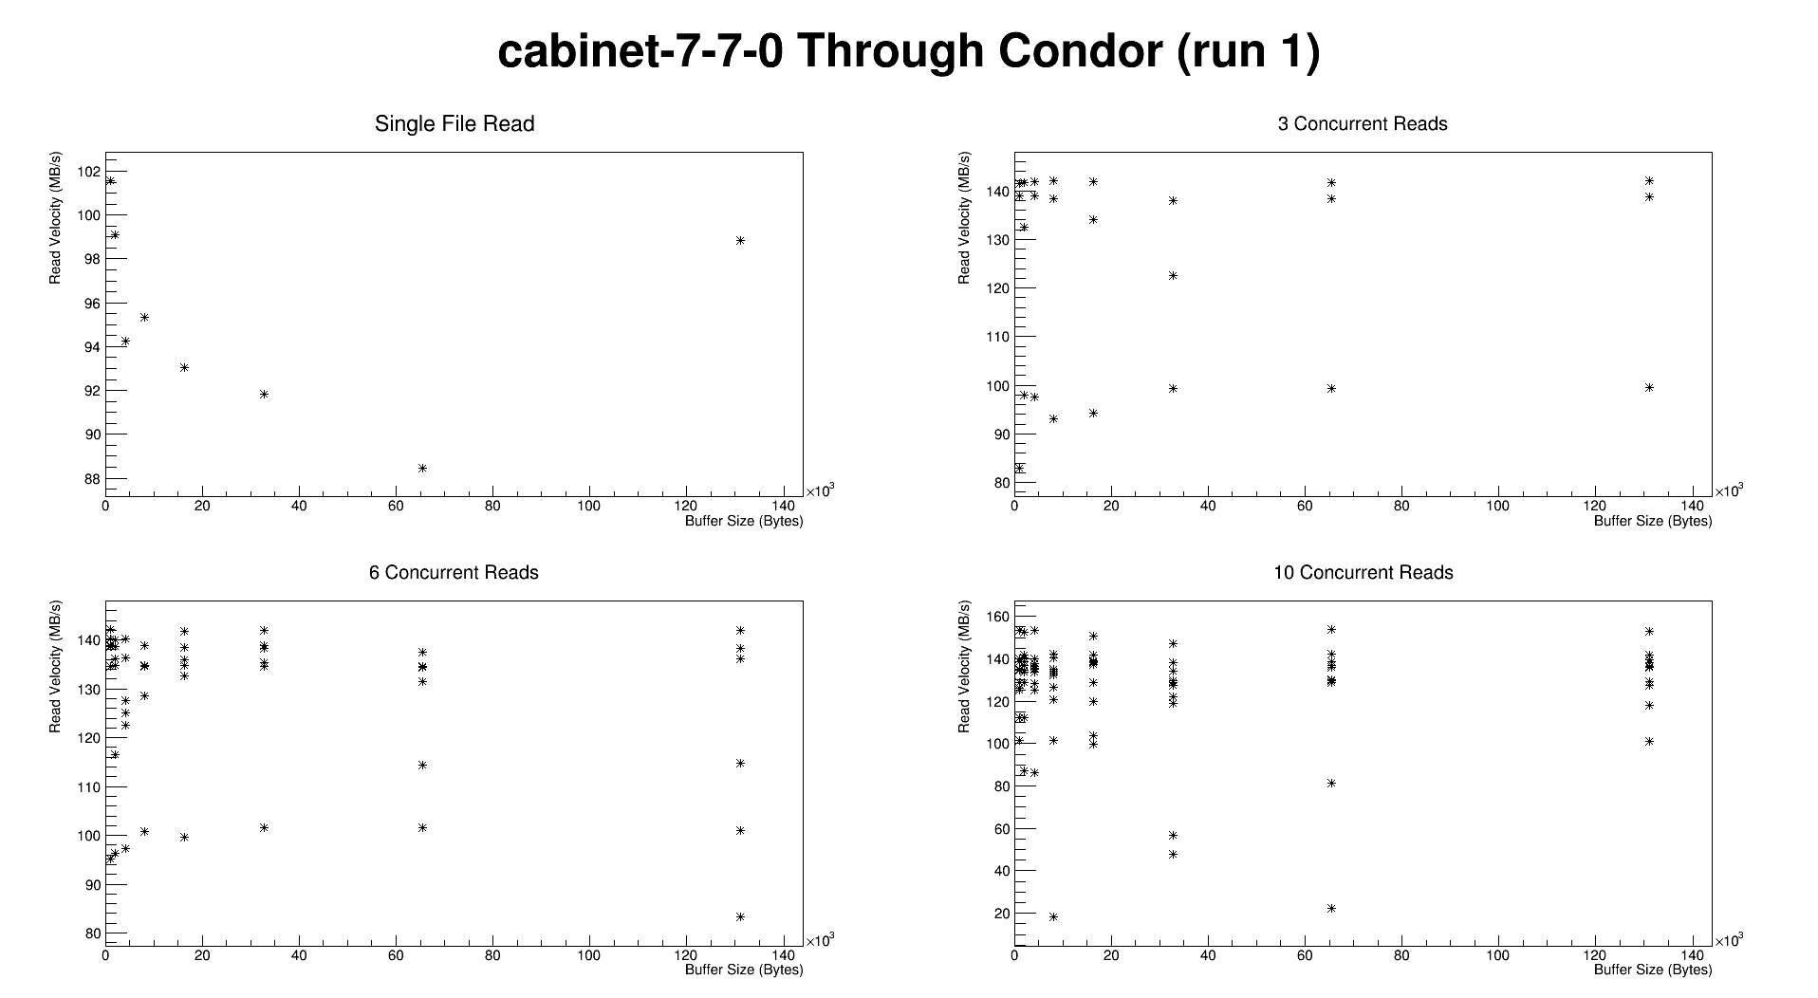
Cabinet-7-7-0

Slide 6
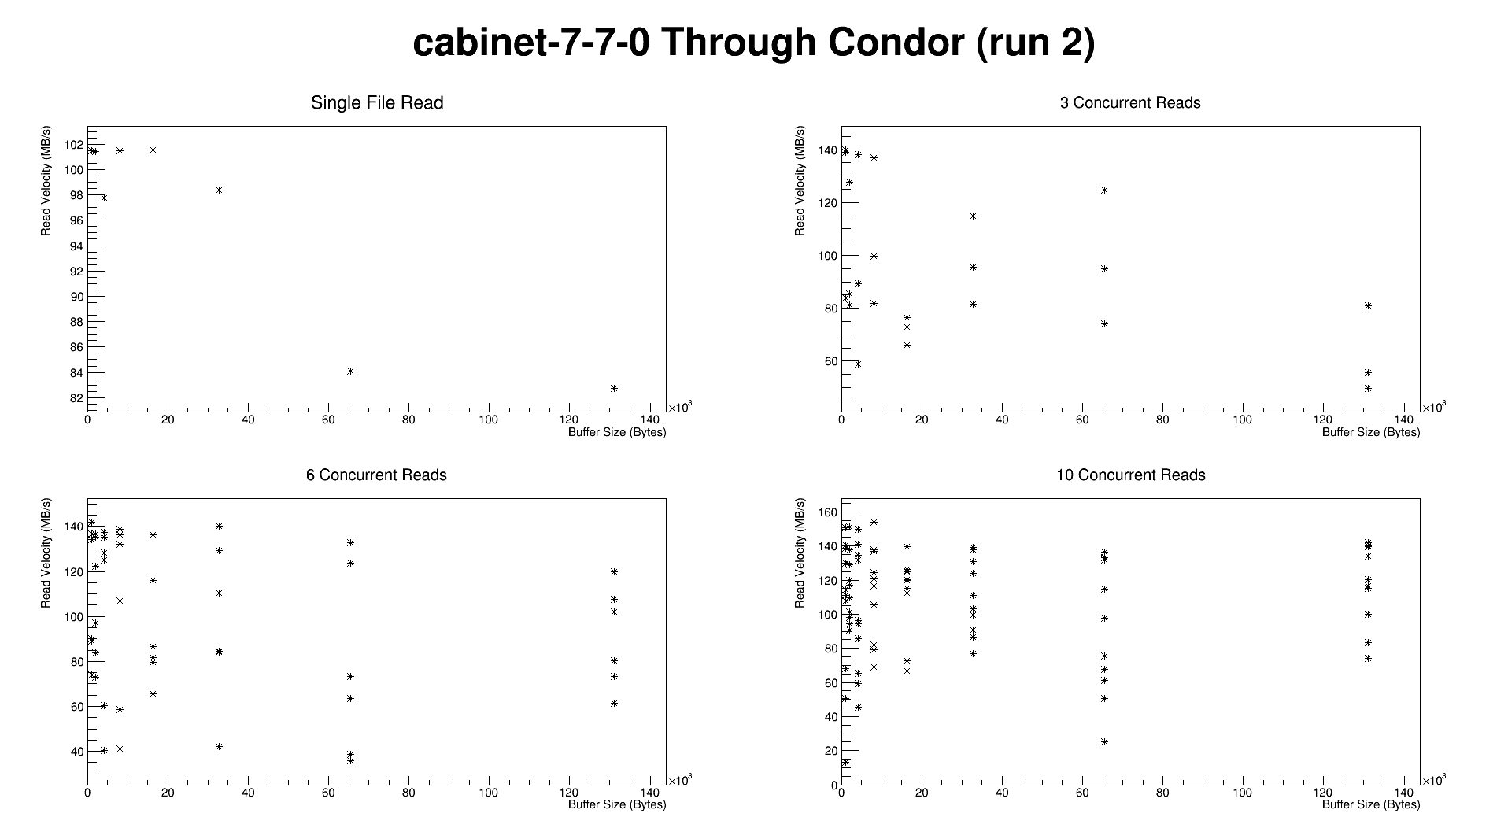
Cabinet-7-7-0

Slide 7
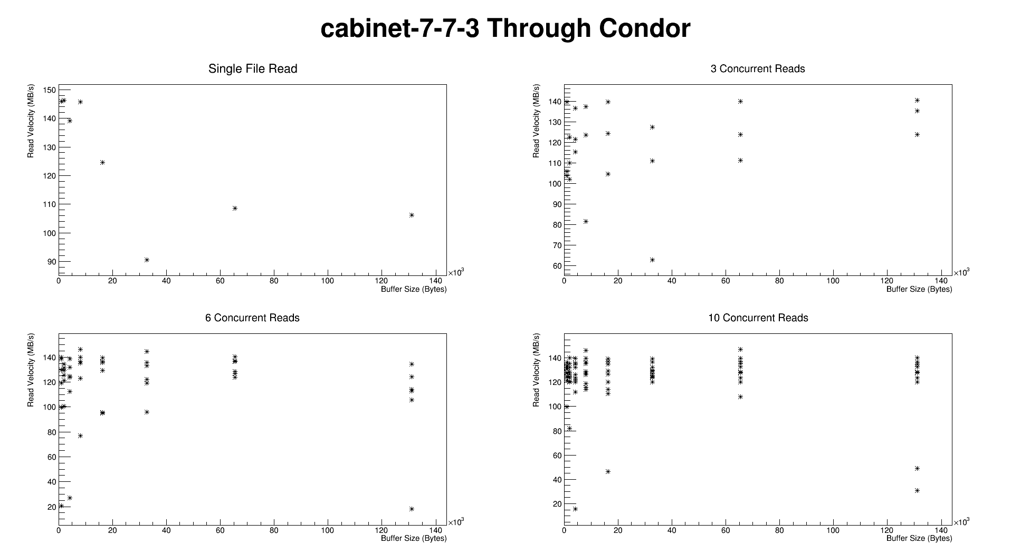
Cabinet-7-7-0

Slide 8
Cabinet-7-7-0

Slide 9
Cabinet-7-7-0

Slide 10
Cabinet-7-7-0

Slide 11
Next Steps
Take HDFS reads when the cache has been dropped?
Convert babymaking code to read from local disk

Slide 12
Conclusions
HDFS read is network limited near 120 MB/s which is approximately equal to the performance of a single drive.
By storing files in a careful ordered maner across disks, file I/O could be niavely sped up by at least half an order of magnitude.

Slide 13
Cabinet-7-7-0
Max Aggrigate Read Velocity ~ 100 MB/s from 1 or 3 files with large buffer size.
30% performance hit when reading from 10 files.

