Slide 1


Cluster I/O Performance On Large Data Files

Slide 2
Specifications
Using root files trimmed to 2GB
Reads compared:
  local disk
  HDFS through FUSE
  HDFS through C API
  ram cache

Slide 3
Read Specifications
Reader Program Psuedocode:
Start Timer
Open File (C open or HDFS open call)
While file has unread data
Read BLOCK_SIZE(C read or HDFS read call)
End Timer
Get File Statistics (filesize)
Compute read velocity

Slide 4
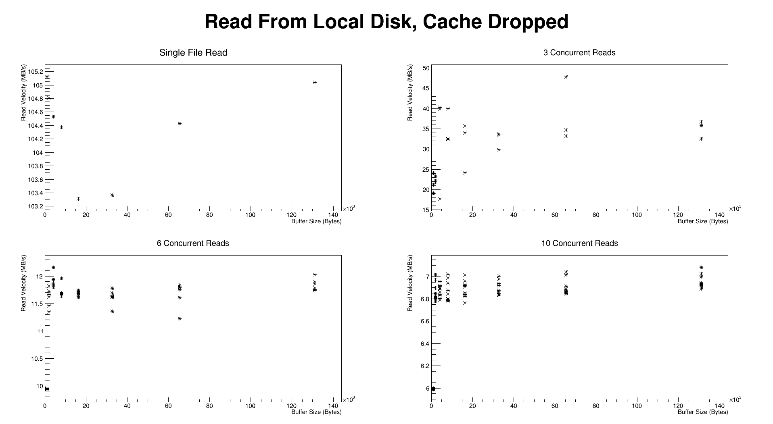
Local Disk Performance

Slide 5
Local Disk Performance
1. No files being written to disk
2. Ram cache dropped after each read
3. Tested on UAF-4
Max Aggrigate Read Velocity ~ 100 MB/s from 1 or 3 files with large buffer size.
30% performance hit when reading from 10 files.

Slide 6
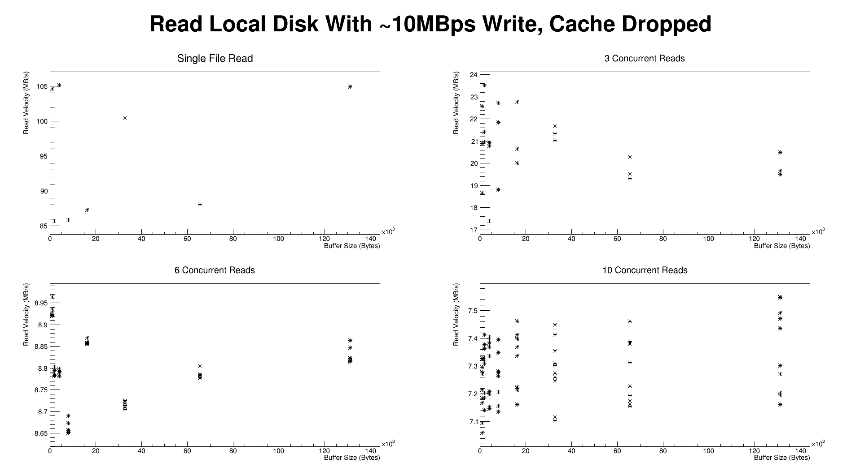
Local Disk Performance (with write)

Slide 7
Local Disk Performance (with write)
1. No files being written to disk
2. Ram cache dropped after each read
3. Continuously writing ~10MB/s to disk (although kernel may have been caching the write to some degree)
4. Tested on UAF-4
Max Read Velocity ~ 95 MB/s from 1 file, buffer size independent?
30% performance hit when reading from 10 files.

Slide 8
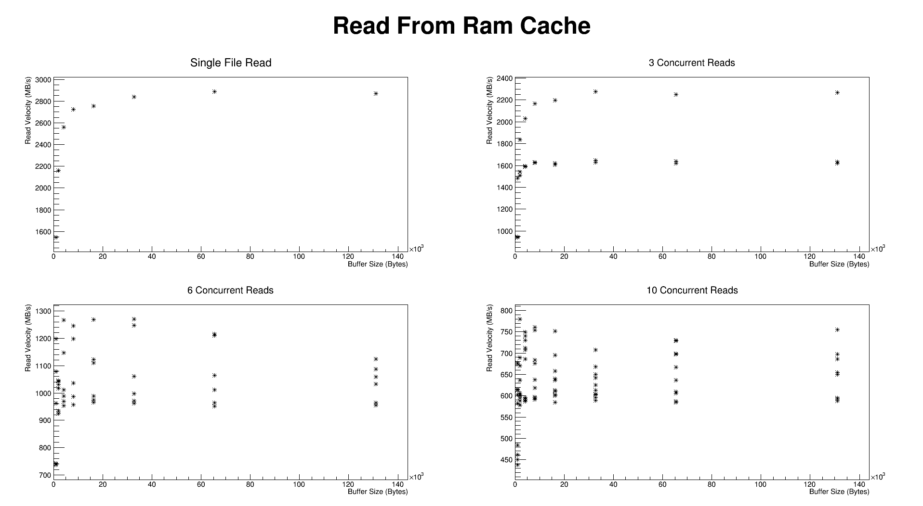
Ram Cache Performance

Slide 9
Ram Cache Performance
1. No files being written to disk
2. Tested on UAF-4
Max Read Velocity ~ 6 GB/s from 3, 6, or 10 files independent of buffer size.
50% performance hit when reading from 1 file.

Slide 10
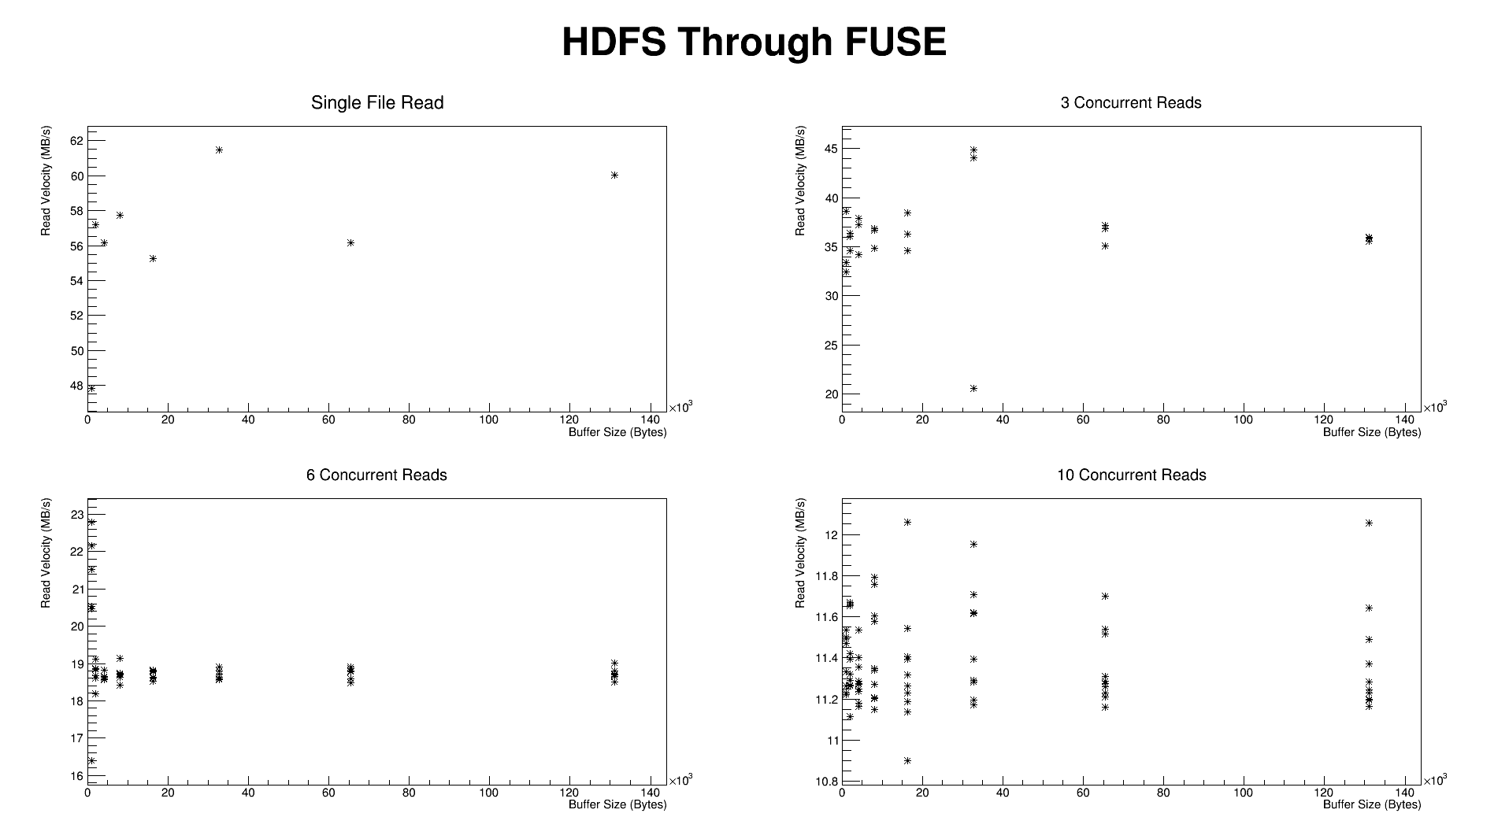
HDFS Performance (FUSE)

Slide 11
HDFS Performance (FUSE)
1. No files being written to disk
2. No attempt to drop ram cache
3. HDFS mounted through FUSE
4. Tested on UAF-4
Reproduces conditions for current babymaking procedure.
Max Read Velocity ~ 115 MB/s from 6 to 10 files with large buffer size.
50% performance hit when reading from 1 file.

Slide 12
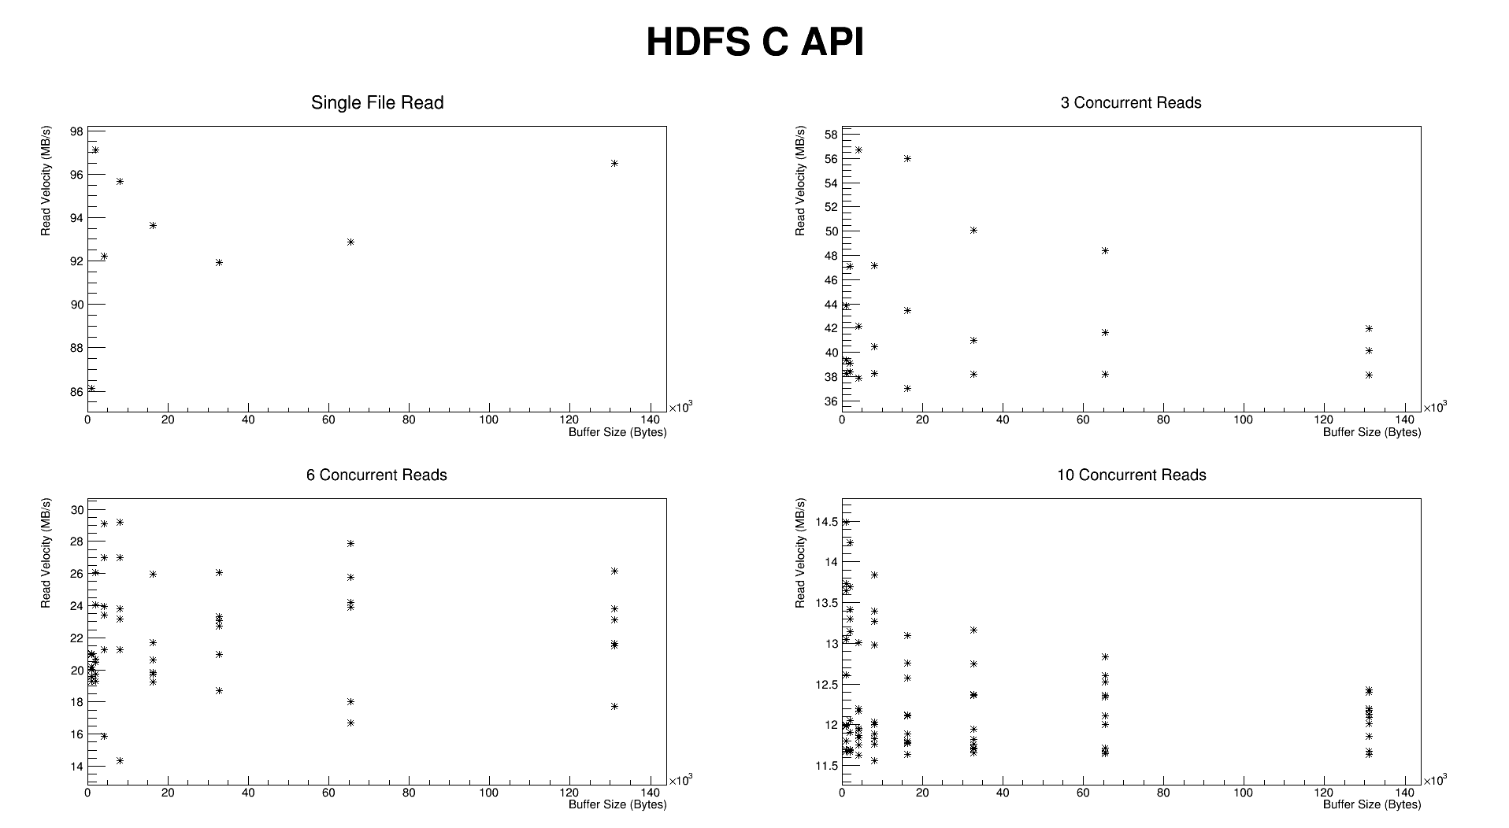
HDFS Performance (C API)

Slide 13
HDFS Performance (C API)
1. No files being written to disk
2. No attempt to drop ram cache
3. HDFS accessed through C API
4. Tested on UAF-4
Reproduces conditions for current babymaking procedure.
Max Read Velocity ~ 130 MB/s from 6 to 10 files with small buffer size.
25% performance hit when reading from 1 file.

Slide 14
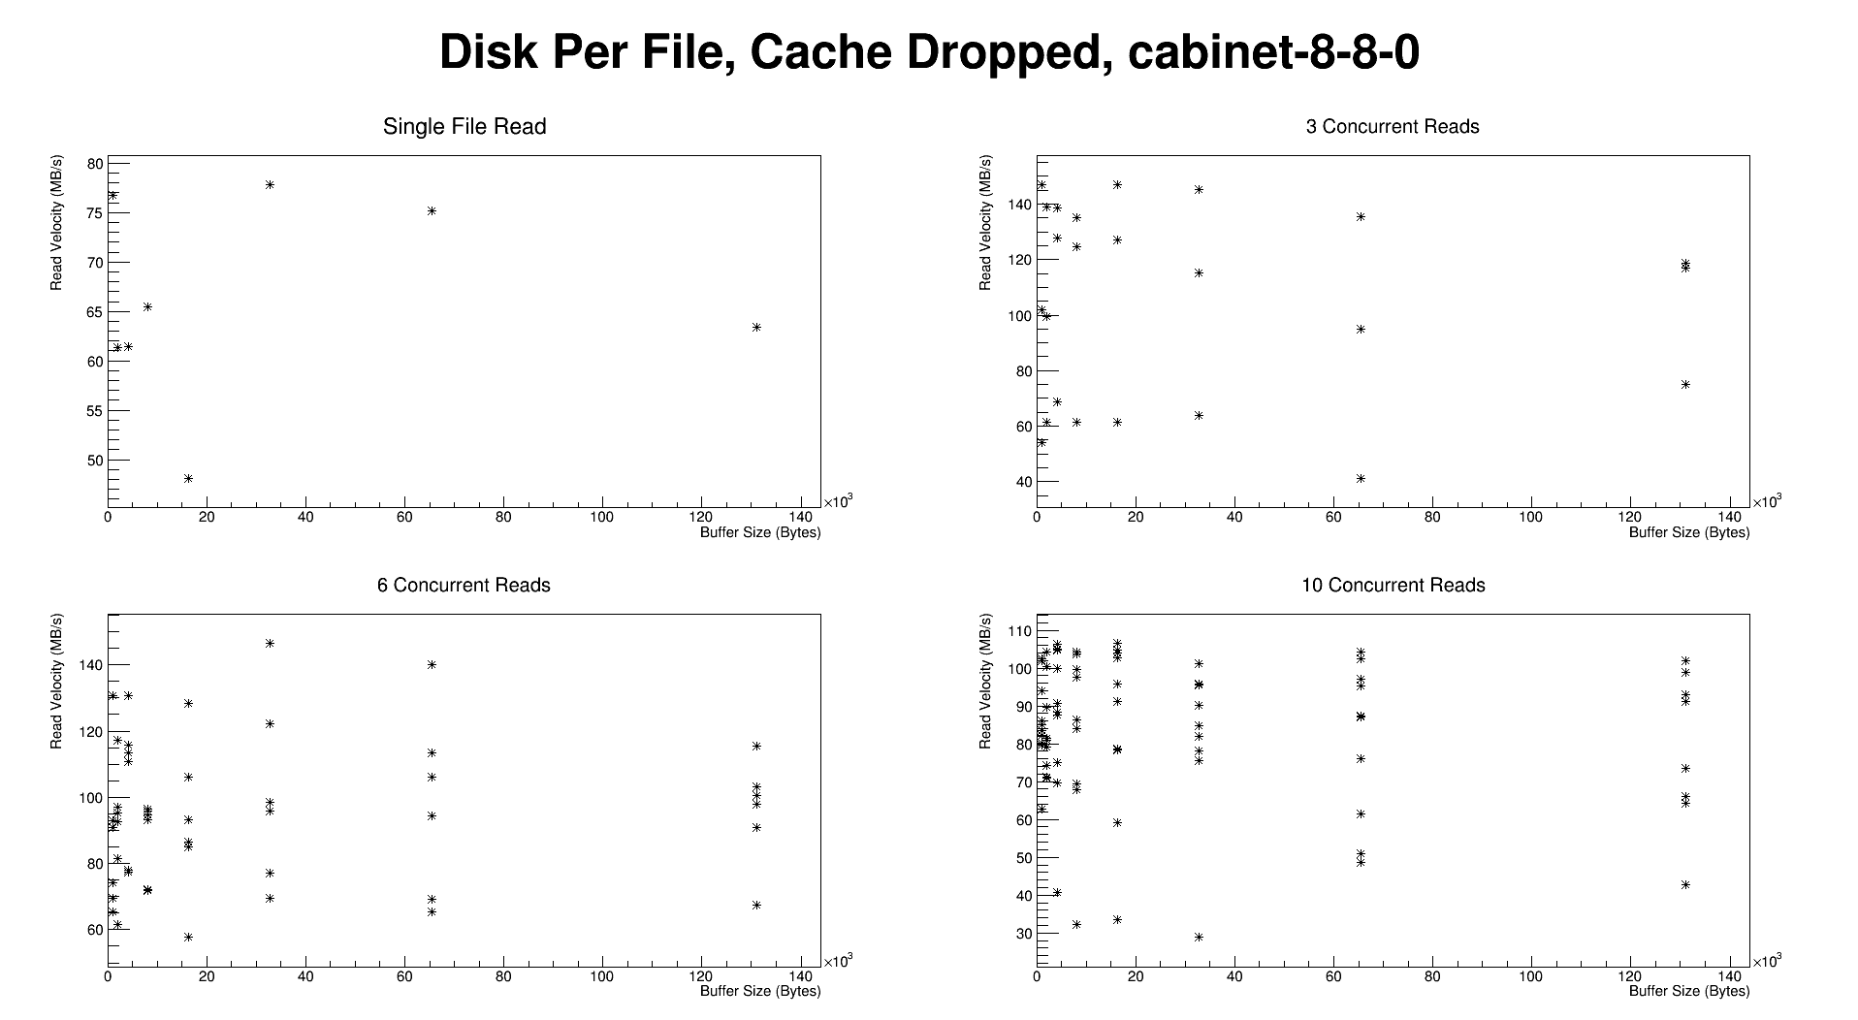
Local Disk Per File

Slide 15
Local Disk Per File
1. No files being written to disk
2. Cache cleared
3. Tested on cabinet-8-8-0 under full load (~24 jobs)
Reproduces conditions for proposed babymaking procedure.
Max Read Velocity ~ 800 MB/s from 10 files, buffer size dependence unclear.
~5x niave improvement over HDFS C API best case(no cache clearing) vs LDPF worst case on 10 file reads.

Slide 16
Next Steps
Take HDFS reads when the cache has been dropped?
Convert babymaking code to read from local disk

Slide 17
Conclusions
HDFS read is network limited near 120 MB/s which is approximately equal to the performance of a single drive.
By storing files in a careful ordered maner across disks, file I/O could be niavely sped up by at least half an order of magnitude.

