Slide 1
Smartsubmit Benchmarking

Slide 2
Outline
Test specs
Issues with test (some files were broken, saw nothing in output.
Timing histos
The IOTime variable
Conclusions from IOTime

Slide 3
Test Specifications
In the first test, we take a look at the time to run the executable ‘runBabyMaker’ on smartsubmit vs. conventional batch submission. This test was run on a modified version of the cmstas/StopAnalysis committed on Nov 23 2015. The version used is here. Smartsubmit uses the same code, but replaces the submission through the batch/ folder with smartsubmit’s code.
Input Sample | run2_25ns_MiniAODv2/DYJetsToLL_M-50_TuneCUETP8M1_13TeV-madgraphMLM-pythia8_RunIISpring15MiniAODv2-74X_mcRun2_asymptotic_v2-v1/V07-04-11/
Sample Stats | ~2.4 TB, ~4GB per file, 581 files
Description | The executable runBabyMaker is run on every file in the sample. runBabyMaker is timed with the ‘time (1)’ command. For smartsubmit, runBabyMaker is run over 4 files at a time, whereas for conventional batch submission, each file gets its own instance. On the next page, we show the ‘real time’ output of the time command for smartsubmit jobs for 3 runs through this sample. On the page after that we show the output for conventional batch, keep in mind the times for smartsubmit have an implicit factor of 4 compared to conventional batch submission.

Slide 4
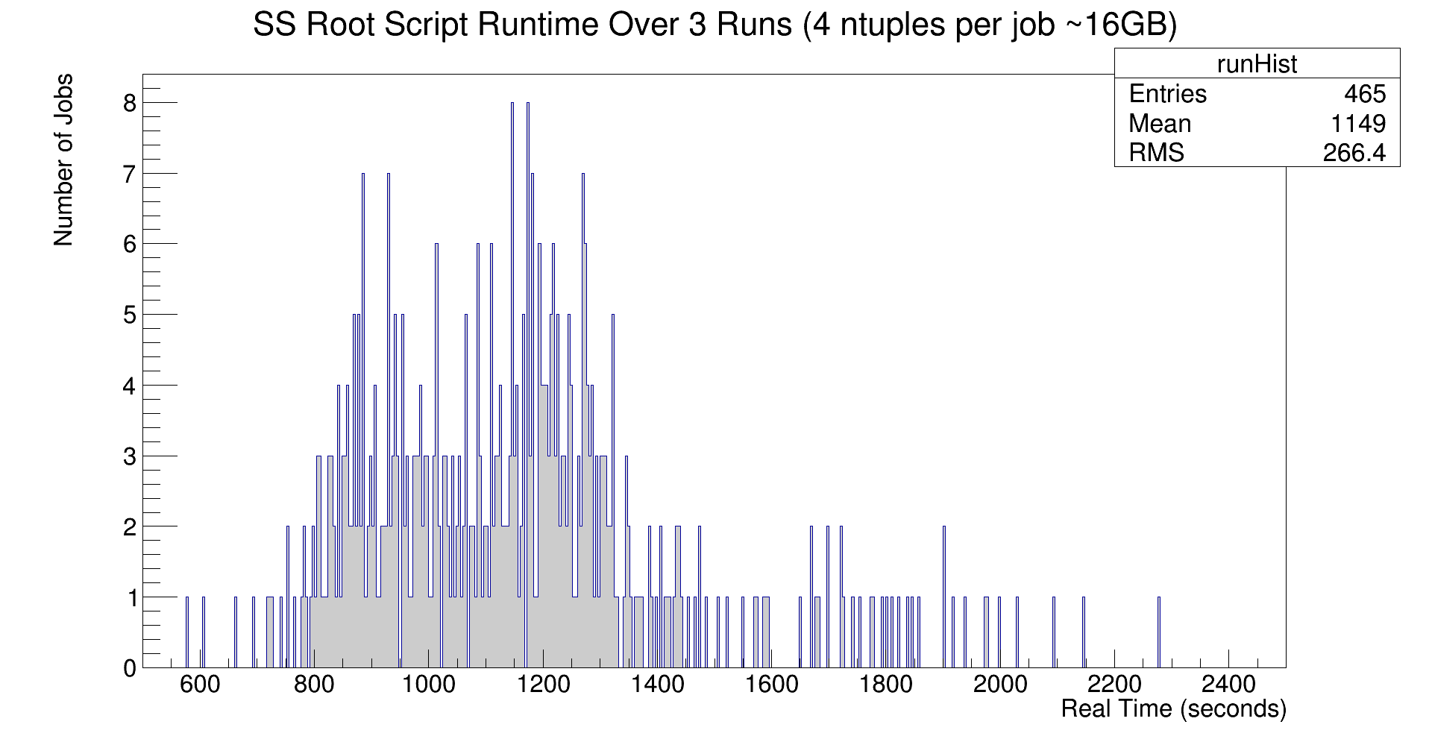
Total Dataset for SS Runs
The dataset above comprises of 3 full baby making runs through the sample (notice 600 * ¾ = 450). We have a mean runtime of 1149 seconds, which corresponds to a data processing velocity for smartsubmit of about 14 MB/sec.

Slide 5
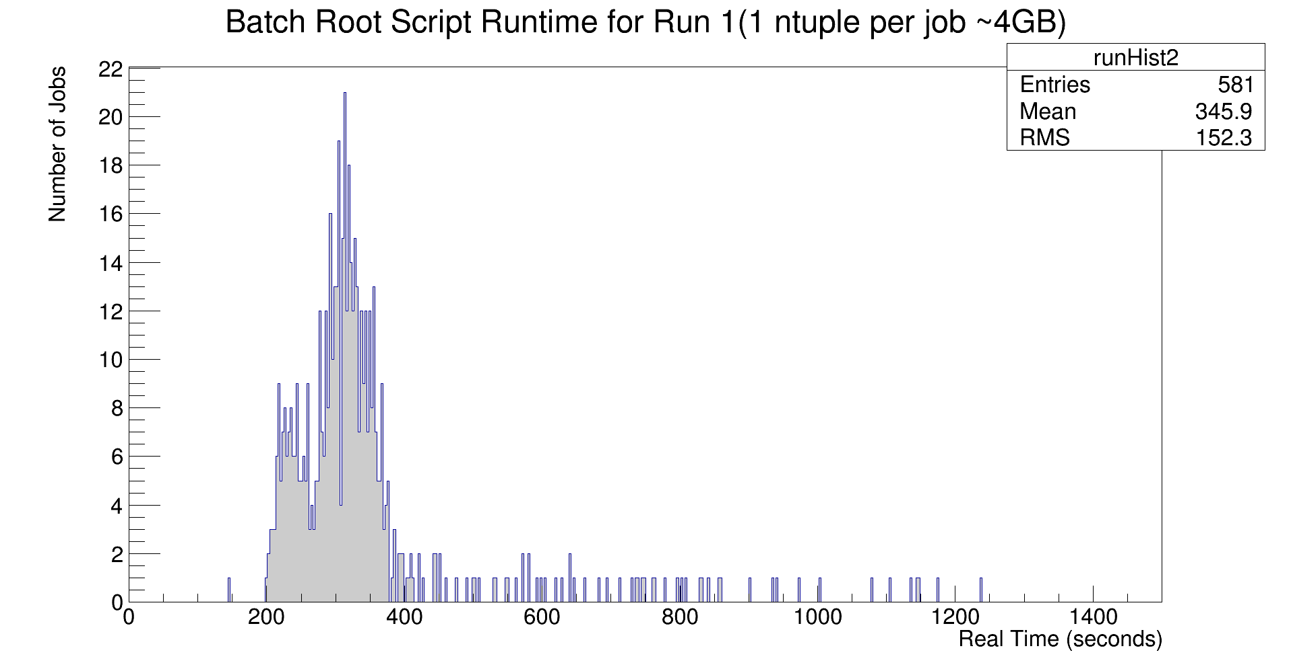
Batch Submission
A mean read time of 345.9 seconds corresponds to a processing velocity of about 11.6 MB/sec. These are fairly minimal gains in time. On the next slide we’ll try and analyze why this is occurring.

Slide 6
IOTiming
The next test was designed to explore whether the small timing gains seen in smartsubmit were due to problems with the testing methodology or a deeper issue with reading root files in general that necessarily slows down read times.
Root attempts to do a sort of smart read when reading in .root files so that it does not access data which will not be needed. In order to find the time it takes to do this ‘smart read’ (IOTime) we ran runBabyMaker on 5 files in the sample mentioned on pg. 4 with the following augmentations:
(1) force the babymaker to read in root files completely with LoadAllBranches tag, but also don’t do any computations with data read, read everything and quit.
(2) read in root files completely with LoadAllBranches tag, do normal analysis. Make babies but read everything.
(3) do normal anaylsis, root does its smart read and makes babies.
We define the following quantities:
Comp Time := (2) – (1) ==> Roughly, the time it takes just to do computations on the data.
IOTime := (3) – Comp Time = Roughly, the time it takes just to do the smart read.

Slide 7
IOTiming
The following data is the result of finding the IOTime when reading from the local disk. Three trails are shown, but this data has been corroborated in about 50 runs:
Run | (1) | (2) | (3) | Comp Time | IOTime
1 | 14m50.718s | 20m14.380s | 13m27.961s | 5m23.662s | 8m4.299s
2 | 14m45.349s | 20m9.433s | 13m35.337s | 5m24.084s | 8m11.253s
3 | 14m41.603s | 20m31.633s | 13m27.057s | 5m50.030s | 7m37.027s
Here we have the output of the same test when reading from Hadoop:
Run | (1) | (2) | (3) | Comp Time | IOTime
1 | 18m26.903s | 23m32.256s | 16m34.533s | 5m5.353s | 11m29.180s
2 | 17m43.819s | 23m5.048s | 16m25.700s | 5m21.229s | 11m4.471s
3 | 18m4.622s | 23m33.325s | 17m14.866s | 5m28.703s | 11m46.163s
% speedup = ( time hadoop – time local )/(time hadoop) ~ 30%

Slide 8
IOTiming
Through remote submission, we found that the rate of data processing for conventional batch submission was about 20% lower than through smartsubmit. On the local tests, results were slightly better at about 30%.
Consider 1 TB of data being processed at 11.6 MB/s vs. 14 MB/s, the difference in time between these speeds would be (1/11.6 – 1/14) = 4 hours. The entire run 2 MC+data set is approximately 80 TB. So in terms of computational time

Slide 9
Miscellaneous Questions
The resident memory size of runBabyMaker for the sample considered was checked by recording the output of ps -o rss. For 5 arbitrarily chosen files in the dataset on page 3, the max resident memory size was ~300MB.

